Slide 1
Hierarchie Game Node
game
flippedcard
active_player_id
lastpair
card
owner
cards
card
...
players
...
player
player
Notes:
Flipped Card , active_player_id, lastpair, owner, players[] cards[]

Slide 2
Aufbau der Nodes
 | game | cards | players | card | player
Attribute | @id @game_state |  |  | @id @pair @card_state | @id
Elemente | flippedcard active_player_id lastpair owner players cards | card card ... | player player ... | position_x position_y | name points
Notes:
Flipped Card , active_player_id, lastpair, owner, players[] cards[]

Slide 3
Neues Spiel
Browser
controller
methodsGame
BaseX
Spieler-Namen
Kartenanzahl
newGameXML()
game
insertGame
game
startByData
html
html

Slide 4
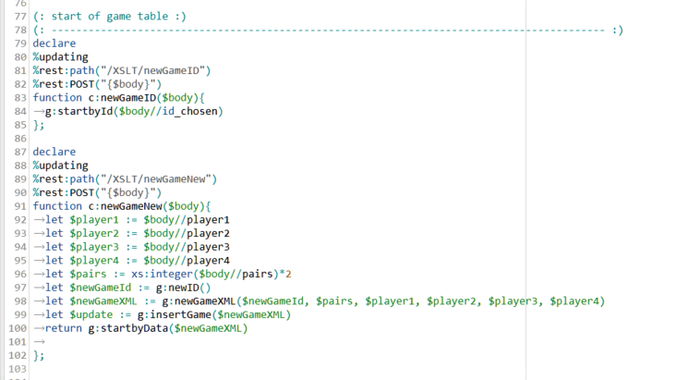
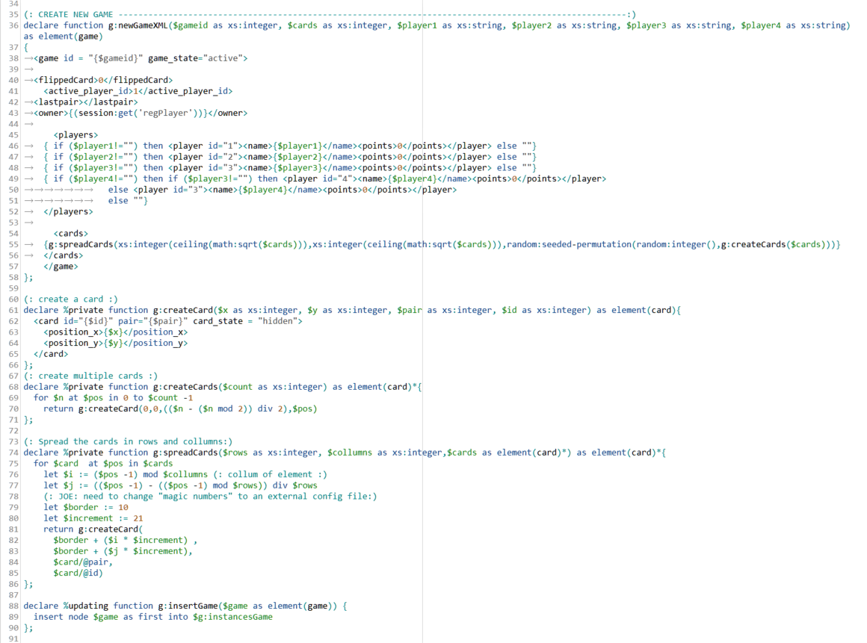
controller
methodsGame
Notes:
Flipped Card , active_player_id, lastpair, owner, players[] cards[]

Slide 6
controller
methodsGame
Notes:
Flipped Card , active_player_id, lastpair, owner, players[] cards[]

