Slide 1

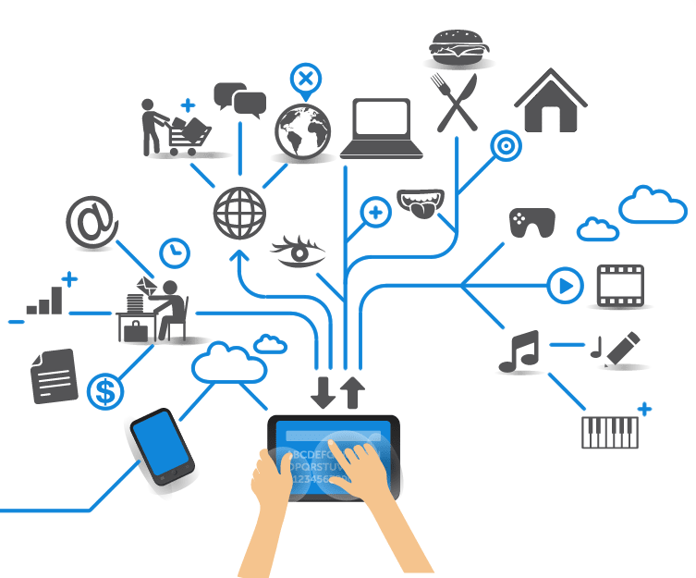
Computer Engineering for the Internet of Things
Distributed Systems and Cloud/Edge Computing for IoT
Practical Lesson 2
Riccardo Cantini
Mail: rcantini@dimes.unical.it
Academic year 2019/2020

Slide 2
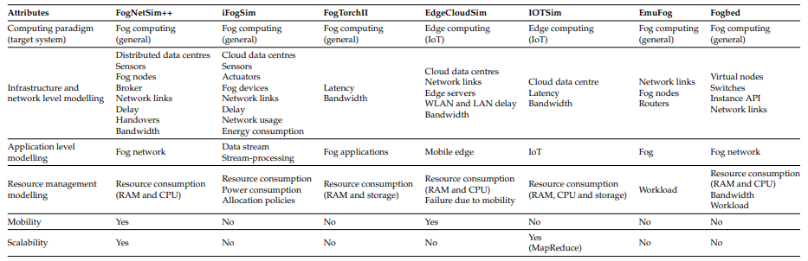
LET’S FOCUS ON IFOGSIM

Slide 3
MAIN FEATURES
Fog computing simulation toolkit, based on CloudSim.
Allows performance evaluation (latency, energy consumption, network usage) and the validation of resource-management and scheduling policies.
Different kinds of devices can be modelled, such as edge devices, cloud data-centres, sensors, network links, data streams, and stream-processing applications.
Simulated services for power monitoring and resource management are integrated at application-placement and application-scheduling level.
Multiple deployment scenarios are supported through two application module placement strategies: cloud-only and edge-ward placement (more on this later…)

Slide 4
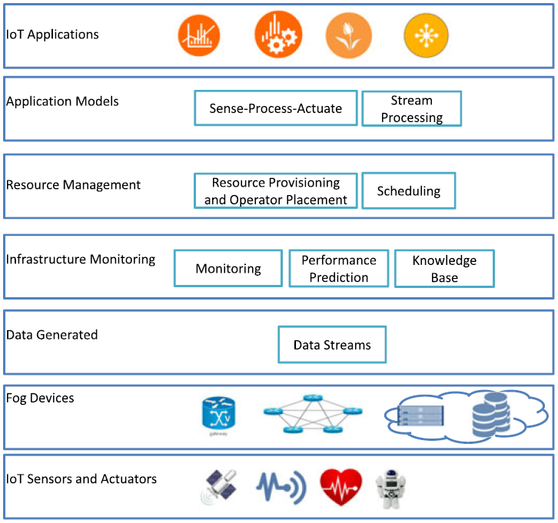
A MULTI-LAYERED ARCHITECTURE
IoT devices model interactions with real-world (source or sink of data).
IoT sensors act as the source of data, sensing the environment and emitting collected values to upper layers for further processing via gateways.
IoT actuators are designed for system mechanism control: they respond to different changes in the environment sensed by IoT sensors.
A sensor is associated with some data-emission characteristics (e.g. data-emission rate) the user can customize for simulating every kind of IoT device (e.g. smart cameras, wearable devices, …).

Slide 5
A MULTI-LAYERED ARCHITECTURE
Fog device is any element in a network capable of hosting an application module.
Gateways are fog devices that connect sensors to the network.
Devices are placed in a hierarchical topology, with a bottom-up parent-child communication model.
An application running in a Fog device is responsible for processing all data coming from elements below in the topology hierarchy.
Device-to-device communication is not supported in iFogSim.

Slide 6
A MULTI-LAYERED ARCHITECTURE
IoT Data streams are sequences of emitted values.
Are referred as tuples in iFogSim.
Streams can be emitted from sensors or from an application module towards another application module or an actuator.
Fog Devices generates data streams containing resource-use and current state details, processed by the Monitoring layer.

Slide 7
A MULTI-LAYERED ARCHITECTURE
Monitoring layer keeps track of:
Resource use
Power consumption
Devices availability
Monitoring components provide necessary informations to the Resources management layer.
Besides monitoring services already present in iFogSim, customized elements can be implemented for realizing more sophisticated logics.

Slide 8
A MULTI-LAYERED ARCHITECTURE
Resource management layer is the core component of the entire architecture.
It is responsible for the management of different resources located on the Fog Devices layer.
The management is performed in such a way that application level QoS constraints are met and resource wastage minimized.
Scheduler and placement components select the best candidate device for hosting a given application module, handling module resources allocation.
Management can be centralized or distributed.
Application module allocation to fog devices is static.

Slide 9
A MULTI-LAYERED ARCHITECTURE
Application/programming models are based on the Directed Data-Flow (DDF) model.
In a DDF model, an application can be represented as a Directed Acyclic Graph (DAG), in which:
Vertices represent application modules
Edges between them show the execution and data flow
DDF modeled applications introduce data dependency between modules and a partial order in the flow of operations.

Slide 10
A MULTI-LAYERED ARCHITECTURE
Two IoT application model are supported:
Sense-process-actuate: information is collected by sensors and transmitted as data stream (tuple) to an application module running on a Fog device which outputs a command for a certain actuator.
Stream-processing: information mined on fog devices from streams generated by sensors can be sent to cloud for large-scale long-term analysis.

Slide 11
DESIGN AND IMPLEMENTATION: DEVICES
FogDevice
Specifies hardware characteristics of fog devices and their connections to other fog devices, sensors, and actuators.
Major attributes are accessible memory, processor, storage size, uplink, and downlink bandwidths.
Methods define how the resources of a fog device are scheduled between application modules running on it and how modules are deployed and decommissioned on them.
Sensor
Contains attributes representing the characteristics of an IoT sensor.
Contains a reference to the gateway fog device to which the sensor is connected and the latency of connection between them.
Defines the output characteristics of the sensor and the distribution of tuple intertransmission, which identifies the tuple arrival rate at the gateway.

Slide 12
DESIGN AND IMPLEMENTATION: DEVICES
Actuator
Defines the effect of the actuation on the environment and the network connections properties, such as latency.
Defines a method to perform an action on arrival of a tuple: this method can be overridden for implementing a certain custom logic, modeling precise actuation effects.
Tuple
Represents the fundamental unit of communication between entities and realize the data stream layer.
A tuple is characterized by its type and the source and destination application modules.
The attributes of the class specify the processing requirements, defined as million instructions (MI), and the length of data encapsulated in the tuple.

Slide 13
DESIGN AND IMPLEMENTATION: DEVICES

Slide 14
DESIGN AND IMPLEMENTATION: APPLICATION
The application design in iFogSim follows the DDF model, in which an application is modeled as a DAG, the vertices representing modules that perform processing on incoming data and edges denoting data dependencies between modules.
AppModule
Represent processing elements and realize the vertices of the DAG in DDF model.
For each incoming tuple, an AppModule instance processes it and generates output tuples that are sent to next modules in the DAG.
The number of output tuples per input tuple is decided using a selectivity model, which can be based on a fractional selectivity or a bursty model.

Slide 15
DESIGN AND IMPLEMENTATION: APPLICATION
AppEdge
Denotes the data dependency between a pair of application modules and represents a directed edge in the DDF application model.
Each edge is characterized by the type of tuple it carries, which is captured by the tupleType attribute of AppEdge class along with the processing requirements and length of data.
Two types of application edges are supported: periodic and event-based.
AppLoop
Additional class, used for specifying the process-control loops of interest to the user.
Allows end-to-end latency measurement.
Consist in a list of modules that compose the loop.

Slide 16
TUPLE EMISSION AND SUBSEQUENT EXECUTION
Gateway
routing (if needed) →

Slide 17
DESIGN AND IMPLEMENTATION: MONITORING SERVICE
In iFogSim, each device monitors and maintains its current resource use statistics.
The executeTuple() method in the FogDevice class contains the tuple processing logic where the device updates its resource use. These statistics can also be encapsulated in a tuple and sent to the resource management.
These resource use values are fed into a related power model to calculate the power consumption of the device, which is reported at the end of the simulation.
Each FogDevice instance is associated with a power model (e.g. PowerModelLinear), which estimates the power consumption at a given CPU use.

Slide 18
DESIGN AND IMPLEMENTATION: BUILT-IN MODULE PLACEMENT STRATEGIES
There are two built-in module placement strategies:
Cloud-only placement:
Is based on the traditional cloud-based implementation of applications where all modules of an application run in data centers.
The sense-process-actuate loop in such applications are implemented by having sensors transmitting sensed data to the cloud where it is processed and actuators are informed if action is required.
Edge-ward placement:
Favors the deployment of application modules close to the edge of the network.
Devices close to the edge of the network not be computationally powerful enough to host all operators of the application. In this case, the strategy iterates on fog devices towards cloud and tries to place remaining operators on alternative devices.

Slide 19
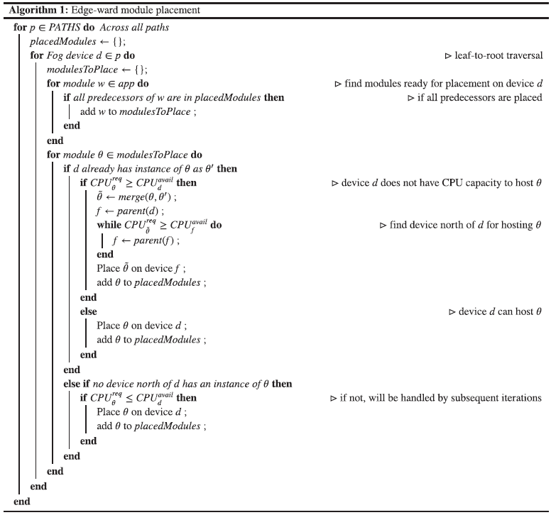
EDGE-WARD MODULE PLACEMENT
Iterates over all leaf-to-root paths in the physical network topology and places modules on each such path.
Placement are performed according to the available capacity of the considered device.
Each device handles all incoming tuples from below levels, so multiple instances of a module are merged and migrated to upper layers by this placement strategy.

Slide 20
DESIGN AND IMPLEMENTATION: UML OVERVIEW

