Slide 1

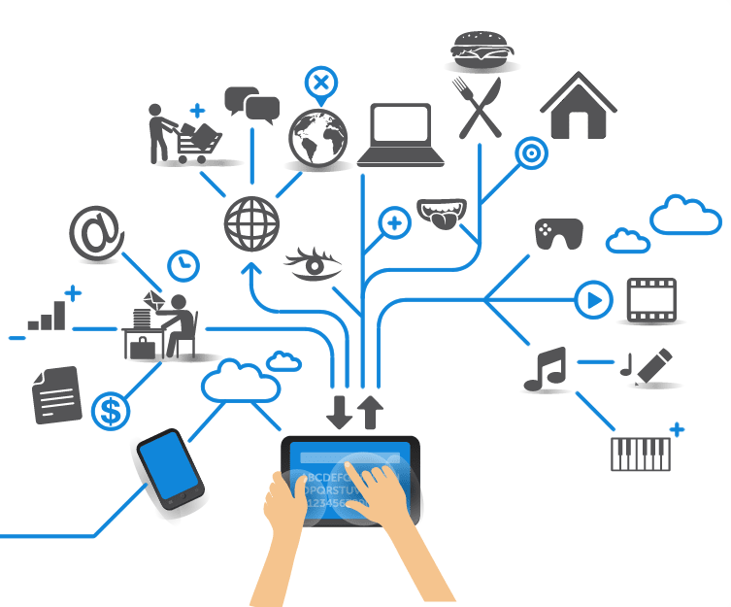
Computer Engineering for the Internet of Things
Distributed Systems and Cloud/Edge Computing for IoT
Practical Lesson 3 - 4
Riccardo Cantini
Mail: rcantini@dimes.unical.it
Academic year 2019/2020

Slide 2
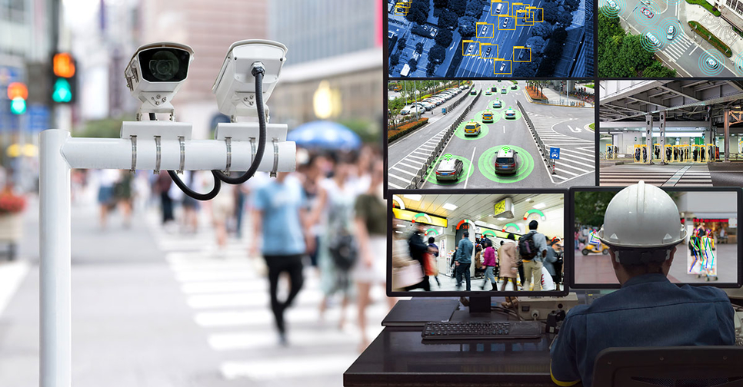
IFOGSIM USE CASE: MODELLING AND SIMULATING A SMART SURVEILLANCE SYSTEM
Automatic analysis of data coming from a large number of cameras and summarization of results in a way that is beneficial to the end-user.
We need a Fog architecture:
A centralized solution would lead to a huge amount of data that needs to be sent to the central processing machine:
High communication latency.
High bandwidth consumption.
→ Decentralization is the way! ;)

Slide 3
SMART SURVEILLANCE SYSTEM: SYSTEM REQUIREMENTS
Low-latency communication: for effective object coverage, the Pan-tilt-zoom (PTZ) parameters of multiple cameras need to be tuned in real-time on the basis of the captured image.
Handling voluminous data: video cameras continuously send captured video frames for processing, which leads to a huge traffic that needs to be handled in order to avoid network congestion.
Heavy long-term processing: the camera control strategy needs to be updated constantly for learning the optimal PTZ parameter calculation strategy. The learning process is carried out with a computationally intensive long-term procedure (maybe running in the cloud).

Slide 4
HOW IT WORKS?
Coordinates multiple cameras with different fields of view (FOVs) to surveil a given area.
PTZ parameters are set constantly so that the best view of the area can be obtained.
Flow of ordered operations:
The smart camera detects motion in its FOV and starts sending a video stream to the Smart Surveillance application.
The application locates the moving object in the video stream sent and initiates tracking.
Tracking of moving objects is done by constantly tuning the PTZ parameters of the cameras at that site so as to obtain the best view of all the tracked objects.
Furthermore, in the event of detection of an event of interest, the application notifies the system user and sends captured video streams to him through the Internet.

Slide 5
APPLICATION MODULES
Motion detection
Module embedded inside the smart cameras.
Continuously reads the raw video streams captured by the camera to find motion of an object
If a motion is detected in the camera's FOV, the video stream is forwarded to the object detection module.
Object detection
The object detection module receives video streams.
Extracts the moving object from the video streams and compares them with previously discovered objects, active in the area currently.
In case the detected object has not been in the area before, tracking is activated.

Slide 6
APPLICATION MODULES
Object tracker
Receives the last calculated coordinates of the currently tracked objects and calculates an optimal PTZ configuration of all the cameras covering the area so that the tracked objects can be captured in the most effective manner.
PTZ information is conveyed to the PTZ control of cameras periodically.
PTZ control
Adjusts the physical camera to conform to the optimal PTZ parameters sent by the object tracker.
This module serves as the actuator of the system and is embedded in the smart cameras itself.
User interface
The application presents a user interface
A fraction of the video streams containing each tracked object is sent to the user's device.

Slide 7
DDF APPLICATION MODEL

Slide 8
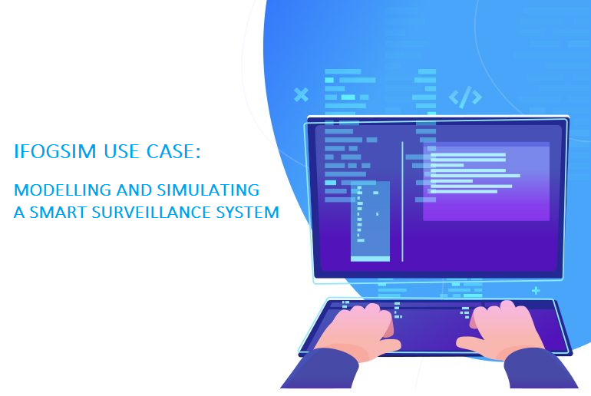
LET’S DO IT!!

Slide 9
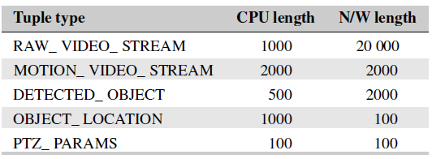
MAIN STEPS
Create the Application following the DDF model:
Application vertices (AppModule).
Edges between them (AppEdge).
Control loops (AppLoop).
Tuple mapping with a certain selectivity.
Create the physical topology of the application:
The infrastructure is organized in Areas: there will be a certain number of areas that need to be monitored and a given number of smart cameras in each area.
As we want to test the performances varying the number of cameras and monitored areas, we will not create different topologies via GUI, but we will code a dynamic parametric topology.
We need to add the Cloud, FogDevices (that will host app modules), cameras (modeled as a FogDevice too) and Sensors and Actuators (PTZ) for each camera.

Slide 10
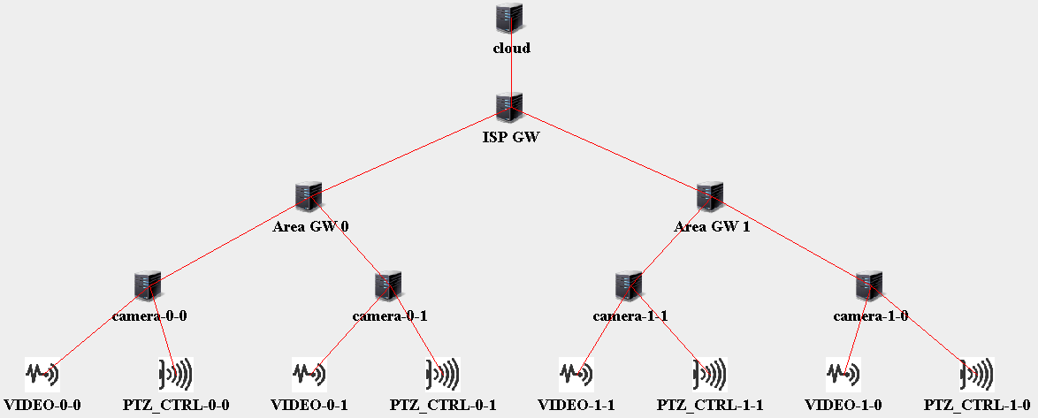
MAIN STEPS
An example of the Smart Surveillance System physical topology, with 2 areas and 2 cameras per area:

Slide 11
MAIN STEPS
Create main and run simulation:
Init simulation.
Select an application ID.
Instantiate the FogBroker that intermediates interaction between Cloud user and the application.
Create the ModuleMapping adding the created modules to the different devices:
Place the motion detection module on the smart cameras.
Fix user interface module instances to the Cloud
Place Fog devices according to the desired module placement policy: we will test both Cloud-only and Edge-ward.
Create the Controller.
Start the Simulation.
Collect and analyze results for performance evaluation.

Slide 12
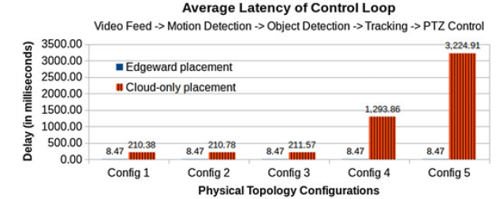
PERFORMANCE EVALUATION: LATENCY
We simulate 4 smart cameras connected to an area gateway: the number of surveilled areas is 1, 2, 4, 8, and 16 for configurations Config1, Config 2, Config 3, Config 4, and Config 5 respectively.
Cloud is a bottleneck!

Slide 13
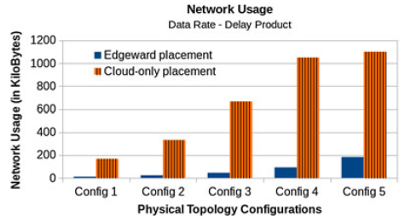
PERFORMANCE EVALUATION: NETWORK USAGE
The load on the network increases significantly in the case of cloud-only deployment, as in the Fog-based execution, most of the data-intensive communication takes place through low-latency links.

Slide 14
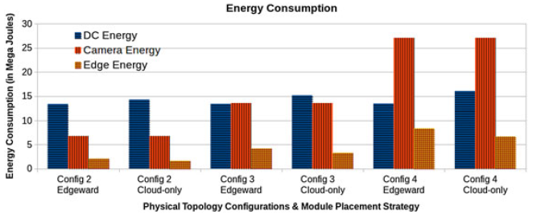
PERFORMANCE EVALUATION: ENERGY CONSUMPTION
The energy consumption in the cloud data center decreases when operators are pushed to Fog devices, so we are able to avoid overloading the cloud

