Slide 1

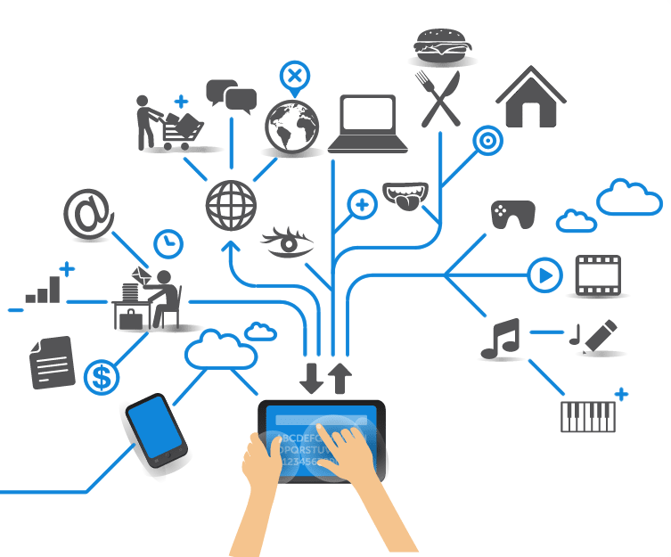
Computer Engineering for the Internet of Things
Distributed Systems and Cloud/Edge Computing for IoT
Practical Lesson 5 - 6
Riccardo Cantini
Mail: rcantini@dimes.unical.it
Academic year 2019/2020

Slide 2
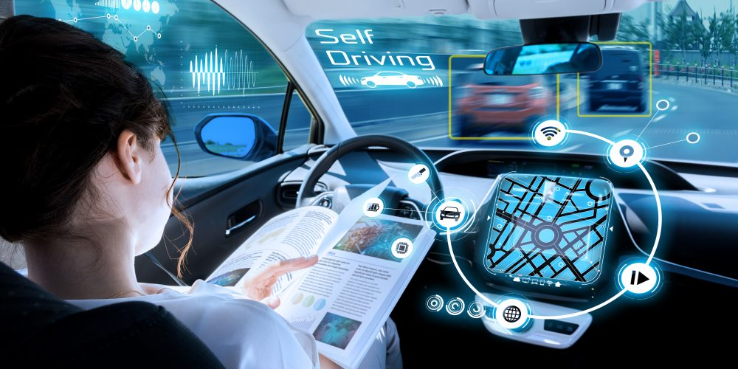
MODELLING AND SIMULATING A SELF-DRIVING SYSTEM
We want to model and simulate an architecture that is a simplified version of a self-driving car infrastructure and its connected modules.
We need a Fog architecture:
Such (near) real time systems need very low-latency responses and generate a huge amount of data, so we need:
Low communication latency.
Reduction of bandwidth consumption.
High performance networking and connectivity (5G).
→ A fog solution is the way! ;)

Slide 3
SELF-DRIVING CAR: SYSTEM REQUIREMENTS
Low-latency communication: a self-driving system moves independently within the environment and must be able to take precise decisions quickly.
Handling voluminous data: sensors embedded in the self-driving car generate a huge amount of data that needs to be handled of used make decision and improve system performances.
Heavy long-term processing: data generated by the system can be classified and stored in the cloud, where the driving style of the car can be analyzed and some tips can be generated to improve the driving abilities of the system and inform the user about the current car driving style.

Slide 4
HOW IT WORKS?
Cars move autonomously in the environment, sensing various informations and making decisions through an intelligent driving controller, actuating in a low-latency manner.
Machine learning and AI algorithms are used to generate advices and fine-tune driving abilities of the intelligent driving controller.
Flow of ordered operations:
Sensors embedded in the car send information to the related smart-driving module.
The smart-driving module process the information sensed on the environment and send it to the classifier for further analysis; if a certain low-latency action needs to be performed, the module sends to the actuator the command to be executed.
The classifier classifies the received informations and send its output to the AI-advicer.
The AI-tuner analyze the classified data for identifying the current behavior of the car, in order to fine-tune the car driving style and generate same tips and statistics to be displayed by a monitor in the car.

Slide 5
APPLICATION MODULES
Smart-driving module
This module is embedded inside the (generic) Intelligent Driving Controller (IDC), placed in the car.
Receives data from the environment, processes it and controls the related actuator, according to a given behavioural model.
Send processed information to the classifier.
Classifier
Classifies the received information in order to identify the current action performed by the driving system (e.g. sudden accelerations, hard brakings, …)
Sends the classified action to the AI-tuner.
AI-tuner
Analyzes the informations sent by the classifier, in order to identify the current driving behavior of the system.
Fine-tunes the behavioural model of the Smart-driving module sending a periodic update.
Sends some tips and statistics to the monitor placed in the car.

Slide 6
DDF APPLICATION MODEL
Sensor-info
Classifier
Sensor_info
Classified_action
Smart-driving
module
Processed_info
AI-tuner
Actuation
control
Low-latency_action
Update_model
Display_info

Slide 7
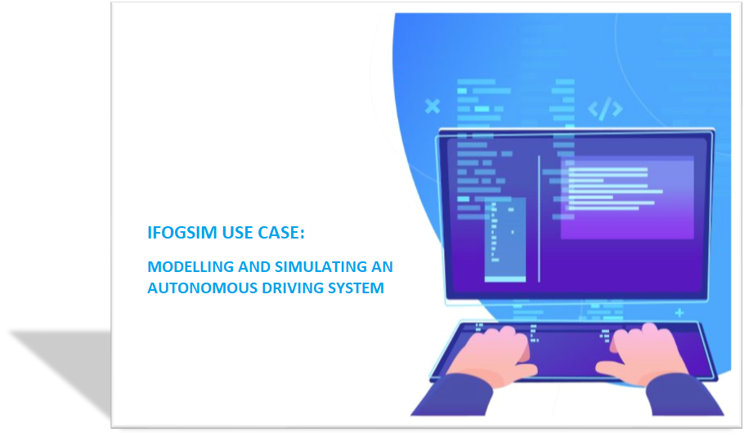
LET’S DO IT!! (THIS TIME BY YOURSELVES)

Slide 8
MAIN STEPS
Create the Application following the DDF model:
Application vertices (AppModule).
Edges between them (AppEdge).
Control loops (AppLoop).
Tuple mapping with a certain selectivity.
Create the physical topology of the application:
The part of the infrastructure located inside the car is composed by a given number of Component Managers (CM).
Each CM controls a certain number of Intelligent Driving Controllers (IDCs), equipped with a generic pair of sensor and actuator.
We want to test the performances varying the number of Component Managers and IDCs.
We need to add the Cloud, FogDevices (ISP Gateway, CM and IDCs) and the desired type of Sensor and Actuator for each IDC, according to our simulation pourposes.

Slide 9
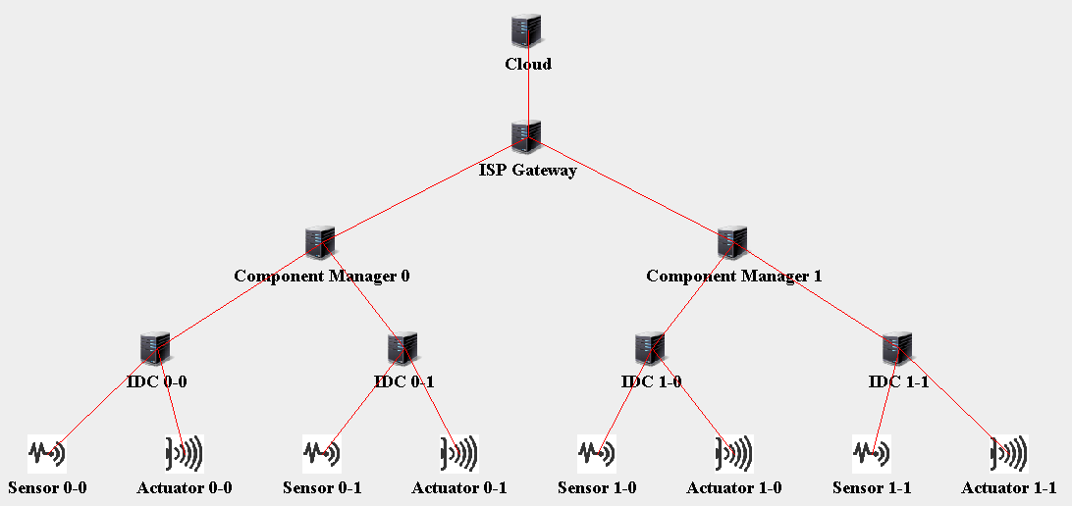
PHYSICAL TOPOLOGY
An example of physical topology, created via iFogSim GUI, with 2 CMs handling 2 IDCs:
The topology is saved in a JSON file: it can be modified if needed and loaded for further usage.

Slide 10
MAIN STEPS
Create main and run simulation:
Init simulation.
Select an application ID.
Instantiate the FogBroker that intermediates interaction between Cloud user and the application.
Create the ModuleMapping adding the created modules to the different devices:
Place the Smart-driving module on the Intelligent Driving Controllers (IDCs).
Fix user Ai-tuner module instances to the Cloud.
Place remaining Fog devices according to the desired module placement policy: we will test both Cloud-only and Edge-ward.
Create the Controller.
Start the Simulation.
Collect and analyze results for performance evaluation.

Slide 11
PERFORMANCE EVALUATION
We need to simulate 4 configurations, varying the number of Component Managers (CMs) and fixing to 3 the number of Intelligent Driving Controllers (IDCs) for each CM:
Config 1 → 1 CM
Config 2 → 4 CM
Config 3 → 16 CM
Config 4 → 32 CM
A comparison of the obtained results is required in terms of:
LATENCY
NETWORK USAGE
ENERGY CONSUMPTION

