Slide 1

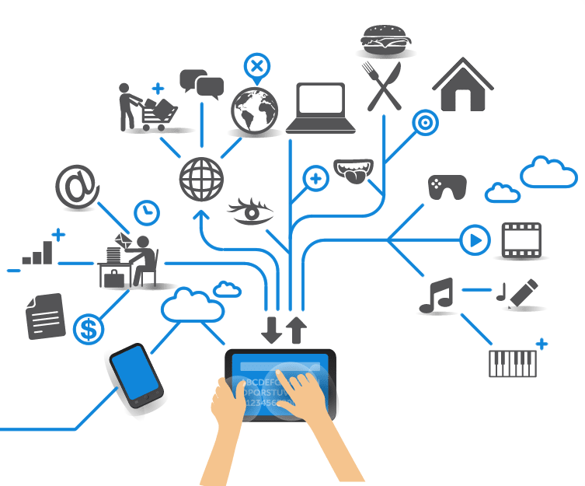
Computer Engineering for the Internet of Things
Distributed Systems and Cloud/Edge Computing for IoT
Practical Lesson 7
Riccardo Cantini
Mail: rcantini@dimes.unical.it
Academic year 2019/2020

Slide 2
IOT DEVELOPERS SURVEY
Since 2015, the Eclipse Foundation has been surveying the developers working in IoT development companies worldwide to understand the overall landscape, challenges, and trends in this field.
The latest IoT developer survey was conducted between January and March 2018 in which 502 individuals participated.
Link to the survey: https://blog.benjamin-cabe.com/2018/04/17/key-trends-iot-developer-survey-2018

Slide 3
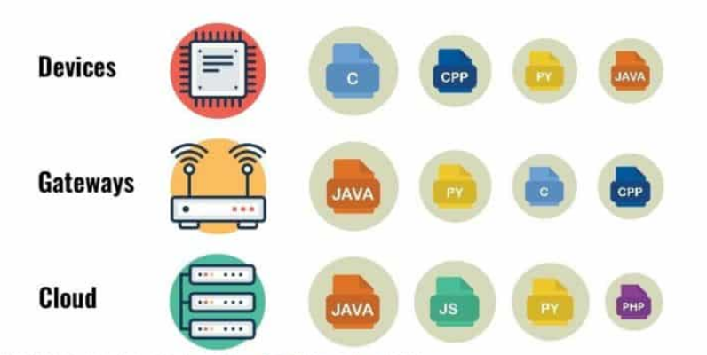
TOP IOT PROGRAMMING LANGUAGES
The image shows the preferred languages based on the given subdomain of IoT development.
For IoT hardware with low computing power and constrained RAM, C is the programming language of choice.
For gateways and cloud platforms, Java is the top choice.

Slide 4
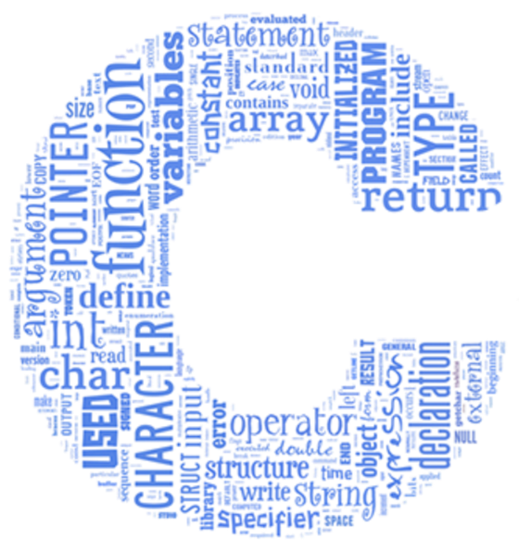
C
IoT devices are usually hard constrained: at this level, resources and computing power is usually quite limited.
C works best here because:
Is ideal for writing low-level code (i.e. code close to the hardware layer).
It doesn’t require a lot of processing power, and it’s able to work directly with the RAM.
C is also a common language for microcontroller programming, quite suitable for sensor and gateway hardware layer applications.
However, since C is such a low-level language, its syntax is more complicated with respect to other high level languages, such a Pyhton.

Slide 5

JAVA
Java is an object-oriented programming language widely used among programmers.
“Write once, run everywhere”:
The code can be used wherever JVMs are supported, not just on places where JVMs are common (servers and smartphones), but also on the smallest machines.
Java is highly portable and doesn’t have hardware limitations.
Java Micro Edition specification was approved in 2000.
It saved space with a very limited collection of class libraries and other tools.
Today, most of the focus is on Java SE Embedded, which is much closer in capability to the Standard Edition.
Developers can use the latest features of the Java 8 platform and then move their code to a smaller, embedded device.

Slide 6
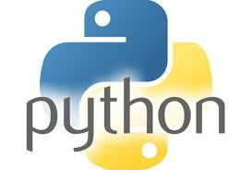
PYTHON
Pyhton is one of the most used high-level scripting language.
It is ideal for the data analysis layer of IoT systems:
It has a large number of useful libraries, and it can get more stuff done with fewer lines of code.
The source code is compact and readable as the syntax is clean.
It is easy to learn, widely used, and robustly supported.
Excellent choice for managing and organizing complex data streams without having to maintain equally complex codebases.
There are versions of Pyhton designed for programming small embedded devices.
The MicroPython board and software package is a small microcontroller optimized to run Python on a small board that’s only a few square inches.

Slide 7

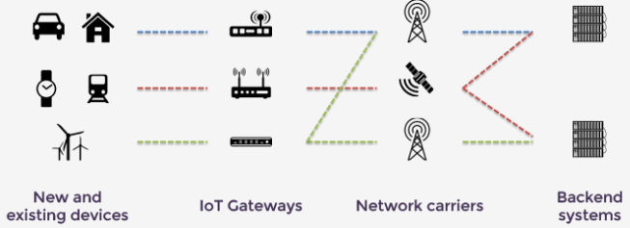


ECLIPSE FOR IOT
IOT Eclipse is an open source community that provides the open source building blocks for creating an open and interoperable Internet of Things
It provides open source projects that developers can use to build their IoT solutions.
The focus is on providing:
Open source implementations of popular IoT standards (e.g. MQTT protocol).
Frameworks and services required for building IoT solutions.
A variety of tools required by IoT developers.
IoT solutions offered by these projects can be divided according to the layer of reference:
Constrained devices
Gateways
Cloud platform

Slide 8
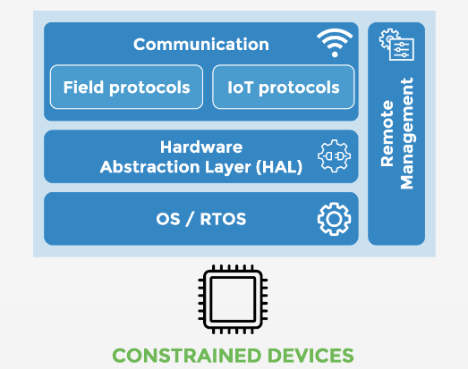
CONSTRAINED DEVICES
The “Thing” in the IoT is the starting point for an IoT solution: it is typically the source of the data, and it interacts with the physical world.
These devices are often very constrained in terms of size and resources and programmed using microcontrollers (MCU) that have very limited capabilities.
They are specialized on a specific task and optimized to minimize the consumption of resources.
Open source components for IoT Devices:
Hardware abstraction
Communication
Remote Management

Slide 9
HARDWARE ABSTRACTION: ECLIPSE MRAA
In order to ensure portability, an IoT device needs to include a software layer that enables access to the hardware features of the MCU, such as:
Flash memory
General Purpose-IOs
Serial interfaces
…
Eclipse MRAA is a low-level library written in the C/C++ language.
MRAA abstracts the details associated with accessing and manipulating the basic I/O capabilities of popular IoT platforms and boards and presents a single and concise API.

Slide 10
HARDWARE ABSTRACTION: ECLIPSE MRAA
Eclipse MRAA provides the following architectural features:
Physical Pin Mapping
MRAA provides clear and consistent API function calls that match the corresponding physical pin labels on supported IoT boards.
Kernel to User Space I/O Abstraction
Although Linux provides a rich infrastructure for manipulating GPIOs and standard bus protocols, it does so at the kernel level.
MRAA serves as a translation layer on top of the Linux I/O facilities.

Slide 11
HARDWARE ABSTRACTION: ECLIPSE MRAA
I/O Expansion
MRAA provides access to I/O expanders and Arduino MCUs, via Firmata protocol, connected to a Linux host running MRAA, using the same API classes found on regular boards.
MRAA refers to these expanders as sub-platforms, and the application runs on the Linux host.
Portability
Applications developed with the MRAA library can be ported to other supported boards if the same type of I/O exists on the new target.
The C APIs simplify portability between Linux boards and MCUs running Zephyr RTOS through the use of the ZMRAA project which provides a near one-to-one mapping for the API calls.

Slide 12
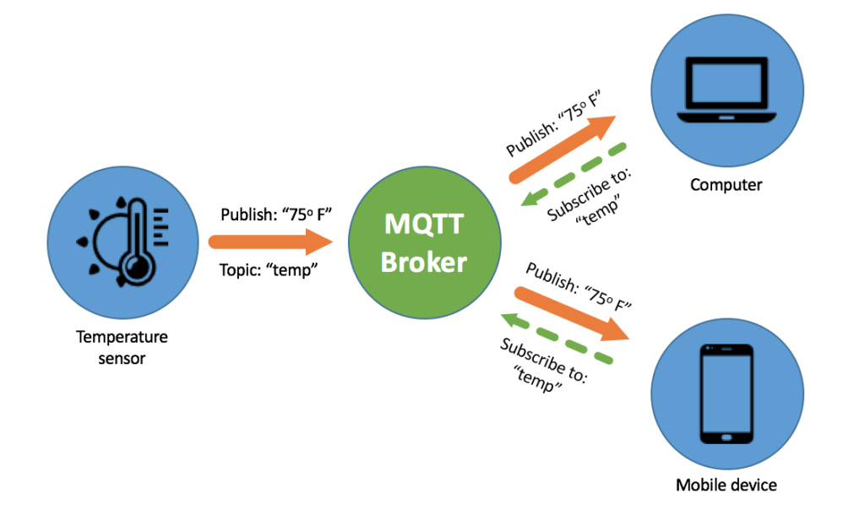
COMMUNICATION: ECLIPSE PAHO
An IoT device requires drivers and protocols that allow to connect it to a wired or wireless protocol, thus enabling communication.
Eclipse Paho provides an implementation of the MQTT protocol.
MQTT is a lightweight, publish-subscribe network protocol that transports messages between devices.
The protocol usually runs over TCP/IP, but can be supported by any network protocol that provides a connection that is:
Ordered
Lossless
Bi-directional

Slide 13
MORE ON MQTT
The MQTT protocol defines two types of network entities:
An MQTT broker is a server that receives messages from the clients and then routes each message to the appropriate destination client.
An MQTT client is any device connected to an MQTT broker.
Information is organized in a hierarchy of topics:
Publishers send control messages with the data to the connected broker.
The broker distributes the information to any clients that have subscribed to that topic.

Slide 14
MORE ON MQTT
Messages linked to topic no client subscribed to are discarded, unless the publisher indicates explicitly that the topic is to be retained.
Clients only interact with the broker.
A system may contain several broker servers that exchange data based on the topic of current connected subscribers.

Slide 15
REMOTE MANAGEMENT: ECLIPSE WAKAAMA
There are many cases where an IoT device needs to be remotely controlled:
Firmware upgrade
Battery-level monitoring
…
Eclipse Wakaama provides an implementation of the OMA LWM2M standard.
OMA Lightweight M2M is a protocol from the Open Mobile Alliance for M2M designed to provide IoT device management functionality.
Machine to machine (M2M) is the direct communication between devices using any communications channel, including wired and wireless.

Slide 16
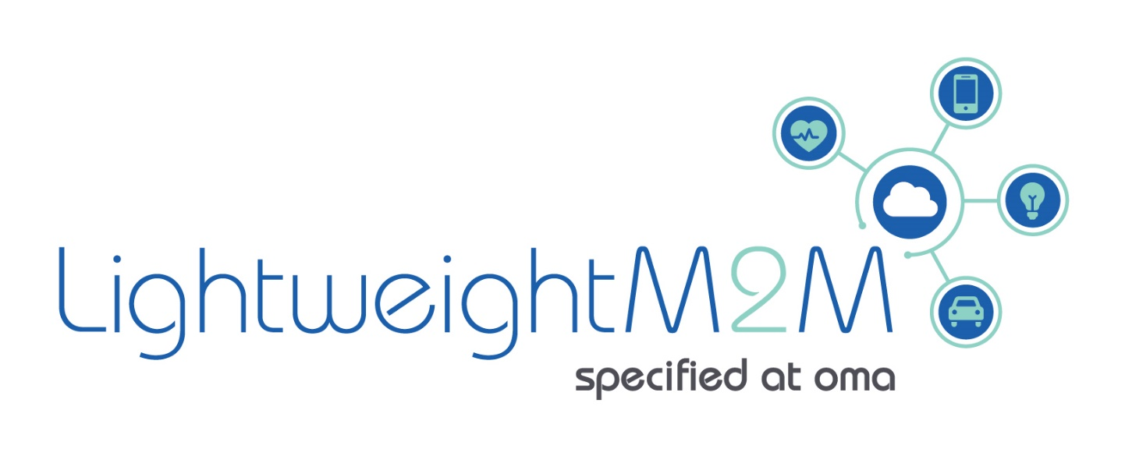
MORE ON OMA-LWM2M
The main characteristics of the OMA Lightweight M2M protocol are:
UDP and SMS transport layer support.
Simple object-based resource model.
It offers basic M2M functionalities:
Access Control
Connectivity
Firmware Update
Location
Connectivity Statistics

Slide 17
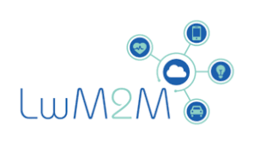
MORE ON OMA-LWM2M
It is generally used with CoAP:
Constrained Application Protocol (CoAP) is a service-layer protocol for constrained devices.
It enables constrained devices, called nodes to communicate with the Internet.
CoAP is designed for use between devices on different (also constrained) networks connected through the internet.
CoAP is also used via other mechanisms, such as SMS on mobile communication networks.
It offers DTLS based security:
Datagram Transport Layer Security (DTLS) is a communications protocol that provides security for datagram-based application, protecting the communication against:
Eavesdropping
Tampering
Message forgery

