Slide 1

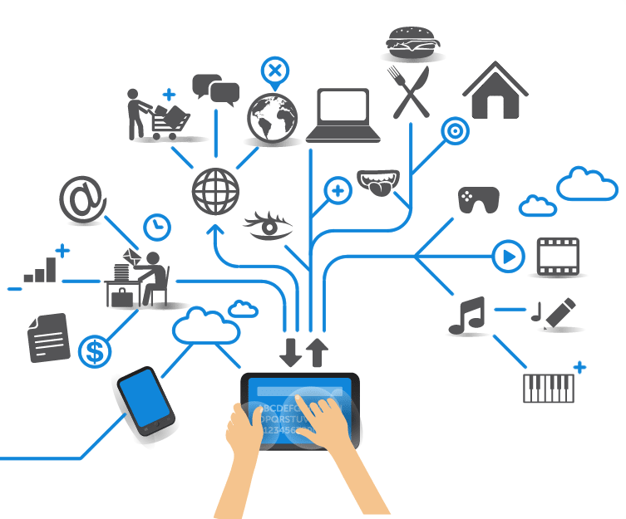
Computer Engineering for the Internet of Things
Distributed Systems and Cloud/Edge Computing for IoT
Practical Lesson 8
Riccardo Cantini
Mail: rcantini@dimes.unical.it
Academic year 2019/2020

Slide 2

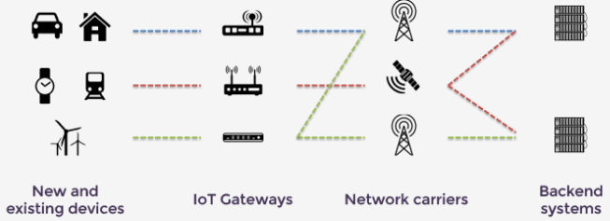


ECLIPSE FOR IOT
IOT Eclipse is an open source community that provides the open source building blocks for creating an open and interoperable Internet of Things
It provides open source projects that developers can use to build their IoT solutions.
The focus is on providing:
Open source implementations of popular IoT standards (e.g. MQTT protocol).
Frameworks and services required for building IoT solutions.
A variety of tools required by IoT developers.
IoT solutions offered by these projects can be divided according to the layer of reference:
Constrained devices
Gateways
Cloud platform

Slide 3
IOT GATEWAYS & SMART DEVICES
The IoT gateway acts as the aggregation point for a group of sensors and actuators.
It coordinates the connectivity of these devices to each other and to the internet.
An IoT gateway can be a physical piece of hardware or functionality that is incorporated into a larger Thing connected to the network.
Examples:
An industrial machine
A connected car
A home automation appliance

Slide 4
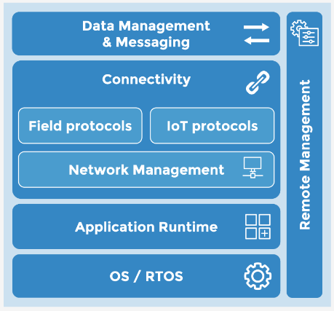
ECLIPSE KURA
Eclipse Kura provides a general purpose middleware and application container for IoT gateway services.
An IoT gateway stack based on Eclipse Kura would include:
Operating System
Application Container or Runtime Environment:
Eclipse Equinox
Eclipse Concierge
Implementations of the OSGi core framework specification (more on this later…).
Communication & Connectivity:
APIs to interface with gateway I/Os
Support for many field and IoT protocols used for connecting to devices.

Slide 5
ECLIPSE KURA
Data management & Messaging:
Provides a native implementation of a MQTT-based messaging solution
Applications running on the gateway can communicate with a Cloud Platform in a transparent way, without having to deal with:
Network interfaces availability
IoT data representation
Support for additional messaging protocols
Remote management:
Is based on the MQTT protocol and allows:
Monitoring of the IoT gateway state
Settings modifying
Software install and update
...

Slide 6
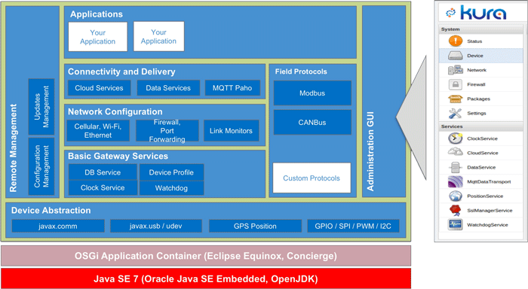
ECLIPSE KURA OVERVIEW

Slide 7
OSGI FRAMEWORK
As the complexity of a software product increases, the attention moves on:
Modularity
Dynamic extensibility
The OSGi framework aims to implement a complete and dynamic component model, that is not present in Java environment, that provides only low-level mechanisms for component model creation.
OSGi solves many of the issues related to lack of support in modularity and dynamism, by:
Definition of the concept of module, named bundle
Automatic management of dependencies
Management of the code life cycle

Slide 8
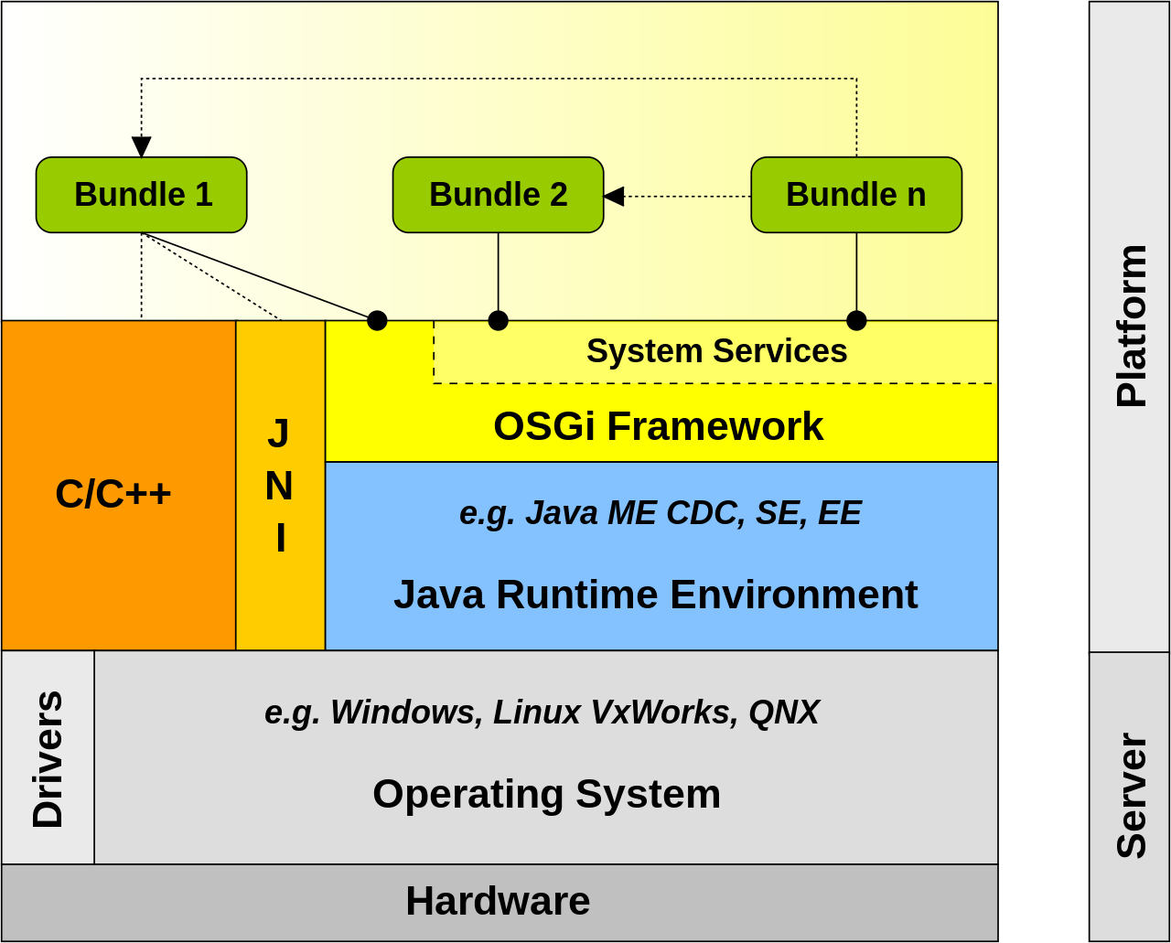
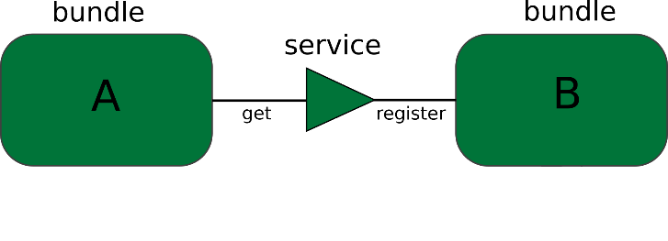
OSGI FRAMEWORK
OSGi technology can thus be seen as:
A modular system for the Java platform.
A dynamic system, which allows installation, start-up, stop and removal of bundles at runtime, without requiring restarts.
Service-oriented, where services can be dynamically registered and used in the JVM.
Eclipse Equinox and Eclipse Concierge are Implementations of the OSGi core framework specification.

Slide 9
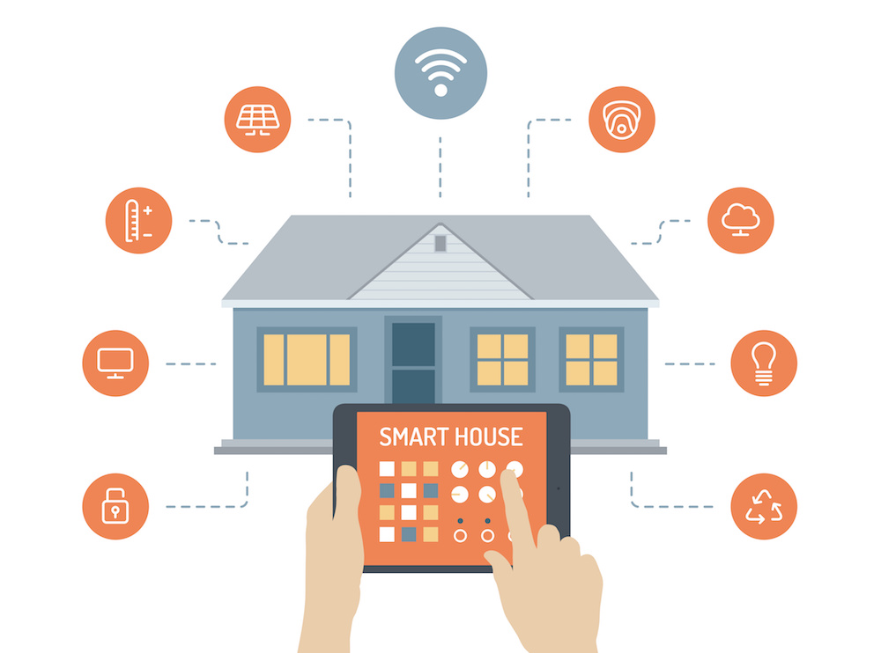
SMARTHOME AUTOMATION
Monitoring
There are a wide range of possible monitoring applications:
Smart surveillance
Energy consumption monitoring
Consumption behaviour analysis
Smart energy grids for efficient energy distribution
Many different safety sensors can be used in combination, such as:
Motion detectors
Water, fire and smoke detectors
Smart cameras
Smart plugs and meters
Door and window monitoring sensors

Slide 10
SMARTHOME AUTOMATION
Comfort
Smart objects can be easily controlled from a smartphone, doing almost everything on their own, acting autonomously in a smart way:
The vacuum takes care of cleaning while you are shopping.
The washing machine can easily be switched on and off from work.
You can wake up and find freshly brewed coffee
Smart wall and radiator thermostats begin heating as soon as a resident approaches the house (for example by inferring the usual behaviour of the owner), and turns off if nobody is in the house, avoiding wastes.

Slide 11

ECLIPSE SMARTHOME
Eclipse SmartHome provides an IoT gateway platform that is specifically focused on the home automation domain.
It is flexible and customizable.
An Eclipse SmartHome stack would include:
Operating System
Application Container or Runtime Environment (OSGi Runtimes):
Eclipse Equinox
Eclipse Concierge
Communication & Connectivity:
Support for many home automation devices
Enabling home automation solutions communication within an “Intranet of Things”

Slide 12
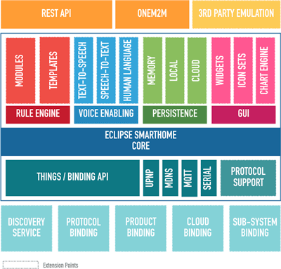
ECLIPSE SMARTHOME
OVERVIEW
Data Management & Messaging:
Eclipse SmartHome has an internal event bus, which can be exposed to external systems through MQTT.
It provides mechanisms for:
Persistent storage in DBs
Rule engine for running custom business logic
Remote Management:
Support for device onboarding and configuration.
Support for firmware update of connected devices.

Slide 13
INDUSTRY 4.0
Industry 4.0 refers to the use of automation and data exchange in manufacturing.
According to the Boston Consulting Group there are nine principal technologies that make up Industry 4.0:
Autonomous Robots
Simulation
Horizontal and Vertical System Integration
Industrial Internet of Things
Cybersecurity
Cloud
Additive Manufacturing
Big Data analytics
Augmented Reality

Slide 14
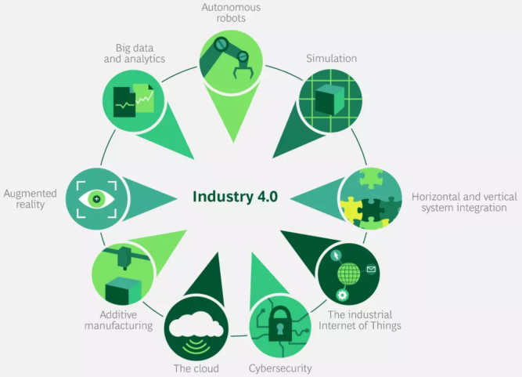
INDUSTRY 4.0
These technologies are used for creating a smart factory where machines, systems, and humans communicate with each other in order to coordinate and monitor progress along the assembly line.

Slide 15


ECLIPSE 4DIAC
Provides an industrial-grade open source infrastructure for distributed industrial process measurement and control systems based on the IEC 61499 standard.
4DIAC is ideally suited for Industrie 4.0 and Industrial IoT applications in a manufacturing setting.
The IEC 61499 standard defines a domain specific modeling language aimed at:
Developing distributed industrial control solutions by providing a vendor independent format.
Simplifying support for controller to controller (C2C) communication.

