Slide 1

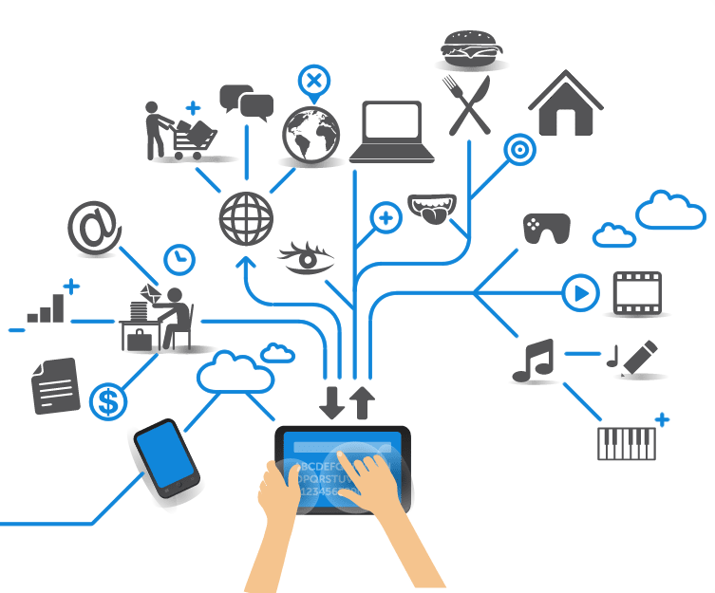
Computer Engineering for the Internet of Things
Distributed Systems and Cloud/Edge Computing for IoT
Practical Lesson 9
Riccardo Cantini
Mail: rcantini@dimes.unical.it
Academic year 2019/2020

Slide 2

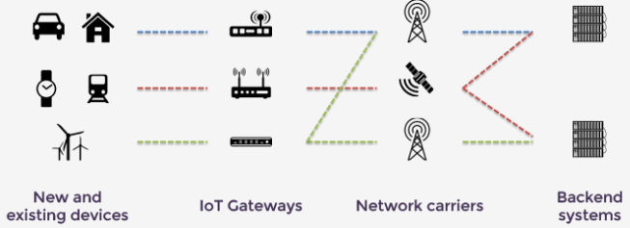


ECLIPSE FOR IOT
IOT Eclipse is an open source community that provides the open source building blocks for creating an open and interoperable Internet of Things
It provides open source projects that developers can use to build their IoT solutions.
The focus is on providing:
Open source implementations of popular IoT standards (e.g. MQTT protocol).
Frameworks and services required for building IoT solutions.
A variety of tools required by IoT developers.
IoT solutions offered by these projects can be divided according to the layer of reference:
Constrained devices
Gateways
Cloud platform

Slide 3
IOT CLOUD PLATFORM
Represents the software infrastructure and services required to enable an IoT solution.
Operates on different infrastructures:
Cloud infrastructure
OpenShift
AWS
Microsoft Azure
Enterprise data centers
Main characteristics:
Scalability
Vertical: address the variety of IoT solutions in terms of computational power and heterogeneity.
Horizontal: maintain the QoS as the number of connected devices increases.
Interoperability: ensure the integration between developed IoT solutions, existing ones and enterprise applications.

Slide 4
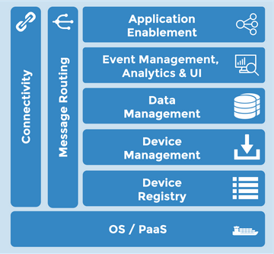
CLOUD STACKS: ECLIPSE KAPUA
Modular platform providing services for IoT gateways and smart edge IoT devices management.
Provides comprehensive management of edge IoT nodes including their connectivity, configuration, and application life cycle.
Aggregated real-time data streams from the edge can be archived for historical analysis or flexibly routed towards enterprise IT systems and applications.
Provides a web-based administration console and is accessible through RESTful API for easy application integration.
IoT Cloud platform

Slide 5
ECLIPSE KAPUA: MAIN GOALS
The goal of Eclipse Kapua is to create a growing ecosystem of microservices through the extensions provided by other Eclipse IoT projects and organizations.
It aims at providing an IoT integration platform with the following high-level requirements:
Connectivity management for IoT devices and IoT gateways.
Initial support will be offered to established IoT protocols like MQTT.
Other protocols like AMQP, HTTP, and CoAP will be added over time.
The connectivity layer is responsible for managing device authentication and authorization.
Edge-device management:
Device configuration introspection and remote control.
Independency from the device software stack.
Further development for LW-M2M protocol support.

Slide 6
ECLIPSE KAPUA: MAIN GOALS
Enabling of data pipelines for batch and streaming processing:
Handling of large amounts of telemetry data.
Data archival for dashboards or business intelligence applications.
Enable real-time analytics and business rules.
Flexible and configurable data integration.
Data storage and collection of incoming data, in order to and make it available to upstream enterprise applications.
Ensure security and authentication
Account management
User management
Permissions and roles

Slide 7




ECLIPSE KAPUA: FUNCTIONALITIES
Kapua is a Modular IoT cloud platform to manage and integrate devices and their data.
Main functionalities:
Connect IoT devices (usually via MQTT protocol).
Manage device applications, configurations, and resources through remote administration.
Store and index data published by IoT devices for quick analysis and visualization into dashboards.
Integrate Kapua services with IT applications through flexible message routing and REST APIs.

Slide 8
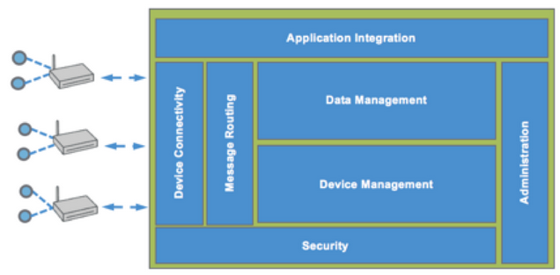
ECLIPSE KAPUA: ARCHITECTURE
Device Connectivity
Is managed through a multi-protocol message broker (MQTT or others).
The device connectivity module is responsible to:
Authenticate connections
Appropriate authorization (i.e. in the topic namespace)
Maintain a Device Registry
The Device Registry:
Stores the device profile, the device connection status and the device connection log.
Enables device organization through custom attributes and tags.

Slide 9
ECLIPSE KAPUA: ARCHITECTURE
Message Routing
Data stream published by devices may have different consumers.
The Message Routing component allows for flexible handling of message streams avoiding hard coded behaviors through configurable massage routes:
Certain messages (e.g. control messages) are meant to be consumed by the Device Manager.
Others (e.g. telemetry data) are meant to be archived in the IoT Platform or re-directed to other systems.

Slide 10
ECLIPSE KAPUA: ARCHITECTURE
Device Management
No assumption on the device software stack.
Allows performing remote operations on the connected devices, using an open application protocol over MQTT:
Manage the device configuration
Manage the device services
Manage the device applications
Execute remote OS commands
Provision initial device configuration
In the future, Eclipse Kapua may adopt additional device management protocols like the emerging LWM2M standard.

Slide 11
ECLIPSE KAPUA: ARCHITECTURE
Data Management
Persistent storage of telemetry data sent by the devices for application retrieval.
A reference message payload is defined which:
Contains timestamp, geo position, …
The chosen encoding is based on an open Google Protocol Buffers grammar.
A NoSQL data storage is used to allow for a flexible indexing of the telemetry messages.
Incoming messages are stored and indexed by timestamp, topic, and originating asset.

Slide 12
ECLIPSE KAPUA: ARCHITECTURE
Security
Various aspects of the IoT platform are taken into account, such as the management accounts and users.
The account model supports a hierarchical access control structure.
Following Role Based Access Control (RBAC), user identities can be defined and associated with one or more permissions guaranteeing the principle of least privilege.
Devices connect to the platform using the credentials of one of these user identities or through SSL authentication.

Slide 13
ECLIPSE KAPUA: ARCHITECTURE
Application Integration
Eclipse Kapua offers Web Services API based on Representational State Transfer (REST).
REST APIs:
Expose all the platform functionality.
Offer a bridge to the MQTT broker enabling the routing of commands from applications to devices (without the need of a specific connection to the message broker).
Support real-time display of data published by the devices in web pages and mobile dashboards, helping analysts and users for an easy monitoring.

Slide 14
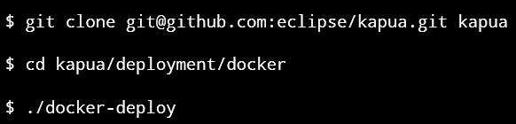
GETTING STARTED WITH ECLIPSE KAPUA
Install and run Eclipse Kapua:
Requirements:
64 bit architecture
Java VM Version 8
Docker Version 1.2+
Internet Access
Run the docker containers through Docker Compose, a tool that makes possible an easy handling of multiple containers at once, by applying a set of rules declared within a single docker-compose.yml configuration file.

Slide 15
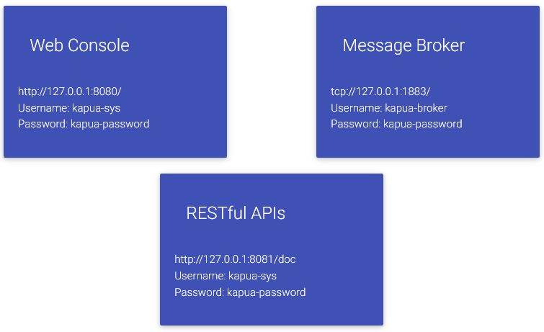
GETTING STARTED WITH ECLIPSE KAPUA
After that, you’ll have the following services available:

Slide 16
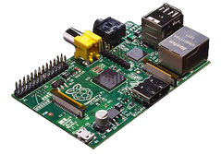
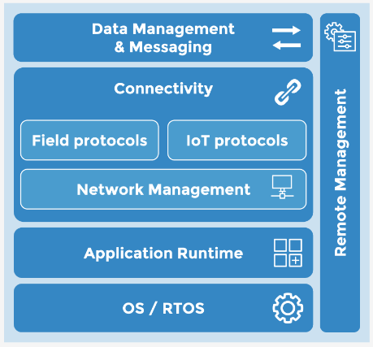

GETTING STARTED WITH ECLIPSE KAPUA
Connect a gateway-level device: for example, a Kura-powered device like a RaspberryPi can be connected to Kapua.
Eclipse Kura provides a general purpose middleware and application container for IoT gateway services.
An IoT gateway stack based on Eclipse Kura would include:
(Real-time) Operating System
Application Container or Runtime Environment (OSGi compliant): Eclipse Equinox or Concierge
Communication & Connectivity
Data management & MQTT-based messaging
MQTT-based remote management
Other MQTT devices can be connected.

Slide 17
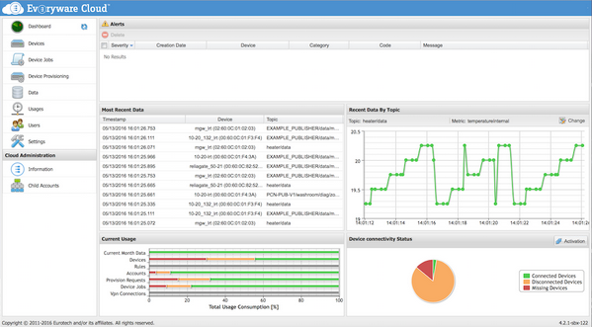
GETTING STARTED WITH ECLIPSE KAPUA
Menage the IoT devices.
You can install a generic application on the device.
Data coming from managed devices can be easily analyzed using a dashboard.
Eclipse Kapua features a web-based administration Console to perform all device and data management operations.

Slide 18
ONE-M2M SPECIFICATION
One M2M is a global partnership whose goal is to create a global technical standard for interoperability concerning the architecture, API specifications, security and enrolment solutions for Machine-to-Machine and IoT technologies.
The oneM2M functional architecture comprises the following functions:
Application Entity (AE)
Is an entity in the application layer that implements an M2M application service logic.
Each application service logic is placed in one or many M2M nodes.
Each execution instance of an application service logic is called Application Entity (AE) and is identified with a unique AE-ID.
Examples:
Remote blood sugar measuring application
Power metering application

Slide 19
ONE-M2M SPECIFICATION
Common Services Entity (CSE)
A Common Services Entity represents an instantiation of a set of common service functions of the oneM2M Service Layer.
A CSE contains a collection of oneM2M common service functions that AEs are able to use.
Service functions are exposed to other entities through different reference points:
Mca: exposure to Aes
Mcc: exposure to other CSEs
Mcn: used for accessing services provided by the underlying Network Service
Each CSE is identified with a unique CSE-ID.
Examples:
Data storage and sharing with access control and authorization
Event detection and notification
Device management

Slide 20
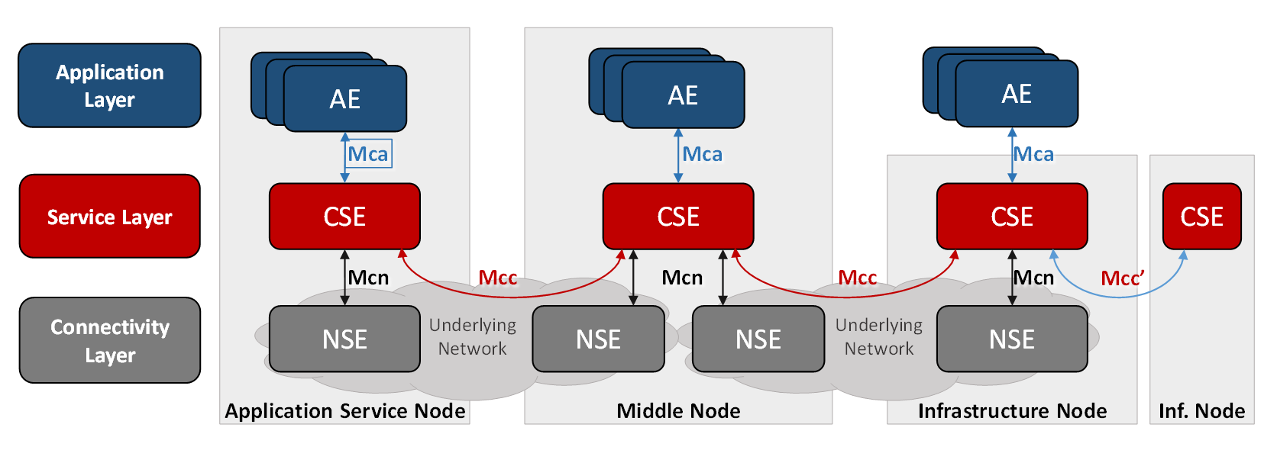
ONE-M2M SPECIFICATION
Network Services Entity (NSE)
A Network Services Entity provides services from the underlying network to the CSEs.
Examples:
Location services
Device triggering

Slide 21
CLOUD STACKS: ECLIPSE OM2M
Is an IoT Platform specific for the telecommunication industry, based on the oneM2M specification.
It provides a horizontal Common Service Entity (CSE) that can be deployed in an M2M server, a gateway, or a device.
Each CSE provides:
Application Enablement
Security
Triggering
Notification
Persistency
Device Interworking
Device Management

Slide 22


OPEN SOURCE COMPONENTS FOR IOT CLOUD PLATFORMS
Connectivity & Message Routing
IoT platforms need to be able to interact with very large numbers of devices and gateways.
The heterogeneity of devices leads to the need for supporting different protocols and data formats.
On the other side, it has to be able to normalize it in an homogeneous view, to allow for easy integration into the rest of the enterprise.
Eclipse projects:
Eclipse Hono provides a uniform API for interacting with devices using arbitrary protocols, as well as an extensible framework to add other protocols.
Eclipse Mosquitto provides an implementation of an MQTT broker.
IoT Cloud platform

Slide 23
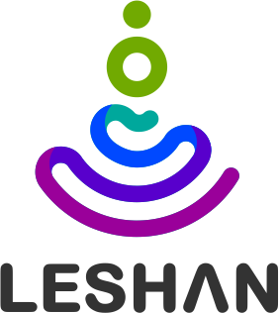

OPEN SOURCE COMPONENTS FOR IOT CLOUD PLATFORMS
Device Management
An IoT platform has to be able to provision new software updates and manage the devices.
Eclipse Leshan provides an implementation of the OMA LWM2M device management protocol.
Device Registry
A central registry helps to identify and authenticate devices and gateways running in an IoT solution.
Eclipse HawkBit provides the management tools update software of devices and gateways.
IoT Cloud platform

Slide 24
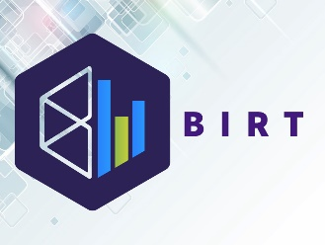
OPEN SOURCE COMPONENTS FOR IOT CLOUD PLATFORMS
Analytics
Outside of the Eclipse IoT community there are many open source options for data analytics and visualization:
Apache Hadoop: distributed data-processing computation framework based on Map-Reduce paradigm for parallel computing.
Apache Spark: distributed data-processing computation framework based on DAG parallelism.
Apache Storm: distributed stream processing computation framework.
Apache Kafka: open-source software platform for real-time stream processing.
Eclipse BIRT provides support for dashboards and reporting of data stored in a variety of data repositories.
IoT Cloud platform

Slide 25
OPEN SOURCE COMPONENTS FOR IOT CLOUD PLATFORMS
Application Enablement
Data consolidation and analysis.
Support, by exposing APIs, the creation of:
Reports
Graphs and infographics
Dashboards
Eclipse Hono gives an IoT solution the way to expose consistent APIs for consuming telemetry data and sending commands to different devices.
IoT Cloud platform

