Slide 1
Course Schedule Maker
COMP2680 Web project

Slide 2
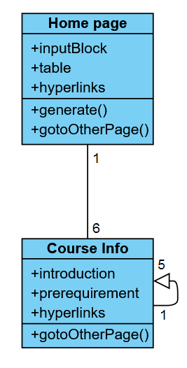
Overall structure

Slide 3
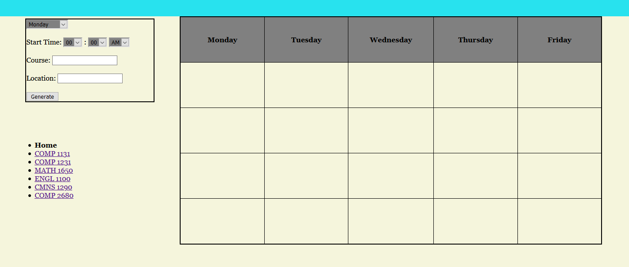
Home page

Slide 4
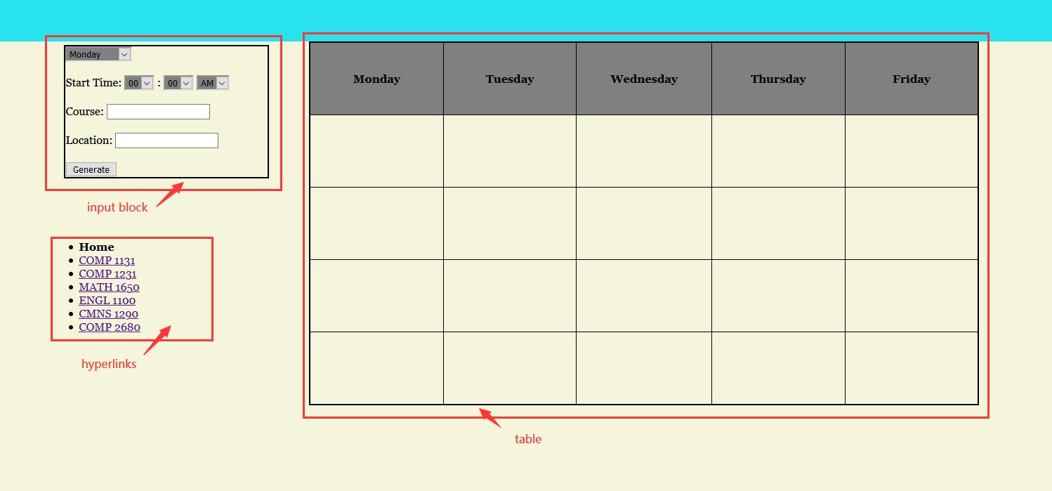
Home page(structures)

Slide 5
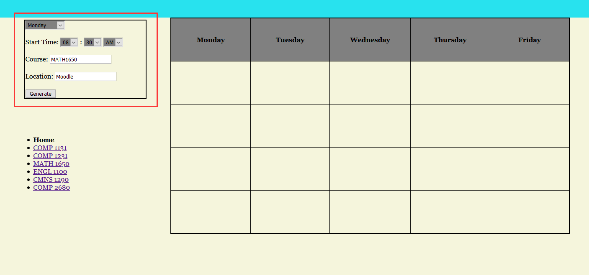
Home page(how to use)

Slide 6
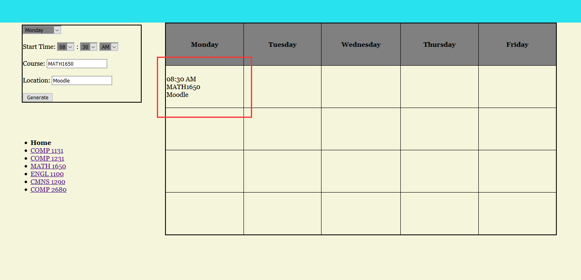
Home page (how to use)

Slide 7
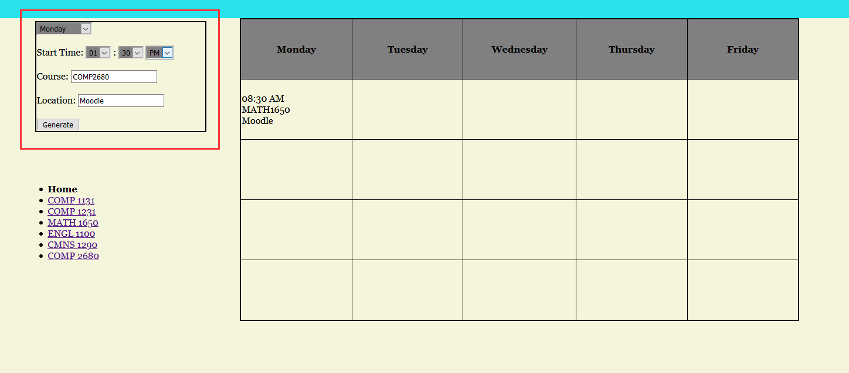
Home page (how to use)

Slide 8
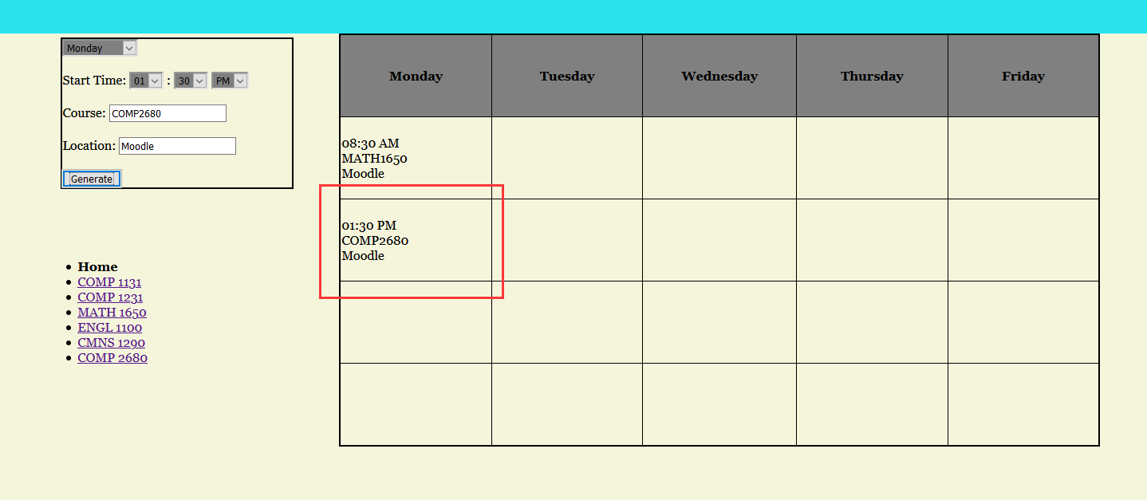
Home page (how to use)

Slide 9
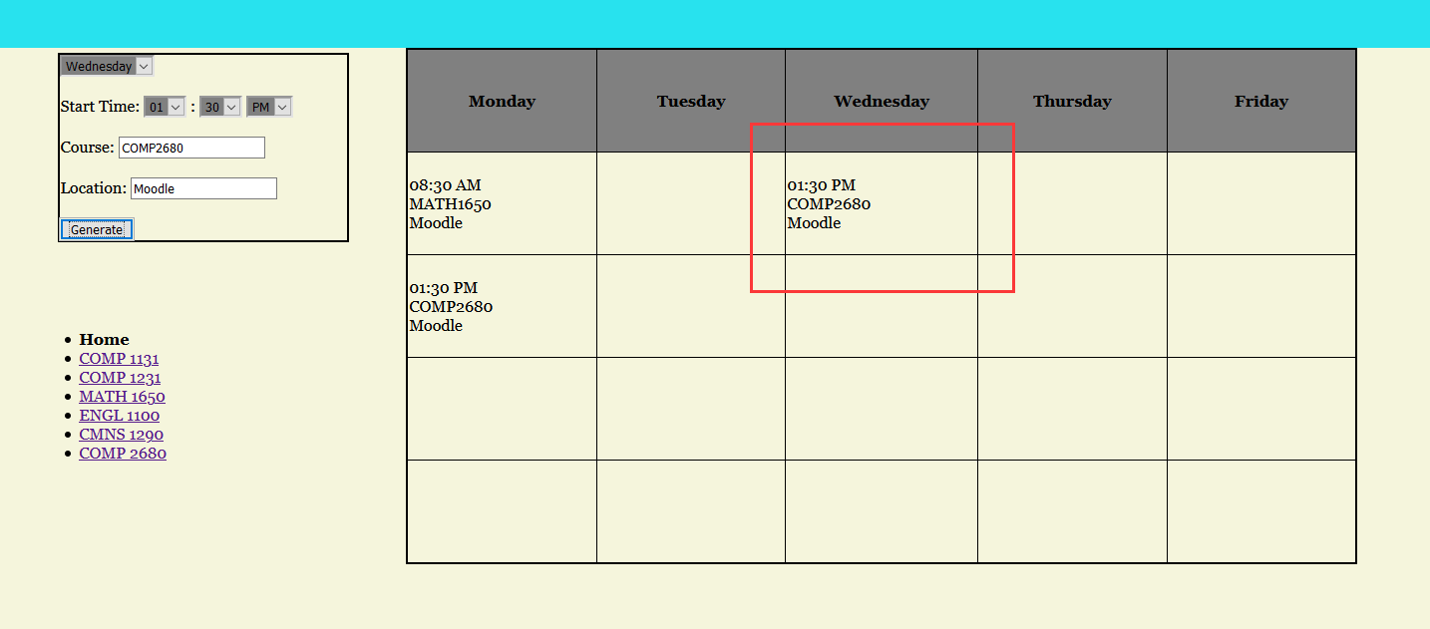
Home page (how to use)

Slide 10
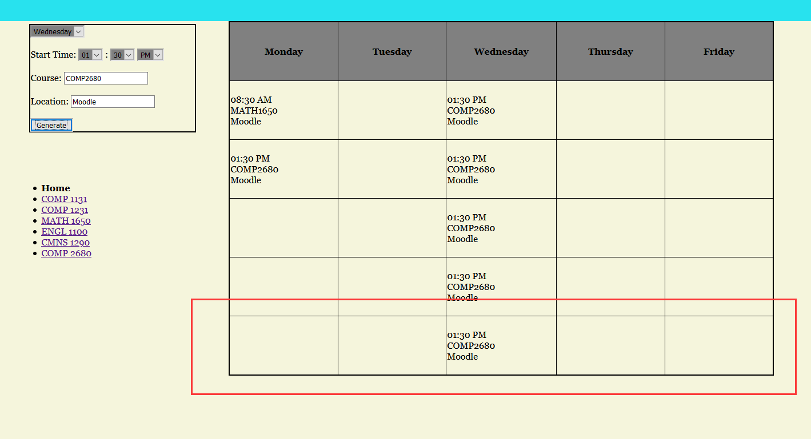
Home page (how to use)

Slide 11
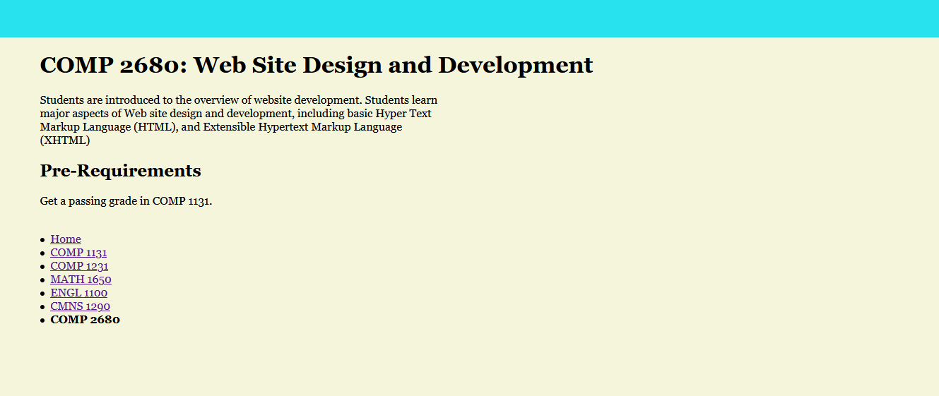
Course Info

Slide 12
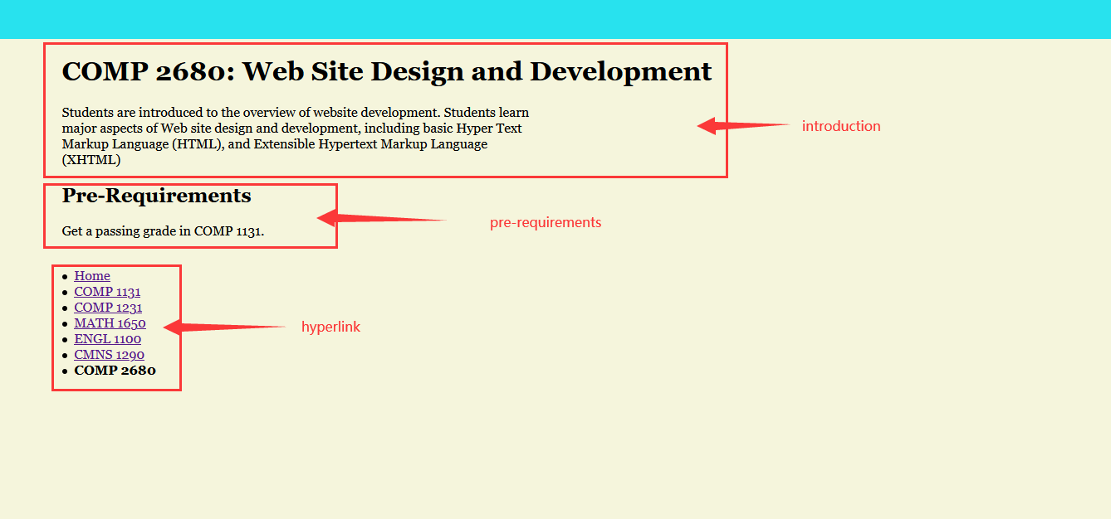
Course Info(structures)

