Slide 1
SciantixML
Fletcher Smith
February 20, 2026

Slide 2
Outline
Neural Networks
Perceptron
Multi-Layer Perceptron
Recursive Neural Networks (RNNs)
NeuralODE
Gathering Data

Slide 3
Neural Networks

Slide 4
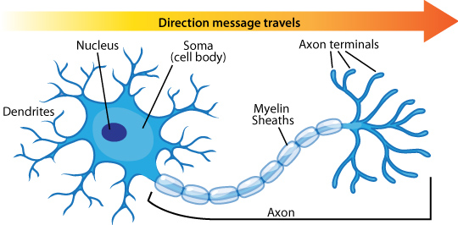
Neurons
Neurons receive signals via their dendrites
Once they neuron’s action potential has been reached, it sends an electrical signal to the axon
The axon signals to other neurons

Slide 5
Perceptron

Slide 6
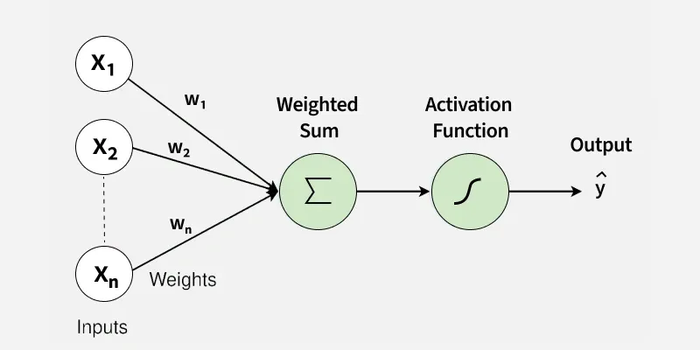
Perceptron
Published by Frank Rosenblatt in 1958
Multiplies input by a weight and takes the sum
If sum exceeded a threshold, output 1
If not, output 0

Slide 7
Perceptron Example – Good Pizza
Pepperoni
10
0.2
Cheese
5
0.1
Weighted Sum
1.9
Threshold
0
Output
1
-0.2
Veggies
3
-1
Gluten-Free
0

Slide 8
Perceptron Example – Bad Pizza
Pepperoni
1
0.2
Cheese
3
0.1
Weighted Sum
-2.3
Threshold
0
Output
0
-0.2
Veggies
9
-1
Gluten-Free
1

Slide 9
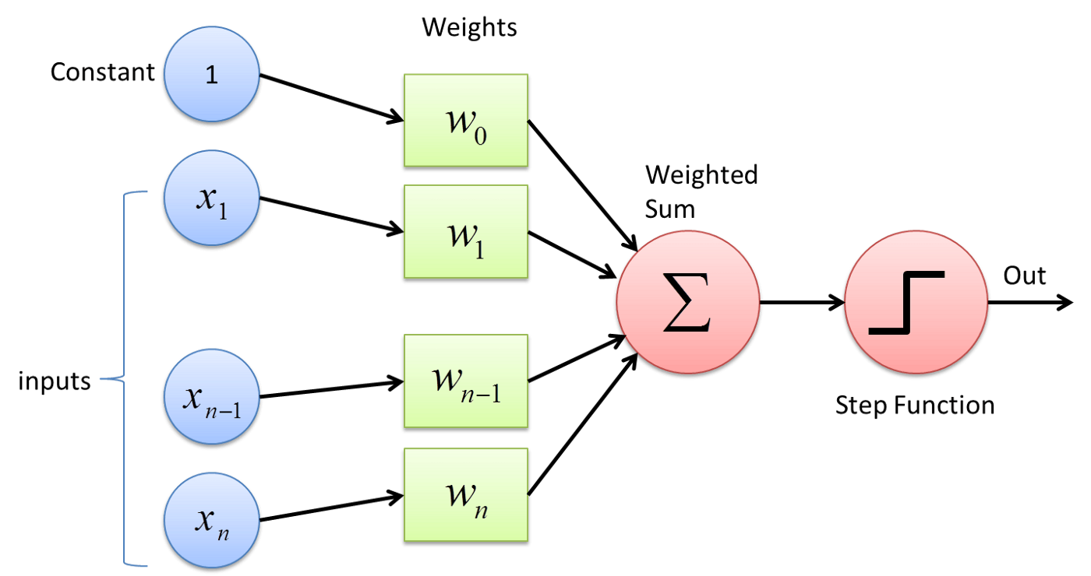
Threshold as a Learned Weight

Slide 10
Training Perceptron
Weights are learned as perceptron sees data
Weights change if perceptron is wrong, no change if right
Dataset is repeated until perceptron has learned
Each time through dataset called an “epoch”
$$Δw_{i}=c\left(y_{data}-y_{pred}\right)x_{i}$$
$$w_{i}$$ – weight
$$c$$ – learning rate
$$y_{data}$$ – target value
$$y_{pred}$$ – predicted value
$$x_{i}$$ – input

Slide 11
Training Perceptron
Features |  |  | Target
1 | 0 | 1 | 0
1 | 0.5 | 0 | 0
1 | -0.4 | 1 | 1
0 | 1 | 0.5 | 1
$$Δw_{i}=c\left(y_{data}-y_{pred}\right)x_{i}$$
$$w_{i}$$ – weight
$$c$$ – learning rate
$$y_{data}$$ – target value
$$y_{pred}$$ – predicted value
$$x_{i}$$ – input
Learning Rate = 1

Slide 12
Training Perceptron
Features (with bias) |  |  |  | Target | Weights (with bias) |  |  |  | Net | Output | $$Δw$$
1 | 0 | 1 | 1 | 0 | 1 | 1 | 1 | 1 | 3 | 1 | -1 | 0 | -1 | -1
1 | 0.5 | 0 | 1 | 0 | 0 | 1 | 0 | 0 | 0.5 | 1 | -1 | -0.5 | 0 | -1
1 | -0.4 | 1 | 1 | 1 | -1 | 0.5 | 0 | -1 | -2.2 | 0 | 1 | -0.4 | 1 | 1
0 | 1 | 0.5 | 1 | 1 | 0 | 0.1 | 1 | 0 | 0.6 | 1 | 0 | 0 | 0 | 0
1 | 0 | 1 | 1 | 0 | 0 | 0.1 | 1 | 0 | 1 | 1 | -1 | 0 | -1 | -1
1 | 0.5 | 0 | 1 | 0 | -1 | 0.1 | 0 | -1 | -1.95 | 0 | 0 | 0 | 0 | 0
1 | -0.4 | 1 | 1 | 1 | -1 | 0.1 | 0 | -1 | -2.04 | 0 | 1 | -0.4 | 1 | 1
0 | 1 | 0.5 | 1 | 1 | 0 | -0.3 | 1 | 0 | 0.2 | 1 | 0 | 0 | 0 | 0

Slide 13
Training Perceptron
Features (with bias) |  |  |  | Target | Weights (with bias) |  |  |  | Net | Output | $$Δw$$
1 | 0 | 1 | 1 | 0 | 1 | 1 | 1 | 1 | 3 | 1 | -1 | 0 | -1 | -1
1 | 0.5 | 0 | 1 | 0 | 0 | 1 | 0 | 0 | 0.5 | 1 | -1 | -0.5 | 0 | -1
1 | -0.4 | 1 | 1 | 1 | -1 | 0.5 | 0 | -1 | -2.2 | 0 | 1 | -0.4 | 1 | 1
0 | 1 | 0.5 | 1 | 1 | 0 | 0.1 | 1 | 0 | 0.6 | 1 | 0 | 0 | 0 | 0
1 | 0 | 1 | 1 | 0 | 0 | 0.1 | 1 | 0 | 1 | 1 | -1 | 0 | -1 | -1
1 | 0.5 | 0 | 1 | 0 | -1 | 0.1 | 0 | -1 | -1.95 | 0 | 0 | 0 | 0 | 0
1 | -0.4 | 1 | 1 | 1 | -1 | 0.1 | 0 | -1 | -2.04 | 0 | 1 | -0.4 | 1 | 1
0 | 1 | 0.5 | 1 | 1 | 0 | -0.3 | 1 | 0 | 0.2 | 1 | 0 | 0 | 0 | 0

Slide 14

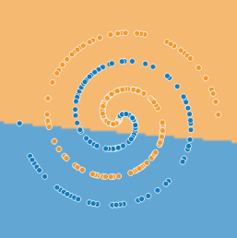
Perceptron Predictions
Simple model to understand and train
Has interpretable results (larger weight, more important factor)
Can only classify hyperplanes

Slide 15
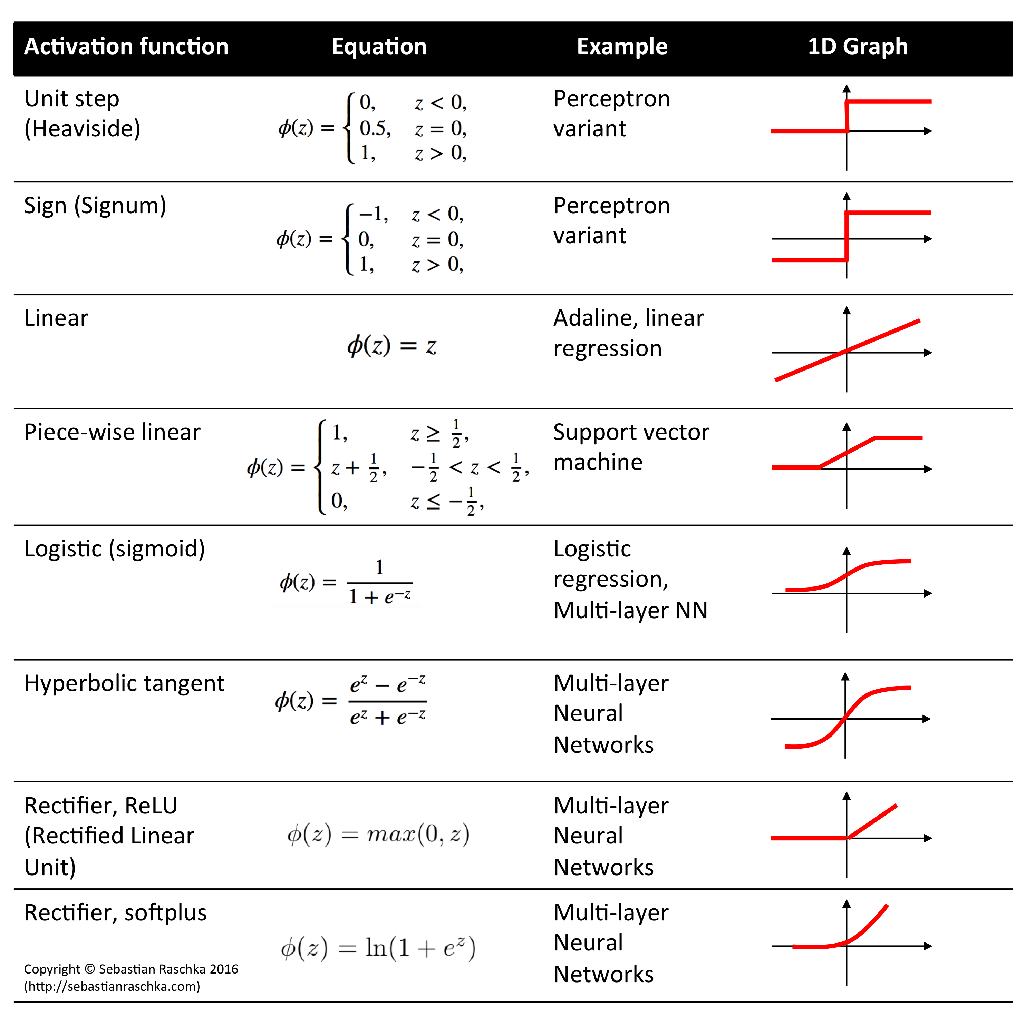

Slide 16
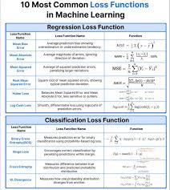
Can perceptron do regression?
Yes!
Use activation function
Scale inputs before putting in perceptron
Use same scaling to output regression value
Use MSE or other regression loss function

Slide 17
Multi-Layer Perceptron (MLP)

Slide 18

Multi-Layer Perceptron
Rather than 1 layer of nodes, let’s have multiple layers of nodes
Output from one node becomes the input to the next node
“Hidden layers” are layers inside network

Slide 19
Training Steps
Forward Propagation
Back propagation
Update weights

Slide 20
Backpropagation
Needs a differentiable activation function
$$f\left(net\right)=Z=\frac{1}{1+e^{-net}}$$

Slide 21
Gathering data

Slide 22

Determining Variables
input_history.txt
time (hr)
Temperature (K)
Fission Rate (fissions/m^3*s)
Hydrostatic Stress (MPa)
Code linearly interpolates between entries

Slide 23
Time
PWRs refuel every 18 months
BWRs refuel every 24 months
One-third of the fuel is shuffled every fuel cycle
Average capacity factor is 92.7%¹
$$Operating Hours=3 cycles⋅\frac{24 months}{1 cycle}⋅\frac{30 days}{1 month}⋅\frac{24 hours}{1 day}⋅92.7\% capacity factor=48,056 hours≈50,000 hours$$
Source: https://www.nei.org/resources/statistics/us-nuclear-operating-plant-basic-information Received data from U.S. Energy Information Administration, updated July 2023

