Slide 1
Car detection using YOLO and Faster R-CNN
Filip Buljan, Lovro Akmačić, Lucia Crvelin, Lorena Švenjak, Tomislav Čupić
Zagreb, May 2025.

Slide 2
Overview
Problem
  About the problem
  Existing methods
  Our approach to the problem
  Eksperimental results of methods
Conclusion
  Future improvements
Zagreb, May 2025.

Slide 3
About
Used two state-of-the-art deep models
  YOLO (You only look once)
  Faster R-CNN (Region based Convolutional network)
Implementation and evaluation
Comparing the results of models
Zagreb, May 2025.

Slide 4
Why car detection matters and why is it challenging
Autonomous driving
Surveillance and traffic analysis
Varying object sizes and angles
Lightning Conditions
Speed vs. accuraccy trade-off
Zagreb, May 2025.

Slide 5
Existing methods overview
YOLO
  Single stage detector
  Entire image in a single pass
  Real-time perfomance
  Fast
  Less accurate for small objects
Zagreb, May 2025.

Slide 6
Existing methods overview
Faster R-CNN
  Two stage detector
  Region proposal network (RPN)
  High precision
  Better bounding boxes
  Slower and more expensive
Zagreb, May 2025.

Slide 7
Our approach
YOLOv8
  pre-trained
  Detection and counting with bounding boxes and confidence scores
Zagreb, May 2025.

Slide 8
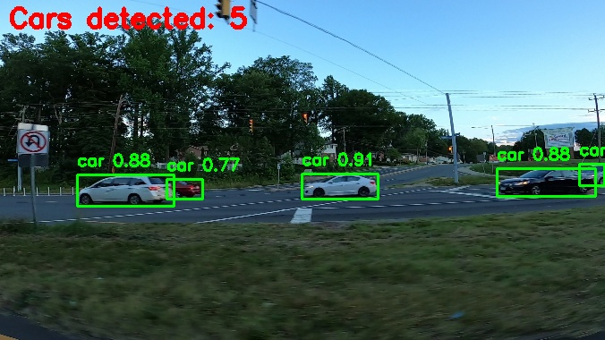
Yolo model – test output example
Zagreb, May 2025.

Slide 9
Our approach
Faster R-CNN
  Pre-trained model – COCO
  Fine tuned model
    Classification head for cars only
    Trained with annotated car dataset
    Improved precision
Zagreb, May 2025.

Slide 10
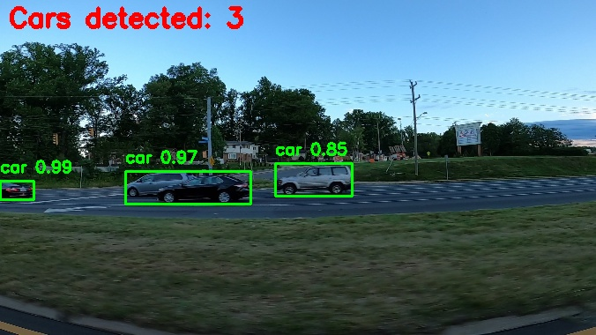
Pre-trained Faster R-CNN – test output example
Zagreb, May 2025.

Slide 11
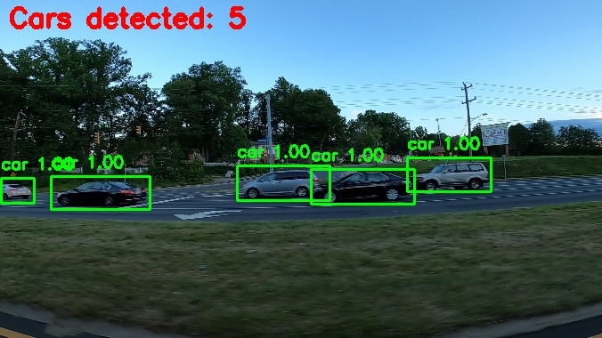
Fine-tuned Faster R-CNN – test output example
Zagreb, May 2025.

Slide 12
Our approach
Our own custom model
Bad results
Challenges:
  Structure of the network
  Small dataset
  Custom loss function
  Connecting postprocessing with training process
Zagreb, May 2025.

Slide 13
Experiment results
YOLOv8 results
  Precision - 0.919
  Recall – 0.857
  mAP@50 – 0.904
  mAP50-95 – 0.360
Fast and accurate
Low precision at IoU thresholds
Zagreb, May 2025.

Slide 14
Experiment results
Faster R-CNN pre-trained
  mAP@50 – 0.7768
  mAP@75 – 0.0645
Bad localization and detection of small object
Weak performance without tuning
Zagreb, May 2025.

Slide 15
Experiment results
Faster R-CNN Fine-tuned:
  mAP@50 – 0.9987
  mAP@75 – 0.7541
High precision after fine-tuning
Still weak on small objects
Fine-tuning is an effective strategy
Zagreb, May 2025.

Slide 16
Video of GUI:
https://drive.google.com/file/d/19FnDuNmnvrjnNum3ipGIGDVimcg3iWXY/view?usp=sharing
Zagreb, May 2025.

Slide 17
Conclusion
YOLOv8 – ideal for fast real-time identification of an object
  Highly efficient for car detection
  Not precise
Faster R-CNN – ideal when accuracy is critical
  superior precision
Zagreb, May 2025.

Slide 18
Future improvements
Edge deployment
Robustness to challenging conditions
Improvements in detection
Different datasets
Zagreb, May 2025.

