Slide 1
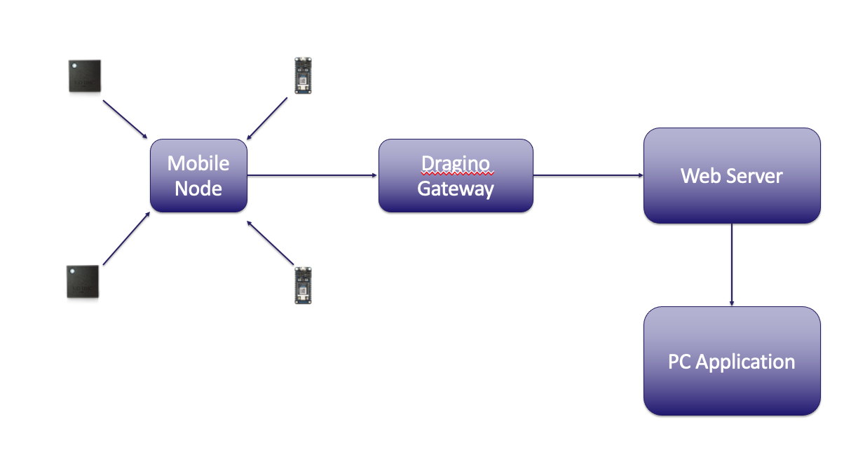
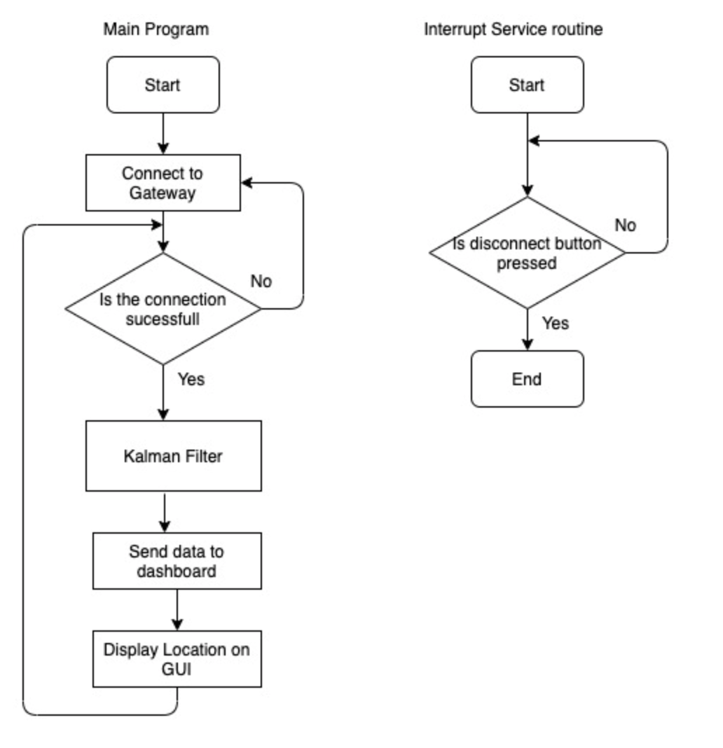
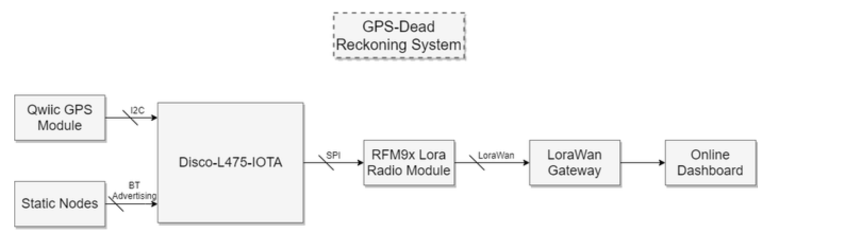
Outdoor GPS Dead-Reckoning with Lorawan
Nicholas and Fletcher, Adonis-Red
PROJECT KEY PERFORMANCE
1.Be able to track a person using the GPS module
When Moving, visual dashboard/coordinate system
2. Able to send data from the LoraWan module to the LoraWan gateway
The LoraWan radio module should be able to send movement data/basic information to the LoraWan gateway
3. Implement the dead-reckoning model using the Kalman filter
The dead reckoning model will calculate current position of a moving object and determine an estimate of the direction.
4. Able to send data to the dashboard
Movement data/basic information should be sent back to the dashboard.
5. Static beacon network using the thingy:52 implemented
Implement a static beacon, which sends RSSI ranging information to the mobile node
SYSTEM OVERVIEW
CONCLUSIONS
We were able to track a person using the GPS module.
A dead-reckoning system was implicated using a Kalman filter
Data could be sent to the dashboard
Static beacon using thingy 52 implemented
For the last KPI, a complication occurred where we were unable to send data to the LoraWan gateway. We combated this by instead switching to a mote to PC network configuration and we sent our data via Bluetooth.

Slide 2
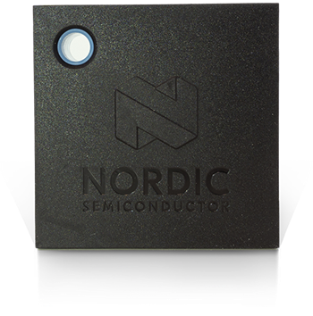
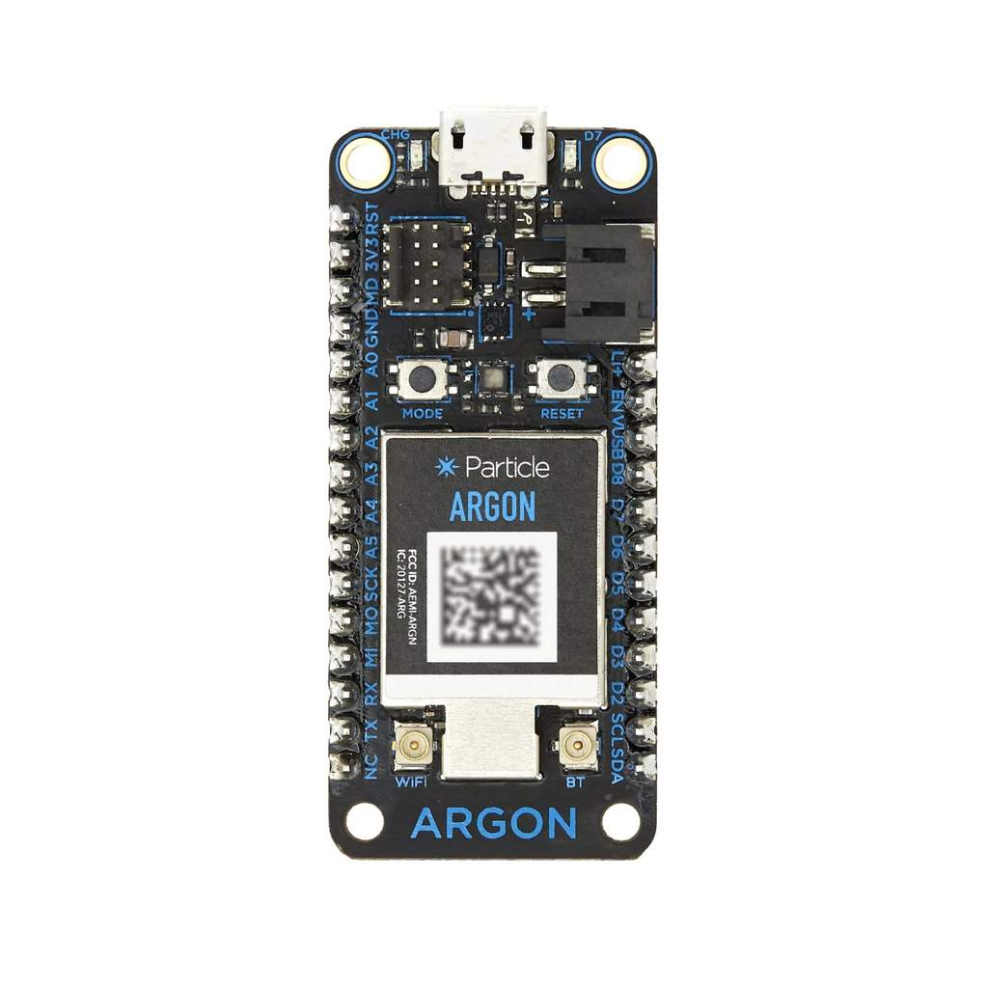
Mobile Node
Dragino Gateway
Web Server
PC Application

