Slide 1
Medical Diagnosis
Of Pneumonia
Using
DEEP LEARNING

Slide 2
Where did this start?
Why should we lag behind the world.. When this world has undergone transformation of technology! Let us bring the technology into the study of medical science. Till now the technology has been introduced for convenience of the doctor but now let us bring the technology for the ease of patients to really understand what our reports say and to clearly understand what our body is. We can make this happen with the help of machine learning and giving system the artificial intelligence for making it work like a doctor. So this project can also be helpful for poor when they are educated in their basic level. So we developed this project to bring latest trend of technology into the diagnosis of medical sciences.

Slide 3
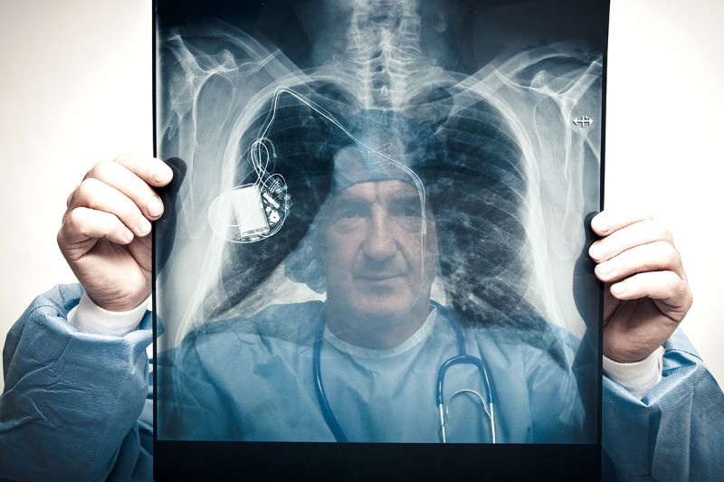
Our approach to solution.
Using Deep Learning we are going to train our model to identify if a person is effected with Pneumonia or not using individual’s chest X-Ray.

