Slide 2
Yum install git
docker compose环境搭建
Git clone
Yum install maven
chmod +x run.sh
./run.sh
docker-machine

Slide 3
Docker-compose
https://github.com/docker/compose/releases/tag/1.7.0
curl -L https://github.com/docker/compose/releases/download/1.7.0/docker-compose-`uname -s`-`uname -m` > /usr/local/bin/docker-compose chmod +x /usr/local/bin/docker-compose

Slide 4
Git clone
git clone https://github.com/kbastani/spring-cloud-event-sourcing-example.git -b pcf-deployment

Slide 5
Maven 3.3.9
http://mirrors.tuna.tsinghua.edu.cn/apache/maven/maven-3/3.3.9/binaries/apache-maven-3.3.9-bin.zip
Unzip
cp -Rf /data/maven3.3.9/apache-maven-3.3.9/* /usr/share/maven/*
http://www.theshell.guru/install-maven-3-3-3-centos-6-7/

Slide 6
Jdk 1.8
http://blog.csdn.net/czmchen/article/details/41047187
rpm -qa | grep java
rpm -e --nodeps
yum remove java-1.7.0-openjdk
yum -y list java*
yum -y install java-1.8.0-openjdk
Devel* 为 javac
Notes:
yum install java-1.8.0-openjdk-devel.x86_64
yum install -y java-1.8.0-openjdk*
[root@bogon alternatives]# rpm -qa | grep java
python-javapackages-3.4.1-11.el7.noarch
java-1.7.0-openjdk-devel-1.7.0.111-2.6.7.2.el7_2.x86_64
tzdata-java-2016d-1.el7.noarch
javassist-3.16.1-10.el7.noarch
java-1.7.0-openjdk-1.7.0.111-2.6.7.2.el7_2.x86_64
java-1.7.0-openjdk-headless-1.7.0.111-2.6.7.2.el7_2.x86_64
java-1.8.0-openjdk-headless-1.8.0.101-3.b13.el7_2.x86_64
javamail-1.4.6-8.el7.noarch
java-1.8.0-openjdk-1.8.0.101-3.b13.el7_2.x86_64
javapackages-tools-3.4.1-11.el7.noarch
[root@bogon alternatives]# rpm -e --nodeps tzdata-java-2016d-1.el7.noarch
rpm -e --nodeps java-1.7.0-openjdk-1.7.0.111-2.6.7.2.el7_2.x86_64
rpm -e --nodeps java-1.7.0-openjdk-headless-1.7.0.111-2.6.7.2.el7_2.x86_64
alternatives --install /usr/bin/java java /usr/java/jdk1.8.0_05/jre/bin/java 20000 alternatives --install /usr/bin/jar jar /usr/java/jdk1.8.0_05/bin/jar 20000 alternatives --install /usr/bin/javac javac /usr/java/jdk1.8.0_05/bin/javac 20000 alternatives --install /usr/bin/javaws javaws /usr/java/jdk1.8.0_05/jre/bin/javaws 20000 alternatives --set java /usr/java/jdk1.8.0_05/jre/bin/java alternatives --set jar /usr/java/jdk1.8.0_05/bin/jar alternatives --set javac /usr/java/jdk1.8.0_05/bin/javac alternatives --set javaws /usr/java/jdk1.8.0_05/jre/bin/javaws

Slide 7
库
https://github.com/shuyouliu/zycloudconfig.git

Slide 8
Source 库
https://github.com/shuyouliu/zycloud.git

Slide 9
mvn package -U

Slide 10
docker-machine
curl -L https://github.com/docker/machine/releases/download/v0.8.1/docker-machine-`uname -s`-`uname -m` >/usr/local/bin/docker-machine && \ chmod +x /usr/local/bin/docker-machine
https://github.com/docker/machine/releases/

Slide 11
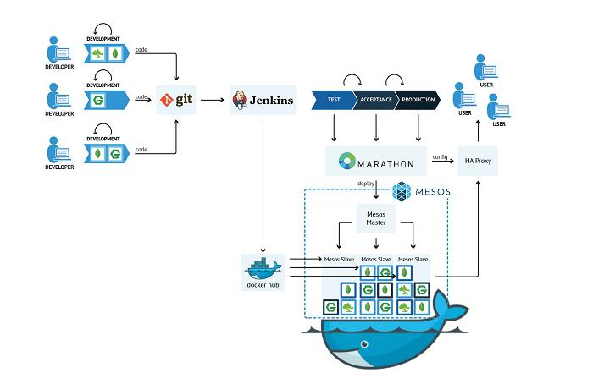

Slide 12
docker-machine
docker-machine create -d generic --generic-ip-address=192.168.1.128 --generic-ssh-user=root 1.128

Slide 13
http://www.tuicool.com/articles/N3EjQvi
vi /etc/ssh/sshd_config
PermitRootLogin yes #修改此项为允许root登录
/bin/systemctl restart sshd.service
ssh-keygen #一直回车
ssh-copy-id root@192.168.1.128
Defaults visiblepw
docker-machine create -d generic --generic-ip-address=192.168.1.128 --generic-ssh-user=root 1.128

Slide 14
Docker 修复
http://blog.chinaunix.net/uid-30025710-id-4983616.html
dmsetup info docker-8:1-1612350994-pool
dmsetup clear docker-8:1-1612350994-pool
Reboot
systemctl start docker
service iptables stop
systemctl stop firewalld.service

Slide 15
Docker images删除
docker stop $(docker ps -a -q)
docker rm $(docker ps -a -q)
docker images 。。
docker rmi

Slide 16
yum install iptables-services
systemctl restart iptables.service

Slide 17
scp account-service/target/account-service-0.0.1-SNAPSHOT.jar root@192.168.1.129:/data/liusy/jar/account-service-0.0.1-SNAPSHOT.jar

Slide 18
Scp 无密码
http://it.oyksoft.com/post/1836/
ssh-keygen -t rsa
scp .ssh/id_rsa.pub 192.168.1.129:/root/.ssh/authorized_keys
ssh-agent bash
ssh-add /root/.ssh/id_rsa_129
scp account-service/target/account-service-0.0.1-SNAPSHOT.jar root@192.168.1.129:/data/liusy/jar/account-service-0.0.1-SNAPSHOT.jar

Slide 19
Scpar.sh
#! /bin/sh
ssh-agent bash
ssh-add /root/.ssh/id_rsa_129
./scpbase.sh account-service
./scpbase.sh catalog-service
./scpbase.sh hystrix-dashboard
./scpbase.sh inventory-service
./scpbase.sh order-service
./scpbase.sh shopping-cart-service

Slide 20
Scpbase.sh
#! /bin/sh
name=$1
scp ${name}/target/${name}-0.0.1-SNAPSHOT.jar root@192.168.1.129:/data/liusy/jar/${name}-0.0.1-SNAPSHOT.jar

Slide 21
diff
Git pull
git fetch origin master:tmp git diff tmp git merge tmp
http://blog.csdn.net/hudashi/article/details/7664457

Slide 22
Git
$ git config --global user.name "Your Name" $ git config --global user.email email@example.com
git add filename
git commit -m "comment message«
git status
git diff filename
git push origin master
git fetch --all git reset --hard origin/master git pull

Slide 23
