Slide 1
jenkins
刘树友

Slide 2
是什么
Jenkins是基于Java开发的一种持续集成工具，用于监控持续重复的工作，功能包括：
1、持续的软件版本发布/测试项目。
2、监控外部调用执行的工作。

Slide 3
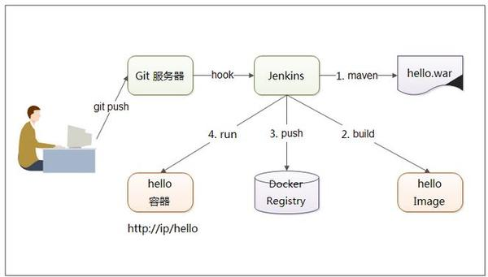
怎么用
Notes:
http://www.csdn.net/article/2015-07-21/2825266

Slide 4
安装- Docker方式
docker pull stephenreed/jenkins-java8-maven-git
docker run -p 8080:8080 -t -v /jenkins:/jenkins stephenreed/jenkins-java8-maven-git
Notes:
https://hub.docker.com/_/jenkins/

Slide 5
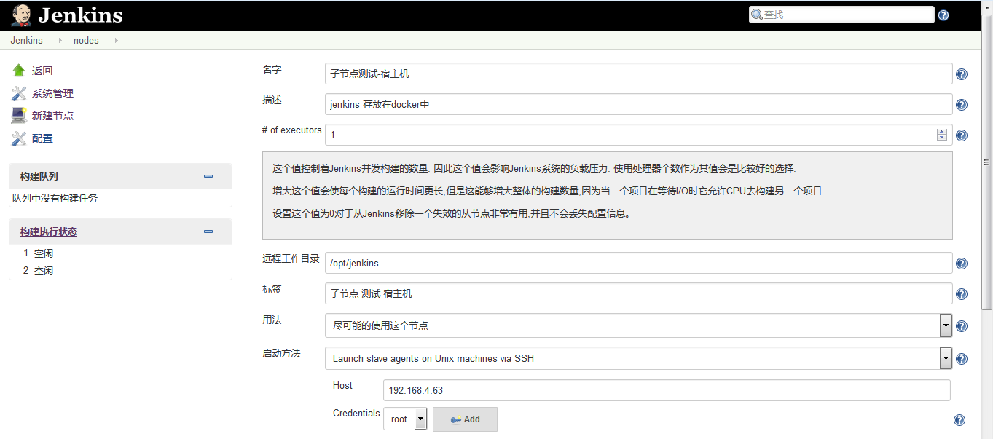

Slide 6
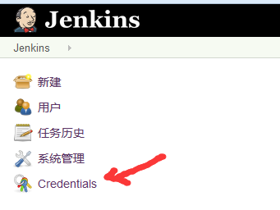
宿主机节点
1、添加凭证

Slide 7
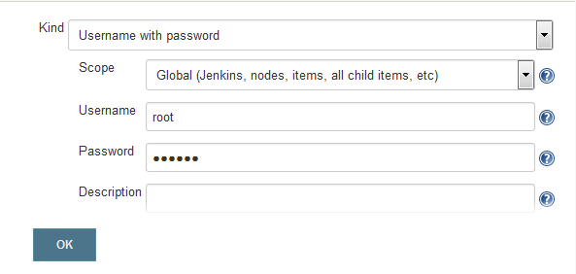
凭证
用户名密码

Slide 8
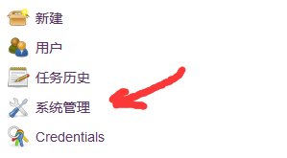
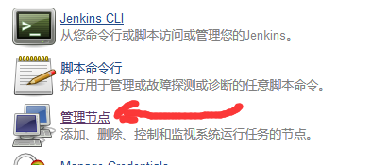
添加节点
系统管理-管理节点

Slide 9
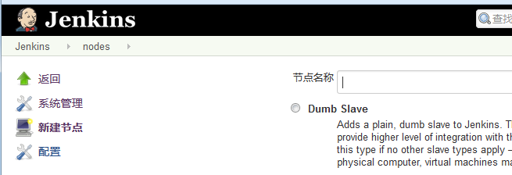
新建节点

Slide 10
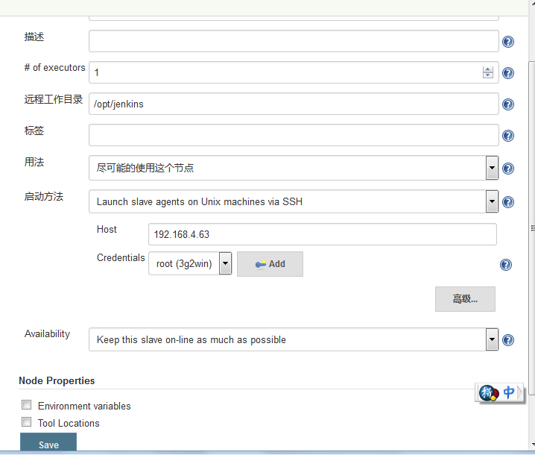

Slide 11
任务
https://github.com/shuyouliu/maven-web-demo.git
Git plugin
FROM tomcat:8
ADD maven-web-demo/target/wardemo.war /usr/local/tomcat/webapps/
CMD ["catalina.sh", "run"]
docker build -t maven-web-demo .
docker run -d -p 9090:8080 maven-web-demo
docker run -d -p 9999:8080 shuyouliu/wardemo
docker stop shuyouliudemo
docker run --name shuyouliudemo -d -p 9999:8080 shuyouliu/wardemo
systemctl stop firewalld

Slide 12
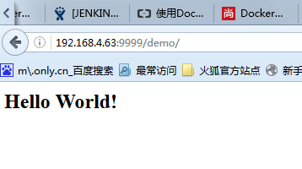
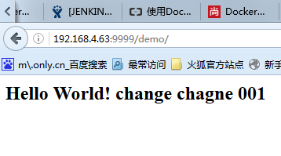
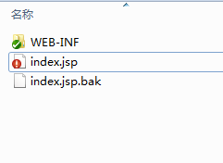
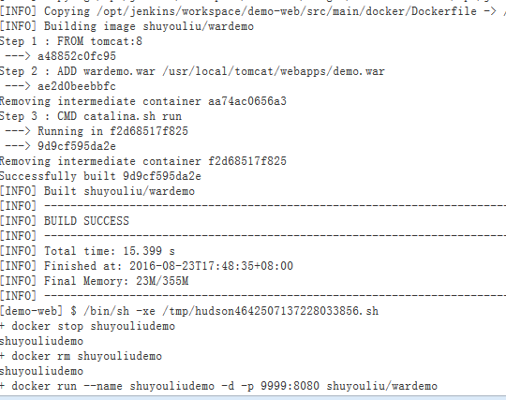

Slide 13
上传正式环境
docker tag shuyouliu/wardemo reg.carson.com:5000/shuyouliu/wardemo
docker push reg.carson.com:5000/shuyouliu/wardemo

Slide 14
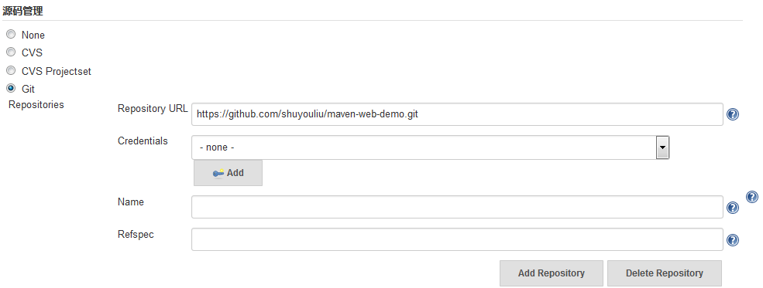

Slide 15
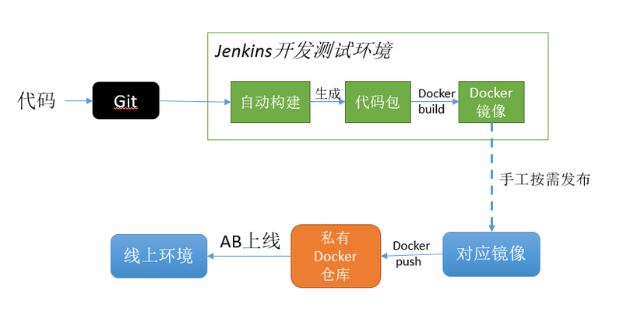
Notes:
https://segmentfault.com/a/1190000003732967

Slide 16
of executors
这个值控制着Jenkins并发构建的数量. 因此这个值会影响Jenkins系统的负载压力. 使用处理器个数作为其值会是比较好的选择. 增大这个值会使每个构建的运行时间更长,但是这能够增大整体的构建数量,因为当一个项目在等待I/O时它允许CPU去构建另一个项目.
设置这个值为0对于从Jenkins移除一个失效的从节点非常有用,并且不会丢失配置信息。

Slide 17
启动方法
Controls how Jenkins starts this slave. Launch slave agents on Unix machines via SSHStarts a slave by sending commands over a secure SSH connection. The slave needs to be reachable from the master, and you will have to supply an account that can log in on the target machine. No root privileges are required.Launch slave agents via Java Web StartStarts a slave by launching an agent program through JNLP. The launch in this case is initiated by the slave, thus slaves need not be IP reachable from the master (e.g. behind the firewall.) It is still possible to start a launch without GUI, for example as a Windows service.Launch slave via execution of command on the MasterStarts a slave by having Jenkins execute a command from the master. Use this when the master is capable of remotely executing a process on a slave, such as through ssh/rsh.Let Jenkins control this Windows slave as a Windows serviceStarts a Windows slave by a remote management facility built into Windows. Suitable for managing Windows slaves. Slaves need to be IP reachable from the master.Start and stop this node on-demand Wrapper for other launch methods: executes a script (i.e. to provision a VM) before attempting to connect to the slave machine; then launches the Jenkins slave with a launch method of your choice, and after disconnection executes another script (i.e. for shutting down the VM).
Notes:
http://blog.csdn.net/whuyi/article/details/37881091
配置jenkins的slave节点
进入jenkins，系统管理，管理节点，新建节点，创建一个dumb slave。
进去其配置页面，主要说明的是launch method
选择 launch slave agents on unix machinesvia ssh
host：机器ip
credentials：授权信息（可在jenkins里配置 add credentials）
选择launchslave agent via Java Web start,这个方式建议在windows上使用
Fill outthe following:
1. Set a number of executors (one ormore) as needed.
2. Set a Remote FS Root, a home directory for themaster on the slave machine.
1. For a Windows slave, use something like:"C:\Jenkins\"
2. TODO: add details.
3. Select the appropriate Usage setting:
1. For an additional worker: Utilizethis slave as much as possible
2. For specialized jobs: Leave thismachine for tied jobs only
4. Launch Method:
1. An easy way to control a Windows slaveis by using Launchslave agents via Java Web Start (Recommendedfor Windows)
2. TODO: add steps for other methods.
5. Availability --> Keep thisslave online as much as possible
1. TODO: add details for each option.
6. Press OK.
7. Now you need to connect your slavemachine to the master using the following steps.
1. Open a browser on the slavemachine and go tothe Jenkinsmaster server url (http://yourjenkinsmaster:8080).
2. Go to Manage Jenkins > ManageNodes, Click onthe newly created slave machine. You will need to login as someone that has the"Connect" Slave permission if you have configured global security.
3. Click on the Launch button tolaunch agent from browser on slave.
4. Run the program.
5. Nowyou should see the Slave machine connected under Nodes.
下面介绍另一种更简单的方式：
1,进入需要控制的远程机器上，一定要进入远程的slave机器，而不是你的master机器。输入对应的你的jenkins的地址，例如这里：
http://jenkins.meilishuo.com/computer/
点击进入对应的该slave机器的图标进入：此时可能会报一些错误，不用管。
点击图中的launch按钮，他会提示你下载该文件slave-agent.jnlp.按照提示下载该文件，并保存在本地。我们这里需要确认两个问题是否存在：
问题一，确认slave-agent.jnlp 是用javaws来运行的，而不是java.exe 或者是javaw.exe来运行，因为一般的机器默认是采用java.exe启动的。我曾经因为这个问题折腾了好久。
问题二，将slave-agent.jnlp用notepad打开后，确认其中的URL是可用的Jenkins地址。其中的配置可能是这样的：
<jnlp spec="1.0+" codebase="http://jenkins.meilishuo.com/computer/192.168.161.34/">
<information>
<title>Slave Agent for 192.168.161.34</title>
<vendor>Jenkins project</vendor>
<homepage href="https://jenkins-ci.org/"/>
</information>
<security><all-permissions/></security>
<resources><j2se version="1.5+"/><jar href="http://jenkins.meilishuo.com/jnlpJars/remoting.jar"/><property name="hudson.showWindowsServiceInstallLink" value="true"/>
</resources><application-desc main-class="hudson.remoting.jnlp.Main">
<argument>60c101541d377ad629da21b37c24cd6227edef74b97ff663c5b09e261ac2d5d6</argument><argument>irshost12.tc.tb.com</argument>
<argument>http://jenkins.meilishuo.com/</argument>
</application-desc>
</jnlp>
确认其中的url地址是上面的正确的地址,而不是localhost,因为我的jenkins部署在本地测试。所以这里就遇到了显示localhost的地址问题。
之所以说这个是因为这个是jenkins的一个bug：http://stackoverflow.com/questions/11287845/jenkins-slave-cant-get-started
如果直接launch出错，我们就不要在点击launch按钮起启动了，采用命令行去启动也是一样的，命令行的命令上面已经给出了：
命令1： javawshttp://jenkins.meilishuo.com/computer/irshost12.tc.com.com/slave-agent.jnlp
命令2： java -jar slave.jar -jnlpUrl http://jenkins.meilishuo.com/computer/192.168.161.34/slave-agent.jnlp -secret xxxxx(该字符串就在slave-agent.jnlp文件中)
如果上面的正常的话，过一会几分钟后，这个界面应该就会变成下面的界面，就是多了一个File菜单，下拉这个File菜单就有一个选项他会提示你是 否想设置为一个自启动的服务。可能将当前的slave设置成一个服务，每次机器重启的时候都自动启动slave服务，这样就不能每次都去启动这个 slave agent了。
# Master Jenkins服务器端的配置细节
如果上面的窗口中显示Connected，可是一会有出现了Terminated的状态，那么很可能是因为你的jenkins配置权限的时候没有给匿名用户启动slave的权限：http://stackoverflow.com/questions/14277512/problems-launching-the-slave-agent-via-java-web-start-on-jenkins
Two solutions seem to becoming up:
8. Download the JNLP file (via browser, wget, curl,whatever) then run locally - may require extra parameters.
9. Go to Manage Jenkins -> Configure Global Security, andunder Project-based Matrix Authorization Strategy, enable “connect” in the“slave” section, for user “Anonymous”. This would leave you open to attackwhere someone emulates a slave (but in my case, on a private work network -that's not an issue.)
具体操作是进入jenkins主界面，然后进入Manage Jenkins ->Configure Global Security ，勾选其中的anonymous用户的slave部分的权限。
注：当slave没有与master建立连接时，从jenkin页面可以看到怎样通过命令建立连接

Slide 18
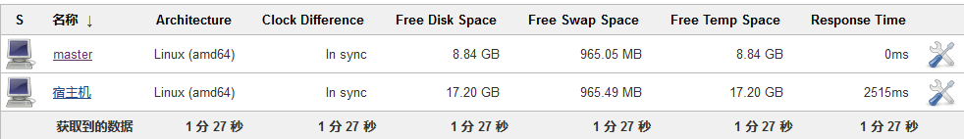

Slide 19
Docker registry
?** docker pull daocloud.io/library/registry:2.4.0
docker search localhost:5000
docker run \ -e SETTINGS_FLAVOR=s3 \ -e AWS_BUCKET=acme-docker \ -e STORAGE_PATH=/registry \ -e AWS_KEY=AKIAHSHB43HS3J92MXZ \ -e AWS_SECRET=xdDowwlK7TJajV1Y7EoOZrmuPEJlHYcNP2k4j49T \ -e SEARCH_BACKEND=sqlalchemy \ -p 5000:5000 \ daocloud.io/registry

Slide 20
……………………
参考文章
http://www.csdn.net/article/2015-11-24/2826315

Slide 21
仓库本机
Cd
mkdir registry && cd registry && mkdir certs && cd certs
openssl req -x509 -days 3650 -subj '/CN=reg.carson.com/' -nodes -newkey rsa:2048 -keyout registry.key -out registry.crt
cd .. && mkdir auth docker run --entrypoint htpasswd daocloud.io/registry -Bbn testuser password > auth/htpasswd
docker run -d -p 5000:5000 --restart=always --name registry -v `pwd`/auth:/auth -e "REGISTRY_AUTH=htpasswd" -e "REGISTRY_AUTH_HTPASSWD_REALM=Registry Realm" -e REGISTRY_AUTH_HTPASSWD_PATH=/auth/htpasswd -v `pwd`/certs:/certs -e REGISTRY_HTTP_TLS_CERTIFICATE=/certs/registry.crt -e REGISTRY_HTTP_TLS_KEY=/certs/registry.key -v /data:/var/lib/registry daocloud.io/registry
mkdir -p /etc/docker/certs.d/reg.carson.com:5000
cp ./certs/registry.crt /etc/docker/certs.d/reg.carson.com:5000
echo 192.168.4.63 reg.carson.com >> /etc/hosts
docker tag hello-world reg.carson.com:5000/hello-world
docker login reg.carson.com:5000
docker push reg.carson.com:5000/hello-world

Slide 22
Cd
mkdir registry && cd registry && mkdir certs && cd certs
openssl req -x509 -days 3650 -subj '/CN=reg.zy.com/' -nodes -newkey rsa:2048 -keyout registry.key -out registry.crt
cd .. && mkdir auth docker run --entrypoint htpasswd daocloud.io/registry -Bbn zy zy > auth/htpasswd
docker run -d -p 5000:5000 --restart=always --name zy_registry -v `pwd`/auth:/auth -e "REGISTRY_AUTH=htpasswd" -e "REGISTRY_AUTH_HTPASSWD_REALM=Registry Realm" -e REGISTRY_AUTH_HTPASSWD_PATH=/auth/htpasswd -v `pwd`/certs:/certs -e REGISTRY_HTTP_TLS_CERTIFICATE=/certs/registry.crt -e REGISTRY_HTTP_TLS_KEY=/certs/registry.key -v /data:/var/lib/registry daocloud.io/registry
mkdir -p /etc/docker/certs.d/reg.zy.com:5000
cp ./certs/registry.crt /etc/docker/certs.d/reg.zy.com:5000
echo 192.168.4.63 reg.zy.com >> /etc/hosts
docker tag hello-world reg.zy.com:5000/hello-world
docker login reg.zy.com:5000
docker push reg.zy.com:5000/hello-world
docker tag stephenreed/jenkins-java8-maven-git reg.zy.com:5000/stephenreed/jenkins-java8-maven-git
docker login reg.zy.com:5000
docker push reg.zy.com:5000/stephenreed/jenkins-java8-maven-git

Slide 23
远程
mkdir -p /etc/docker/certs.d/reg.carson.com:5000
scp -r root@192.168.4.63:~/registry/certs/registry.crt /etc/docker/certs.d/reg.carson.com:5000
echo 192.168.4.63 reg.carson.com >> /etc/hosts
docker login reg.carson.com:5000
docker pull reg.carson.com:5000/hello-world

Slide 24
mkdir -p /etc/docker/certs.d/reg.zy.com:5000
scp -r root@192.168.4.63:~/registry/certs/registry.crt /etc/docker/certs.d/reg.zy.com:5000
echo 192.168.4.63 reg.zy.com >> /etc/hosts
docker login reg.zy.com:5000
docker pull reg.zy.com:5000/stephenreed/jenkins-java8-maven-git

Slide 25
基于kubernetes的docker集群实践
https://segmentfault.com/a/1190000002978115#articleHeader6

Slide 26
docker run -p 81:8080 -t -d -v /jenkins:/jenkins --name zy_jenkins stephenreed/jenkins-java8-maven-git
docker run -p 81:8080 -t -d -v /opt/jenkins:/jenkins --name zy_jenkins reg.zy.com:5000/stephenreed/jenkins-java8-maven-git

Slide 27
<build>
<finalName>wardemo</finalName>
<plugins>
<plugin>
<groupId>com.spotify</groupId>
<artifactId>docker-maven-plugin</artifactId>
<version>${docker.plugin.version}</version>
<executions>
<execution>
<phase>install</phase>
<goals>
<goal>build</goal>
</goals>
</execution>
</executions>
<configuration>
<imageName>${docker.image.prefix}/${project.artifactId}</imageName>
<dockerDirectory>${project.basedir}/src/main/docker</dockerDirectory>
<resources>
<resource>
<targetPath>/</targetPath>
<directory>${project.build.directory}</directory>
<include>${project.build.finalName}.war</include>
</resource>
</resources>
</configuration>
</plugin>
</plugins>
</build>

Slide 28
yum install ppp pptp pptp-setup
pptpsetup --create vpn --server 60.10.134.171 --username zyydtest --password 123456 –start
modprobe ppp_mppe
http://blog.csdn.net/neilalexander/article/details/38950097
http://blog.csdn.net/ibm_hoojo/article/details/14164263
BinDiff
pptpsetup --create zyvpn --server 60.10.134.171 --username zyydtest --password 123456 –start

Slide 29
.120
docker run -p 81:8080 -t -d -v /jenkins:/jenkins --name zy_jenkins stephenreed/jenkins-java8-maven-git
docker run -p 81:8080 -t -d -v /jenkins:/jenkins --name docker.io/jenkins
docker run -p 82:8080 -p 50000:50000 -v /opt/home:/var/jenkins_home jenkins

Slide 30
120
Maven 宿主机环境
maven
Jdk
yum install maven
yum install git
docker save stephenreed/jenkins-java8-maven-git > jenkins.tar.gz
docker load < jenkins.tar.gz

Slide 31
http://blog.csdn.net/ownfire/article/details/50274335
docker pull mysql
docker run -v /data/var/mysql/:/var/lib/mysql -e MYSQL_ROOT_PASSWORD=kS4pJUIb mysql

Slide 32
GRANT ALL PRIVILEGES ON *.* TO ‘root'@'%'IDENTIFIED BY ‘3g2win.com' WITH GRANT OPTION;

