Slide 1
Fernando Crespo
Computer Science 232: Python

Slide 2
Coolest thing about my program
The coolest thing about my program is that I got to make a Graph View interface(Something that I have been wanting to learn since I got into stock)

Slide 3
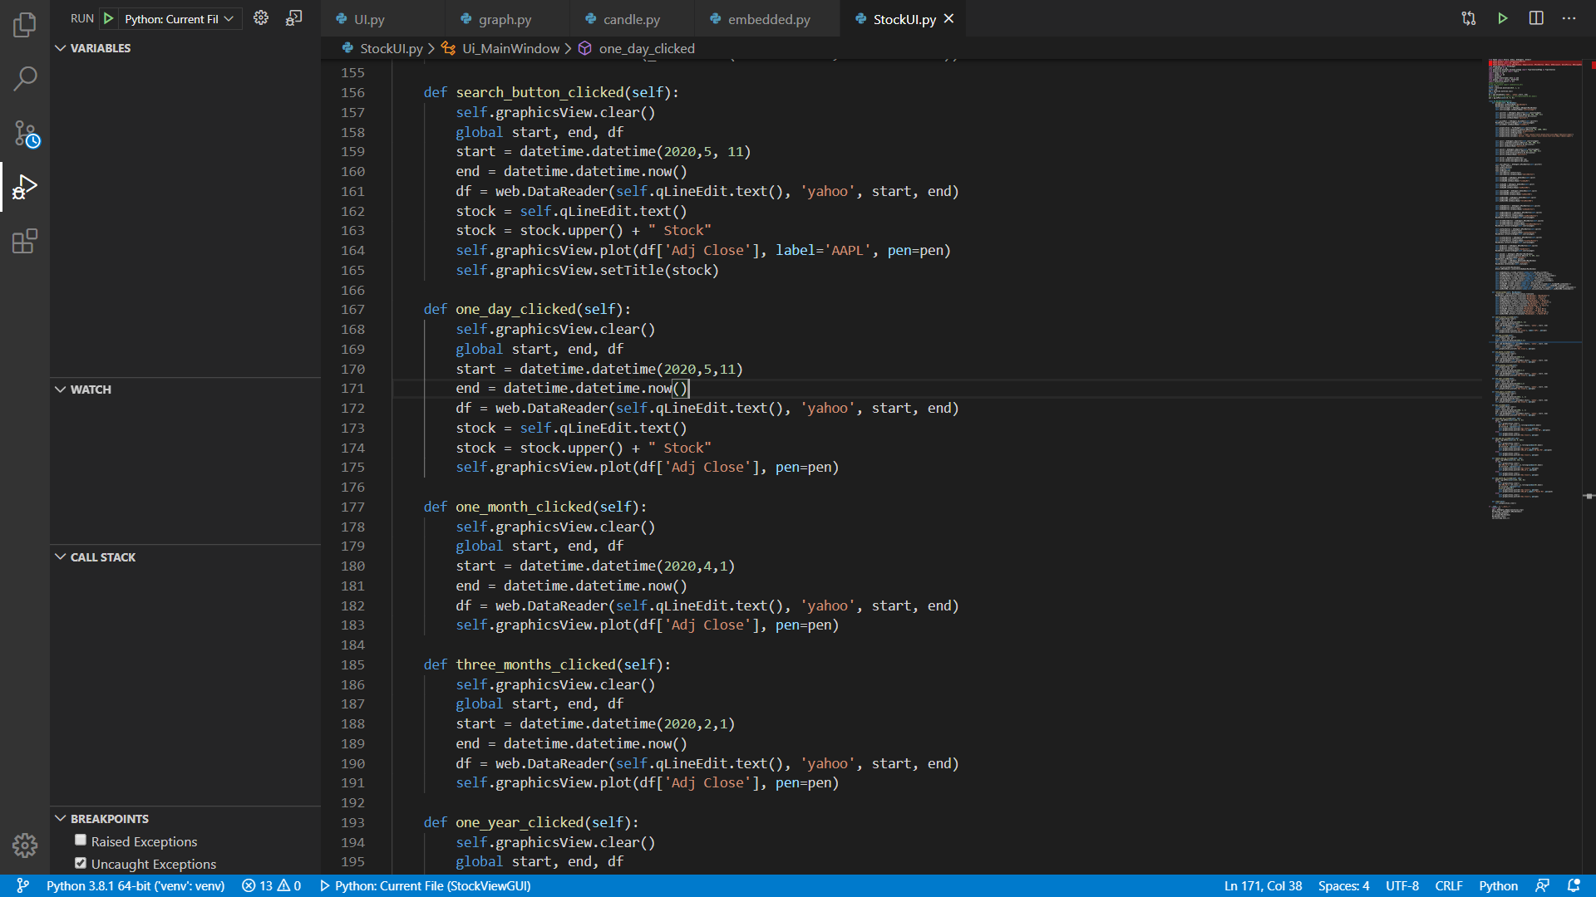
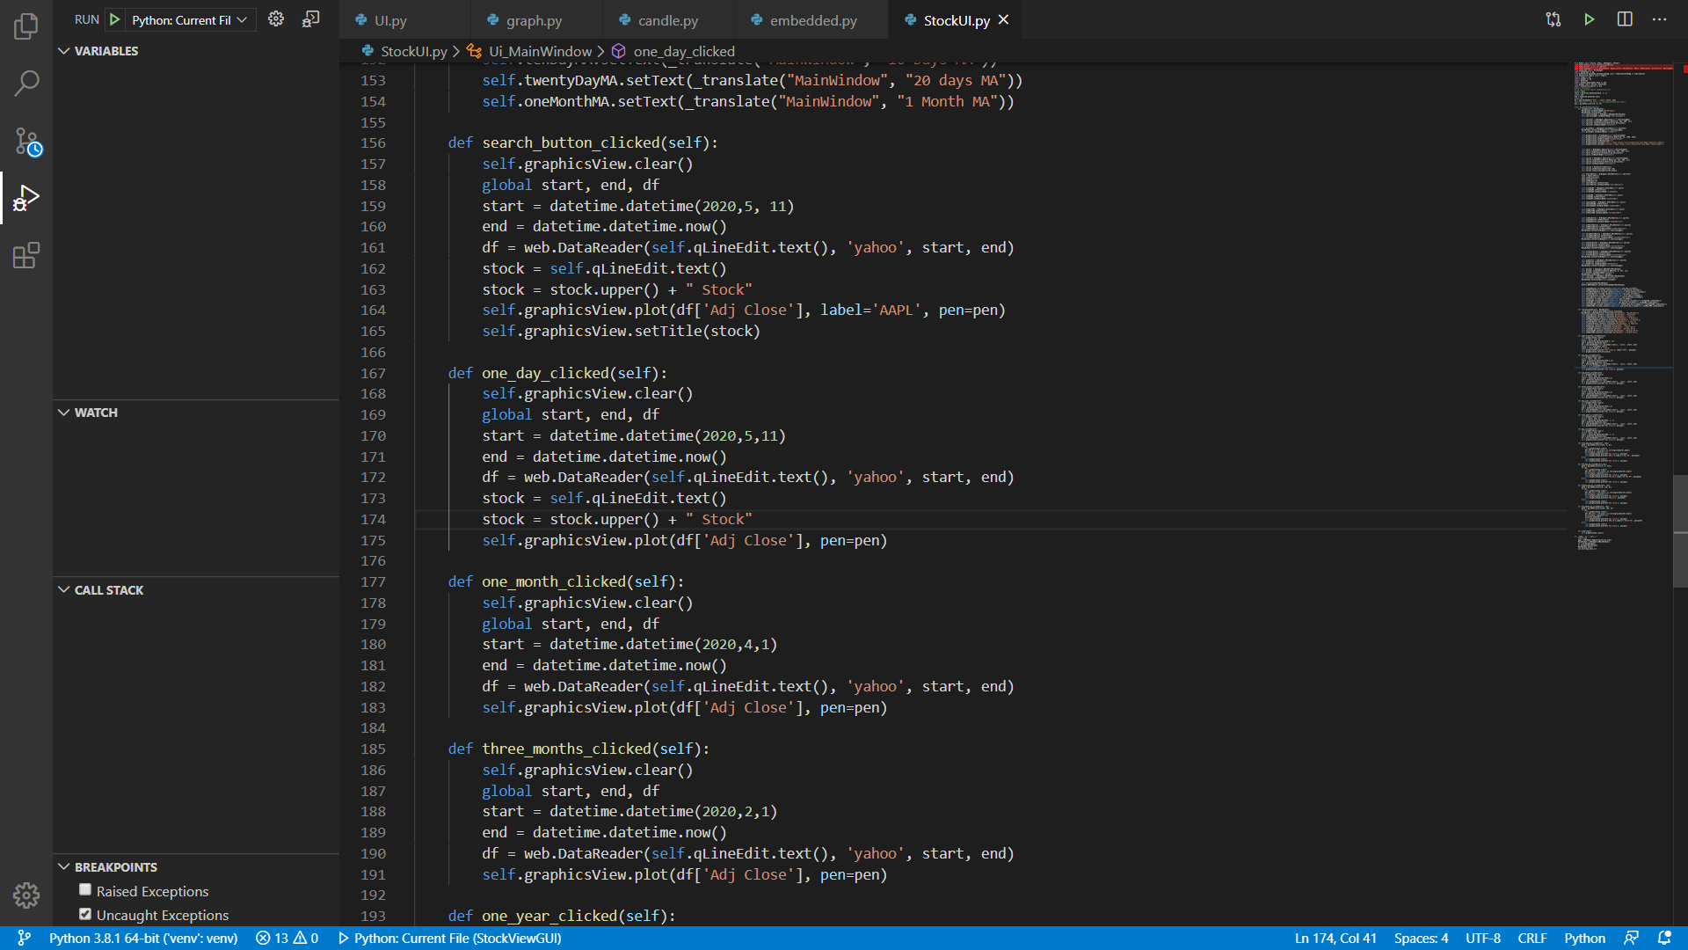
The Code I was most proud of
Making the User interface work

Slide 4
If I could do it all over again, I would…
Put more time into working on my project
Learn the libraries a lot more

Slide 5
The thing that I learned the most was…
How to embed different kinds of libraries into other libraries
How to mess around different kinds of user interfaces like buttons, checkboxes, and graphicsview windows

Slide 6
Freedom and Creativity
I really liked that you gave us the freedom to choose what we want to create and build throughout this class
This allowed us to be creative and passionate on something we could love and enjoy
I now love computer science even more because we got to create games, modify them, and mess with different kinds of GUI’s

