Slide 1
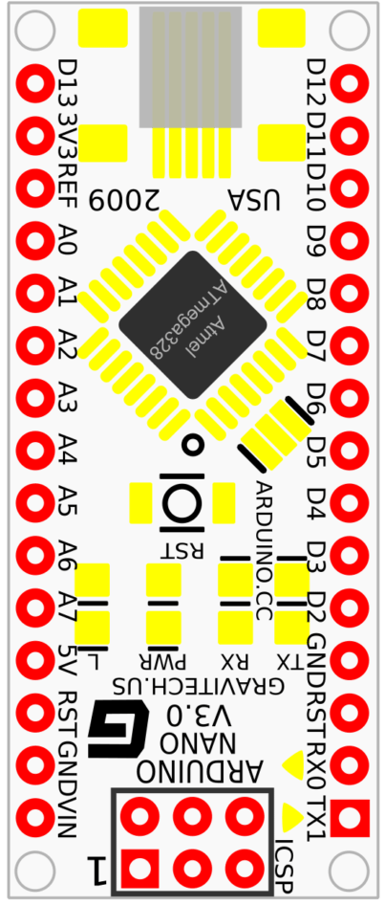
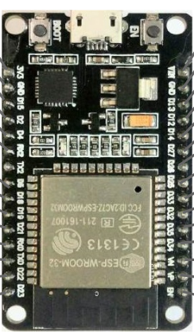
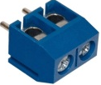
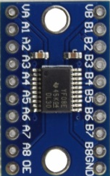
5V
pinoSensor_01
pinoSensor_02
pinoSensor_03
SENSOR_TENSAO_1
SENSOR_TENSAO_2
SENSOR_TENSAO_3

