Slide 1
Gemstone TESLA Subgroup …….
List of group Members…
28 Feb. 2014
Review Objectives and Goals: Grand, mid-range, short-term …..
Results from this week: …..
Show diagram of measurement or simulation setup
Show a clear result, preferably with a graphic
Why is this important / relevant to your objectives?
What problems / issues did you encounter? Brainstorm for solutions
How does this result influence your (or others’) next step?
Plans for next week: …..
Describe clearly what you will do next week and explain why it is important
Proposed schedule – does it conflict with other sub-groups?
What do you need to make progress?

Slide 2
TESLA Subgroup Reports
7 March 2014

Slide 3
Nonlinear Response Team Tim, Frank, Ben
7 March 2014
Grand – Develop/build rectenna to both transform input into power and to create a strong nonlinear response.
Mid – Characterize and select elements suited to this goal. Short – Explore pulse inversion as a “fingerprinting” method.
This Week:
Literature review on rectennas and their functionality.
A rectenna is, by definition, an antenna to convert microwaves to DC current.
The first low pass filter “prevents harmonics from re-radiating” – can we omit this component and still have the device function?
Lots of literature available for rectennas with the harmonic reduction; seemingly little without.
Pulse Inversion Experiments.
Image courtesy Octavian Sima, Design of a large area rectenna for Energy Harvesting using Ambient RF Energy

Slide 4
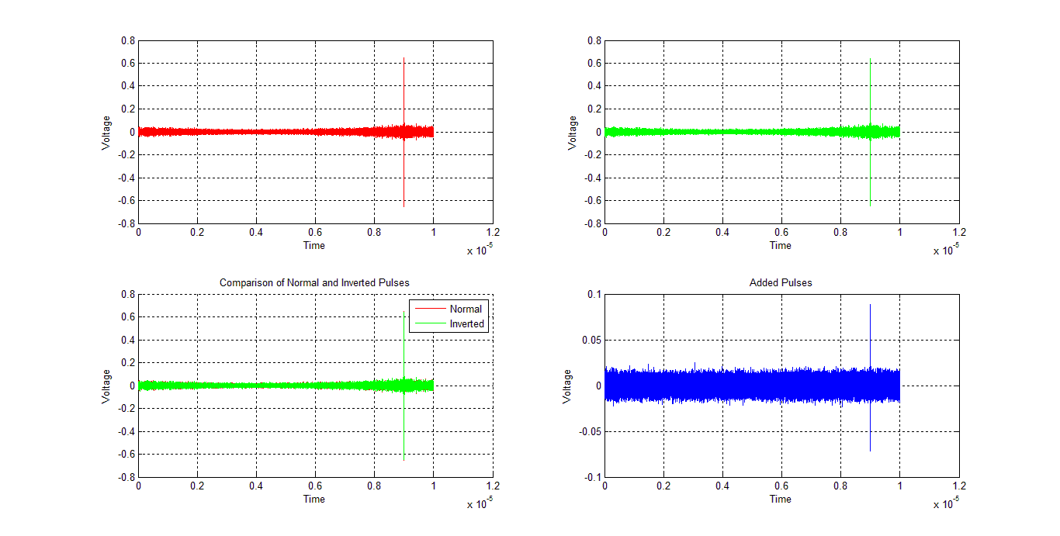
Results of Pulse Inversion (“Linear” Component)
7 March 2014

Slide 5
Nonlinear Response Team Tim, Frank, Ben
7 March 2014
Grand – Develop/build rectenna to both transform input into power and to create a strong nonlinear response.
Mid – Characterize and select elements suited to this goal. Short – Explore pulse inversion as a “fingerprinting” method.
Next Week
Need a schedule to avoid conflict with other subgroups.
Should easily be able to perform the same experiment with a nonlinear instead of a linear antenna, finishing the team’s short term goal.
Proposed next step: construct real rectenna for actual microwave-to-DC conversion.

Slide 6
Antenna Team Patrick, Alex
7 March 2014
Grand – To develop an antenna that operates in desired (legal) frequencies, has sufficiently low reflection at such frequencies, and can most efficiently transmit a signal to a recipient.
Mid – To prototype constructed antennas; to identify patterns in behavior consistent with size, length, and geometry; and to apply foundational knowledge in order to create novel antennas for further testing and experimentation.
Short – Ordering supplies from Pasternack
This Week:
Four antennas have been constructed for “go-to” use phase in testing.
We acquired the PNA (again).
Pasternack Enterprises, Inc. 2008B Catalog
Characterized the impedance of two antennas (25mm and 35 mm).
Next Week:
Ordering parts
Gigabox testing on other antennas.

Slide 7
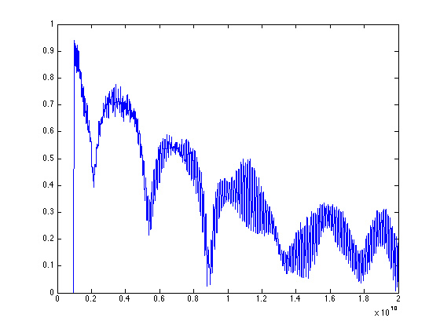
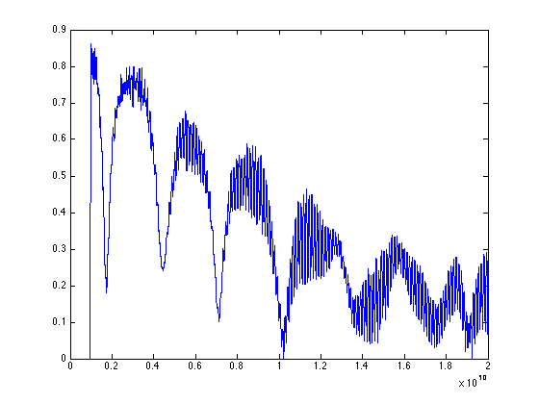
Antenna Team Patrick, Alex
7 March 2014
Results for Impedance Testing:
25 mm Antenna
35 mm Antenna

Slide 8
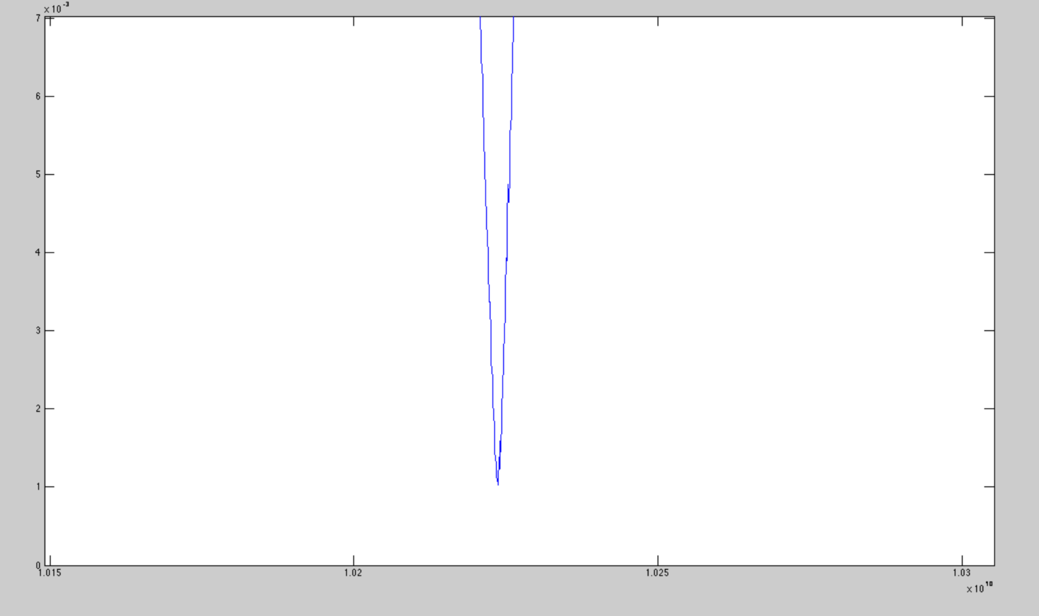
Antenna Team Patrick, Alex
7 March 2014
Results for Impedance Testing:
35 mm Antenna
Seems to indicate:
MIN of approx. 1/1000 (units?)
Works best around 10.22 GHz
Narrow Bandwidth
FCC Rules (Next Page)
If anyone wants to further investigate FCC Rules and Regulations:
http://tinyurl.com/m85awno

Slide 9
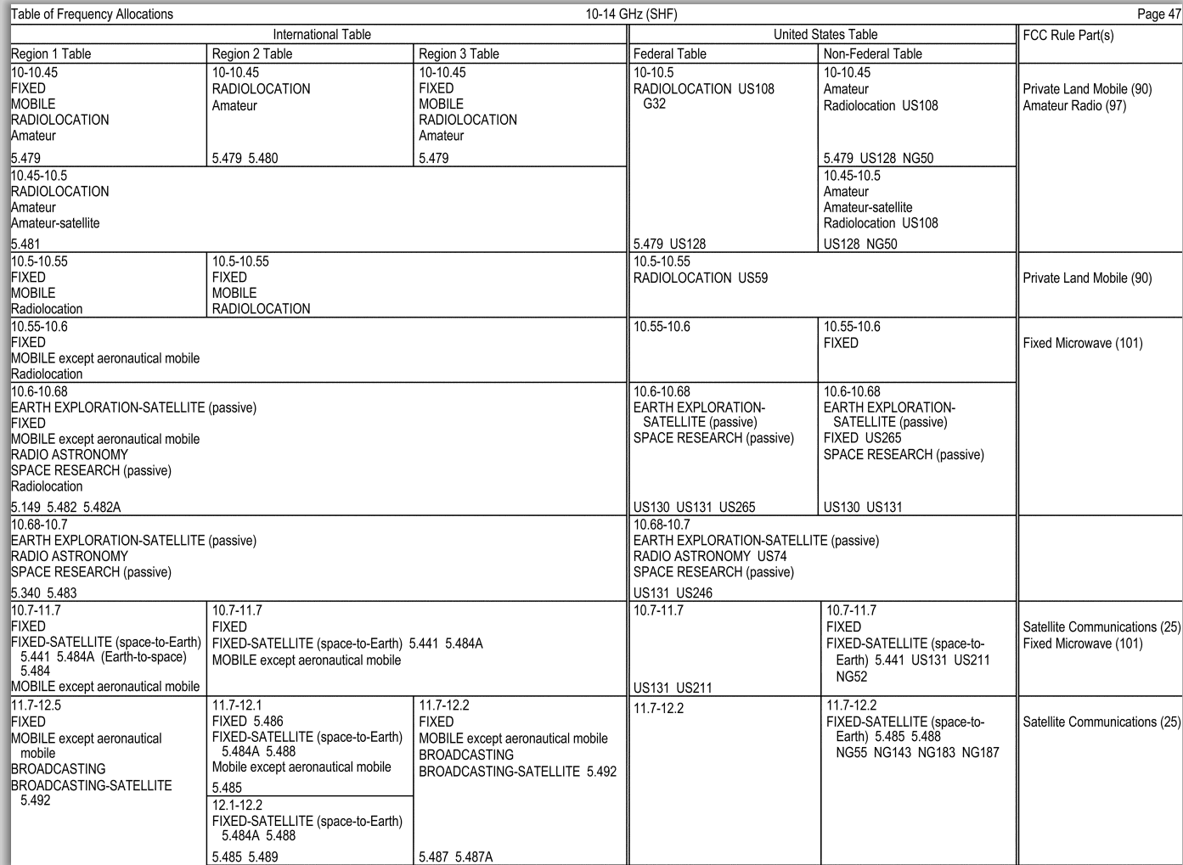
Antenna Team Patrick, Alex
7 March 2014
International Table: (Region 2 Table): 10-10.45 GHz RADIOLOCATION Amateur
5.479 5.480
United States Table:
(Federal Table): 10-10.5 GHz
RADIOLOCATION US108 G32
5.479 US128
(Non-Federal Table): 10-10.45 GHz
Amateur, Radiolocation US108
5.479 US129 NG50
FCC Rule Part(s)
Private Land Mobile (90)
Amateur Radio (97)
We may need to register/verify with the FCC eventually.
Results for Impedance Testing:
35 mm Antenna

Slide 10
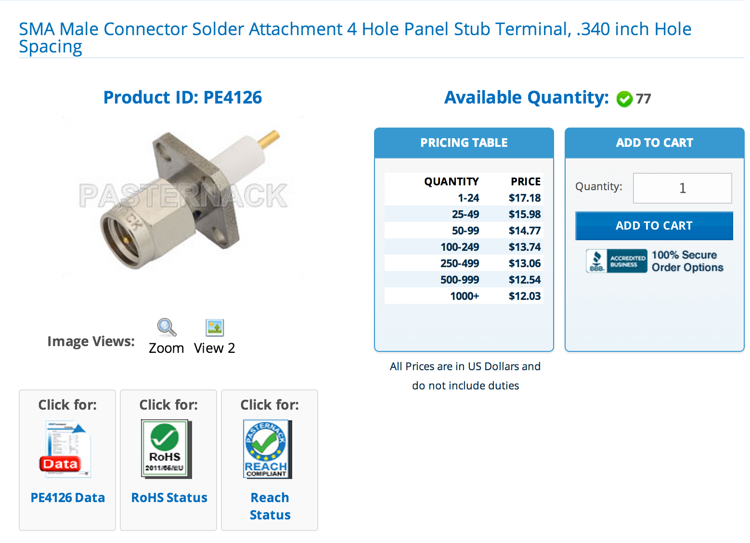
Antenna Team Patrick, Alex
7 March 2014
How we plan on moving ahead:
Pros: Large amount available (77 units) Fairly economical Already in use by the lab, no MacGyver-ing. Quality does not seem to be an issue Would allow for much faster antenna testing
Cons: Shipping – How much time? Misc: Does anyone know of a better place or model to go with that would be compatible?

Slide 11
Lossy Events Andrew, Brett, Anu, and Dan
7 March 2014
Grand –
Mid –
Short –
This Week:
After initial tests with an empty gigabox, we put one microwave absorbing pad in the box at a certain position. After three trials, we moved it to another position, etc. until we had three measurements for each of four positions.
We plan on repeating this experiment with two pads in each position, and then three and four.
This should allow us to measure the efficiency difference according to two variables- placement in the box and amount of lossy surface.

Slide 12
Lossy Events Andrew, Brett, Anu, and Dan
7 March 2014
Trial # | V (peak to peak) | % average
1 | 333.511 | 98.64%
2 | 338.632 | 100.2%
3 | 328.041 | 97.02%
4 | 352.256 | 104.2%
Placement | Trial # | V_pp | Average V_pp
A | 1 2 3 | 103.360 63.7170 67.7883 | 78.2881
B | 1 2 3 | 141.429 136.387 137.240 | 138.352
C | 1 2 3 | 95.5480 77.4507 81.6931 | 84.8973
D | 1 2 3 | 86.0880 90.0828 90.1788 | 88.7832
% base V_pp
23.16%
40.92%
25.11%
26.26%

Slide 13
Modeling Team Scott, Tyler, and LC
7 March 2014
Grand – Design the WPT system in a computer simulation to optimize parameters and find theoretical max efficiency transmission %
Mid – HFSS and CST : Get reasonable output data from realistic Gigabox dimensions;
HPC : Complete basic submission and analysis as directed by Dr. Moglie
Short – Get HFSS resonant frequencies, complete preliminary troubleshooting in CST, and be able to access files and parts of HPC
This Week:
HFSS – Scott : No progress due to CPU upgrade to Windows 7 --> CPU out of the lab
CST – Tyler and LC : Worked on applying HFSS Gigabox model to CST --> still in troubleshooting and no results
HPC – Everyone : We now have access to it from Dr. Moglie. He has instructed us to start with test runs of simulations to learn to submit tasks and obtain data. Frank has opted to help us out with syntax with the Secure Shell program.

