Slide 1


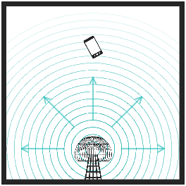
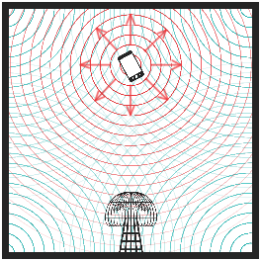
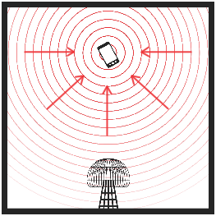
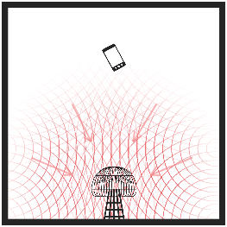
Use of Time-Reversal to Deliver Wireless Power via Electromagnetic Waves
Prof. Steven Anlage and Gemstone Team TESLA, University of Maryland
Problem Statement
Approach
We propose development of a novel method for wireless power transfer (WPT) using time-reversal (TR) of electromagnetic (EM) waves. TR allows waves to be focused to a specific point, which will dramatically increase the range and efficiency of WPT.
The overall goal of this research is to prove this technique can effectively power moving objects. To this end, a system will be built to power a single continuously moving object. This will demonstrate that the concept allows for adjustment in real time for changes in position of the target.
The basic operation of the TR WPT will consist of a rectenna and time-reversal mirror as shown:
1. An EM pulse is generated by the TR mirror.
2. Device echoes the EM pulse using an attached rectenna.
3. Signal is processed by the time-reversal mirror and rebroadcast at higher amplitude.
4. Return signal converges on rectenna with a net power gain. This process repeats to provide continuous energy.
Target
Mirror
Applications/Relevance
Work Plan
The greatest benefit of time-reversed wireless power will be in removing the logistical limitations inherent to wired systems.
Allow for charging of moving/in-use devices
Allow for charging of many devices at the same time
Allow for the creation of more efficient/lighter electrical systems
Additionally, devices could be built that rely solely on TR power supply to be functional, controlling their use.
Prevent the continued use/study of captured weapons (drones, intelligence gathering equipment, etc.)
Work will be carried out by a graduate student and thirteen undergraduate honors students. Deliverables include the demonstration of WPT, data showing the efficiency and responsiveness of the process, and a summary of possible improvements to the process.

