Slide 1

Data science final project
By Mekonet Ageza & Yakov Avata
GitHub

Slide 2
Our research - intro
Research question :
Can we predict success of anime based on features ?

Slide 3
anime in numbers
The global anime market size was valued at USD 23.5 Billion in 2020 and is expected to reach USD 25.46 billion in 2021.
According to Netflix reports, over 100 million households around the world watch at least one anime title.
A survey held in the United States found that 27 percent of adults aged 18 to 29 years old stated that they watched at least one anime.
in Japan, the birthplace of anime. reports show that almost 76% of the population watch anime.

Slide 4
Data sources
https://myanimelist.net/

Slide 5
Cleaning data
fixing columns names.
filling missing values with median and other values.
Converting data from strings to floats.
dropping unnecessary columns.

Slide 6
EDA

Slide 7
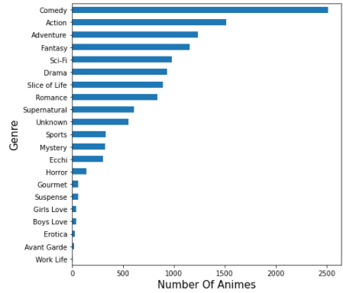
Plotting Genres Feature
We saw that the most common and successful genre is action

Slide 8
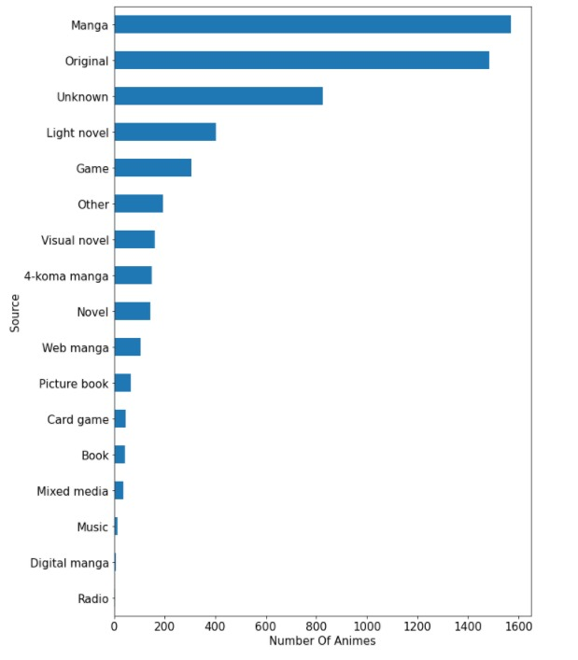
Plotting Source Feature
We saw that the most common and successful Source is Manga

Slide 9
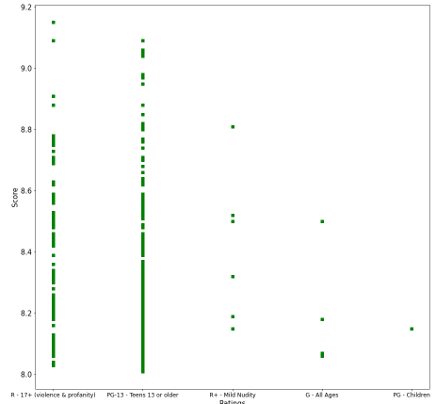
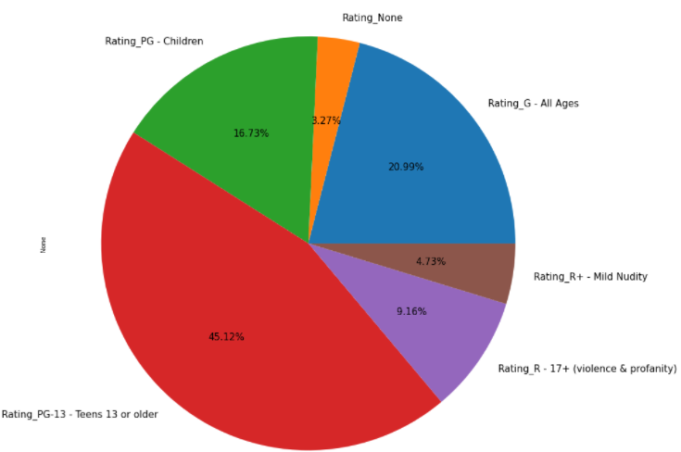
Plotting Rating Feature
According to the data, most of the amines are rated as PG-13.
We wanted to find out to ratings among the top 100 Anime by score. For that we used a scatter plot and discovered that most of the anime are rated as PG-13 and R17+.

Slide 10
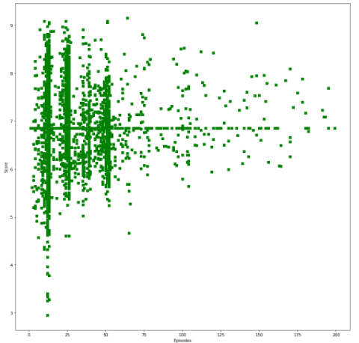
Score and Number of episodes
According to the scatter plot there is no correlation between the number of episodes and the score given.

Slide 11
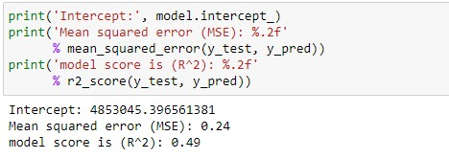
Machine learning
We wanted to predict the Score of a given Anime based on the following features : Rank, Scored by, Episodes, Duration, Popularity, Members, Favorites, Genres, Source and rating.
We tried building linear regression models using only : Rank, Scored by, Episodes , Members, Favorites but the model score was about 0.34
To increase the model score we added Genres, Source and Rating.
To convert those features we used get dummies.
After adding the additional features and using standard-scaler we only got 0.49..

Slide 12
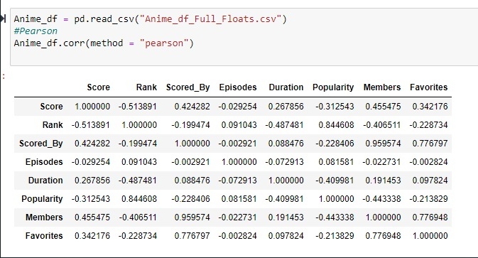
Pearson correlation
After trying to improve our prediction score we decided to check if the correlation between score and other features.
We saw a low correlation between the features and the Score.

Slide 13
In conclusion,
trying to predict the score was unsuccessful because we had a low correlation between the score and the other features.
we tried to add more features but we still didn't got a high score for our model.
we learned that most of the successful animes are rated as PG-13 or R17+ and are part of the Action or comedy genre

