Slide 1

Data science final project
By Mekonet Ageza & Yaakov Avata

Slide 2
Our research - intro
Research question:
Can we predict success of anime based on feather ?
Like- number of episodes , rank, score , members, popularity

Slide 3
anime statistics
The global anime market size was valued at USD 23.5
Billion in 2020 and is expected to reach USD 25.46 billion in 2021
Netflix reported that over 100 million households around the world watched at least one anime title in the first nine months of 2020, a 50% increase from 2019.

Slide 4
Data sources
Crawling
www.myanimelist.net

Slide 5
Cleaning data
fixing columns names and sorting columns
filling missing values with mean and other values
cleaning nulls and converting from strings to floats etc.'
dropping unnecessary columns

Slide 6
EDA

Slide 7
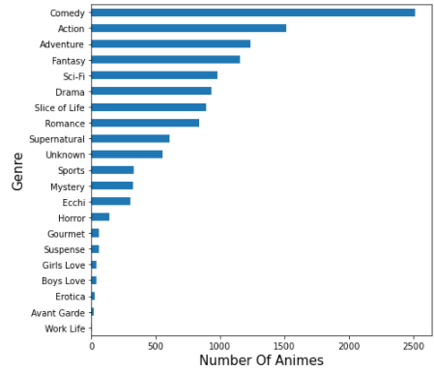
Plotting Genres Feature
We saw that the most common and successful genre is action

Slide 8
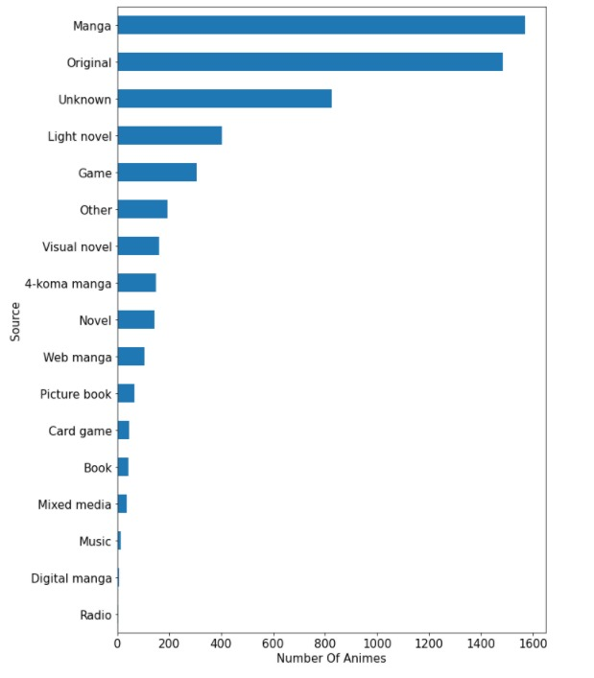
Plotting Source Feature
We saw that the most common and successful Source is Manga

Slide 9
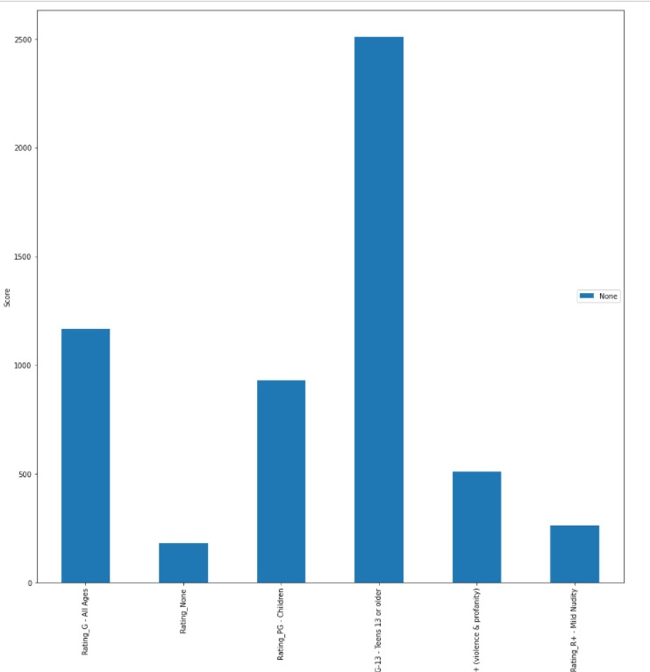
Plotting Rating Feature
Sum of amines in each Rating
We can see that most of the amines are rated as PG-13

Slide 10
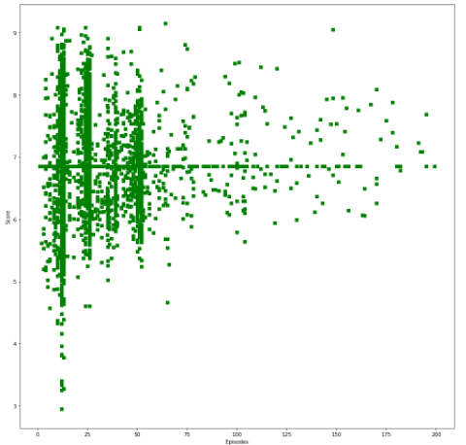
Score and Num Of Episodes
We can see that the number of episode doesn't affect the rating and Score of the anime

