Slide 1

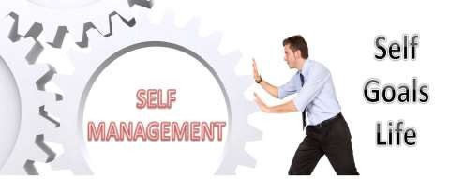
1
All of us have dreams, a vision of future, what we might become.
How can you map out steps that take you on a clear path to your goals?
1

Slide 2

Introduction to Self-Management
2
What is Self-Management?
Management of or by oneself; the taking of responsibility for one's own behaviour and well-being.
Organizations like self-managed workers
Self-management helps you become a successful
learner.
It refers to strategies, techniques and approaches we use to direct our activities and behaviours effectively. Self-management includes goal setting, planning and managing your time. Self-management is a key skill that will help you throughout your life
https://student-learning.tcd.ie/learning-resources/self-managem n /
2
e
t

Slide 3
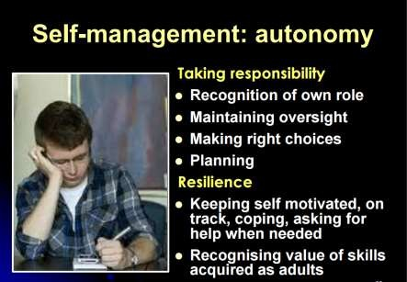
3
3

Slide 4
4
 | The Underlying Theme
 | The development of skills needed to manage one’s life as well as relationships with others is a ceaseless endeavor
4
Notes:
1. The Underlying Theme
Concept: Managing one's life and relationships is a continuous journey. Example: Learning to communicate effectively with family members and friends is an ongoing process that helps in building stronger bonds over time.

Slide 5

Developing Management Skills
Tenth Edition
Chapter 1
Developing Self-Awareness
Copyright © 2020, 2016, 2011 Pearson Education, Inc. All Rights Reserved
5

Slide 6
Specific Learning Objectives Lectures 1 & 2
6
Increase personal awareness of your:
Sensitive line
Emotional intelligence (briefly)
Cognitive style
Orientation toward change
Core self-evaluation
Personal values and moral maturity
Character Strengths
Copyright © 2016 Pearson Education, Inc.
6

Slide 7
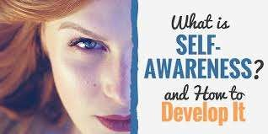


Developing Self-Awareness
7
7
Notes:
Self-awareness means recognizing both your strengths and weaknesses. For example, you might realize you get nervous speaking in public, which can be uncomfortable but helps you know where to improve.

Slide 8
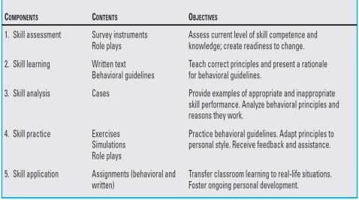
8
The Approach to Development
8
Notes:
3. The Approach to Development
A. Skill Assessment
Content: Use surveys and role plays to assess skill level.
Objective: Understand your current competence and readiness to improve.
Example: Completing a survey to gauge communication skills before starting a course on effective communication.
B. Skill Learning
Content: Written guidelines and principles.
Objective: Learn correct behaviors and understand why they are important.
Example: Reading about active listening to improve communication skills.
C. Skill Analysis
Content: Case studies to demonstrate behaviors.
Objective: Identify good and bad examples to analyze why certain behaviors work.
Example: Reviewing cases of good and poor teamwork to understand effective team dynamics.
D. Skill Practice
Content: Exercises, role plays, and simulations.
Objective: Practice behaviors and adapt them to your style with feedback.
Example: Practicing conflict resolution in a role-play setting with classmates.
E. Skill Application
Content: Real-life assignments.
Objective: Transfer skills learned in class to everyday situations.
Example: Applying time management strategies learned in class to balance study and social life.

Slide 9
9
 | Things to Remember
 | A high IQ alone does not guarantee success in life and work. Your ATTITUDE is what matters Personal skills can be improved with the proper balance of learning of concepts and behavioral practice.
9
Notes:
4. Things to Remember
A high IQ doesn’t guarantee success; your attitude matters more. Personal skills can be improved through a mix of learning and practice.
Example: Someone with a positive attitude and good self-discipline may succeed more than someone with a high IQ but poor work habits.

Slide 10
Keys to Self- Awareness
10
“Know Thyself”
Carved on the temple to the Oracle at Delphi
“To conquer others is strong; to
conquer oneself is mighty.”
Lao-Tzu 5th Century BC
“He that would govern others must first master himself”
Philip Messinger 1624
Copyright © 2016 Pearson Education, Inc.
10

Slide 11
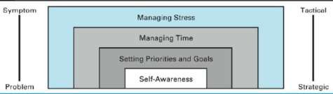
A Hierarchy of Personal Life Management Skills
11
11

Slide 12

12
 | The Enigma of Self-Awareness
 | Seeking self knowledge is a prerequisite for personal growth. However, we avoid seeking information about ourselves because it may make us feel inferior.
Copyright © 2016 Pearson Education, Inc.
12
Notes:
5. The Enigma of Self-Awareness
Seeking self-knowledge is essential for growth, but people often avoid it because it can challenge their self-image.
Example: Some may avoid feedback on their work because they fear criticism, even though it could help them improve.

Slide 13
13
 | The Sensitive Line
 | The point at which individuals become defensive when encountering information about themselves that is inconsistent with their self- concept.
Copyright © 2016 Pearson Education, Inc.
13
Notes:
6. The Sensitive Line
The point where people feel defensive when confronted with information that challenges their self-image.
Example: Receiving constructive criticism at work might cross someone’s sensitive line, making them defensive.

Slide 14
Crossing the Sensitive Line
14
Our sensitive line is less likely to
be crossed…
When information is verifiable,
predictable and controllable.
When we “self-disclose”.
Copyright © 2016 Pearson Education, Inc.
14

Slide 15
15
 | Appreciating Individual Differences
 | Differences Distinctions We observe • We create differences distinctions Appreciating differences helps • Making distinctions eliminate social creates social barriers barriers
Copyright © 2016 Pearson Education, Inc.
15
Notes:
7. Appreciating Individual Differences
Recognizing and appreciating differences can remove social barriers, while making distinctions can create them.
Example: Understanding a friend’s different approach to problem-solving rather than judging it as inferior helps build stronger relationships.

Slide 16

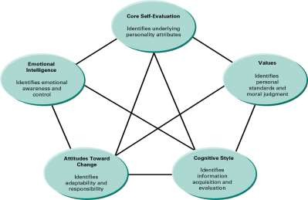

Five Core Aspects of Self-Awareness
16
Copyright © 2016 Pearson Education, Inc.
16

Slide 17


17
 | Emotional Intelligence
 | Difficult to measure and define. Considered to be an important measure of managerial success.
Copyright © 2016 Pearson Education, Inc.
17
Notes:
8. Five Core Aspects of Self-Awareness
Emotional Intelligence: Ability to understand and manage your own and others' emotions.
Example: Staying calm and managing emotions during a heated discussion at work.

Slide 18
18
Components of Emotional
Intelligence
The ability to diagnose and recognize your own emotions.
The ability to control your own
emotions.
The ability to recognize and diagnose the emotions of others.
The ability to respond appropriately to emotional cues.
Copyright © 2016 Pearson Education, Inc.
18

Slide 19
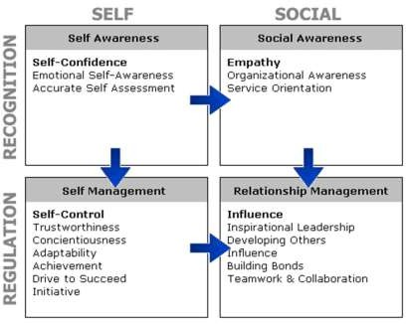
19
19

Slide 20
20
 | Cognitive Style
 | An individual’s inclination to perceive, interpret, and respond to information in a certain way Book page 14
Copyright © 2016 Pearson Education, Inc.
20
Notes:
Cognitive Style: The way you perceive and process information.
Example: Preferring detailed plans and clear agendas in group projects.

Slide 21
Cognitive Style Indicator
21
This instrument assesses the way you gather and evaluate information and make decisions.
There are no right or wrong answers, and the accuracy of your results will depend
on the extent to which you honestly answer each question. Please use the following scale in responding to each item.
Rating Scale
Totally disagree
Disagree
Neither agree nor disagree
Agree
Totally agree
1. Developing a clear plan is very important to me.
2. I like to contribute to innovative solutions.
3. I always want to know what should be done when.
4. I prefer to look at creative solutions.
5. I want to have a full understanding of a problem.
6. I like detailed action plans.
7. I am motivated by ongoing innovation.
8. I like to analyze problems.
9. I prefer a clear structure to do my job.
10. I like a lot of variety in my life.
11. I engage in detailed analyses.
12. I prefer well-planned meetings with a clear agenda.
13. New ideas attract me more than existing solutions.
14. I study each problem until I understand the underlying logic.
15. I make definite appointments and follow-up meticulously.
16. I like to extend the boundaries.
17. A good task is a well-prepared task.
18. I try to avoid routine.
Source: Cognitive Style Indicator, Cools, E. and H. Van den Broeck. (2007) “Development and Validation of the Cognitive Style Indicator.” Journal of Psychology, 14: 359–387.
21

Slide 22
22
 | Three Dimensions of Cognitive Style
 |  | Attributes | Possible Liabilities
Knowing |  | Emphasizes facts, details, and data Seeks clear, objective solutions Focuses on validity, credibility of data Emphasizes accuracy and precision | Slow to make decisions Not very creative Resistant to innovation Intolerant of multiple views
Planning |  | Emphasizes planning and preparation Seeks agendas and outlines Focuses on methods, processes, and follow-up Emphasizes clear actions and routine | Frustrated by the status quo Intolerant of ambiguity Stressed by complexity Difficulty handling illogical issues
Creating |  | Emphasizes creativity, risk-taking, and innovation Seeks novelty and ambiguity Focuses on spontaneity and possibilities Emphasizes interaction and getting many inputs | Resistant to structure Tends to break rules May make many mistakes Tends to ignore data and facts
Copyright © 2016 Pearson Education, Inc.
22

Slide 23
23
 | Attitudes Toward Change
 | Graduates of management schools today will face an environment unlike any person has ever experienced before
Copyright © 2016 Pearson Education, Inc.
23
Notes:
9. Attitudes Toward Change
Tolerance of Ambiguity: Comfort with uncertain situations.
Example: Being comfortable working on a project with few guidelines and figuring things out as you go.
Locus of Control
Internal Locus: Belief in personal control over outcomes.
Example: Thinking, “I succeeded because of my hard work.”
External Locus: Belief that external factors control outcomes.
Example: Thinking, “I failed because of bad luck.”

Slide 24
Change Orientation
24
Tolerance of Ambiguity: The extent to which individuals are comfortable coping with unclear situations.
Book page 15
Copyright © 2016 Pearson Education, Inc.
24

Slide 25
Please respond to the following statements by indicating the extent to which you agree or disagree with them.
25
Fill in the blanks with the number from the rating scale that best represents your evaluation of the item.
Rating Scale
Stronglydisagree
Moderately disagree
Slightlydisagree
Neither agree nor disagree
Slightly agree
Moderately agree
Stronglyagree
An expert who doesn’t come up with a definite answer probably doesn’t know too much.
I would like to live in a foreign country for a while.
There is really no such thing as a problem that can’t be solved.
People who fit their lives to a schedule probably miss most of the joy of living.
A good job is one where what is to be done and how it is to be done are always clear.
It is more fun to tackle a complicated problem than to solve a simpleone.
In the long run it is possibleto get more done by tackling small, simple problems rather than large and complicated ones.
Often the most interesting and stimulating people are those who don’t mind being different and original.
What we are used to is always preferable to what is unfamiliar.
People who insist upon a yes or no answer just don’t know how complicated things really are.
A person who leads an even, regular life in which few surprises or unexpected hap- penings arise really has a lot to be grateful for.
Many of our most important decisions are based upon insufficient information.
I like parties where I know most of the people more than ones where all or most of the people are complete strangers.
Teachers or supervisors who hand out vague assignments give one a chance to show initiative and originality.
The sooner we all acquire similar values and ideals the better.
A good teacher is one who makes you wonder about your way of looking at things.
Source: S. Budner (1962), “Intolerance of Ambiguityas a Personality Variable,” from Journal of Personality,30: 29–50. Reprinted with the permission of Blackwell Publishing, Ltd.
25

Slide 26
26
 | Change Orientation (cont’d)
 | Locus of Control: The attitude people develop regarding the extent to which they control their own destinies.
Copyright © 2016 Pearson Education, Inc.
26

Slide 27
Locus of Control
27
Internal Locus of Control:
“I was the cause of the success or failure.”
External Locus of Control:
“Something else caused the success or failure.”
Copyright © 2016 Pearson Education, Inc.
27

Slide 28
28
 | Internal Locus of Control
 | Associated with… Managerial success (at least in North America) Less alienation from work environment More satisfaction at work Less stress More position mobility (promotions and job changes)
Copyright © 2016 Pearson Education, Inc.
28

Slide 29
External Locus of Control
29
Most commonly found in managers from Eastern cultures
Tend to use coercive power
more than internal leaders
Perform poorly in stressful situations
Copyright © 2016 Pearson Education, Inc.
29

