Slide 1
Power Laws and Prediction Gaps
A Statistical Framework for Extreme Dengue Outbreaks
in Brazilian Cities
15 Years of Epidemic Data | 5,000+ Municipalities

Slide 2
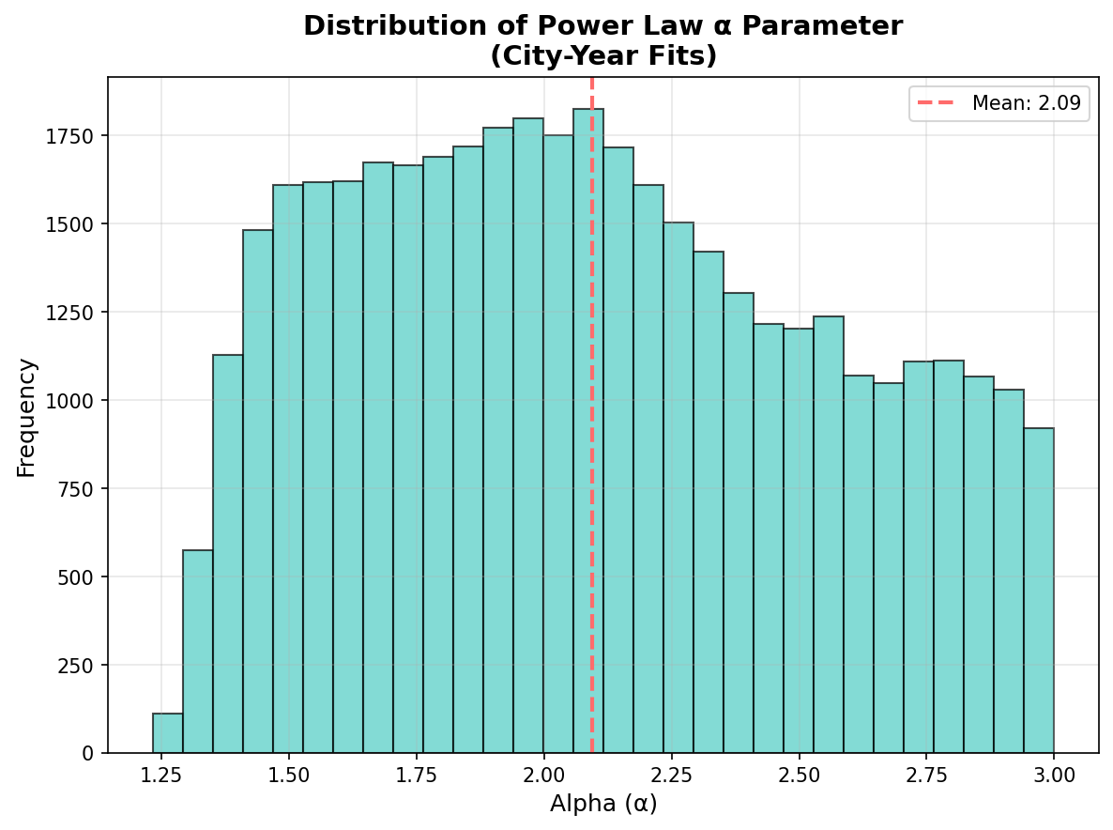
Overview
01
The Challenge
Why power laws matter for epidemics
02
Data & Methods
Brazilian dengue surveillance data
03
Power Law Fitting
Statistical methodology
04
Key Findings
Spatial and temporal patterns
05
Machine Learning
Predictive modeling with α features
06
Implications
Early warning & resource allocation
2

Slide 3
The Challenge: Extreme Events
Dengue fever affects 5,500+ municipalities in Brazil with recurrent seasonal outbreaks of varying intensity.
Key Insight: Extreme outbreak magnitudes follow power law scaling
Traditional Models
Power Law Approach
Assume normal/exponential distributions
Underestimate extreme events
Fail when it matters most
Heavy-tailed distributions
Rare events more likely than expected
Quantifies "black swan" potential
3

Slide 4
Data Sources
Infodengue API
Episcanner Data
Weekly estimated case counts (casos_est)
15+ years of data (2010-present)
5,000+ Brazilian municipalities
Climate variables (temperature, humidity)
Annual epidemic characteristics
Total cases per epidemic
Epidemic duration (weeks)
Peak week timing
Basic reproduction number (R₀)
Data integrated via Mosqlimate Platform
4

Slide 5
Power Law Fitting Methodology
Following Clauset et al. (2009) maximum likelihood approach
P(X ≥ x) ∝ x⁻⁽ᵅ⁻¹⁾
Key Parameters
α (alpha): scaling exponent
xmin: tail begins
xmax: data limit
R, p: power law vs exponential test
Power law probability distribution
where α is the scaling exponent
Fitting Levels
City
Yearly
State
National
Weekly cases per municipality
Annual fits per city
Aggregated state-level fits
Brazil-wide distributions
5

Slide 6
Distribution of α Parameters
Key Statistics
Mean α ≈ 2.3
Range: 1.5 - 4.0
Lower α = heavier tail
More extreme events
Interpretation
α ≈ 2 means probability of extreme outbreak (10x typical) is ~1%
6

Slide 7
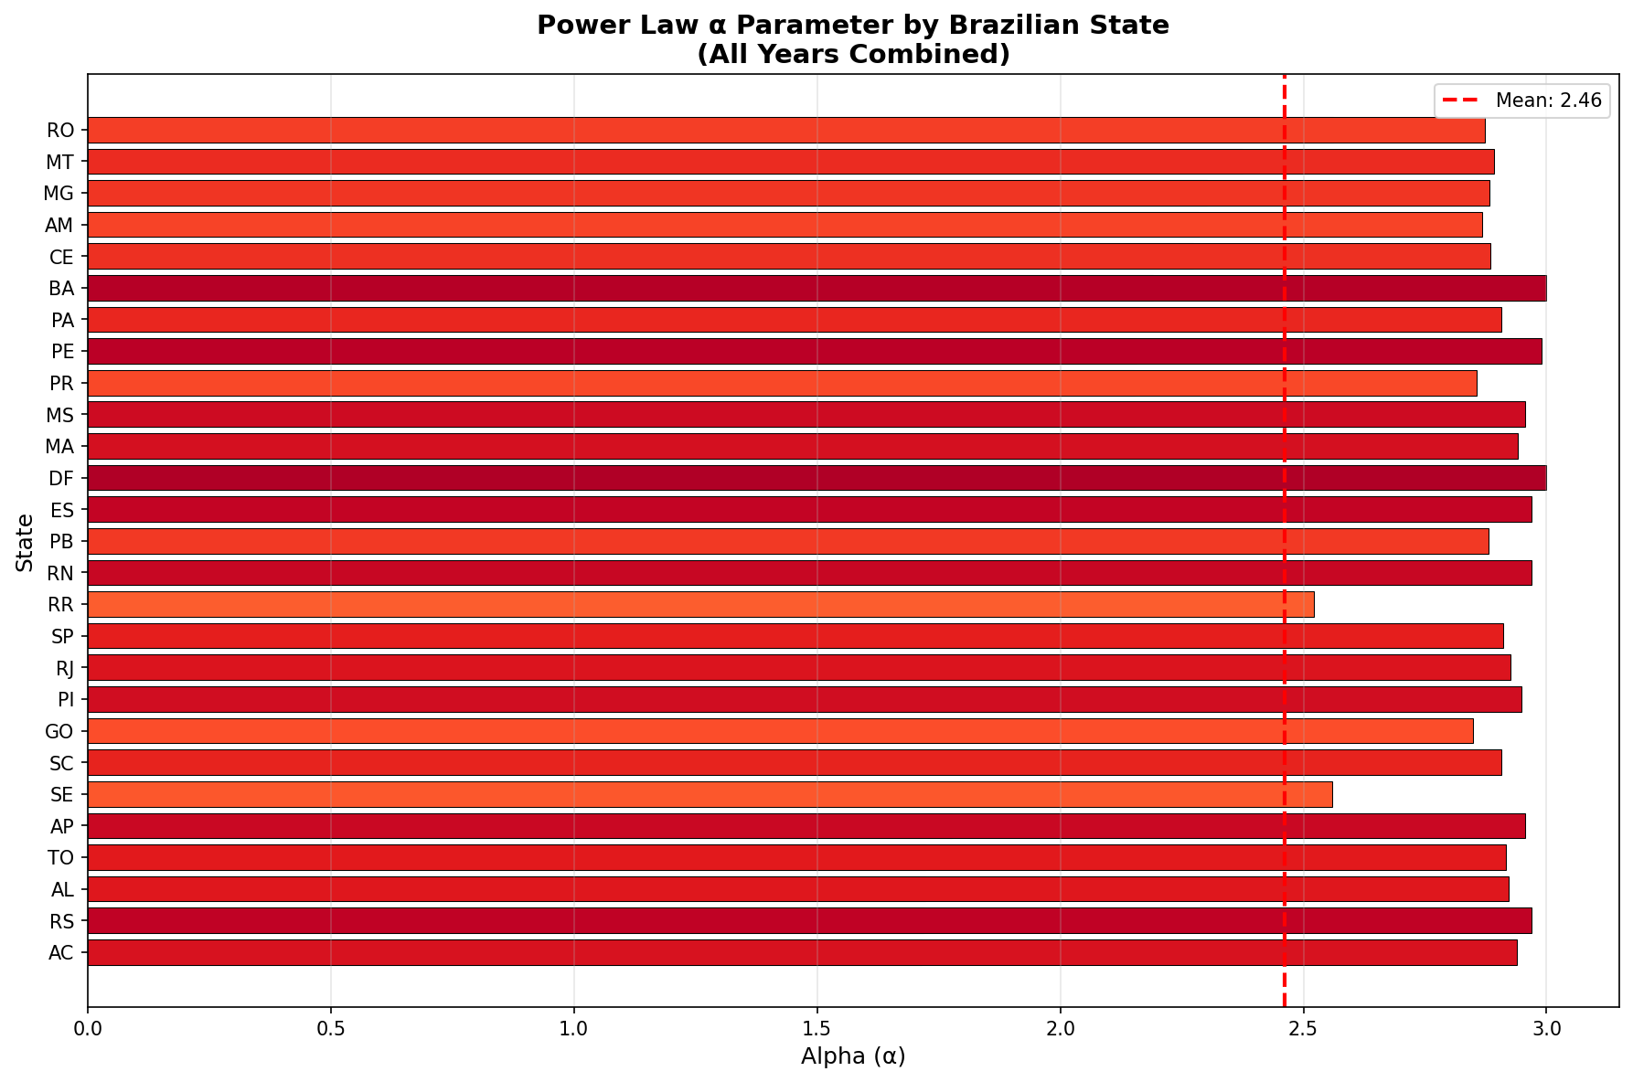
Spatial Patterns: α by State
Regional Insights
North & Northeast
Lower α → heavier tails
More extreme outbreaks
Southeast
Higher α → thinner tails
More predictable
Amazon Region
Variable α values
Heterogeneous dynamics
7

Slide 8
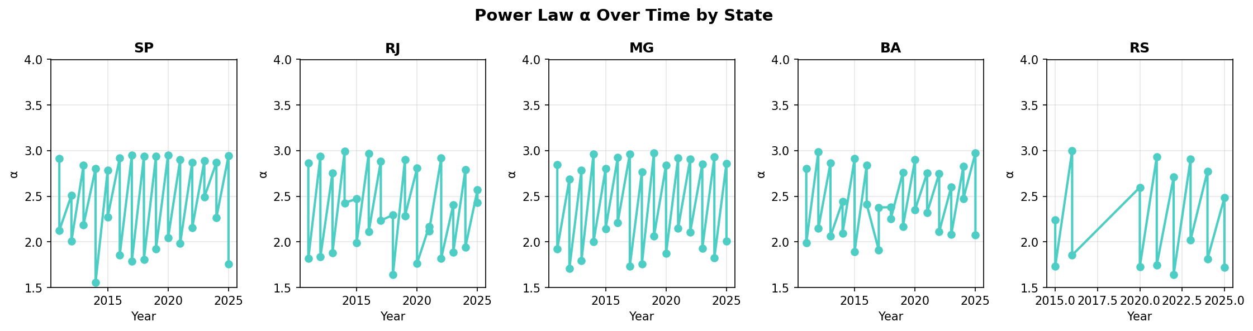
Temporal Evolution of α
α trends reveal shifting epidemic regimes — lower α indicates increasing dominance of extreme events
8

Slide 9
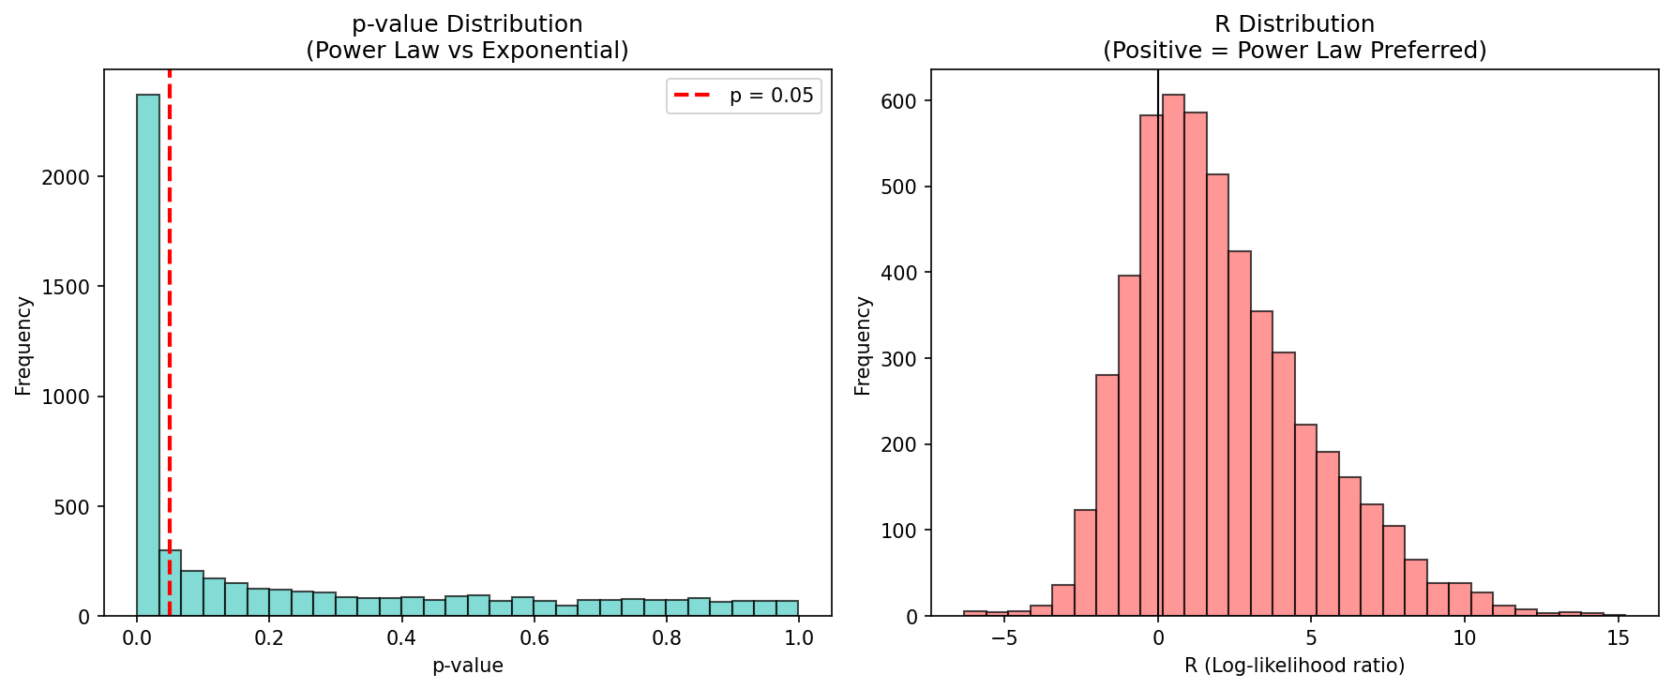
Model Validation
Power Law vs Exponential Comparison
R > 0 & p ≤ 0.05 → Power law preferred
9

Slide 10
Machine Learning Predictions
Random Forest models leveraging power law features for epidemic forecasting
Feature Engineering
Prediction Targets
Lagged epidemiological metrics
Historical α trends (slope)
Quarterly climate data
Population (log-transformed)
Geographic encoding
Total epidemic cases
Epidemic duration
Peak week timing
Log-transformed targets for total_cases handle order-of-magnitude variation
Key Result:
Cities with lower α (heavier tails) show reduced predictability in standard models, creating "prediction gaps" where traditional forecasting fails — precisely when extreme outbreak potential is highest.
10

Slide 11
Implications & Applications
Early Warning Systems
α parameters can serve as indicators of upcoming extreme event probability
Resource Allocation
Regions with lower α require more surge capacity due to unpredictable extremes
Climate Change Assessment
Tracking α trends reveals shifting epidemic regimes under climate change
Model Improvement
Power law features improve prediction accuracy for extreme events
11

Slide 12
Thank You
Power Laws and Prediction Gaps
A Statistical Framework for Extreme Dengue Outbreaks in Brazilian Cities
Power Law • Dengue • Extreme Events • Machine Learning • Spatial Analysis

