Slide 1
Add Title Here
Felipe Cecagno
Rosália Galiazzi Schneider

Slide 2
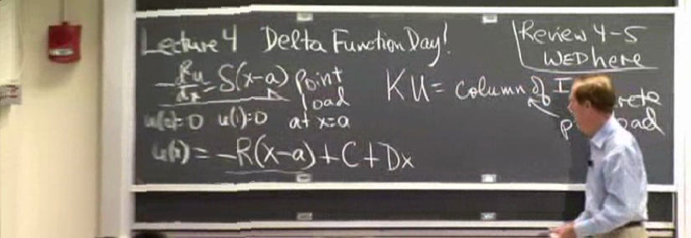
Motivation
Worldwide e-learning industry is estimated to be worth over 48 billion dollars
Create more intuitive navigation on e-learning videos

Slide 3
Related Work

Slide 4
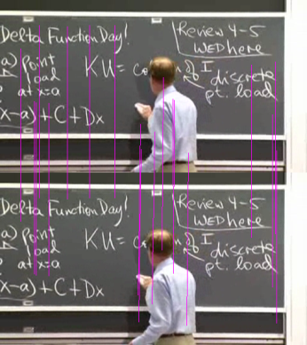
Overview
Algorithm takes 3 steps:
Point correspondence
Homography estimation
Video reproduction using transformed coordinates

Slide 5
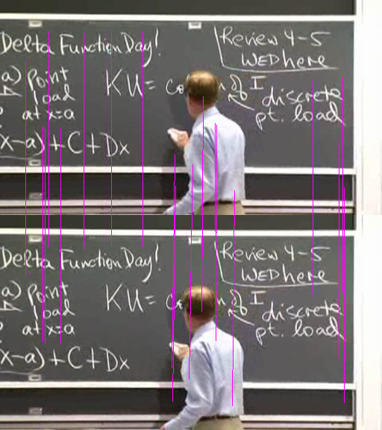
Point Correspondence
Goal: Find point correspondences between two images
Points will be used to
estimate camera
movement

Slide 6
Point Correspondence
Kanade-Lucas-Tomasi
Results were not satisfactory
Sequences with movement had around 10 matches
SIFT: Scale-invariant feature transform
Much better performance

Slide 7
Homography Estimation
Estimate a matrix that maps the points in one image to the points on the other
Simple least squares approach lead to problems

Slide 8
Homography Estimation
RANSAC

Slide 9
Video Reproduction
Inverse of the homography is used to transform the camera

