Slide 1
Finding best London borough for Indian Restaurant
Jyoti Kumar

Slide 2
Introduction
London has huge variety of restaurant for every taste and thus to start restaurant business may not be an easy task.
Our stakeholder would like to open an Indian restaurant with middle-high level price.
There are many criteria which affect the decision to select the location for restaurant to maximize revenue.
In this project we perform basic analysis to chose most optimum borough in London for opening an Indian restaurant.
The analysis is purely based on the population, density of current restaurants and income per person in the borough.

Slide 3
Data acquisition and cleaning
Data related Net income per person, population, population density and Asian community population for each borough was sourced from London datastore https://data.london.gov.uk/dataset/
Coordinates of all the borough in London was sourced from Wikipedia https://data.london.gov.uk/dataset/land-area-and-population-density-ward-and-borough
Number of restaurants and Indian restaurants within certain radius of each borough was sourced using Foresquare API.
All the relevant data from each source was combined in one dataframe, which required cleaning, formatting and harmonizing from each source.
Cleaned data has 32 rows (for each borough) and 10 columns.

Slide 4
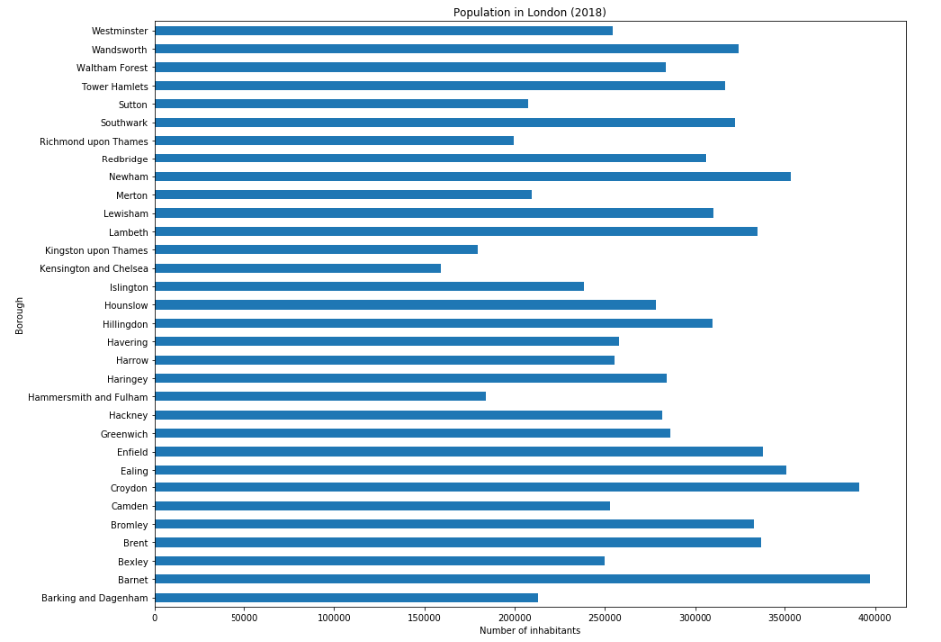
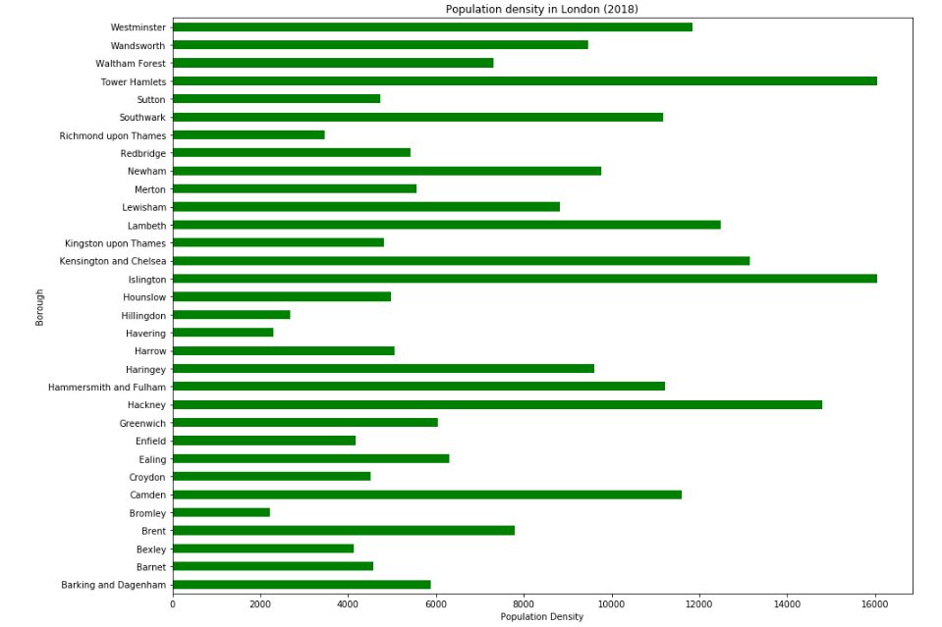
Exploratory Data analysis - population
Simple bar chart of population data reveals that even if the most populated borough is Barnet the population density in that borough is only average as the area of this borough is really large. The most densely populated borough on the other hand is Tower Hamlets and Islington.

Slide 5
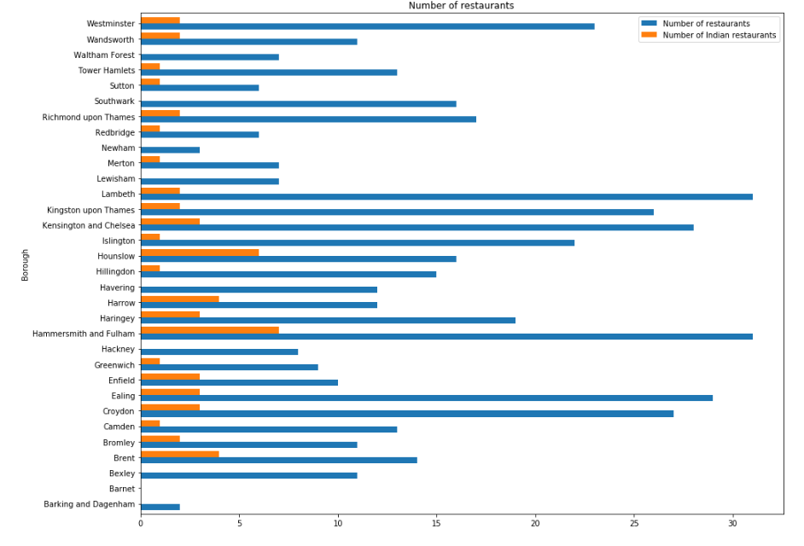
Exploratory data analysis - Restaurants
Simple bar chart analysis on number of restaurant gives some idea how these are distributed over different boroughs.
Hammersmith and Fulham clearly have large number of restaurants as well as good proportion of that are Indian restaurant.
On the other hand Westminster doesn’t have enough proportion of Indian restaurant

Slide 6
Cluster Analysis
Two cluster analysis was performed
First using total population
Second using Asian population only
To identify groups (clusters) with similar characteristics, the unsupervised learning method to our data, namely K-Means algorithm, was applied to our data.
The strategy was to compare the result and the common set from optimum clusters of two analysis might be the most optimum borough.

Slide 7
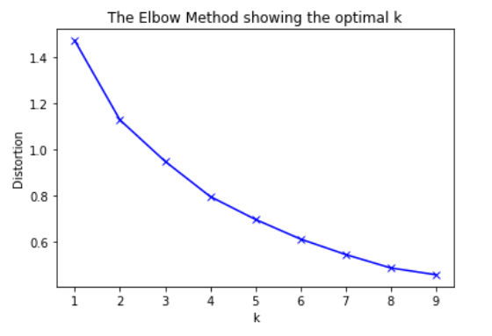
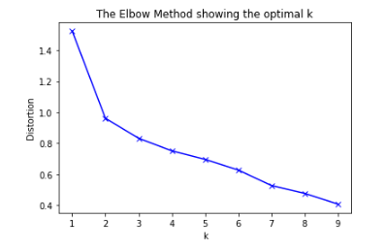
Cluster analysis – No of clusters
To identify the optimum number of clusters the elbow method was used
When doing analysis using total population 3 clusters were used whereas only 2 clusters were used when doing analysis using Asian population only
Using total population
Using Asian population only

Slide 8
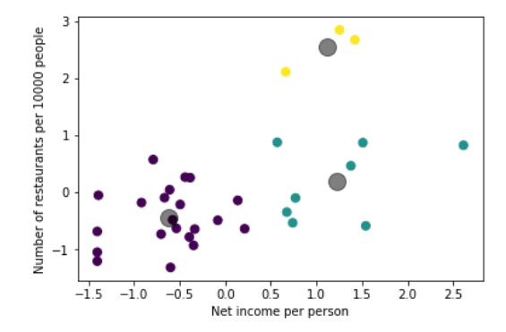
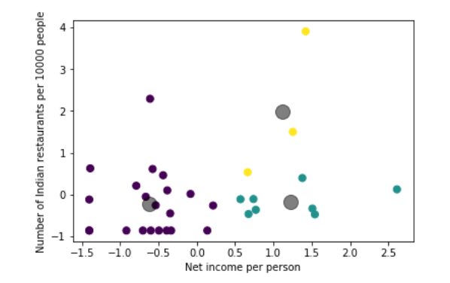
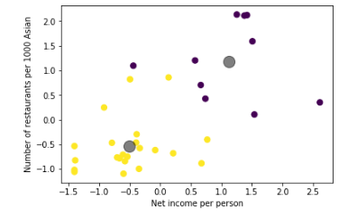
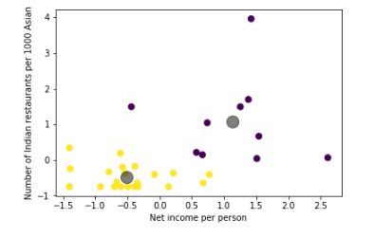
Custer analysis - Result
Restaurant density vs Net income
Indian Restaurant density vs Net income
Scatter plot has been shown. Grey color shows the center of cluster.
Using total population one cluster is clearly an outlier which has high number of restaurants. Out of these one also has high number of Indian restaurants.
Both analysis shows there is good number of boroughs in a cluster where income is high but restaurant density is not so high, especially Indian restaurant. Our target should be these clusters.
Using total population
Using Asian population only

Slide 9
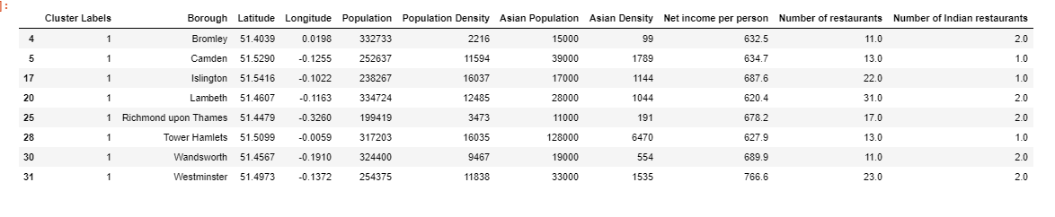
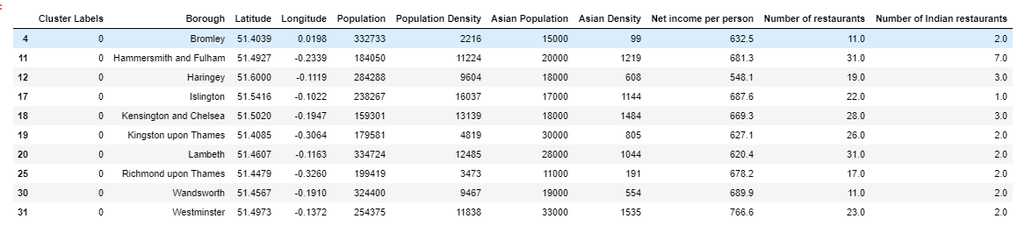
Cluster analysis – Optimum cluster
Using total population
Using Asian population only
Common set of boroughs from the two analysis are Bromley, Islington, Richmond upon thames, Wandsworth and Westminster, out of this Wandsworth and Westmisnter can be most attractive due to high value of income per person.

Slide 10
Conclusion and further direction
Based on the analysis Westminster & Wandsworth were chosen the most attractive option.
Further analysis can also be done on other Boroughs in the common set defined from two analysis based on other factors such as distance to city center etc.
Once borough is selected deeper analysis can be done to find the best exact restaurant location in that borough taking into account factors such as number of parking places in the vicinity etc.
Foursquare doesn’t represent the full picture as many venues are not listed, so another map such as Google map or Openstreetmap may provide more insights.
Also Borough have complex geometry and doing analysis based on radius from center might have missed some key venues and prone to error. This can definitely be further improved.

