Slide 1
Human Body Concept Map
Fundamentals of Human Nutrition
Dr. Kristina von Castel-Roberts
University of Florida

Slide 2
Overview: Human Body Concept Map
The central concepts for the project:
  Macronutrients
  Micronutrients
  Metabolism
  Malnutrition
You will build your map over time by using the main topic of the week to augment your Human Body Concept Map and align any branches and sub-branches for each week’s additions to the overall map. Some weeks you might be adding branches and sub-branches for multiple central concepts.
The next slide provides a model for the project.
You are what you eat

Slide 3
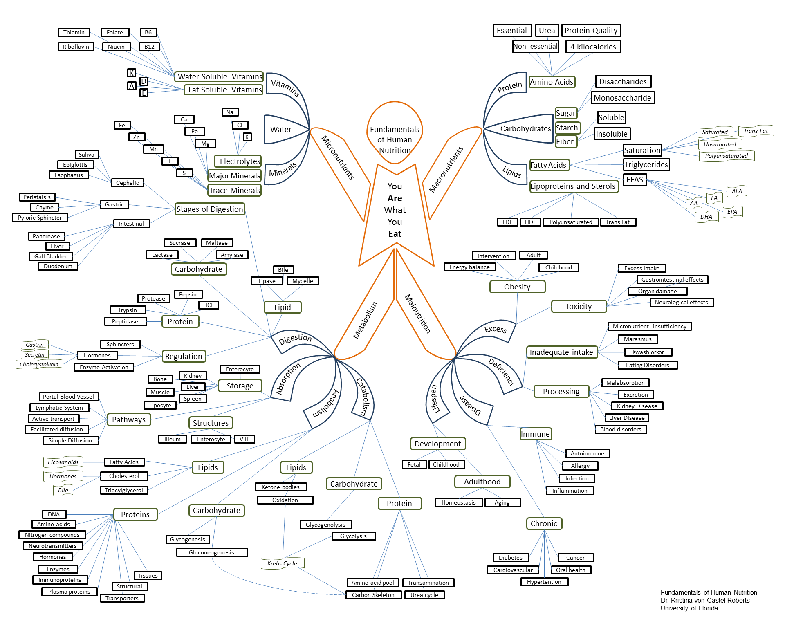
Model: Human Body Concept Map

Slide 4
Directions: Human Body Concept Map
Copy and paste the shapes from this page onto your Human Body Concept Map as you build your design each week.
Add text boxes, additional shapes and lines, and other details to your design to develop the visual and textual connections among the central concepts, primary branches, and sub-branches.

Slide 5
- potassium
- fiber
- calcium
- vitamin D
- vegetables
- fruits
- whole grains
- dairy
More
Fat & Sugar
Meat & bean
Milk
Fruit
Vegetable
Grain
- sodium
- saturated fats
- added sugar
- refined
grains
Less
Macro nutrients
Micro nutrients
- carbohydrates
- lipids
- proteins
- vitamins
- minerals
energy
- water

