Slide 1

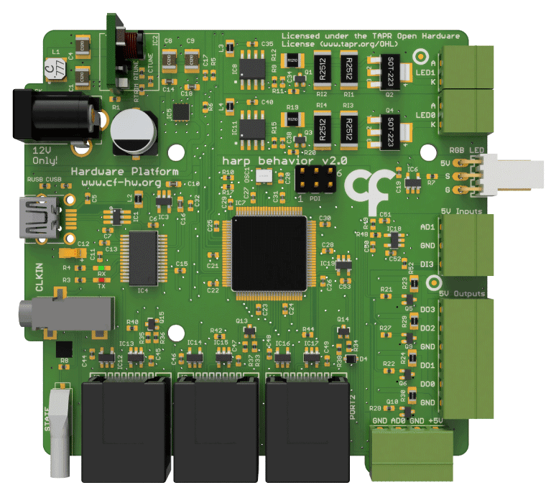
Bonsai
Reactive
LED0-1
LED Colored
AD1
DI3
Servos2-3
Camera0-1
DO0-3
PWM0-3
DI0-2
Poke0-2
AD0

Slide 2
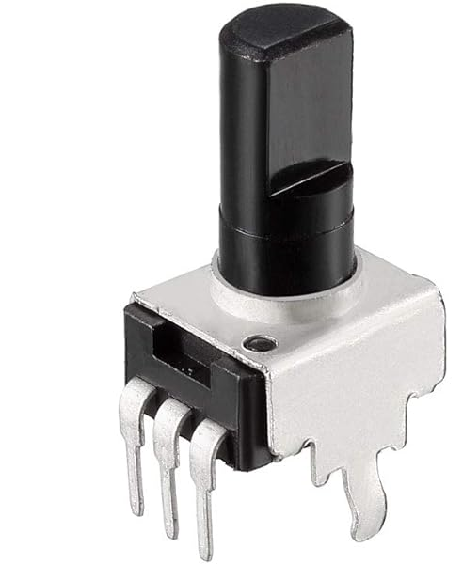
AD0

Slide 3
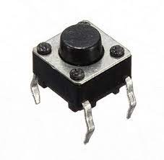
DI3

Slide 4
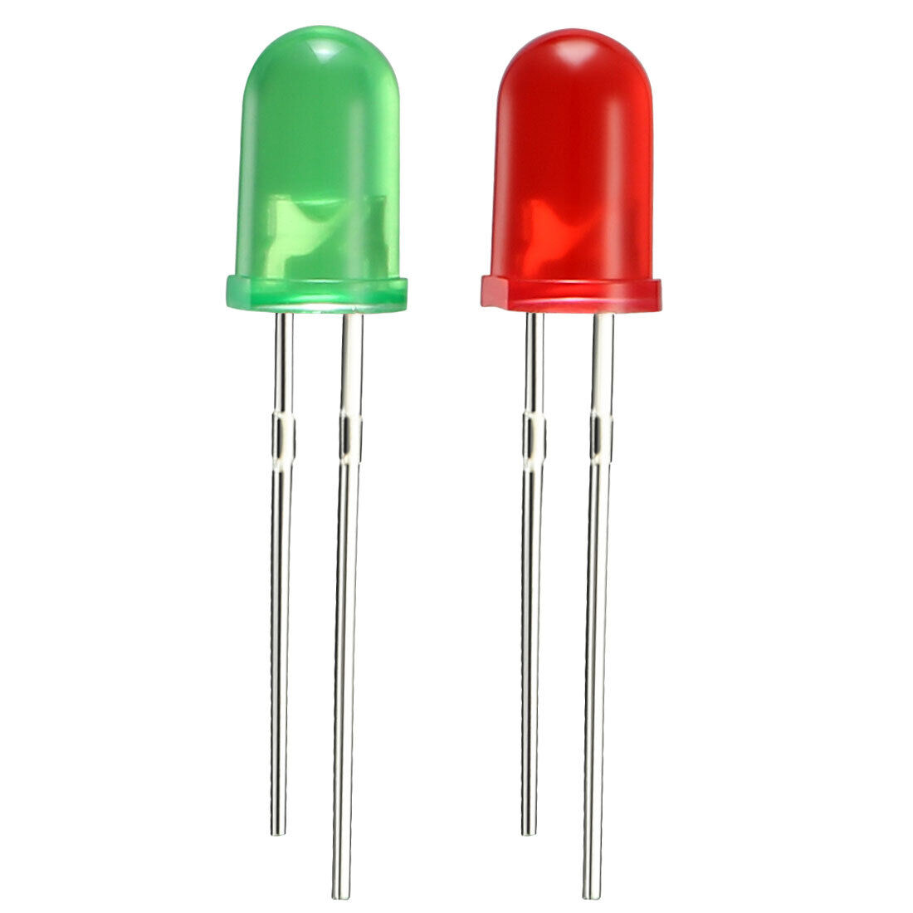
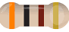
DO0

Slide 5
LED0

Slide 6
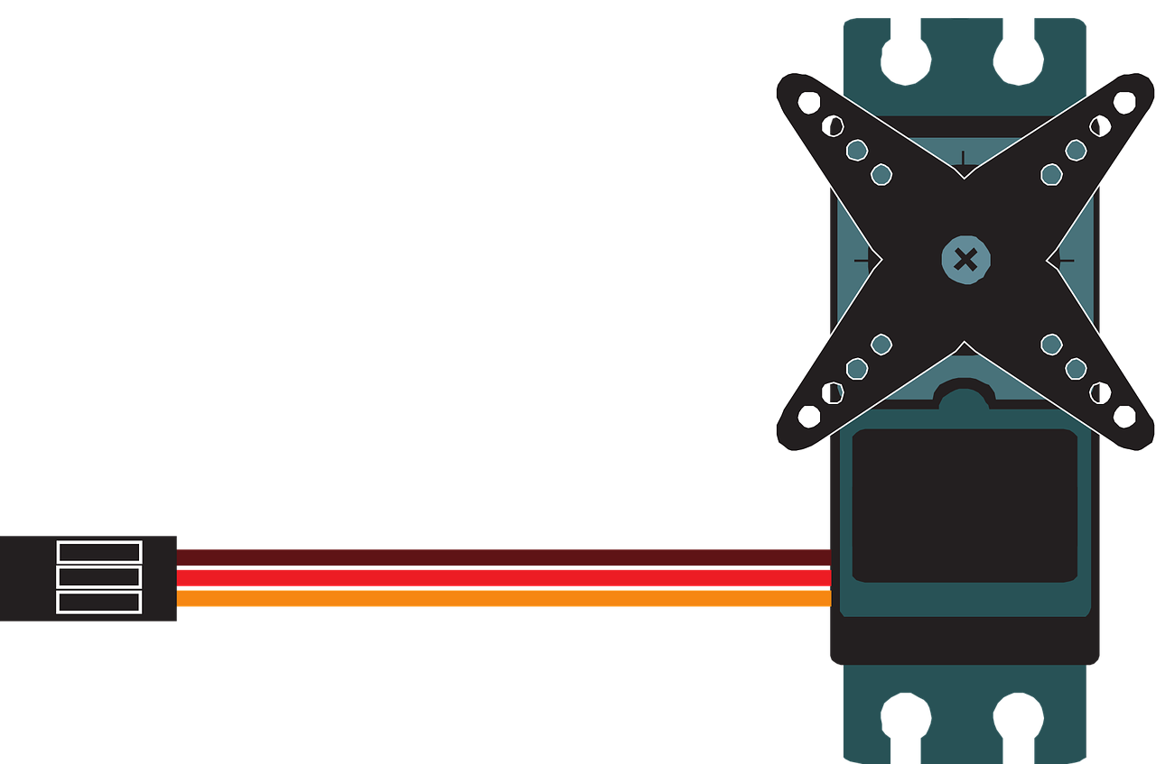
DO2

Slide 7
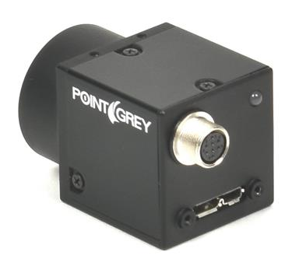
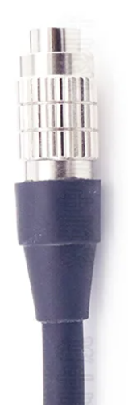
DO0

Slide 8
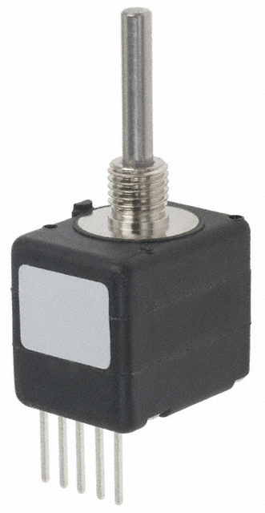
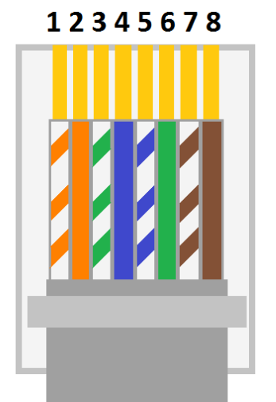
Port2
-
B
+
A

Slide 9

HARP
Digital inputs
DI3

Slide 10
HARP
Digital outptus
LED1
LED0
PWM1
DO0

Slide 11
HARP
PWM Outputs: Servo motors
Servo2

Slide 12
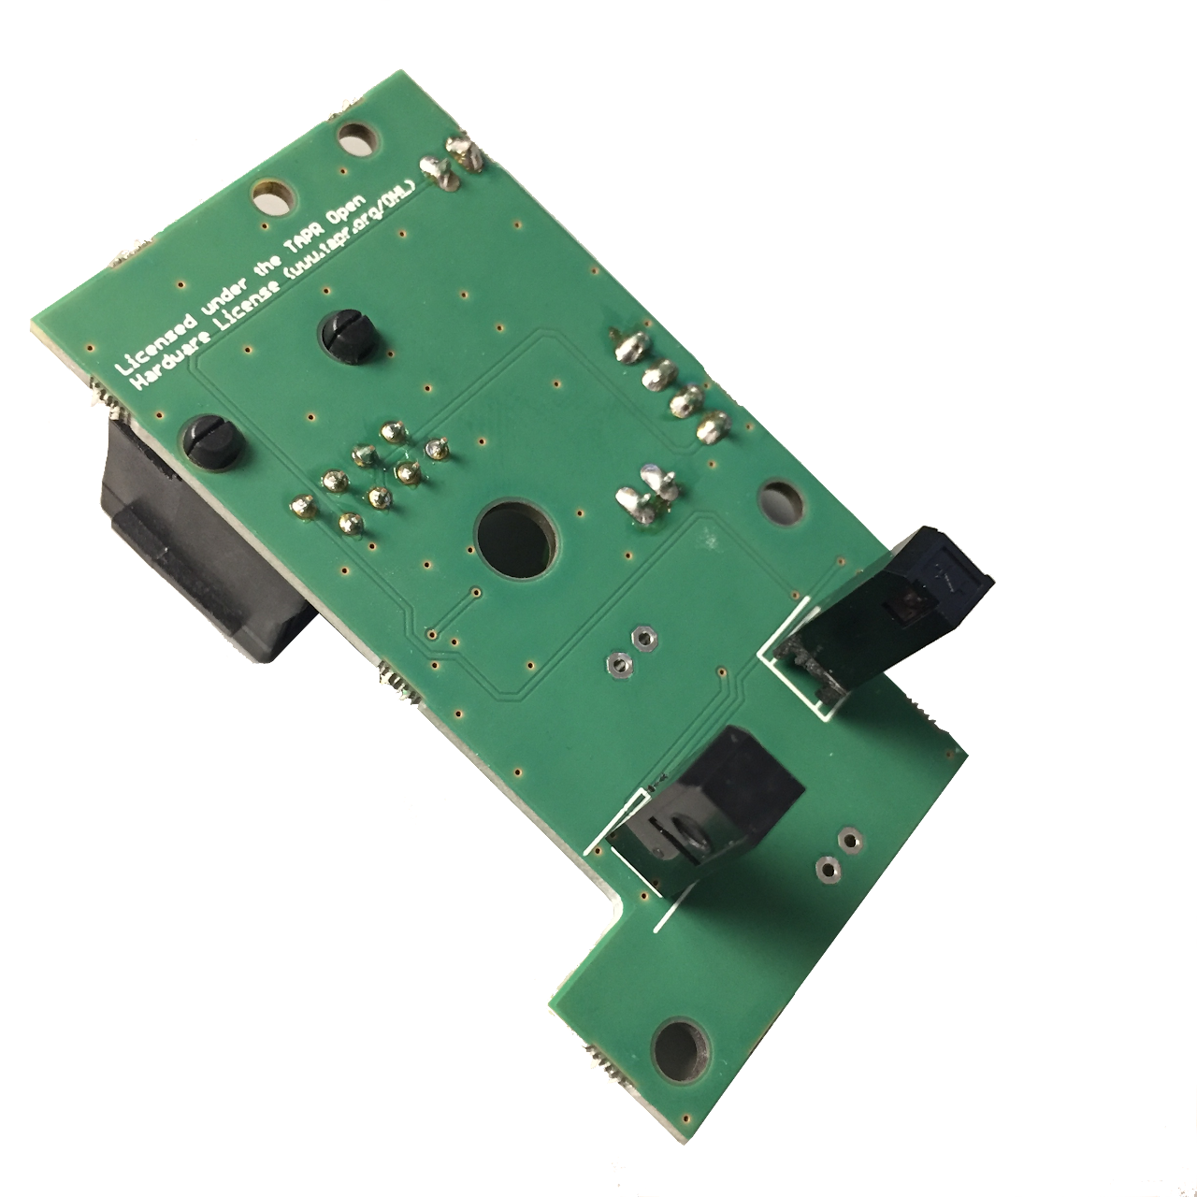
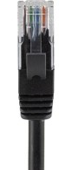
HARP
Digital inputs
DI3
DI0-2
Poke0-2

Slide 13
HARP
PWM outptus
What is the current in these ports?
DO0-3
PWM0-3

