Slide 1
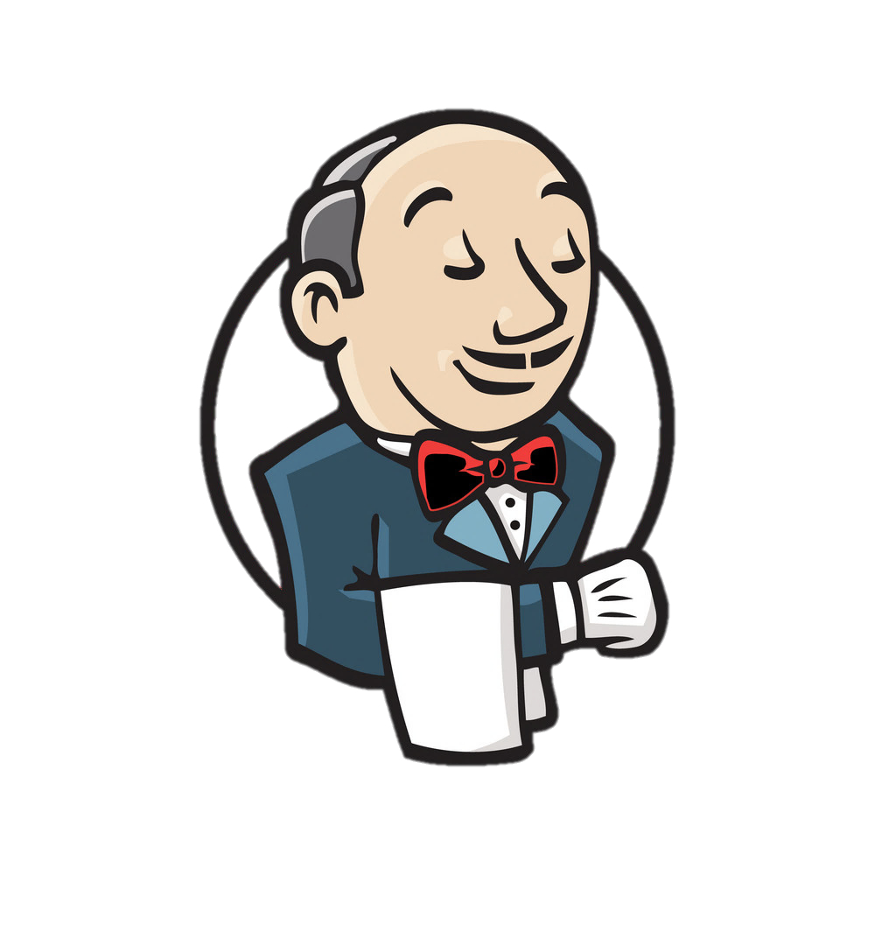

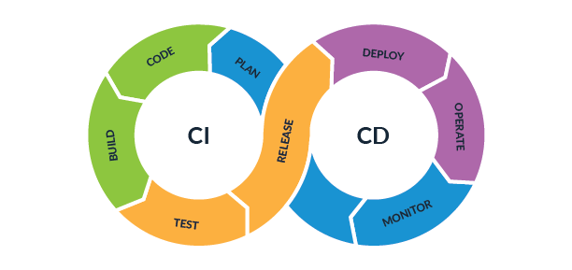
CODING
DOJO
Jenkinsfile

Slide 2
Prerequisites
Ensure you have access to and cloned this github project https://github.com/fchastanet/coding_dojo_jenkins
Run docker pull commands found in README.md
Run setup.sh
Then docker-compose up –d command
Before we begin
Notes:
While you’ll listen to my explanations
Ensure you have access to and cloned this github project in your wsl environment
https://github.com/fchastanet/coding_dojo_jenkins
Don’t forget a git pull if you cloned this repository before this meeting
Ensure you run the specified docker pull commands specified by the README.md file present in this repository
Please do not forget to run the setup.sh that allows to setup a ssh key(don’t worry, not your home ssh key, just a local one dedicated to this project).
This ssh key will be used to let Jenkins controller to talk with the Jenkins agent, I will explain this concept later in the presentation.
Then run the docker-compose up –d command to let the Jenkins server have the time to completely load.

Slide 3
What is a Coding Dojo ?
Programming challenge
Acquire skills
Collaborative, non-competitive, fun
Open to all skill levels
Pair-programming and TDD
Notes:
PROGRAMMING CHALLENGE
Coding dojos are events where we meet altogether to work on a specific programming challenge.
The objective of the session is to solve a problem so that every attendant feel comfortable enough to replicate the solution afterwards
ACQUIRE SKILLS
During these events, we are focusing on skills acquisition, preferably in a continuous process. So we hope this session will be the first of a long series.
We want to help spreading technical knowledge, tips and tricks and share best practices.
COLLAB. NON-COMPET, FUN!!
Dojos are collaborative sessions, where we work together, in a non competitive environment.
We want them to be fun moments to spend with colleagues, to try and learn new things
OPEN TO ALL
Therefore it’s opened to every skill levels. Everyone is welcomed in the sessions, to find a master, understand better something difficult, and then become a master.
KATAS
Sessions are played around Katas, like martial arts.
Katas are exercices (from simple to complex), that we can try to complete in order to learn something.
You didn’t understand yet? No pb, just do it again to improve.
PAIR & TDD
Katas are usually driven by some of the fundamental agile principles like pair-programming and TDD
Note however, even if I found that it is possible to do Test Driven Development with Jenkinsfile, it has not been implemented due to personal lack of experience and not used PL level.

Slide 4
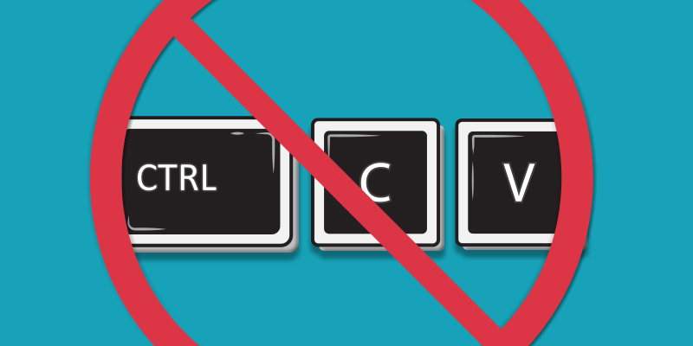
Why not using copy paste ?
Better learning ROI
We learn better by making mistakes
Makes your 2 hemispheres be connected
Kata
Notes:
What I will say could be obvious for some of you, or even have non sense at all, but just try even if you do not believe me.
So why not using copy/paste ?
(*) Typing code instead of copy-pasting provides a better learning Return On Investment, mostly because we’re practicing instead of just reading.
(*) By typing code, you will probably do some mistakes (syntax error for example), and most of the time, by making mistakes we better learn.
(*) By typing code, you are thinking and acting at the same time, making your brain more attentive, attention is the key for a better understanding.
(*) Finally, it is really the principle behind the Kata, reproduce the movement until you master it

Slide 5


Exercices
Jenkins
Basics
1 – Python basics
2 – Connecting to a database in Python
3 – My First API with Flask
Notes:
Let’s first see a small introduction, no more than 10 minutes to better understand what is jenkins and how it works

Slide 6
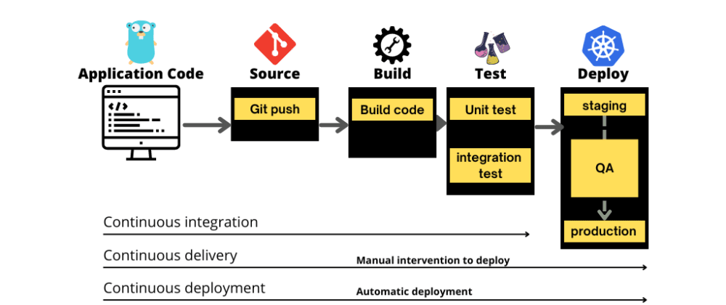
What is Jenkins ?
Jenkins is a Continuous Integration(CI)/Continuous Deployment(CD) tool
Notes:
Continuous integration is focused on automatically building and testing code,
as compared to continuous delivery, which automates the entire software release process up to production.
A Jenkins pipeline will usually start from a code commit, do the build, test, and deployment to different environments that could include production one.

Slide 7
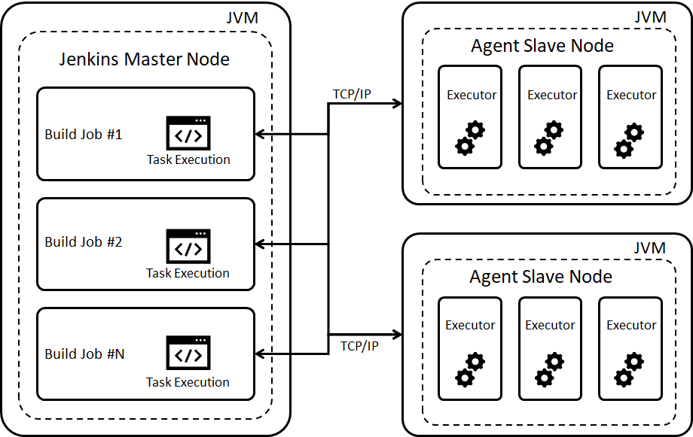
How does Jenkins work ?
Architecture: Master/Slave
Notes:
Let’s see quickly how Jenkins work
(*) The Jenkins controller is the master node
(*) which is able to launch jobs
(*) on different nodes (the term node refers to a machine) directed by an Agent.
(*) The Agent can then use one or several executors to execute the job(s) depending on configuration.
It’s important to note that the master node is the coordinator that is able to launch jobs on nodes.

Slide 8
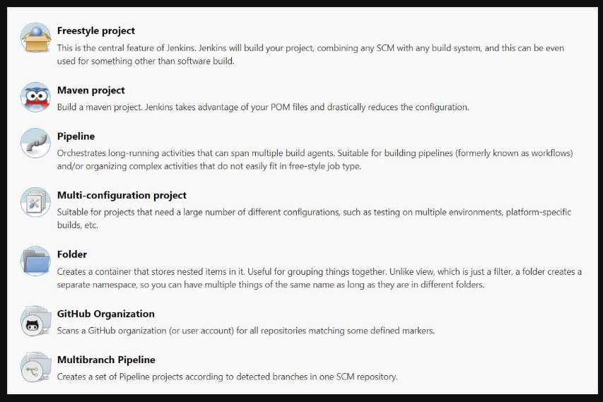
What is a job ?
Notes:
Jobs are the heart of Jenkins's build process. A job can be considered as a particular task to achieve a required objective in Jenkins.
There is several kind of jobs that can be run in Jenkins.
You have the ability to create freestyle project that allows you to create a pipeline using the UI but it is not recommended.
(*) We will see instead during this coding dojo how to create a Jenkins pipeline also known as pipeline as code.
We can specifically mention here the Github Organization job that is responsible to scan the User’s GitHub account for all repositories matching some defined markers.

Slide 9
How does this coding dojo configuration work ?
Architecture: Master/Slave
docker service
Jenkins service
jenkins-agent
mail-catcher
docker-registry
Notes:
In this coding dojo, we simulate those machines by docker containers
(*) Jenkins service that represents the Jenkins controller that is able to provide the UI (web interface from which you will configure your jobs)
(*) a docker agent to allow building docker images and launching docker containers using a specific docker jenkins plugin
(*) a Jenkins agent from which most of the coding dojo builds will rely on that is also able to run docker in another way and lint Dockerfiles
(*) Finally 2 other services allowing to simulate sendmail server with a UI and a local docker registry

Slide 10
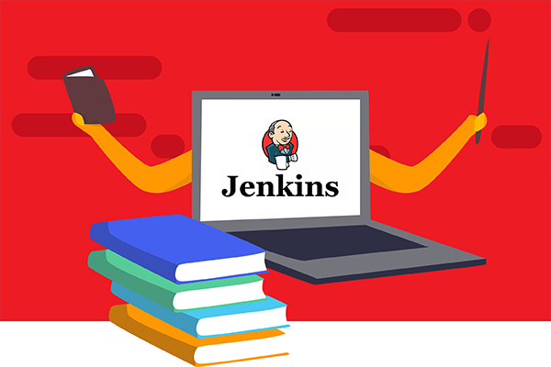
Exercices
Exercise 1 : your first pipeline based
on a simple Jenkinsfile
Exercise 2 : a second pipeline
with some advanced usage
Exercise 3 : a third pipeline that will
build/test/deploy a js project
1 – Python basics
2 – Connecting to a database in Python
3 – My First API with Flask
Notes:
This is the end of this small technical introduction, now keep prepared to get your hands dirty.
This Coding dojo session will send you on a three exercises journey.
(*) First exercise: discover how to create a simple pipeline.
(*) The second exercise will teach you some more advanced usage and an introduction to docker plugin.
(*) The third exercise will show you how to build a complete jenkins pipeline able to build, test and deploy a javascript project.
Finally, if it is too easy for you and you are curious, just check how the docker-compose stack has been designed to run this project. There is some additional ressources that you can check in the README.md.

Slide 11
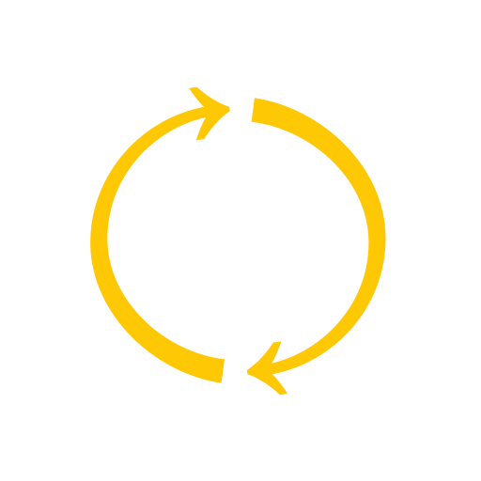
How does it work?
You will be broken into pairs
You will have 40 minutes on the room
After the 40 minutes session we call you back to this room and we discuss
Notes:
So how does it work
You will be broken into pairs in different teams rooms
You will have 40 minutes on the room.
During this time, your facilitators and I will navigate through the rooms to check if you need help during the exercises.
After the 40 minutes session we call you back to this room and we discuss

Slide 12

Let’s go!
You will be switched in your breakout rooms for the first exercise
Notes:
Let’s GO !
You will be switched in your breakout rooms for the first exercise
---------------------------------------------
Set 40 minutes timer
Adjust sessions depending on affluence, timezone and availability of moderators.
Duration of the session: 3.5 hours.
The idea is to have one breakout for one exercise, but people can decide to continue on the same exercise, depending on their own knowledge.
Example:
10 minutes - Presentation (keep it short to don t lose people)
40 minutes - First breakout session
5 minutes - Regroup (people do not like to be interrupted)
40 minutes - Second Breakout Session
5 minutes - Regroup
15 minutes - Coffee Break
40 minutes - Third Breakout Session
5 minutes - Regroup
35 minutes - Fourth Breakout Session
15 minutes - Close Coding Dojo (time for questions, Say thanks and share the feedback survey)

Slide 13



Groovy Single quoted string
Related documentation: https://groovy-lang.org/syntax.html#all-strings
No need to escape single and double quotes
String concatenation
Notes:
Jenkinsfile is using groovy language which is a script language derived from Java.
Let’s see some ways to create strings in groovy language
(*) Example of a single quoted string
(*) Example of a single quoted string with a single quote inside that needs to be escaped
(*) Triple single quote allows to write multi lines string, you can write single quote inside this string without the need to escape it
(*) Use the + operator to concatenate strings

Slide 14

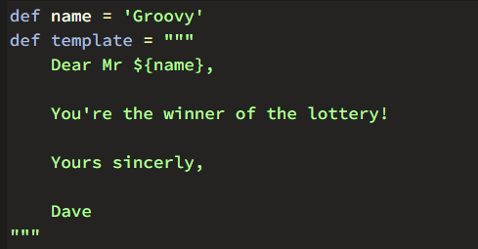
Groovy String and interpolation
Related documentation: https://groovy-lang.org/syntax.html#all-strings
Notes:
String interpolation (or variable interpolation,) is the process of evaluating a string literal containing one or more placeholders,
(*) Here the name variable will be replaced by Guillaume string during interpolation
(*) Triple double quotes allows to write multi lines string, you can write single quote or double quotes inside this string without the need to escape it

Slide 15
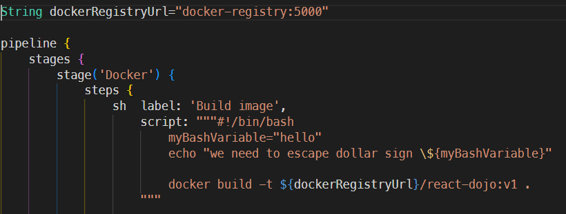
String interpolation tricky example
Related documentation: https://groovy-lang.org/syntax.html#all-strings
Notes:
Here a little tricky example that we are often using in Jenkinsfiles
In this example myBashVariable is a local variable inside the shell script
If we want to display this variable, we must escape the dollar sign, otherwise groovy would try to interpolate a groovy variable called myBashVariable which would result to a runtime error
On the other hand, the variable dockerRegistryUrl value will be replaced during string interpolation

Slide 16

Dojo Retro
Notes:
I hope you enjoyed this coding dojo
How do you feel ?
What did you achieved ?
What is difficult ?
Were the exercises well explained ?
Before closing this coding dojo
Please provide your feedback using the following form
And I would like to thank warmly all the craftsmanship community and all the persons involved in the preparation of this coding dojo
and particularly {helpers name} for the thoroughly tests and code reviews and {helpers name} for the communication, registrations and facilitation.

