Slide 1
Algorithm Efficiency
The Art of Counting
Week 2 / Lecture 1
Franck Chauvel
Axbit & NTNU
franck.chauvel@ntnu.no

Slide 2

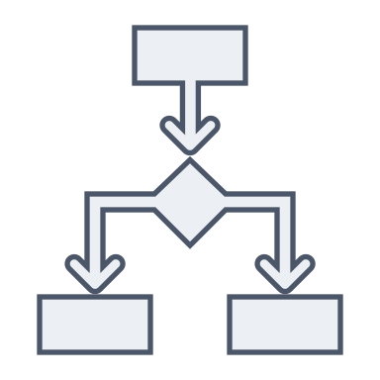


Correctness and Efficiency
Programs
Algorithms
Problems
correctness
Algorithm 1
efficiency
Algorithm 2

Slide 3
Which One Would you Choose?
#include <stdio.h>
#define LIMIT 100
int main(int argc, char** argv) {
int sum = 0;
for (int any_integer=0;
any_integer <= LIMIT ;
any_integer++) {
if (any_integer % 2 == 0) {
sum += any_integer;
}
}
printf("Total: %d\n", sum);
}
LIMIT = 100
half = LIMIT / 2
total = half * (half + 1)
print(f"Total: {total}")

Slide 4
Which one Would you Choose?
start
sum ← 0
start
tmp ← n/2
each ← 0
each ≤ limit
[no]
sum ← tmp*(tmp+1)
stop
[yes]
[no]
end
each ← each + 1
each % 2 = 0
[yes]
sum ← sum + each

Slide 5
Agenda
Resources: Time and Memory
Measuring Time
Cost Model
Frequency Count
Measuring Memory
Example

Slide 6
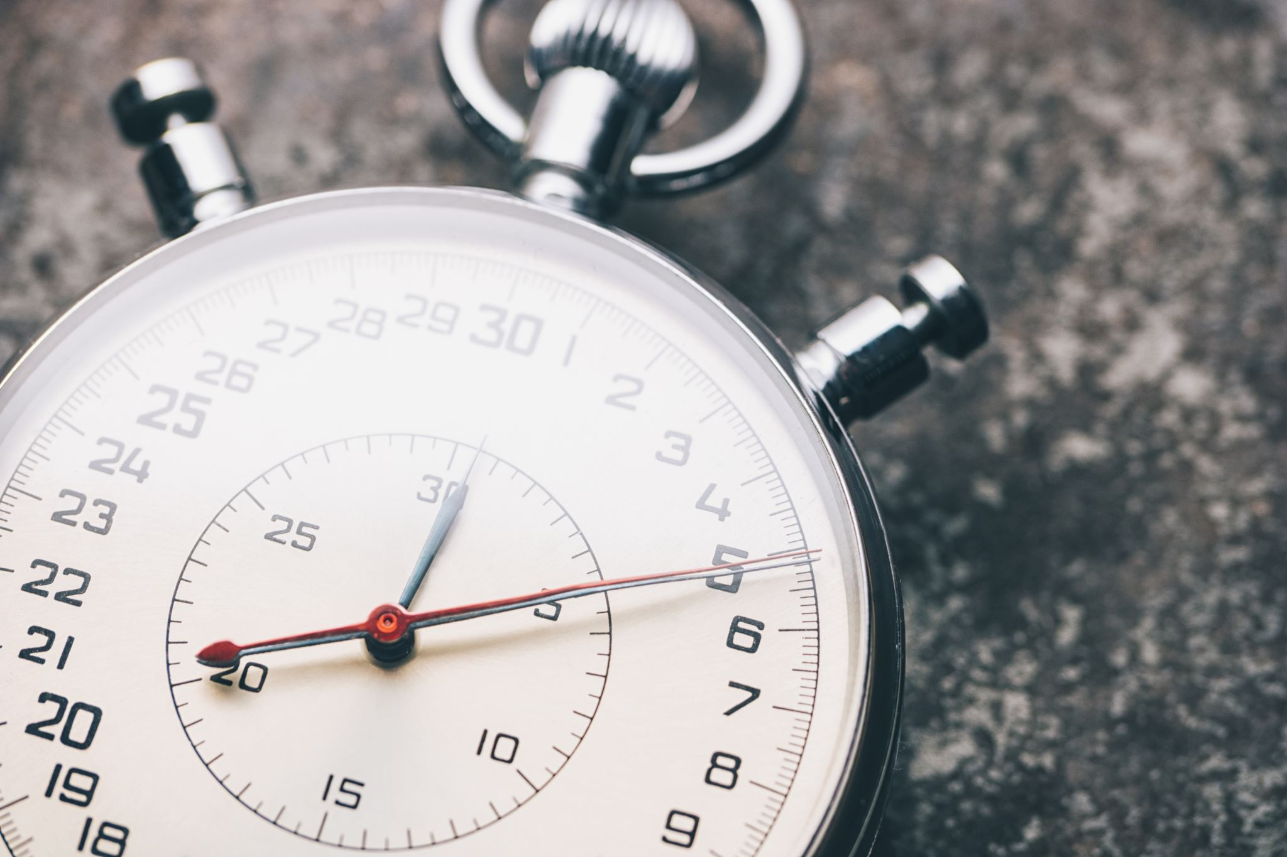

Runtime & Memory
The two things that matters (here)

Slide 7
Runtime

Slide 8
Measuring Runtime
Performance testing
Many runs + statistics
Describe executors/programs more than algorithms!
$ time ./a.out
Total: 2550
./a.out 0.00s user 0.00s system 63% cpu 0.002 total
Macbook Air
Apple M1 8 cores
MacOS 11.3
Python 3.9.5
Apple C-Lang 12.0.5
$ time python3 sum.py
Total: 2550.0
python3 sum.py 0.01s user 0.01s system 42% cpu 0.046 total

Slide 9
Counting Steps
segment: data
limit 1 100
half 1 0
divisor 1 2
increment 1 1
total 1 0
segment: code
load 0
add limit
div divisor
store half
add increment
mul half
store total
print total
LIMIT = 100
half = LIMIT / 2
total = half * (half + 1)
print(f"Total: {total}")
4
+ 3
+ 1
8

Slide 10
Cost Model
segment: data
limit 1 100
half 1 0
divisor 1 2
increment 1 1
total 1 0
segment: code
load 0
add limit
div divisor
store half
add increment
mul half
store total
print total
Code | Mnemonic | Parameter | Cost
1 | LOAD | value | 1
2 | ADD | address | 1
3 | SUBTRACT | address | 1
4 | STORE | address | 1
5 | JUMP | address | 1
6 | READ | address | 1
7 | PRINT | address | 1
? | HALT |  | 1
 | MUL | address | ?
 | DIV | address | ?
cost(load)
+ cost(add)
+ cost(div)
+ cost(store)
+ cost(add)
+ cost(mul)
+ cost(store)
+ cost(print)
8

Slide 11
Takeaway
The cost model defines how long every instruction takes.

Slide 12
What about Loops Counting Steps
#include <stdio.h>
#define LIMIT 100
int main(int argc, char** argv) {
int sum = 0;
for (int any_integer=0 ;
any_integer <= LIMIT ;
any_integer++) {
if (any_integer % 2 == 0) {
sum += any_integer;
}
}
printf("Total: %d\n", sum);
}
#include <stdio.h>
#define LIMIT 100
int main(int argc, char* argv[]) {
int sum = 0;
int any_integer = 0;
while (any_integer <= LIMIT) {
if (any_integer % 2 == 0) {
sum = sum + any_integer;
}
any_integer = any_integer + 1;
}
printf("Total: %d\n", sum);
}

Slide 13
What about Loops Counting Steps
#include <stdio.h>
#define LIMIT 100
int main(int argc, char* argv[]) {
int sum = 0;
int any_integer = 0;
while (any_integer <= LIMIT) {
if (any_integer % 2 == 0) {
sum = sum + any_integer;
}
any_integer = any_integer + 1;
}
printf("Total: %d\n", sum);
}
Cost
Frequency
Total Cost
1
1
1
1
1
1
1
LIMIT+2
LIMIT+2
2
LIMIT+1
2*LIMIT+2
2
(LIMIT+1)/2
LIMIT+1
2
LIMIT+1
2*LIMIT+2
1
1
1
Grand Total:
6*LIMIT+10
610

Slide 14
Runtime Comparison
#include <stdio.h>
#define LIMIT 100
int main(int argc, char** argv) {
int sum = 0;
for (int any_integer=0;
any_integer <= LIMIT ;
any_integer++) {
if (any_integer % 2 == 0) {
sum += any_integer;
}
}
printf("Total: %d\n", sum);
}
LIMIT = 100
half = LIMIT / 2
total = half * (half + 1)
print(f"Total: {total}")
Time = 8
Time = 610

Slide 15
Memory
The other important resource

Slide 16
Measuring Memory
$ /usr/bin/time -l python3 sum.py
Total: 2550.0
0.04 real 0.01 user 0.01 sys
8257536 maximum resident set size
0 average shared memory size
0 average unshared data size
0 average unshared stack size
493 page reclaims
199 page faults
0 swaps
0 block input operations
0 block output operations
0 messages sent
0 messages received
0 signals received
110 voluntary context switches
16 involuntary context switches
102597177 instructions retired
44639544 cycles elapsed
4932640 peak memory footprint
$ /usr/bin/time -l ./a.out
Total: 2550
0.00 real 0.00 user 0.00 sys
1245184 maximum resident set size
0 average shared memory size
0 average unshared data size
0 average unshared stack size
81 page reclaims
4 page faults
0 swaps
0 block input operations
0 block output operations
0 messages sent
0 messages received
0 signals received
1 voluntary context switches
4 involuntary context switches
4562725 instructions retired
2047296 cycles elapsed
754456 peak memory footprint
7.8 MiB
1.18 MiB

Slide 17
Counting Memory Cells
segment: data
limit 1 100
half 1 0
divisor 1 2
increment 1 1
total 1 0
segment: code
load 0
add limit
div divisor
store half
add increment
mul half
store total
print total
5 cells
LIMIT = 100
half = LIMIT / 2
total = half * (half + 1)
print(f"Total: {total}")
8 instructions
16 cells (ignored)

Slide 18
Counting Memory Cells
#include <stdio.h>
#define LIMIT 100
int main(int argc, char* argv[]) {
int sum = 0;
int any_integer = 0;
while (any_integer <= LIMIT) {
if (any_integer % 2 == 0) {
sum = sum + any_integer;
}
any_integer = any_integer + 1;
}
printf("Total: %d\n", sum);
}
segment: data
limit 1 100
sum 1 0
any_integer 1 0
divisor 1 2
shift 1 1
segment: code
loop: load 0
add any_integer
subtract limit
jump done
load 0
add any_integer
mod divisor
subtract shift
jump skip
load 0
add sum
add any_integer
store sum
skip: load 1
add any_integer
store any_integer
load 0
jump loop
done: print sum
halt
5 cells

Slide 19
Memory Comparison
#include <stdio.h>
#define LIMIT 100
int main(int argc, char** argv) {
int sum = 0;
for (int any_integer=0;
any_integer <= LIMIT ;
any_integer++) {
if (any_integer % 2 == 0) {
sum += any_integer;
}
}
printf("Total: %d\n", sum);
}
LIMIT = 100
half = LIMIT / 2
total = half * (half + 1)
print(f"Total: {total}")
5 cells
5 cells

Slide 20


The Full Comparison
Runtime
Memory
Loop
610
5
Formula
8
5

Slide 21
Recap
Efficiency
Memory
CPU
Measuring describes programs
Just about counting
Runtime
Counting Instructions
Cost model cost(op) = 1
Arithmetic
Logic
Frequency count
Memory
Counting Variables / cells
Ignore code & inputs
Loops are expensive for runtime!

Slide 22
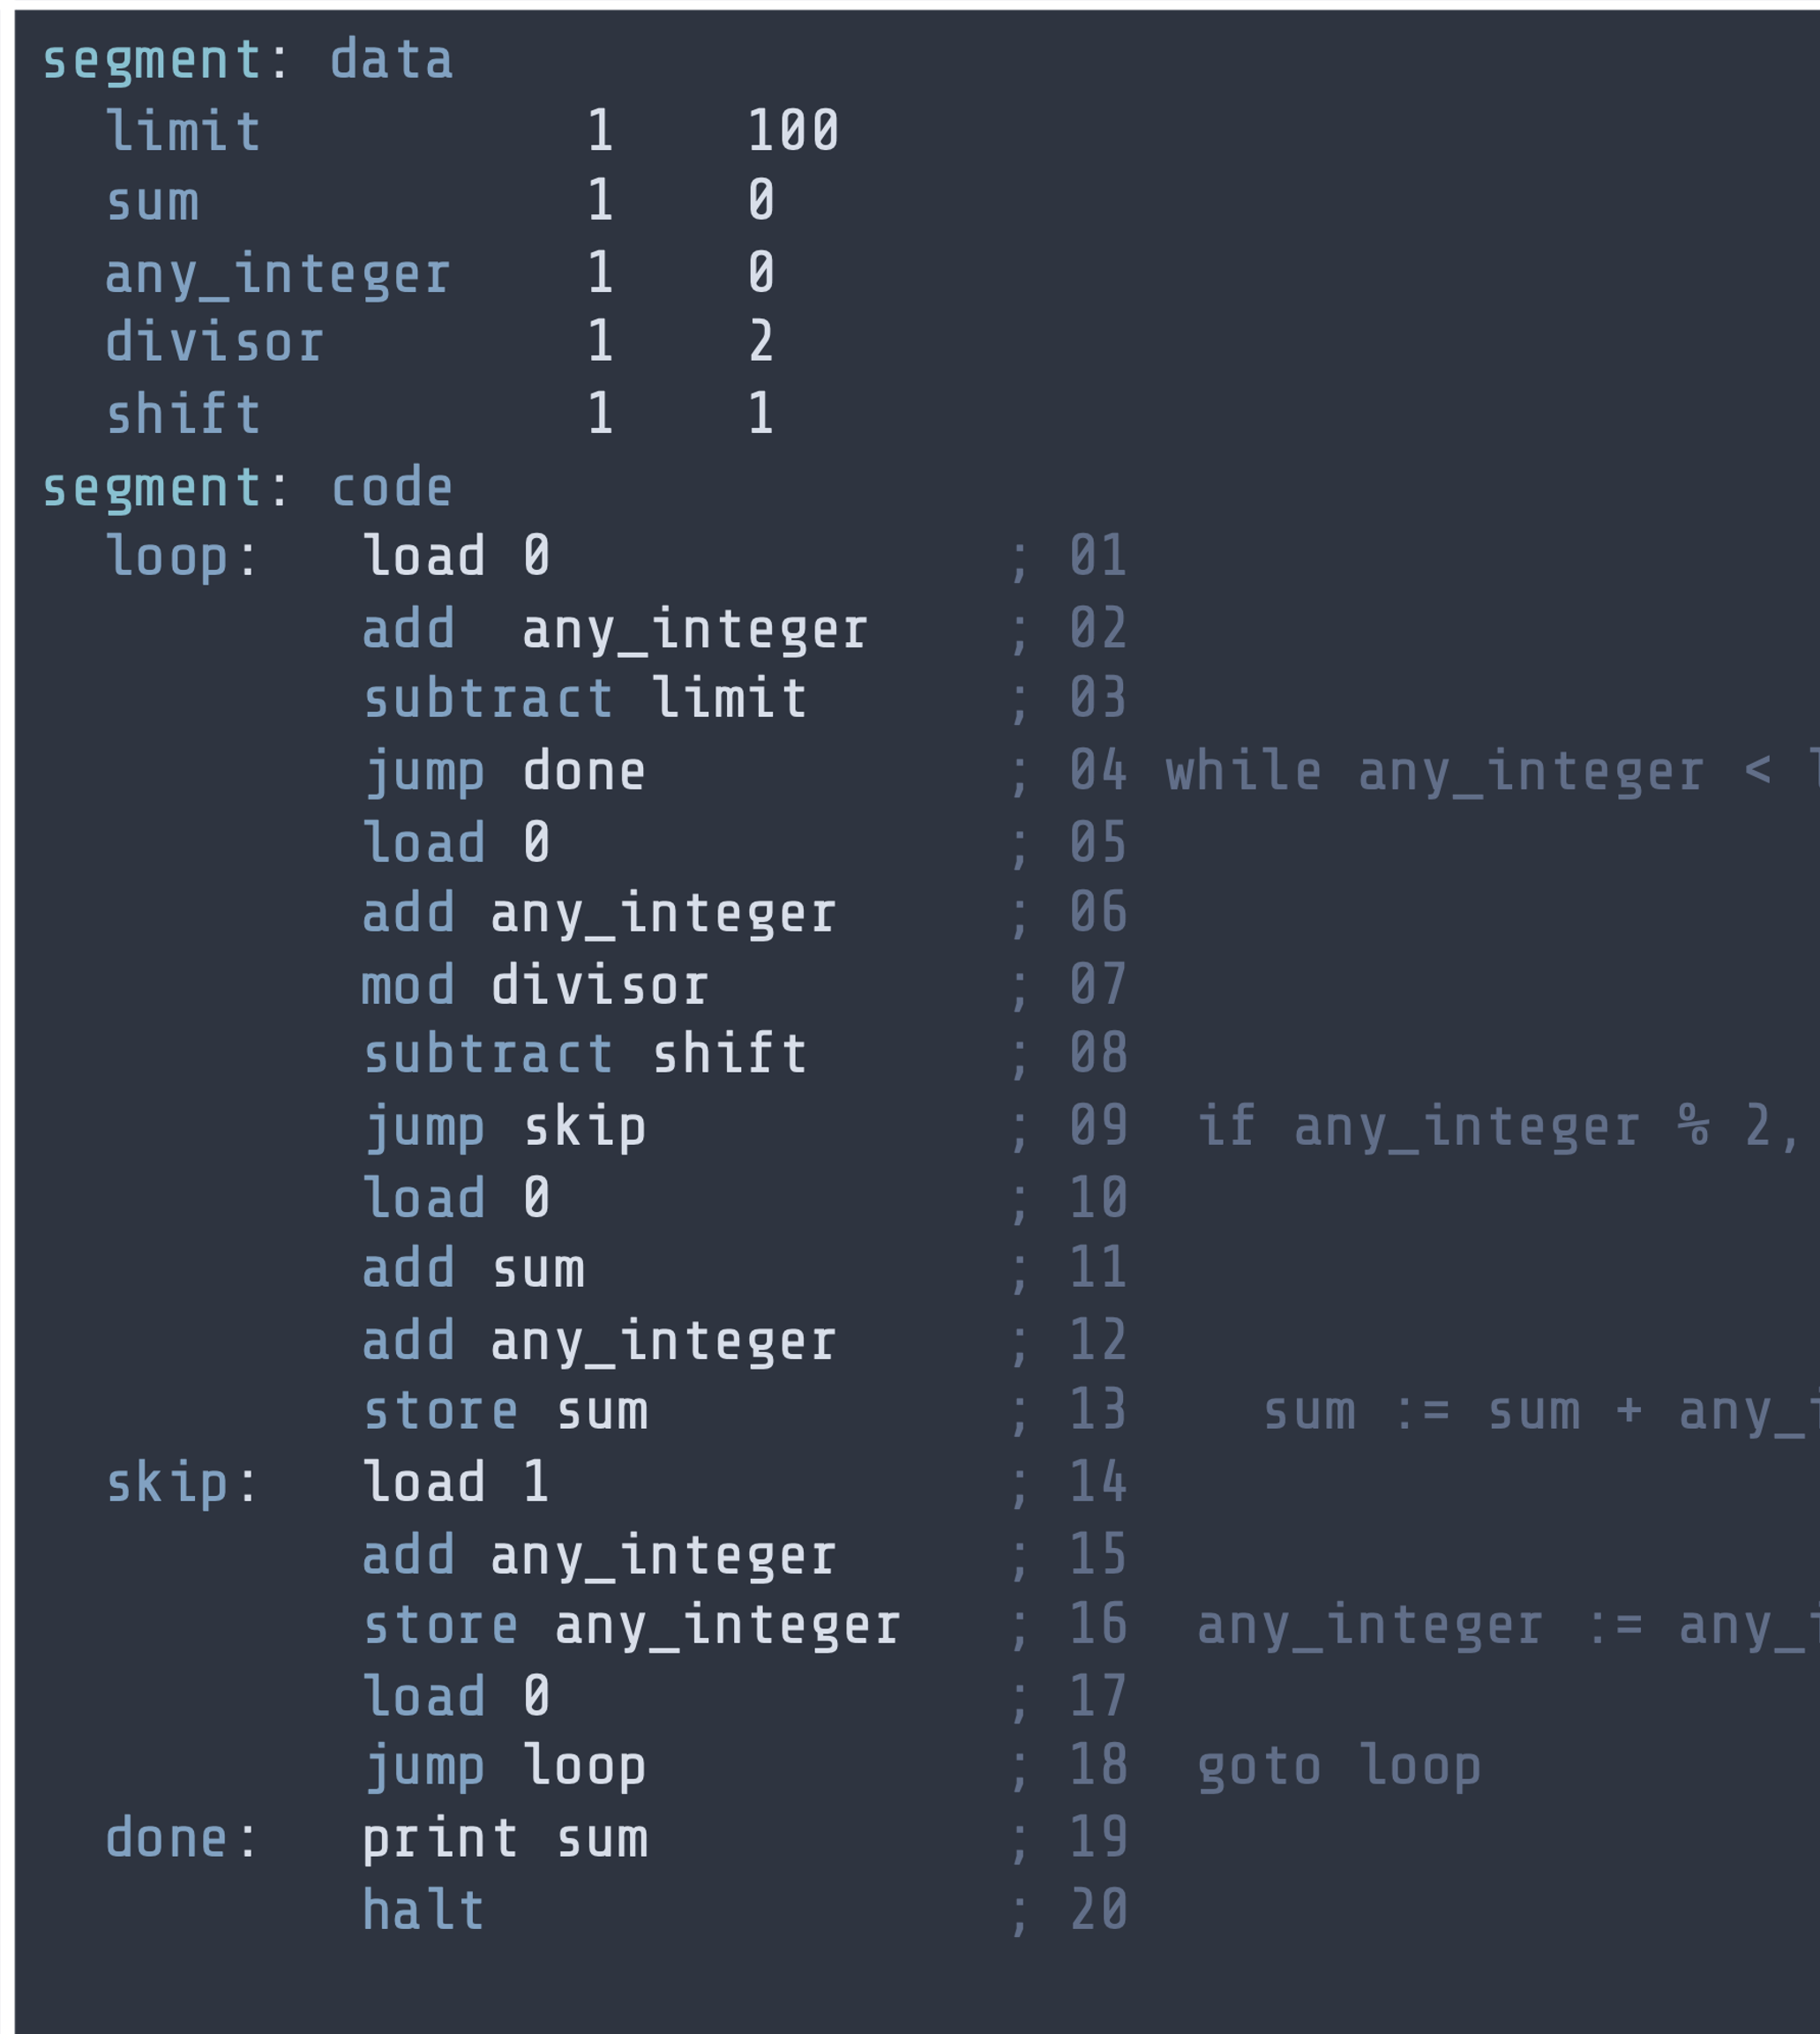
Lab Session
Runtime & Memory efficiency for small programs
On RAM assembly
On Pseudo-code

Slide 23
Adding Three Numbers Problem 1: Java
public static void main(String[] args) {
int total = 0;
Scanner input = new Scanner(System.in);
total = total + input.nextInt();
total = total + input.nextInt();
total = total + input.nextInt();
System.out.println("Total: " + total);
}
Runtime
Memory

Slide 24
Adding Three Numbers Problem 1
SEGMENT: data
value 1 0
total 1 0
SEGMENT: code
load 0
read value
add value
read value
add value
read value
add value
store total
print total
halt -1
Runtime
Memory

Slide 25
Maximum of Two Numbers Problem 2.1: Java
public static void main(String[] args) {
Scanner input = new Scanner(System.in);
int left = input.nextInt();
int right = input.nextInt();
int maximum = 0;
if (left < right) {
maximum = right;
} else {
maximum = left;
}
System.out.println("Maximum: " + maximum);
}
Runtime
Memory

Slide 26
Maximum of Two Numbers Problem 4: RAM ASM
SEGMENT: data
left 1 0
right 1 0
maximum 1 0
SGEMENT: code
read left
read right
load 0
add left
subtract right
jump lmax
load 0
add right
store maximum
load 0
jump done
lmax: load 0
add left
store maximum
done: print maximum
halt -1
Runtime
Memory

Slide 27
Multiplication Problem 5: Java
public static void main(String[] args) {
Scanner input = new Scanner(System.in);
int multiplicand = input.nextInt();
int multiplier = input.nextInt();
int result = 0;
for (int i=0 ; i<multiplier; i++) {
result = result + multiplicand;
}
System.out.println("Result: " + result);
}
Runtime
Memory

Slide 29
Questions, Comments, or Ideas?
Franck Chauvel
Axbit & NTNU
franck.chauvel@ntnu.no

