Slide 1
Algorithm Analysis
Modelling Efficiency
Week 2 / Lecture 2
Franck Chauvel
Axbit & NTNU
franck.chauvel@ntnu.no

Slide 2



User-inputs
#include <stdio.h>
#define LIMIT 100
int main(int argc, char* argv[]) {
int sum = 0;
int any_integer = 0;
while (any_integer <= LIMIT) {
if (any_integer % 2 == 0) {
sum = sum + any_integer;
}
any_integer = any_integer + 1;
}
printf("Total: %d\n", sum);
}
610 cycles
5 cells
What if LIMIT was given dynamically by the user?

Slide 3

Agenda
Parameters & User inputs
Worse Case Analysis
Best Case Analysis
Average Case Analysis

Slide 4

Parameters
def sum_of_even(limit):
total = 0
any_integer = 0
while any_integer <= limit:
if any_integer % 2 == 0:
total = total + any_integer
any_integer = any_integer + 1
return total
print("Total:", sum_of_even(100))
Cost
Frequency
1
1
1
1
1
LIMIT+2
2
LIMIT+1
2
(LIMIT+1)/2
2
LIMIT+1
1
1
6*LIMIT+10 cycles
5 cells

Slide 5

Takeaway #1
Efficiency is a function of the input size
$$time\left(ℓ\right)=6∙ℓ+10$$

Slide 6
User Inputs
def sum_of_even(limit):
total = 0
counter = 0
while counter < limit:
value = int(input("?"))
if value % 2 == 0:
total = total + value
counter = counter + 1
return total
print("Total:", sum_of_even(100))
Cost
Frequency
1
1
1
1
1
LIMIT+2
2
LIMIT+1
2
???
2
LIMIT+1
1
1

Slide 7
Algorithm Analysis
Algorithm Analysis
Best case
Average case
Worst case

Slide 8
Worse Case Runtime Efficiency
def sum_of_even(limit):
total = 0
counter = 0
while counter < limit:
value = int(input("?"))
if value % 2 == 0:
total = total + value
counter = counter + 1
return total
What scenario takes the most cycles?
When the user input only even numbers!

Slide 9
Worse Case Runtime Efficiency
def sum_of_even(limit):
total = 0
counter = 0
while counter < limit:
value = int(input("?"))
if value % 2 == 0:
total = total + value
counter = counter + 1
return total
Cost
Frequency
1
1
1
1
1
LIMIT+2
2
LIMIT+1
2
LIMIT+1
2
LIMIT+1
1
1
7*LIMIT+11

Slide 10
Best Case Runtime Efficiency
def sum_of_even(limit):
total = 0
counter = 0
while counter < limit:
value = int(input("?"))
if value % 2 == 0:
total = total + value
counter = counter + 1
return total
What scenario takes the least cycles?
When the user input only odd numbers!

Slide 11
Best Case Runtime Efficiency
def sum_of_even(limit):
total = 0
counter = 0
while counter < limit:
value = int(input("?"))
if value % 2 == 0:
total = total + value
counter = counter + 1
return total
Cost
Frequency
1
1
1
1
1
LIMIT+2
2
LIMIT+1
2
LIMIT+1
2
0
1
1
5*LIMIT+9

Slide 12
Average Case Runtime Efficiency
def sum_of_even(limit):
total = 0
counter = 0
while counter < limit:
value = int(input("?"))
if value % 2 == 0:
total = total + value
counter = counter + 1
return total
In average, what shall we expect?
We can’t say without more knowledge

Slide 13
Average Case: Making Hypothesis Runtime Efficiency
def sum_of_even(limit):
total = 0
counter = 0
while counter < limit:
value = int(input("?"))
if value % 2 == 0:
total = total + value
counter = counter + 1
return total
How likely is the user to choose
an even number?
an odd number?
We have to make an hypothesis

Slide 14
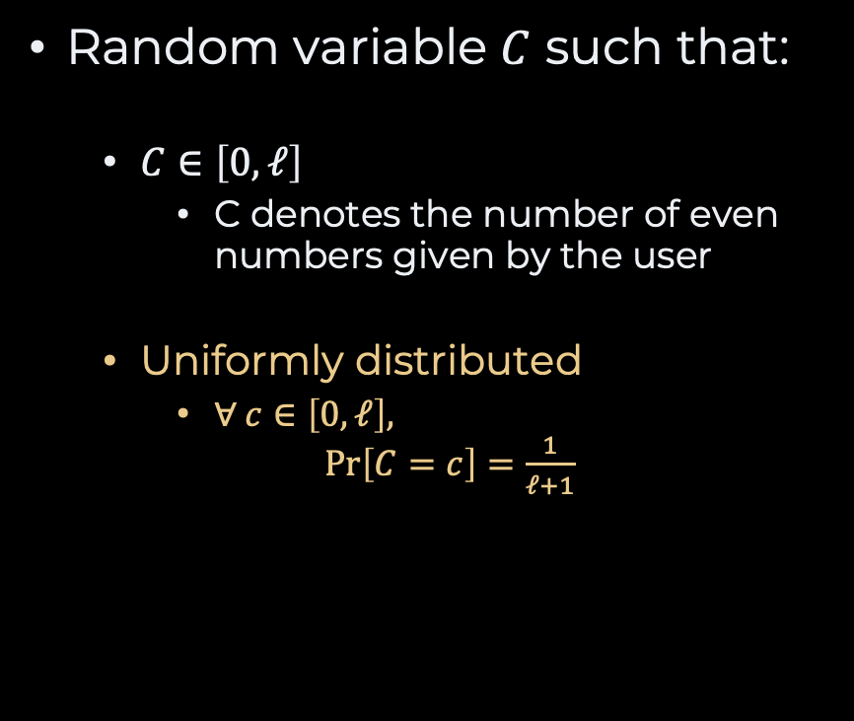
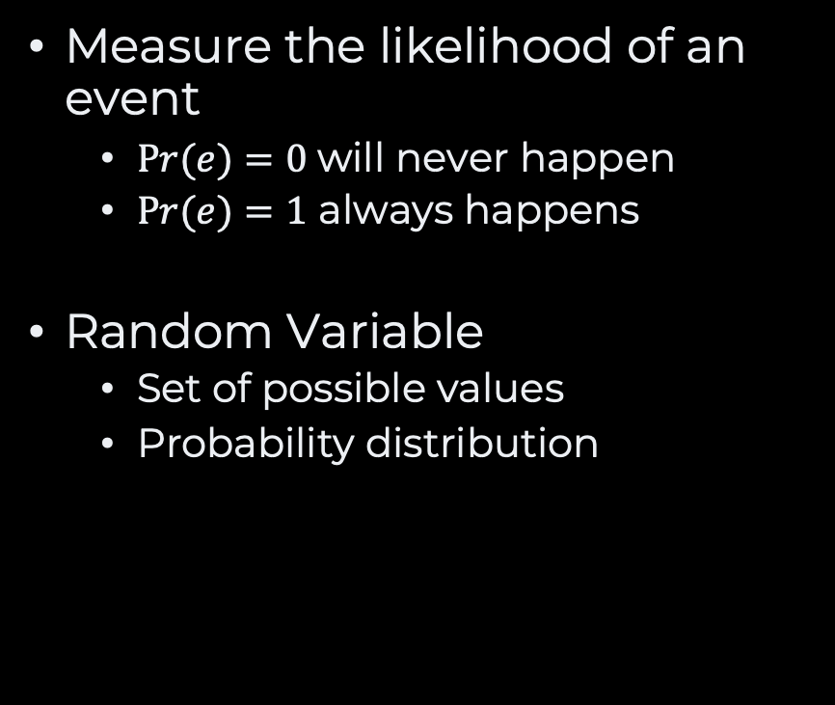
Probability
Measure the likelihood of an event
$Pr(e)=0$will never happen
$Pr(e)=1$ always happens
Random Variable
Set of possible values
Probability distribution
Random variable $C$ such that:
$C∈\left[0, ℓ\right]$
C denotes the number of even numbers given by the user
Uniformly distributed
$∀ c∈\left[0, ℓ\right],$ $\operatorname{Pr}\left[C=c\right]=\frac{1}{ℓ+1}$

Slide 15

Average Case, Take #2 Runtime Efficiency
def sum_of_even(limit):
total = 0
counter = 0
while counter < limit:
value = int(input("?"))
if value % 2 == 0:
total = total + value
counter = counter + 1
return total
Cost
Frequency
1
1
1
1
1
LIMIT+2
2
LIMIT+1
2
LIMIT+1
2
C
1
1
$$time\left(ℓ,C\right)=5ℓ+2C+9$$

Slide 16
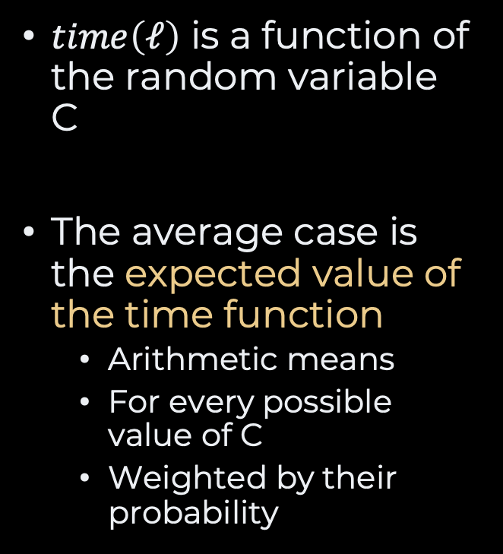
Average Case
$time\left(ℓ\right)$ is a function of the random variable C
The average case is the expected value of the time function
Arithmetic means
For every possible value of C
Weighted by their probability

Slide 17
Takeaway #2
Average cases require making an hypothesis.
A very general hypothesis may not apply to a real-life situation

Slide 18
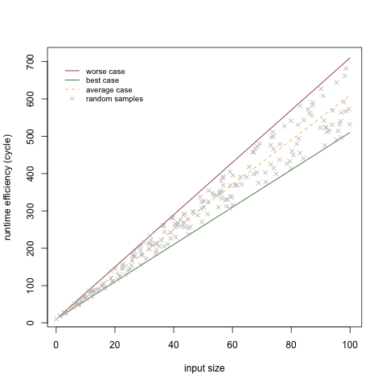
Algorithm Analysis

Slide 19
Recap
Efficiency model
Efficiency as function of input size
Worst case
Things will never be worse
Best case
Things will never get any better
Average case
What we should expect, in average
Is the hypothesis relevant?

Slide 20
Lab Session
Practice makes perfect
Drawing Triangle
Maximum
Rock Paper Scissor

Slide 21
Drawing Triangle Problem 1
public static void printTriangle(int height) {
for(int row=0 ; row<height ; row++){
for(int column=row ; column<height ; column++) {
System.out.print("*");
}
System.out.println();
}
}
Runtime?
Memory?

Slide 22
Rock Paper Scissor Problem 2
public static int play(int player1, int player2) {
if (player1 == ROCK && player2 == ROCK) {
return 0;
} else if (player1 == ROCK && player2 == PAPER) {
return 2;
} else if (player1 == ROCK && player2 == SCISSOR) {
return 1;
} else if (player1 == PAPER && player2 == ROCK) {
return 1;
} else if (player1 == PAPER && player2 == PAPER) {
return 0;
} else if (player1 == PAPER && player2 == SCISSOR) {
return 2;
} else if (player1 == SCISSOR && player2 == ROCK) {
return 1;
} else if (player1 == SCISSOR && player2 == PAPER) {
return 1;
} else if (player1 == SCISSOR && player2 == SCISSOR) {
return 0;
} else {
throw new RuntimeException("Invalid Input");
}
}
Runtime?
Memory?

Slide 23
Maximum Problem 3
public static int maximum(int left, int right) {
if (left < right) {
return right;
}
return left;
}
Runtime?
Memory?

Slide 24
Questions, Comments, or Ideas?
Franck Chauvel
Axbit & NTNU
franck.chauvel@ntnu.com

