Slide 1
String Matching
First contact with Finite Automata
Week 12 / Lecture 1
Franck Chauvel
axbit & NTNU
franck.chauvel@ntnu.no

Slide 2
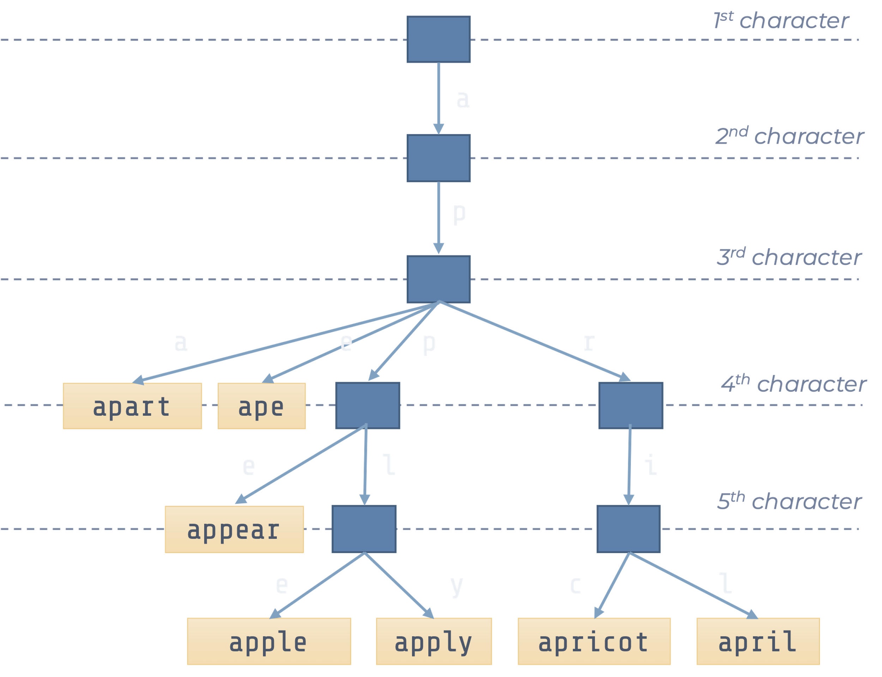
Remember Tries?
What about if I just want to search once?

Slide 3
Agenda
Brute Force
Finite Automata
KMP: Knuth-Morris-Pratt

Slide 4
Brute force
0
7
8
11
0
0
1
3
6
1
2
3
6
1
2
2
3
4
5
6
7
8
11
13
14
15
16
17
18
19
4
5
4
5
9
10
12
9
10
12
-
s
p
l
a
s
h
s
-
s
s
p
l
l
l
i
s
h
-
s
p
l
a
s
h
-
s
p
l
o
s
h
s
h
p
s
h
p
i
text
i
s
s
p
l
a
s
h
s
p
l
s
a
p
s
l
h
s
l
a
s
h
s
s
s
p
p
l
a
s
h
s
s
s
p
l
a
p
a
s
h
s
p
l
a
s
h
s
s
s
p
p
l
l
a
a
s
s
h
h
pattern
s
p
l
a
s
h

Slide 5


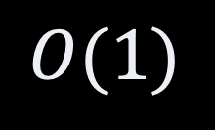

The Code Brute Force
int contains(char[] text, char[] pattern) {
for (int textSpot = 0; textSpot < text.length ; textSpot++) {
int offset = 0;
while (offset < pattern.length
&& text[textSpot + offset] == pattern[offset]) {
offset++;
}
if (offset == pattern.length) {
return textSpot;
}
}
return -1;
}
$$O(\left|T\right|⋅|P|)$$
$$O(1)$$

Slide 6
How could we go faster?
0
1
2
3
4
5
6
7
8
text
a
b
c
a
b
a
b
c
d
a
b
c
d
pattern
a
b
c
d
How could we skip these steps?
a
b
c
d
a
b
c
d
a
b
c
d
a
b
c
d
a
b
c
d

Slide 7
Repeating Patterns
Repeating patterns
shift depends on where the mismatch take place
0
1
2
3
4
4
5
6
7
8
text
a
b
a
b
a
b
a
b
c
a
b
a
c
a
a
a
b
c
pattern
b
a
b
a
b
c
a
a
b
a
b
c
a
b
shift
a
b
a
b
c
a
b
shift

Slide 8
The Key Question
Once we found a mismatch
How to continue?
Which character of the text
against, which character of the pattern?
0
1
2
3
4
4
5
6
7
8
text
a
b
a
b
a
b
c
b
c
a
b
a
c
a
a
a
b
c
pattern
b
a
b
a
b
c
shift
a
a
b
a
b
c
a
b

Slide 9
1. Finite Automata
A crash course

Slide 10



Finite Automata
Machine that consumes symbols
Change state depending on
the given symbol
its current state
automata
$$∂,a, φ, 1, ≡, ⋕$$

Slide 11
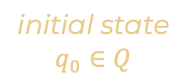
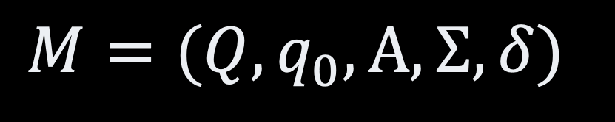


Formal Definition Finite Automata
initial state
$$q_{0}∈Q$$
set of states
accepting states
$$A⊆Q$$
$$M=(Q, q_{0}, A, Σ, δ)$$
automata
alphabet
(set of symbols)
transition function
$$δ:Q × Σ→Q$$

Slide 12
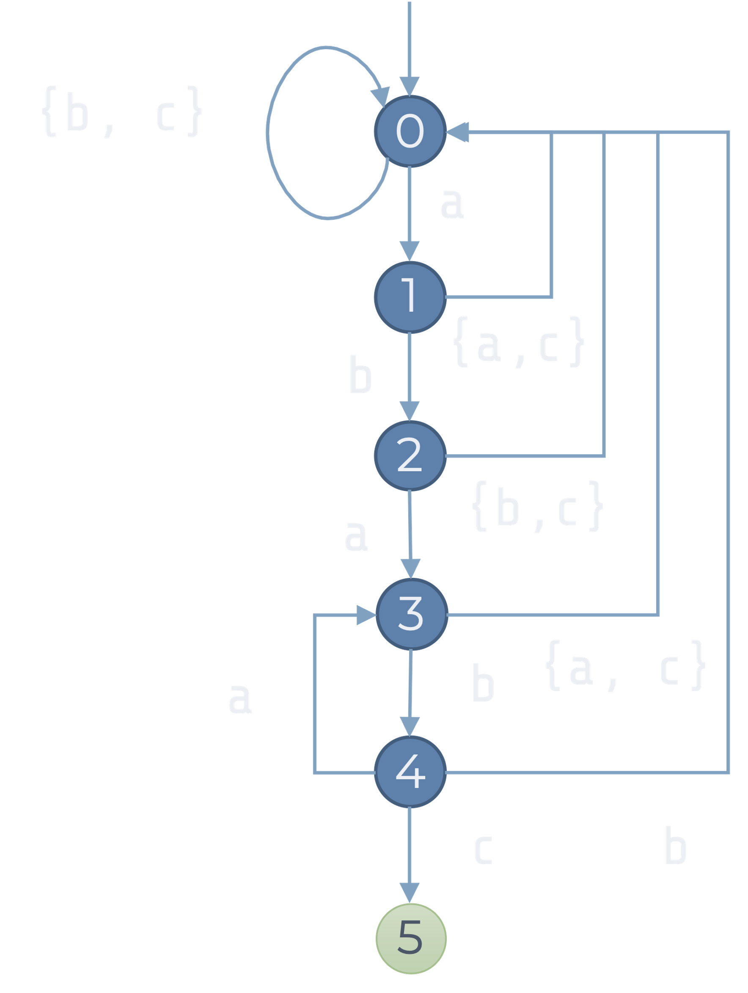

Example Finite Automata
$Q=\{0, 1, 2, 3, 4, 5\}$
$q_{0}=0$
$A=\{5\}$
$Σ=\{a, b, c\}$
$δ=\left[\begin{matrix}1 & 0 & 0 \\ 0 & 2 & 0 \\ 3 & 0 & 0 \\ 0 & 4 & 0 \\ 3 & 0 & 5 \\ 0 & 0 & 0\end{matrix}\right]$

Slide 13
Matching Using an Automata
{b, c}
0
a
0
1
2
3
4
5
6
7
8
1
b
{a,c}
text
a
b
a
b
a
b
c
b
c
2
a
{b,c}
pattern
a
b
a
b
c
3
0
1
2
3
4
3
4
5
a
b
{a, c}
state:
4
c
b
5

Slide 14
The Code String Matching With an Automaton
int contains(char[] text, char[] pattern) {
var transitions = createTransitionTable(pattern, alphabet);
int currentState = 0;
for (int index=0 ; index<text.length ; index++) {
currentState = transitions[currentState][text[index]];
if (currentState == pattern.length-1) {
return index;
}
}
return -1;
}

Slide 15

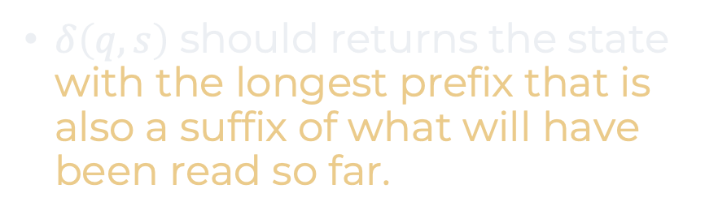
Building the Automaton
$δ\left(q,s\right)$ should returns the state with the longest prefix that is also a suffix of what will have been read so far.
0
$$ε$$
a,c
b
a
a,c
b,c
“a”
1
b
a
b
c
2
“ab”
“”
0
1
0
0
a
“a”
1
0
2
0
3
“aba”
“ab”
2
3
0
0
a
b
“aba”
3
0
4
0
4
“abab”
(“abab” + a) ends with “aba”
“abab”
4
3
0
5
c
“ababc”
5
0
0
0
“ababc”
5

Slide 16
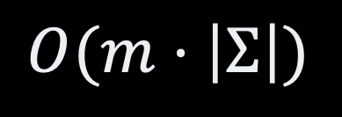
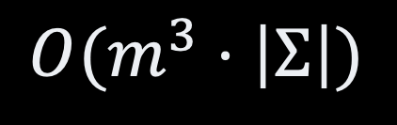
The Code Building The Automaton
int[][] createAutomaton(char[] pattern, char[] alphabet) {
var transitions = new int[pattern.length+1][alphabet.length];
for (int eachState=0 ; eachState<=pattern.length ; eachState++) {
for (var eachLetter: alphabet) {
var nextState = Math.min(eachState+2, pattern.length+1);
do {
nextState--;
} while (!(pattern.prefix(eachState)+eachLetter)
.endsWith(pattern.prefix(nextState)));
transitions[eachState][eachLetter] = nextState;
}
}
return transitions;
}
$$O(m^{3}⋅\left|Σ\right|)$$
$$O(m⋅\left|Σ\right|)$$

Slide 17
Knuth-Morris-Pratt

Slide 18
Optimizations KMP vs. Finite Automata
Useless Alphabet
Only distinguish between
match & mismatch
Better Failure handling
More aggressive continuation

Slide 19



Match vs. Mismatch Optimization n˚ 1
0
$$ε$$
0
fail
a
a,c
b,c
a,c
b
$$ε$$
fail
1
OK
“a”
1
fail
“a”
b
fail
2
“ab”
OK
2
“ab”
a
“aba”
3
OK
“aba”
3
a
b
4
“abab”
OK
4
“abab”
c
“ababc”
5
OK
“ababc”
5

Slide 20
LPS Optimization n˚ 2
a
b
b
a
c
1
a
a
a
a
c
0
1
2
3
4
5
6
7
2
a
a
a
b
a
c
a
b
a
c
pattern
a
b
a
d
a
b
a
c
a
b
c
a
b
c
0
0
1
0
1
2
3
0
2
a
b
shifts
0
a
b
c
c
a
b
c
c
a
b
c
c
3
a
b
c

Slide 21
Match vs. Mismatch Optimization n˚ 2
0
$$ε$$
0
a
a,c
b,c
a,c
b
$$ε$$
OK
fail
“a”
1
“a”
1
fail
b
2
“ab”
OK
“ab”
2
a
“aba”
3
OK
“aba”
fail
fail
3
a
b
4
“abab”
OK
4
“abab”
c
“ababc”
5
OK
“ababc”
5

Slide 22
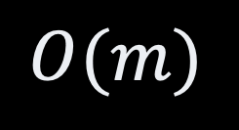
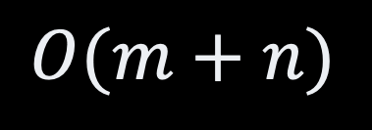
The Code KMP algorithm
int contains(char[] text, char[] pattern) {
failures = createFailureTable(pattern);
int currentState = 0;
for (int index=0 ; index<text.length ; index++) {
while (currentState > 0 && text[index] != pattern[index]) {
currentState = failures[currentState];
}
if (text[index] == pattern[index]) currentState++;
if (currentState == pattern.length-1) return index;
}
}
$$O(m+n)$$
$$O(m)$$

Slide 23


Building the Prefix Table
0
Recursive by definition
if $w_{1}|x$ is the LPS of $w_{2}|x$
then $w_{1}$ is the LPS of $w_{2}$
$$ε$$
fail
OK
“a”
1
fail
OK
“ab”
2
OK
3
“aba”
fail
fail
OK
4
“abab”
OK
“ababc”
5

Slide 24
The Code KMP / Building the Failure Table
int[] createFailureTable(char[] text, char[] pattern) {
int[] table = new int[pattern.length];
table[0] = 0;
int longestPrefix = 0;
for (int eachState=1 ; eachState<=pattern.length-1 ; eachState++) {
while (longestPrefix > 0
&& pattern[longestPrefix+1] != pattern[eachState]) {
longestPrefix = table[longestPrefix];
}
if (pattern[longestPrefix+1] != pattern[eachState]) longestPrefix++;
table[eachState] = longestPrefix;
}
return table;
}

Slide 25
Other Algorithms
Boyer-Moore
Similar ideas to KMP
Rabin-Karp
“Fingerprint” matching
use hashing

Slide 26
Recap
Brute force works in practice
Working in practice
Other solutions
Hard algorithms
Finite Automaton
KMP
Finite Automaton
Core Computer Science
Regular Expression
Compilation
Computability

Slide 27
Questions, Comments, or Ideas?
Franck Chauvel
Axbit & NTNU
franck.chauvel@ntnu.no

