Slide 1
Regular Expressions
A little more on finite automata
Week 12 / Lecture 2
Franck Chauvel
axbit & NTNU
franck.chauvel@ntnu.no

Slide 2
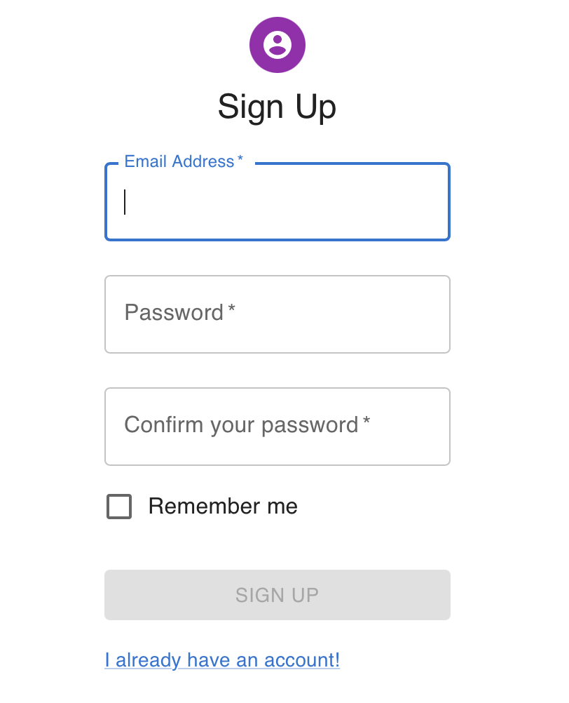
Input Validation
What is a valid email?
What is a valid date?
Infinitely many emails, dates, etc.
Set membership

Slide 3
Regular Expressions
A valid email matches
.+@.+\..+
A valid email matches
[0-9]{2}/[0-9]{2}/[0-9]{4}

Slide 4
Simple Dates Regular Expressions Example
[0-9]{2}/[0-9]{2}/[0-9]{4}
A symbol in the set
{0, 1, 2, ... , 9}
x2
“/”
A symbol in the set
{0, 1, 2, ... , 9}
x2
“/”
A symbol in the set
{0, 1, 2, ... , 9}
x4

Slide 5
Simple Emails Regular Expressions Example
.+@.+\..+
whatever
at least
once
the
“@”
symbol
whatever
at least
once
the
“.”
symbol
whatever
at least
once

Slide 6
Regex = Finite Automaton
[0-9]{2}/[0-9]{2}/[0-9]{2}
[0-9]
[0-9]
/
[0-9]
[0-9]
/
[0-9]
[0-9]

Slide 7
Agenda
What are “Regular Expressions”?
How to Building an Automaton?
How to make it “deterministic”?
How to make it minimal
Recap

Slide 8








A “Grammar” For simplistic regular Expressions
$$RE ∷=RE_{1}→RE_{2}$$
concatenation / sequence
$∷=RE_{1}∗$
zero to many repetitions
$$∷=RE_{1}+$$
one to many repetitions
$$∷=RE_{1} ?$$
zero to one repetitions
$$∷=RE_{1} | RE_{2}$$
alternative
$$∷=[s_{1}, s_{2},…, s_{n}]$$
a symbol from a given set
$$∷=s$$
a given symbol
$$∷=( RE_{1} )$$
a regex delimited by brackets

Slide 9
1. Parsing Regex

Slide 10
Syntax Trees
ab
(ab)|c
((ab)|c)?
(((ab)|c)?)|([def])*
?
|
|
→
→
c
|
?
*
a
b
a
b
→
c
|
[def]
a
b
→
c
a
b

Slide 11
2. How to build the Automaton?

Slide 12



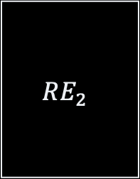

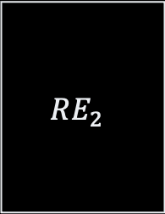
Finite Automata
$$RE ∷=RE_{1}→RE_{2}$$
$$RE ∷=RE_{1} | RE_{2}$$
$$RE_{1}$$
$$RE_{1}$$
$$RE_{2}$$
ε
ε
ε
$$RE_{2}$$
ε

Slide 13




Finite Automata
$$RE ∷=RE_{1} ?$$
$$RE ∷=RE_{1}+$$
$$RE_{1}$$
$$RE_{1}$$
ε
ε
ε
ε
ε
ε

Slide 14
Example From a regex to an automaton
a
(((ab)|c)?)|([aef])+
e
|
ε
f
?
ε
+
a
ε
b
|
ε
ε
[def]
ε
c
ε
→
c
ε
a
b

Slide 15
Non-Deterministic Automata The cost of ε-transitions
Which state should I reach on an “a”?
State 8?
State 2?
a
e
ε
f
8
9
ε
a
ε
b
ε
1
2
3
4
ε
0
ε
7
c
ε
5
6
ε

Slide 16
3. How to make it “deterministic”?

Slide 17
NFA-determinization ε-transitions & conflicting transitions
a
e
a,e,f
ε
f
8
9
{8, 9}
ε
a,e,f
a
b
{2, 3, 8, 9}
ε
ε
1
2
3
4
ε
a
b
0
ε
7
{0,1,5,7,8}
{7}
c
ε
5
6
c
ε
{6, 7}

Slide 18
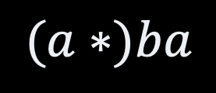
Minimality
a
0
a
2
0
a
b
b
b
$$(a∗)ba$$
1
3
1
a
a
a
4
2

Slide 19
4. How to make it minimal?

Slide 20





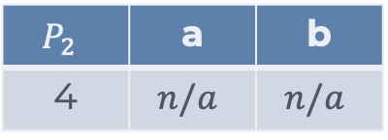
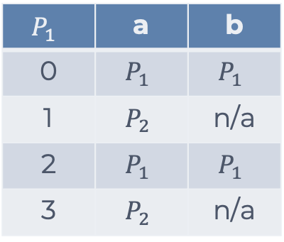
Minimality
$$P_{1}$$
a
$$P_{1}$$ | a | b
0 | $$P_{1}$$ | $$P_{1}$$
1 | $$P_{2}$$ | n/a
2 | $$P_{1}$$ | $$P_{1}$$
3 | $$P_{2}$$ | n/a
a
$$P_{1}$$
0
a
2
a
0
2
b
b
b
b
1
3
1
3
$$P_{3}$$
$$P_{2}$$
a
a
$$P_{2}$$ | a | b
4 | $$n/a$$ | $$n/a$$
a
a
4
$$P_{2}$$
4

Slide 21


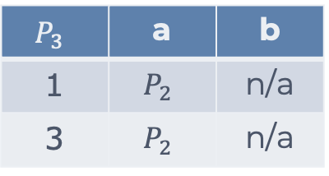

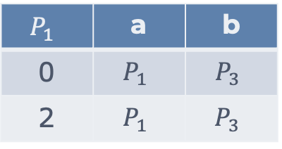
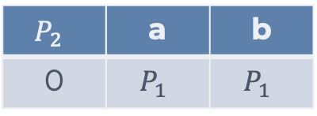



Minimality
$$P_{1}$$ | a | b
0 | $$P_{1}$$ | $$P_{3}$$
2 | $$P_{1}$$ | $$P_{3}$$
a
$$P_{1}$$
a
$$P_{1}$$
0
a
2
a
0
2
b
b
$$P_{3}$$ | a | b
1 | $$P_{2}$$ | n/a
3 | $$P_{2}$$ | n/a
b
b
1
3
$$P_{3}$$
$$P_{3}$$
1
3
a
a
$$P_{2}$$
a
a
$$P_{2}$$
4
4
$$P_{2}$$ | a | b
0 | $$P_{1}$$ | $$P_{1}$$

Slide 22



Minimality
$$P_{1}$$ | a | b
0 | $$P_{1}$$ | $$P_{3}$$
2 | $$P_{1}$$ | $$P_{3}$$
a
0
a
2
$$P_{1}$$
a
b
b
$$P_{3}$$ | a | b
1 | $$P_{2}$$ | n/a
3 | $$P_{2}$$ | n/a
b
1
3
$$P_{3}$$
a
a
a
4
$$P_{2}$$
$$P_{2}$$ | a | b
0 | $$P_{1}$$ | $$P_{1}$$

Slide 23
Full Blown Regex
back referencing
named groups
word boundaries
etc.
sed, grep, awk, perl
Java, Python, Javascript, Ruby, etc.
See RegexPlanet

Slide 24

How Powerful Are Regex?
Regular languages
DFA
What automaton recognizes $a^{n}b^{n}$ ?
Recursively enumerable
Context sensitive
Context-free
Regular (Regex)

Slide 25
Recap
Regex: Useful tool!
Learn it
For every set, there is an ”automaton” that recognizes its member
Finite Automata
DFA: we always know where to go next
NFA: we don’t because of ε-transition
Compilation 101
Build a tree
Transform that tree into something useful
Optimize the output

Slide 26
Questions, Comments, or Ideas?
Franck Chauvel
Axbit & NTNU
franck.chauvel@ntnu.no

