Slide 1
Complexity Classes
A Theoretical Categorization of Problems
Week 12 / Lecture 3
Franck Chauvel
axbit & NTNU
franck.chauvel@ntnu.no

Slide 2

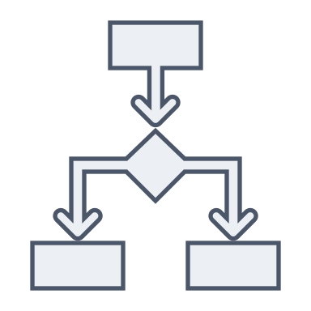


Correctness and Efficiency
Programs
Algorithms
Problems
correctness
Algorithm 1
efficiency
Algorithm 2

Slide 3
Agenda
Problems as Formal Languages
Machines that Recognize a Language
Reduction
NP-Completeness

Slide 4
Problems as Languages
for every problem
there is a related
decision problem
Inputs
Decision
Problem
Is x in Set S?
every decision problem
is recognizing a
word in a language
Yes
No

Slide 5

Languages
Regular languages
DFA
What “machine” recognizes $a^{n}b^{n}$ ?
Recursively enumerable
Context sensitive
Context-free
Regular (Regex)

Slide 6
Languages and Machines
Recursively enumerable
Languages
Turing Machine
Context-senstive Languages
Linear-bound Automata
Context-free Languages
Pushdown Automata
Regular Languages
Finite Automata

Slide 7
Computation Models
Automata are machines
consume inputs
and transition table
to produce a result
Computation Models = executor + algorithm
limit = 100
inputs
algorithm
Executor
output
sum = 2550

Slide 8
Computation Models
Abstract Machines
RAM
Functional Models
Turing machine
Lambda Calculus
Pushdown
Automata
Combinatory Calculus
DFA
Rewriting Systems
Concurrent Model
Actors
Celullar Automata
Petri Nets

Slide 9
Turing-Completeness
A computation model is turing-complete,
if it can be used to emulate a turing machine
We don’t know anything
more powerful
than a turing machine
RAM, Lambda-calculus, Actors, etc.
are all turing-complete

Slide 10
Decidability
Can we solve
everything?
Nope!
Only, those that can be
solved with a Turing-machine
Example:
the halting problem

Slide 11
Resources
needs
Time
How long does it takes?
needs
Space
How much
do we need to remember?
Computation
Model
Some computation models are faster
but not more powerful

Slide 12
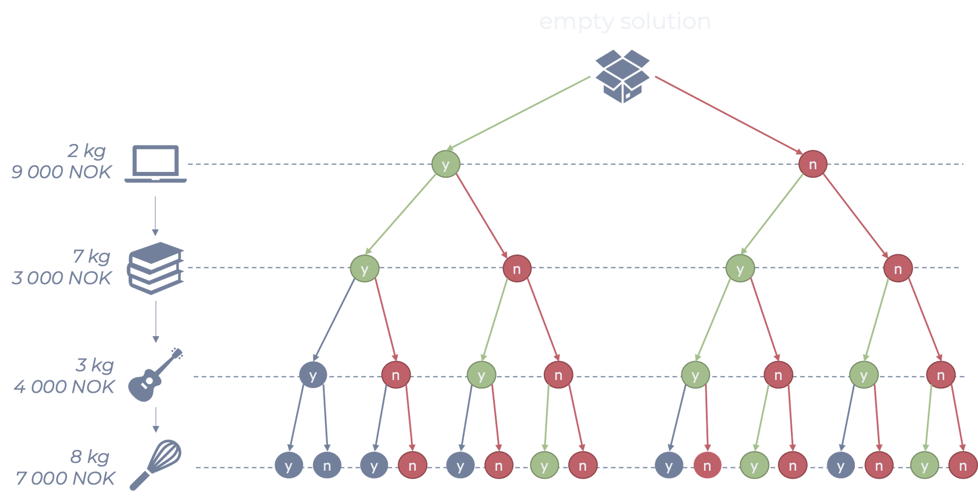
Non-Deterministic Machine
A non-deterministic machine
always picks
the right branch

Slide 13
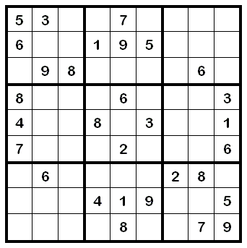

Playing Sudoku With a non-deterministic Turing Machine
Easy !
$O\left(n^{2}\right)$
Just guess every cell!

Slide 14
Complexity Class
Complexity Class
contains problems
Computation
Model
A resource
A bound
The problems that can be solved by a non-deterministic turing machine in linear time

Slide 15
Common Classes
P: Solved by a turing machine in polynomial time
NP: Solved by a non-deterministic Turing machine in polynomial time
Problems verifiable in polynomial time
P ?= NP
NL
P
NP
PSPACE
EXPTIME
EXPSPACE

Slide 16


Problem Reduction It is at least as easy as …
Algorithm that converts a problem into another
and conserves the correctness of solution
A is at least as easy as B
Problem A
Algorithm?
Reduction
(algorithm)
$$O(m^{j})$$
Problem B
$$O(n^{k})$$
Algorithm 2

Slide 17

Problem Reduction It is at least as hard as …
Provided there is algorithm that solves B in polynomial time
By contradiction
B is at least as hard as A
Problem A
Algorithm
Reduction
(algorithm)
$$O(m^{j})$$
Problem B
$$O(n^{k})$$
Algorithm 2

Slide 18
NP-Completeness
A problem is NP-complete
the problem is in NP
at least as hard as every other problem in NP
the hardest problems
A problem is NP-hard
it is not in NP
at least as hard as every other problem in NP
harder than the hardest
NP-hard
NP
NP-complete
P

Slide 19
Why all of that?
Before to embark on a problem
check how hard it is
☺

Slide 20
Recap
Turing-completeness
nothing beats the turing machine
Non-deterministic turing machine
“Perfect guesser”
Do not know how to build that
Complexity class
Resource
Machine
Bound
Reduction
at least as hard
at least as easy
NP-complete
hard to solve / easy to verify
NP-hard
hard to solve / hard to verify
P =?= NP
If we solve one, we solve many

Slide 21
Questions, Comments, or Ideas?
Franck Chauvel
Axbit & NTNU
franck.chauvel@ntnu.no

