Slide 1
Arrays
The first data structure
Week 3 / Lecture 1
Franck Chauvel
Axbit & NTNU
franck.chauvel@ntnu.no

Slide 2
Where Are We?
Foundations
Arrays
Lists
Sorting
Hashing
Trees
Graphs
Wrapping-up
correctness
big Oh
RAM
Searching
deletion
insertion
simple sorting
Calls & Recursions
Stacks & Queues
Recurrences
ADT
Quick sort
Merge sort
Radix sort
Chaining
Hash functions
Open addressing
Binary trees
Search trees
Self-balancing trees
Probing Further
directed graphs
cycles
spanning trees
A*
Sets
Parallel Computing
Quantum Computing
P vs. NP
Optimization
Pattern matching

Slide 3

Frequency Counts
1 45 23 7 23 …
Algorithm
How many variables do we need here?
(1,1) (45,1) (23, 2) (7, 1)

Slide 4
Menu
Records
Arrays
Insertion
Deletion
Search

Slide 5
Records
Memory:
0
Contiguous allocation of
Heterogenous items
Example,
item, count
name, lastname, age, status
etc.
Often a “type” definition
Given by the compiler
1
2
…
item: Integer
59
base
count: Integer
60
+ size of integer
…
∞

Slide 6
Takeaway
An record is a contiguous allocation
of “fields” of varying size,
which we access by name or index.

Slide 7
Records in C
typedef struct {
int item;
int count;
} Frequency;
Frequency frequency;
frequency.item = 12;
frequency.count = 0;

Slide 8
What is an Array?
item
count
Record:
1
1
But we need many!
capacity
(25 buckets)
Memory:
bucket 1
bucket 2
bucket 3
bucket 25
0
1
…
40
41
42
43
44
45
46
47
48
…
88
89
∞
1
1
45
1
23
2
??
??
base address
(index = 0)
bucket size
length
(3 buckets)

Slide 9
Takeaway
An array is a contiguous allocation
of items of similar size,
which we access by index.

Slide 10
Creation
#define CAPACITY 25
int array[CAPACITY] = {5, 4, 3, 5, 1};
int length = 5;

Slide 11
Operations
access(index: Integer): Value
Give the content at a given index
insert(value: Value index: Integer)
Insert an element at a given index
delete(index: Integer)
Delete an element at a given index
search(value: Value): Integer
Find which bucket contains a given value

Slide 12


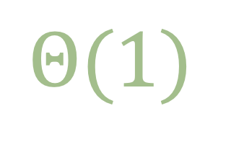

Access
$$Θ(1)$$
$$Θ(1)$$
address = ‘base address’ + (index * sizeof(bucket))
Memory:
bucket size
bucket 3
0
1
…
40
41
42
43
44
45
46
47
48
…
88
89
∞
1
1
45
1
23
2
base address
(index = 0)
40 + 2 * 2

Slide 13
Multi-dimensional Arrays
width
1
2
3
4
A
B
B3
0
1
2
3
4
5
6
7
8
…
15
B3
C
base address
(index = 0)
D
address(row, column) = ‘base address’ + (row * width + column) * ‘sizeof(bucket)

Slide 14
Insertion (at the End) The idea
capacity = 25 buckets
length = 3 buckets
Memory:
bucket size
0
1
…
40
41
42
43
44
45
46
47
48
…
88
89
∞
1
1
45
1
23
2
new bucket
(index = 3)
7
1
new bucket

Slide 15



Insertion At the End The C code
void insert(int value) {
if (length >= CAPACITY) {
return -1;
}
array[length] = value;
length += 1;
}
$$Θ(1)$$
$$Θ(1)$$
This Photo by Unknown Author is licensed under CC BY-SA

Slide 16
Insertion (anywhere) The idea
capacity = 26 buckets
length = 3 buckets
Memory:
bucket size
0
1
…
40
41
42
43
44
45
46
47
48
…
90
91
∞
23
1
1
1
45
1
45
2
23
2
B1
B2
B3
7
1
new bucket
(index = 1)

Slide 17
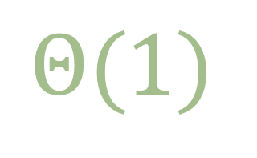
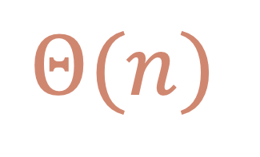
Insertion (anywhere) The C code
int insert (int value, int position) {
if (length >= CAPACITY) {
return -1;
}
length += 1;
for (int index=length-1; index>=position ; index--) {
array[index+1] = array[index];
}
array[position] = value;
}
$$Θ(n)$$
$$Θ(1)$$
This Photo by Unknown Author is licensed under CC BY-SA
This Photo by Unknown Author is licensed under CC BY-SA

Slide 18

Deletion The idea
capacity = 25 buckets
length = 4 buckets
length = 3 buckets
Memory:
bucket size
0
1
…
40
41
42
43
44
45
46
47
48
…
88
89
∞
7
23
23
1
1
45
2
2
1
1
7
1
B1
B2
B3
B4
delete(2)

Slide 19
Deletion (anywhere) The C code
int delete (int position) {
if (length >= CAPACITY) return -1;
int deleted = array[position];
length -= 1;
for (int index=position ; index<length ; index++) {
array[index] = array[index+1];
}
return deleted;
}
$$Θ(n)$$
$$Θ(1)$$
This Photo by Unknown Author is licensed under CC BY-SA

Slide 20
Search The idea
capacity = 26 buckets
length = 3 buckets
Memory:
bucket size
0
1
…
40
41
42
43
44
45
46
47
48
…
90
91
∞
E
M
2
A
2
2
2
V
2
B1
B2
B3
B4
Find “M”?
no!
no!
Yes!

Slide 21
Search The Code
int search(int value) {
for (int index = 0; index < length ; index++) {
if (array[index] == value) {
return index;
}
}
return -1;
}
$$Θ(n)$$
$$Θ(1)$$
This Photo by Unknown Author is licensed under CC BY-SA

Slide 22
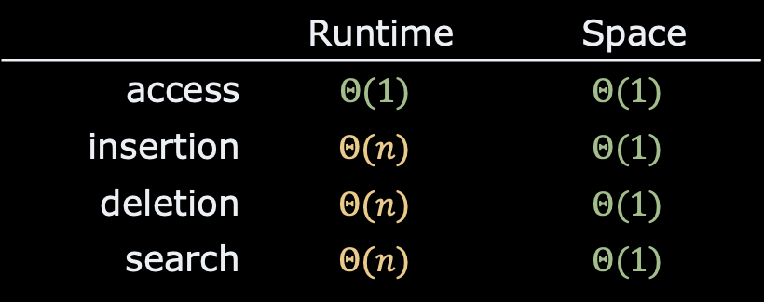
Recap
Records
Contiguous
Varying size
Arrays
Continuous allocation
Same size items
⚠️ Fast access to the i^{th} bucket
Compilers do the “heavy-lifting”
 | Runtime | Space
access | $$Θ(1)$$ | $$Θ(1)$$
insertion | $$Θ(n)$$ | $$Θ(1)$$
deletion | $$Θ(n)$$ | $$Θ(1)$$
search | $$Θ(n)$$ | $$Θ(1)$$

Slide 23
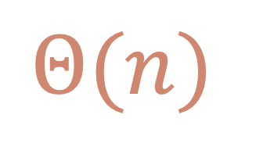
Lab Session
Pen & Paper
Look at the average runtime complexity of the “search”
$$Θ(n)$$

Slide 24
Questions, Comments, or Ideas?
Franck Chauvel
Axbit & NTNU
franck.chauvel@ntnu.no

