Slide 1
Procedure Calls
Efficiency of Dynamic Memory Allocation
Week 5 / Lecture 2
Franck Chauvel
axbit & NTNU
franck.chauvel@ntnu.no

Slide 2
Remember Linked Lists?
Pointers
Memory allocation
Procedures calls
How efficient is all of that?
We don’t want to let any stone unturned!

Slide 3
Agenda
Pointers
Procedures
Inlining vs. Linking
Call-stack
Example: n!
Dynamic Allocation
Recap

Slide 4
Pointers
Memory:
0000
A memory cell
that contains the address of another memory cell
Indirect addressing
Dereferencing
Get the value stored at in the cell refered by the pointer
0001
0002
0005
0003
0004
0005
0006

Slide 5
RAM & Pointers
…
How to load the value referenced by a pointer?
ADD address
ACC += Memory[address]
iADD pointer
ACC += memory[memory[pointer]]
2 approaches:
Add new instructions
Use the compiler
pointer
address
…
address
25
…
LOAD 0
ADD pointer
STORE iadd+1
iadd: ADD 0
CONSTANT TIME!

Slide 6
Procedure Calls
Procedures = Functions, Subroutines, etc.
Single entry points
Parameters
Local variables
Returns a result
DRY: Don’t Repeat Yourself
Enable recursion
What does it cost in terms of time and space?
Go Back to the RAM model!

Slide 7
Two Approaches
Inlining
The compiler
replaces the “call” with the body
Code becomes “fat”
No recursive procedures!
Linking
Branch to another program

Slide 8
Linking
Separate code for each function
Caller evaluates the arguments
Pass them to the callee, with the control
Callee carries out the computation
Callee returns a result and the control
Requires a calling convention

Slide 9
Introducing “the Call-stack”
Caller & callee need to agree upon:
Where are the arguments
Where the callee should return/branch
Where the calle should place the results
Dedicated memory segment: the “call-stack”
Requires a convention
Call-stack
Free Memory
Call-stack
growth
Program Data
Address
Program Instructions

Slide 10
Convention / Caller
stack bottom
previous callers
Caller pushes each argument
Caller pushes the return address
… callee does …
Caller pops the result
Caller pops each argument
Previous frame pointer
Local variables
Argument #N
...
Argument #2
Argument #1
caller
Return address
Previous frame pointer
callee
Local variables
stack top

Slide 11
Convention / Callee
stack bottom
previous callers
pushes the frame pointer
pushes its local variables
Computes the result
pops its local variables
pushes the return address
pops and restores the callers frame pointer
pushes the result
jumps to the return address
Previous frame pointer
Local variables
Argument #N
...
Argument #2
Argument #1
caller
Return address
Previous frame pointer
callee
Local variables
stack top

Slide 12
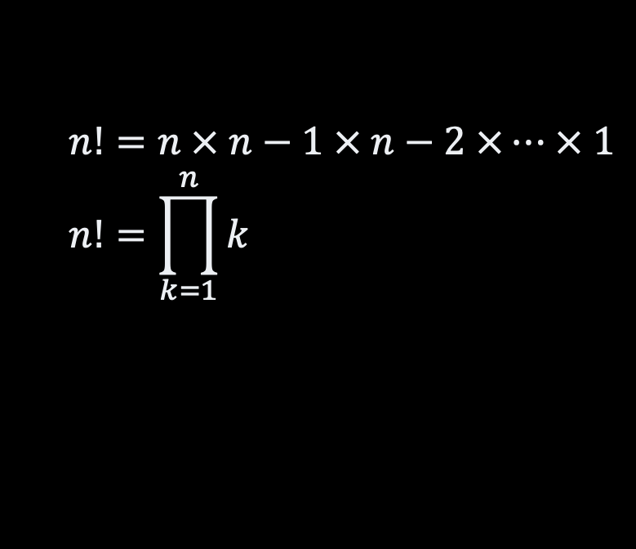
Example: n! “iterative”
#include <stdio.h>
long factorial(int value) {
long product = 1;
for(int each=2 ; each <= value ; each++) {
product = product * each;
}
return product;
}
int main() {
printf("5! = %d\n", factorial(5));
}
$$n!=n × n−1 × n−2 ×… × 1 \\ n!=\prod_{k=1}^{n}{k}$$

Slide 13
Slow Motion
stack bottom
#include <stdio.h>
long factorial(int value) {
long product = 1;
for(int each=2 ; each <= value ; each++) {
product = product * each;
}
return product;
}
int main() {
printf("5! = %d\n", factorial(5));
}
SP:
0
Result = 0
0
Arg. 1 = 5
FP:
return address
FP: 0
product: 0
each: 0

Slide 14
Example: n! recursive
#include <stdio.h>
long factorial(int value) {
if (value == 0) return 1;
return value * factorial(value-1);
}
int main() {
printf("5! = %d\n", factorial(5));
}
$$n!=n × n−1 × n−2 ×… × 1 \\ n!=\prod_{k=1}^{n}{k}$$

Slide 15
Slow Motion
stack bottom
“main” frame
#include <stdio.h>
long factorial(int value) {
if (value == 0) return 1;
return value * factorial(value-1);
}
int main() {
printf("5! = %d\n", factorial(5));
}
factorial(5)
factorial(4)
NOT CONSTANT SPACE!
factorial(3)
factorial(2)
factorial(1)
factorial(0)

Slide 16
Dynamic Memory Allocationx
How to create variables “on the fly”?
Dynamic memory allocation
Manual allocation
E.g., malloc / free in C
Allocator
Many strategies
How fast can we do that?
How much memory does it take?
Your
code
Language Runtime
(libraries)
Operating
System
Machine / Hardware

Slide 17
Introducing the “Heap”
Segment of memory dedicated for “dynamic variables”
Manual allocation
Call-stack
Free Memory
Call-stack
growth
Heap
Heap
growth
Static data
Address
Program Instructions

Slide 18
Heap & Fragmentation
Memory (Heap)
reserved
internal
fragmentation
2 operations
allocate(size). Reserve a “block” of a given size
free(address). Release a block
Problem: Fragmentation
Internal: blocks are over-allocated. Memory is not used in practice
External: only small blocks are free, but none is big enough
reserved
external
fragmentation
reserved
free blocks
growing addresses

Slide 19
Finding a Free Block
Memory (Heap)
reserved
block
start
size
Uses a “free list”
Many “allocation” strategy:
Find the best fit
Find the worse fit
Find the first fit
and more …
Not constant time!
critical for high performance applications
block
start
size
block
start
size
best
NOT CONSTANT TIME!
reserved
block
start
size
worse
reserved
request
first

Slide 20
Recap
Call-stack
Memory Allocation
Free Memory
Call-stack
growth
Pointer
Variable that contains an address
Stack
Automated allocation
Local variables
Contiguous allocation
Enable recursive procedures
Heap
Manual allocation / deallocation
Non-local variables
Non contiguous allocation
Heap
Heap
growth
Static data
Address
Program Instructions

Slide 21
Recap
Efficiency
Pointers dereferencing takes constant time
Procedures calls takes constant time
But recursive functions take much more space!
We don’t know how much time dynamic memory allocation takes

Slide 22
Lab Session: Bubble Sort
def bubble_sort(array)
swapped = true
while swapped
swapped = false
for index in 1 .. array.length-1
if array[index] < array[index-1]
swap(array, index-1, index)
swapped = true
end
end
end
end
How many time will we traverse the array?
At best
At worse
In average?

Slide 23
Lab Session: Bubble Sort
def bubble_sort(array)
swapped = true
while swapped
swapped = false
for index in 1 .. array.length-1
if array[index] < array[index-1]
swap(array, index-1, index)
swapped = true
end
end
end
end
def swap(array, left, right)
tmp = array[right]
array[right] = array[left]
array[left] = tmp
end

Slide 24
Questions, Comments, or Ideas?
Franck Chauvel
Axbit & NTNU
franck.chauvel@gmail.com

