Slide 1
Quick Sort
Deep Dive into a “divide-and-conquer” Algorithm
Week 6 / Lecture 1
Franck Chauvel
axbit & NTNU
franck.chauvel@axbit.com

Slide 2
Lecture Schedule
From the poll, this is the most suitable for you guys:
Monday 8-10
Wednesday 14-16
Thursday 8-10

Slide 3
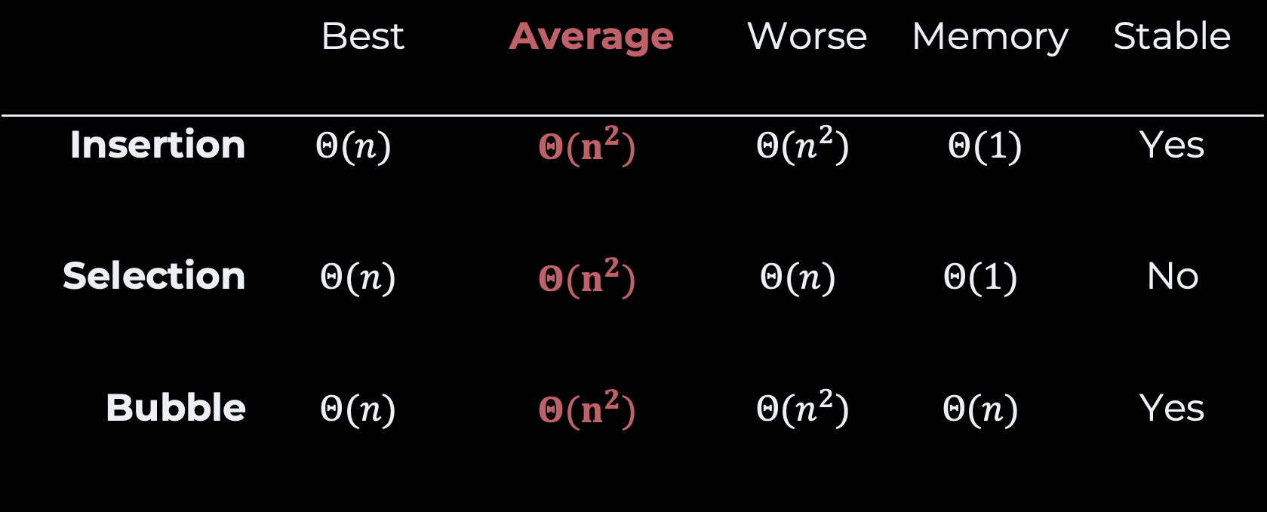

Faster than $O\left(n^{2}\right)$?
 | Best | Average | Worse | Memory | Stable
Insertion | $$Θ(n)$$ | $$Θ(n^{2})$$ | $$Θ(n^{2})$$ | $$Θ(1)$$ | Yes
Selection | $$Θ(n)$$ | $$Θ(n^{2})$$ | $$Θ(n)$$ | $$Θ(1)$$ | No
Bubble | $$Θ(n)$$ | $$Θ(n^{2})$$ | $$Θ(n^{2})$$ | $$Θ(n)$$ | Yes

Slide 4
Introducing: “Quick sort”
Idea
Algorithm
Time-complexity
Space-complexity

Slide 5
Idea
smallest
largest
2
5
17
22
22
23
28
35
36
36
50
51
22
smaller than 22
greater than 22
5
22
17
2
22
50
36
23
28
35
51
36
independent subarrays

Slide 6
Slow Motion
22
5
23
36
2
50
22
17
36
35
28
51
22
5
2
17
22
50
36
35
28
51
22
36
23
2
28
5
22
23
51
36
50
36
35
2
17
22
28
50
17
5
17
22
23
36
35
36
50
51
35
51
def quick_sort(array):
if len(array) < 2: return
pivot = partition(array)
quick_sort(array[:pivot])
quick_sort(array[pivot+1:])
35
36
36
36
36
36
36

Slide 7
Runtime Efficiency

Slide 8
Worst Case
P
P
P
P
P
P
P
P
P
P

Slide 9
Best Case
P
P
P
P
P
P
P

Slide 10
Average Case
P
P
P
P
P
P
P

Slide 11
How to Partition?
And how efficient is it …

Slide 12
How to Partition, with copy?
Pick a “pivot” element
Move to the appropriate area
pivot
Given array
<?
copy
smaller
P
greater

Slide 13
Partitioning, with Copy
def partition(array):
smaller = []
greater = []
pivot = len(array) // 2
for index in range(len(array)):
if index != pivot:
if array[index] <= array[pivot]:
smaller.append(array[index])
else:
greater.append(array[index])
return smaller, array[pivot], greater

Slide 14
How to Partition, in-place?
Pick a “pivot” element
Move to the appropriate area
Smaller than pivot
Not yet processed
greater than pivot

Slide 15
In-place Partitioning (1)
pivot
0
1
2
3
4
5
5
6
7
8
9
10
11
22
5
23
36
2
50
5
22
22
17
36
35
28
51
22
swap

Slide 16
In-place Partitioning (2)
lower
upper
upper
0
1
2
3
4
5
6
7
8
9
10
11
22
23
22
36
2
50
5
17
36
35
28
51
22
23
greater!
swap
smaller than
pivot
greater than
pivot

Slide 17
In-place Partitioning (3)
lower
lower
upper
0
1
2
3
4
5
6
7
8
9
10
11
22
22
22
36
2
50
5
17
36
35
28
51
23
smaller!

Slide 18
In-place Partitioning (4)
lower
upper
upper
0
1
2
3
4
5
6
7
8
9
10
11
22
51
36
2
50
5
17
36
35
28
36
22
51
23
greater

Slide 19
In-place Partitioning (5)
lower
upper
upper
0
1
2
3
4
5
6
7
8
8
9
9
10
11
51
22
28
2
50
5
17
36
35
51
22
28
36
23
greater!
swap

Slide 20
In-place Partitioning (6)
lower
upper
upper
0
1
2
3
4
5
6
7
8
8
9
9
10
11
35
22
22
28
2
50
5
17
36
35
51
36
28
23
greater!
swap

Slide 21
In-Place Partitioning (7)
lower
upper
upper
0
1
2
3
4
5
6
7
8
8
9
9
10
11
36
22
22
35
2
50
5
17
36
51
36
35
28
23
greater!
swap

Slide 22
In-place Partitioning (8)
lower
upper
upper
0
1
2
3
4
5
6
7
8
8
9
9
10
11
36
22
22
17
2
50
5
17
51
36
36
35
28
23
greater!
swap

Slide 23
In-place Partitioning (9)
lower
lower
upper
0
1
2
3
4
5
6
7
8
8
9
9
10
11
22
22
17
2
50
5
36
35
51
36
17
28
23
smaller!

Slide 24
In-place Partitioning (10)
lower
lower
upper
0
1
2
3
4
5
6
7
8
8
9
9
10
11
22
22
2
50
5
36
51
36
17
2
35
28
23
smaller!

Slide 25
In-place Partitioning (11)
lower
upper
upper
0
1
2
3
4
5
6
7
8
8
9
9
10
11
22
50
50
51
22
17
2
5
5
36
35
28
36
23
greater!
swap

Slide 26
In-Place Partitioning (12)
upper
lower
upper
lower
0
1
2
3
4
5
6
7
8
8
9
9
10
11
22
5
50
51
22
17
2
5
36
35
28
36
23
smaller!

Slide 27
In-place Partitioning
lower - 1
lower
0
1
2
3
4
5
6
7
8
8
9
9
10
11
5
5
50
51
22
22
17
2
22
36
35
28
36
23
smaller than 22
greater than 22
swap
result = 4

Slide 28
In-place Partitioning
def partition(array, lower, upper):
pivot = (lower + upper) // 2
swap(array, lower, pivot)
left, right = lower+1, upper-1
while left <= right:
if array[left] <= array[lower]:
left += 1
else:
swap(array, left, right)
right -= 1
swap(array, lower, left-1)
return left-1

Slide 29
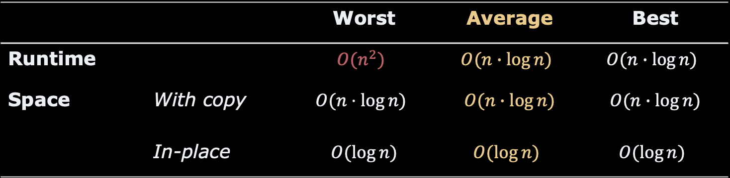
Recap
Recursive
Based on “partitioning”
 |  | Worst | Average | Best
Runtime |  | $$O(n^{2})$$ | $$O(n∙\log{n)}$$ | $$O(n∙\log{n)}$$
Space | With copy | $$O(n⋅\log{n)}$$ | $$O(n∙\log{n)}$$ | $$O(n∙\log{n)}$$
 | In-place | $$O(\log{n)}$$ | $$O(\log{n)}$$ | $$O(\log{n)}$$

Slide 30

References
C. A. R. Hoare, Quicksort, The Computer Journal, Volume 5, Issue 1, 1962, p. 10 – 16
Sedgewick, Robert, and Philippe Flajolet. An introduction to the analysis of algorithms. Addison-Wesley, 2013. p. 18 – 23
Mark A. Weiss. Data Structure and Algorithm Analysis in C++. 4th edition. Pearson 2014. p. 318 – 321
Sir Charles Antony Richard Hoare (2011)
Turing Award (1980)

Slide 31
Questions, Comments, or Ideas?
Franck Chauvel
Axbit & NTNU
franck.chauvel@gmail.com

Slide 32
Lab Session
Pick up where we left …
Look at recursive functions and compute their space and runtime efficiency
factorial
power
sum of array
minimum of array
Iterative, Recursive and tail-recursive

