Slide 1
Bloom Filters
Storing Large Sets
Week 7 / Lecture 3
Franck Chauvel
axbit & NTNU
franck.chauvel@ntnu.com

Slide 2

Sets
No order
$$S=\{∆,∎, ×,⨀\}$$
No duplicate

Slide 3
Agenda
ADT: Sets
Bit Sets
Membership
Union
Intersection
Bloom Filters
Membership

Slide 4
ADT: Sets
A set has no duplicate
A set has no order
create(): Set
insert(item): Set
remove(item): Set
contains(item): Boolean
size(): Integer
union(other: Set): Set
intersection(Set): Set
difference(Set): Set
complement(Set): Set

Slide 5
Bit Sets
Universe
Circle
Universe
Map universe to integer
Map integer to {0, 1}
Line
Cross
Square
Star
Triangle
Spiral
0
1
2
3
4
5
…
n-1
Memory

Slide 6
Insertion
0
1
2
3
4
5
6
7
Set bit b to 1
Mask: Only 0s, but b
S := S OR mask
4
0
1
0
0
0
bitset:
0
1
0
1
0
1
2
3
4
5
6
7
4
mask:
0
0
0
0
1
0
0
0
OR
0
1
2
3
4
5
6
7
4
0
1
0
0
1
1
0
1

Slide 7
Deletion
0
1
2
3
4
5
6
7
Set bit b to 0
Mask: Only 1, but b
S := S AND mask
4
0
1
0
0
0
1
1
0
1
0
1
2
3
4
5
6
7
4
1
1
1
1
0
1
1
1
AND
0
1
2
3
4
5
6
7
4
0
1
0
0
0
1
0
1

Slide 8
Set Cardinality Counting “1”
0
1
2
3
4
5
6
7
0
1
0
1
1
0
0
1
1
0
1
Set cardinality
How to count “1”?
Can we do better than iteration?
0
0
1
0
+
0
1
0
0
0
1
0
1
1, 0, 1, 1
0
1
0
1
+
0
0
0
1
0
0
1
0
1, 2
0
0
0
1
+
0
0
0
0
0
0
1
1
3

Slide 9
Set Cardinality The mechanics…
0
1
2
3
4
5
6
7
4
bitset:
0
1
0
0
0
1
0
1
Set cardinality
How to count “1”?
Can we do better than iteration?
mask:
0
0
1
1
0
0
1
1
AND
0
0
0
0
0
0
0
1
0
1
2
3
4
5
4
>> 2
0
0
0
1
0
0
0
1
0
0
1
1
0
0
1
1
AND
0
0
0
1
0
0
0
1

Slide 10
The Code Set Cardinality
static int cardinality(value) {
value = (value & 0x55555555) + ((value >>> 1) & 0x55555555);
value = (value & 0x33333333) + ((value >>> 2) & 0x33333333);
value = (value & 0x0F0F0F0F) + ((value >>> 4) & 0x0F0F0F0F);
value = (value & 0x00FF00FF) + ((value >>> 8) & 0x00FF00FF);
value = (value & 0x0000FFFF) + ((value >>> 16) & 0x0000FFFF);
return value;
}
0101010…
00110011…
00001111…

Slide 11
Bloom Filters
Handling larger sets using Hashing

Slide 12

Very large sets
0
1
2
3
4
5
6
7
Crawling the web (like Google)
Have we already visited a given page?
Use a bloom filter
0
0
1
1
1
0
1
1
Hash
Hash
Hash
Hash
Hash

Slide 13
Insertion
insert(“Algorithms”)
Hash 1
Hash 2
Hash 3
12
3
5
0
1
2
3
3
4
5
6
7
8
9
10
11
12
13
14
15
5
12
0
0
0
1
1
0
0
0
0
0
0
0
0
0
0
0
0
0
1

Slide 14
Search If we can’t find it…
insert(“Algorithms”)
Hash 1
Hash 2
Hash 3
12
3
5
0
1
2
3
3
4
5
6
7
8
9
10
11
12
13
14
15
5
12
?
?
?
?
1
?
?
?
?
?
?
?
?
?
?
?
?
0
1
FAILED

Slide 15
Search If we can find it…
insert(“Algorithms”)
Hash 1
Hash 2
Hash 3
12
3
5
0
1
2
3
3
4
5
6
7
8
9
10
11
12
13
14
15
5
12
?
?
?
?
1
?
?
?
?
?
?
?
?
?
?
?
?
1
1
FOUND

Slide 16
False Positive
“structure” (false positive)
“algorithms”
0
1
2
3
4
13
3
4
5
6
7
8
9
10
11
12
13
14
15
5
10
12
0
0
0
1
1
0
0
0
0
0
0
0
1
0
0
0
0
0
1
1
1
1
“data”

Slide 17
Takeaway
Bloom filters are “probabilistic”
They may generate false positive search

Slide 18
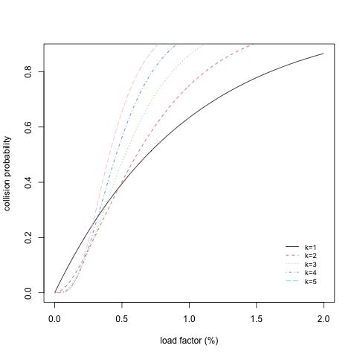
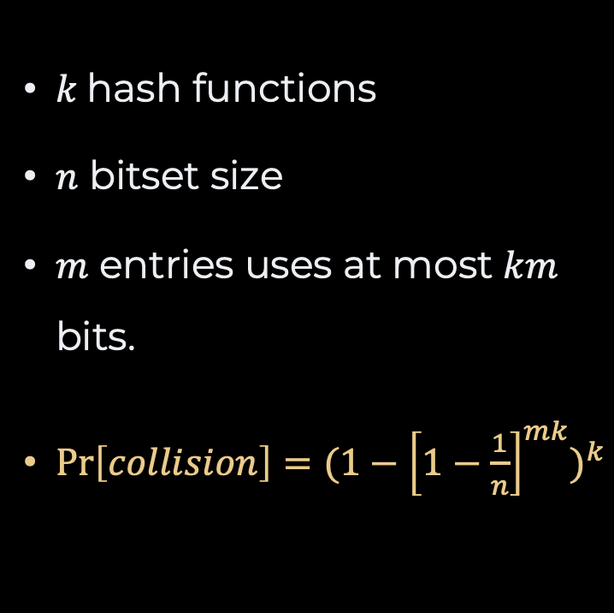
False Positives
$k$ hash functions
$n$ bitset size
$m$ entries uses at most $km$ bits.
$\operatorname{Pr}\left[collision\right]={(1−{\left[1−\frac{1}{n}\right]}^{mk})}^{k}$

Slide 19
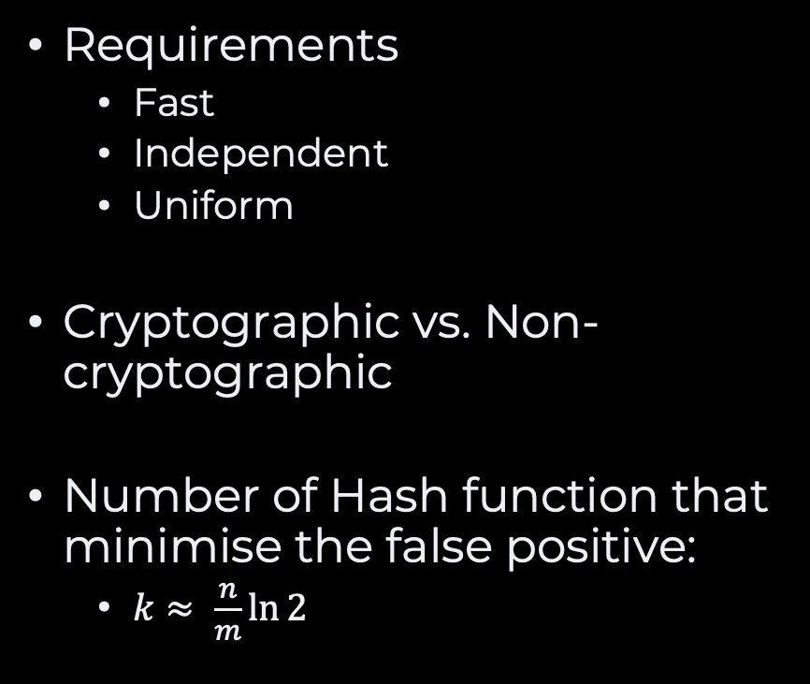
Hash Functions
Requirements
Fast
Independent
Uniform
Cryptographic vs. Non-cryptographic
Number of Hash function that minimise the false positive:
$k≈ \frac{n}{m}\ln{2}$
Many
Murmur Hash
HashMix
CityHash
FNV-1A
…

Slide 20
Takeaway
Bloom filters are never full
The probability of false positive only increases

Slide 21
Deletion
delete(“Algorithms”)
NOT SUPPORTED
Hash 1
Hash 2
Hash 3
0
1
2
3
4
5
6
7
8
9
10
11
12
13
14
15
?
?
?
?
?
?
?
?
?
?
?
?
?
?
?
?

Slide 22
Cardinality
size?
NOT SUPPORTED
Hash 1
Hash 2
Hash 3
0
1
2
3
4
5
6
7
8
9
10
11
12
13
14
15
?
?
?
?
?
?
?
?
?
?
?
?
?
?
?
?

Slide 23
Recap
Set ADT
Array, Sorted Array, Hash tables, Bitsets, etc.
Bitset
Minimum memory footprint
Compressed is sparse
Bloom Filters
Probabilistic data structure
False positive
No deletion
Never full!

Slide 24
Questions, Comments, or Ideas?
Franck Chauvel
Axbit & NTNU
franck.chauvel@ntnu.no

Slide 25
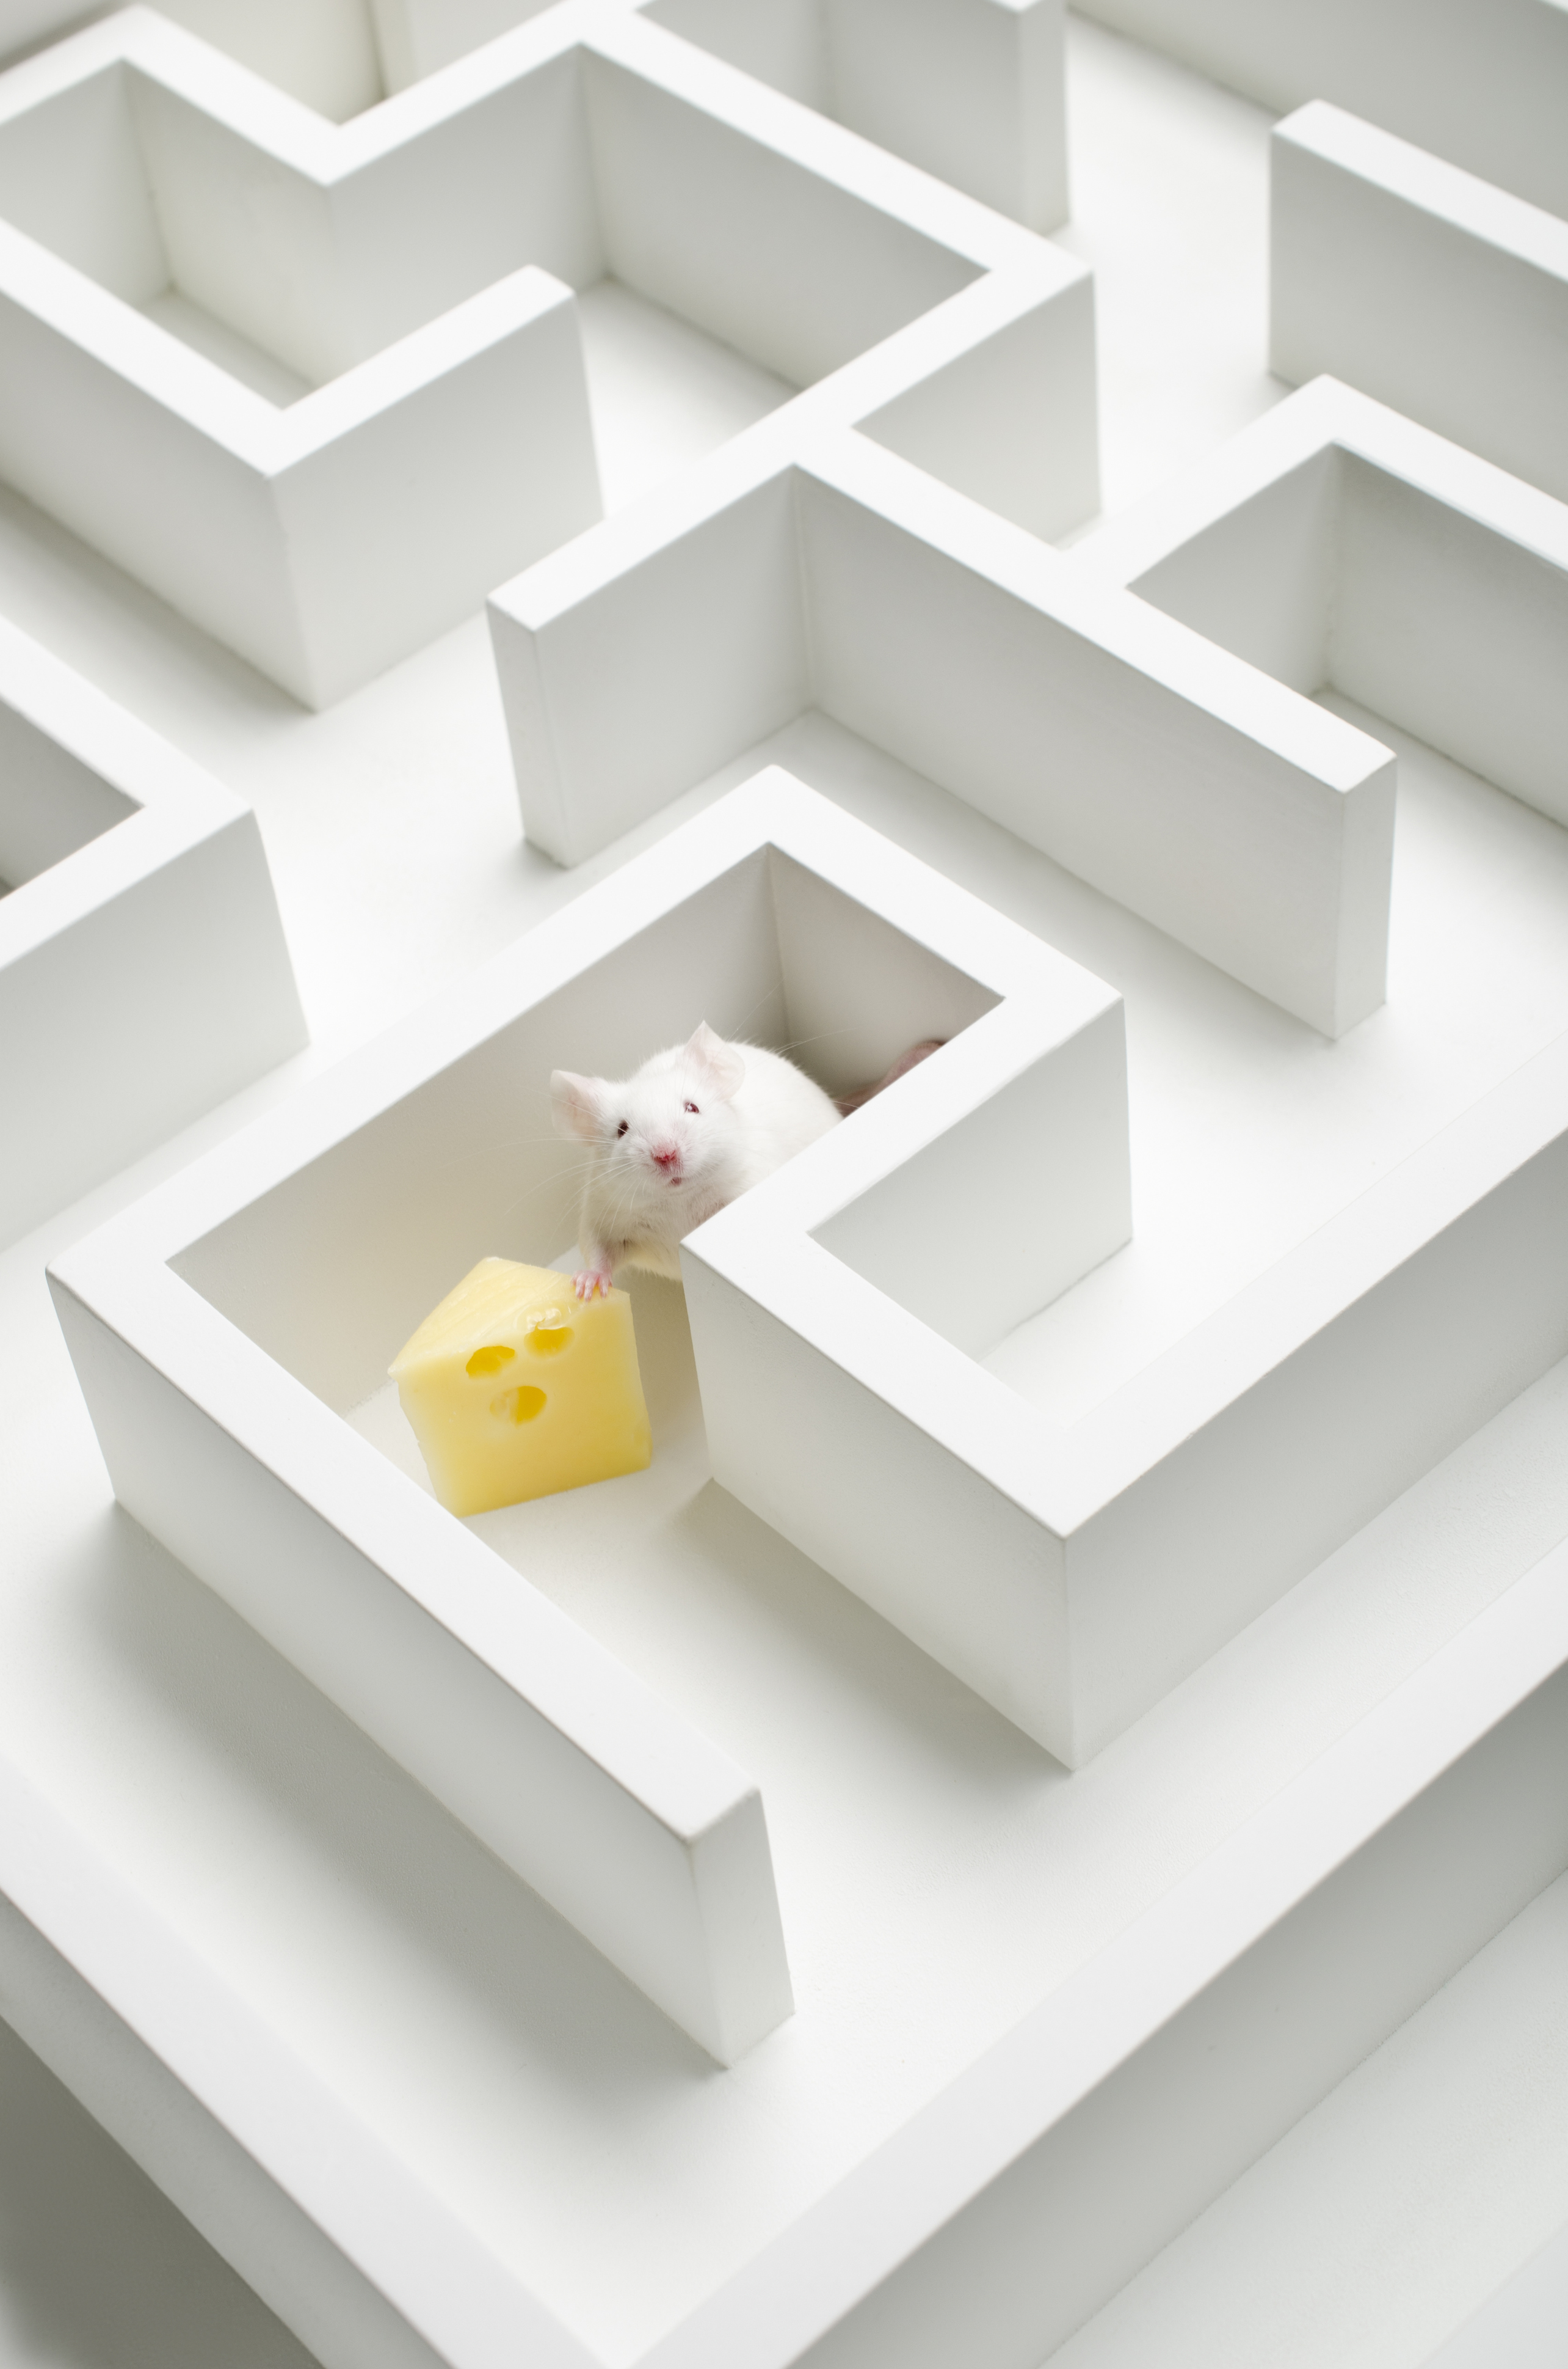
Lab Session
Home Exam 1 solutions

