Slide 1
Algorithms & Data Structures
NTNU 2302—Retrospective

Slide 2
Agenda
Quick Tour
Lecturer Feedback
Students’ Feedback

Slide 3
Learning Outcomes
Competence
Computational Problem Solving
Skills
Design Alg. & D.S. to solve specific problems
Argue for correctness
Knowledge
Big-Oh
Compare Efficiencies
RAM
Arrays, Lists
Trees
Graphs
Hashing
Recursions

Slide 4
Syllabus
Foundations
Arrays
Lists
Recursion
Sorting
Hashing
Trees
Graphs
Combinatorial Optimization
Regular Expressions
Wrap-up
2 weeks
2 weeks

Slide 5

Course Organization
Take Home Exam
Take Home Exam
1
2
3
4
5
6
7
8
9
10
11
12
13
14
15
Foundations
Foundations
Arrays
Lists
Recursion
Sorting
Hashing
Trees
Trees
Graphs
Optimization
RE
Wrap-up
Rerview
Exam
Lecture (30 – 40 min)
Lecture (30 – 40 min)
Lecture (30 – 40 min)
Weekly Quiz
(optional)
Lab. Session (1 h)
Lab. Session (1 h)
Lab. Session (1 h)

Slide 6
Lecturer’s Feedback
The “competence” did not went through
Underestimation of the ”effort” required to acquire the competence
Failed to engage students (5 – 10 students attending)
Lab sessions: Live-coding did not work

Slide 7
Students’ Feedback
From a survey run before the Exam

Slide 8
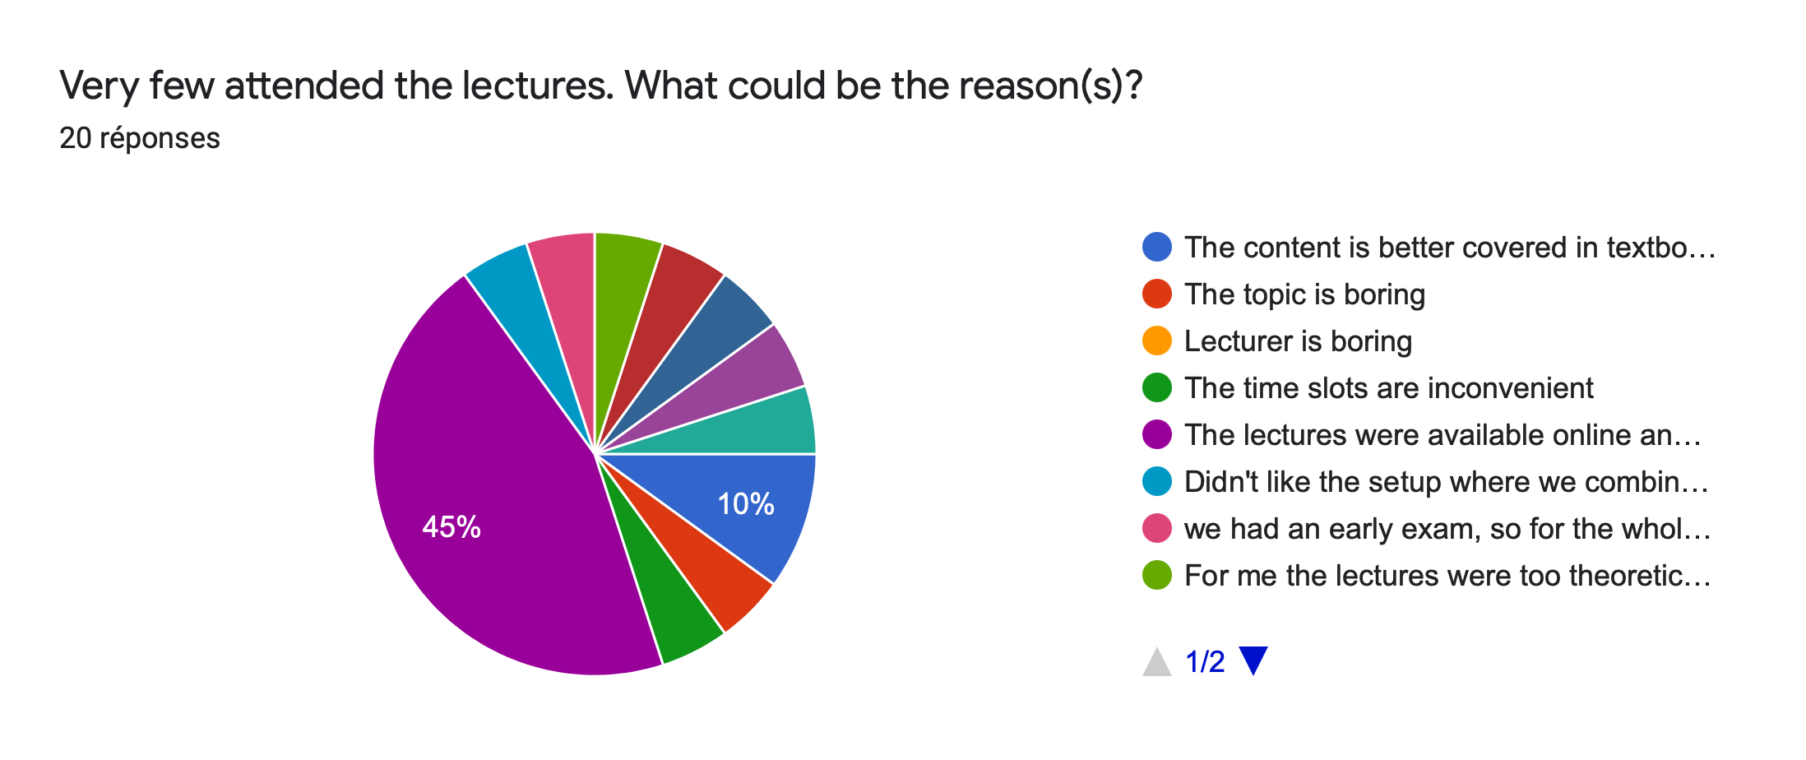
Low Participation

Slide 9
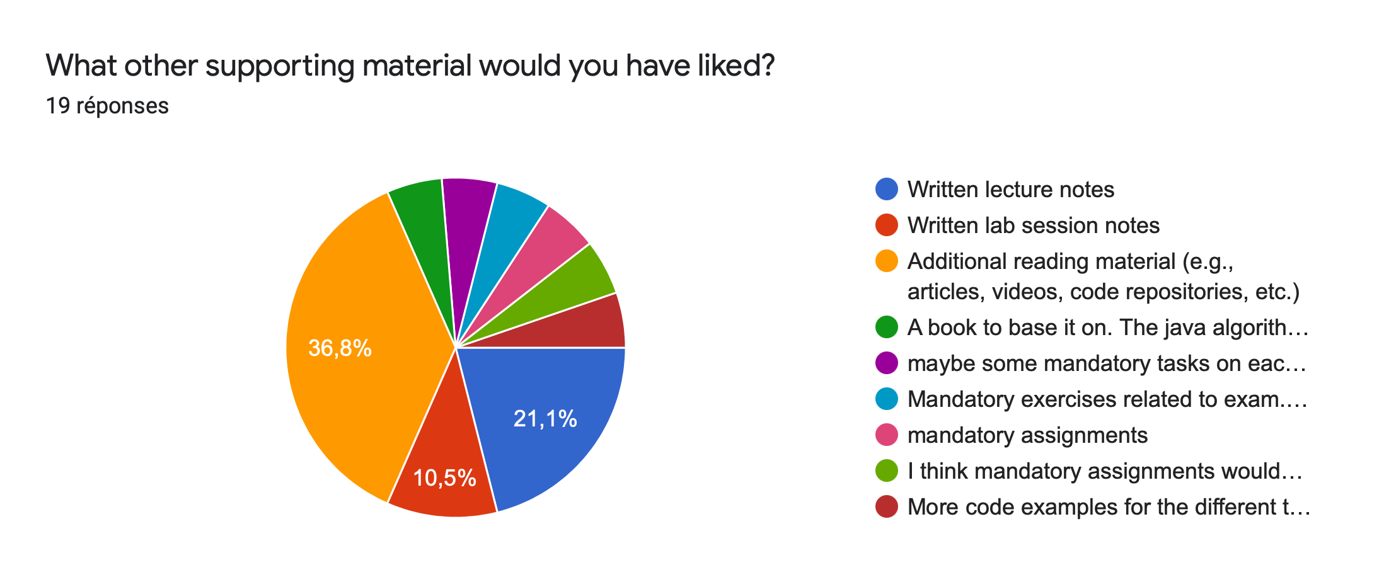
Material

Slide 10
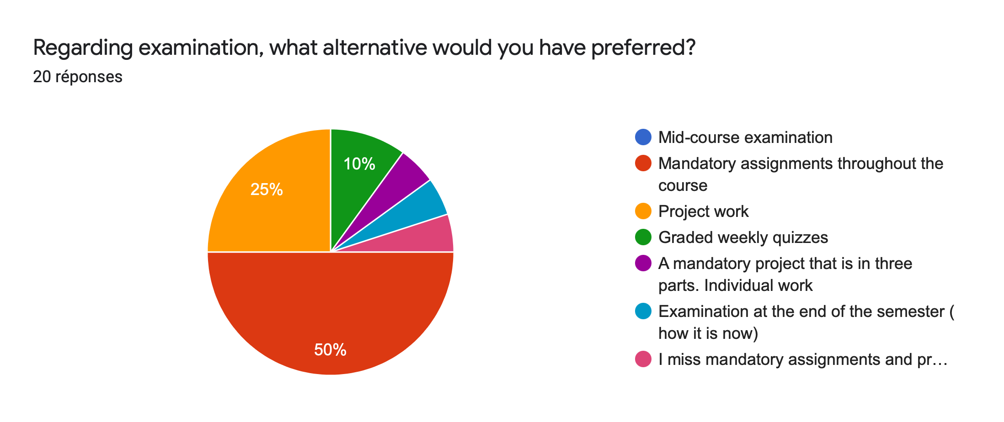
Examination

Slide 11
Changes for 2022
No video streaming
Detailed lectures notes
Done for the theoretical part
Many more as time allows
Mandatory home exams?
Better lab/longer lab sessions

Slide 12
Lab Session Plan
Take Home Exam
Take Home Exam
1
2
3
4
5
6
7
8
9
10
11
12
13
14
15
Foundations
Foundations
Arrays
Lists
Recursion
Sorting
Hashing
Trees
Trees
Graphs
Optimization
RE
Wrap-up
Rerview
Exam
???
RLE (arrays)
Sorting
Cr
BST
(trees)
Mazes
(Graph & Opt.)
Cr

Slide 13
Thank You
franck.chauvel@ntnu.no

Slide 14
Java
Maven
Git

