Slide 1
IDATA2302—Onboarding
Algorithms & Data Structures
Thanks for helping

Slide 2
Agenda
Overview of the course
Feedback from last year
Plan for next year
Lab ideas

Slide 3
Course Overview
IDATA 2302 as during the fall 2021

Slide 4
Learning Outcomes
Competence
Computational Problem Solving
Skills
Design Alg. & D.S. to solve specific problems
Argue for correctness
Knowledge
Big-Oh
Compare Efficiencies
RAM
Arrays, Lists
Trees
Graphs
Hashing
Recursions
etc.

Slide 5
Syllabus
Foundations
Arrays
Lists
Recursion
Sorting
Hashing
Trees
Graphs
Combinatorial Optimization
Regular Expressions
Wrap-up
2 weeks
2 weeks

Slide 6

Course Organization
Take Home Exam
Take Home Exam
1
2
3
4
5
6
7
8
9
10
11
12
13
14
15
Foundations
Foundations
Arrays
Lists
Recursion
Sorting
Hashing
Trees
Trees
Graphs
Optimization
RE
Wrap-up
Rerview
Exam
Lecture (30 – 40 min)
Lecture (30 – 40 min)
Lecture (30 – 40 min)
Weekly Quiz
(optional)
Lab. Session (1 h)
Lab. Session (1 h)
Lab. Session (1 h)

Slide 7
Feedback
From students and myself

Slide 8
Lecturer’s Feedback
The “competence” did not went through
Underestimation of the ”effort” required to acquire the competence
Failed to engage students (5 – 10 students attending)
Lab sessions: Live-coding did not work

Slide 9
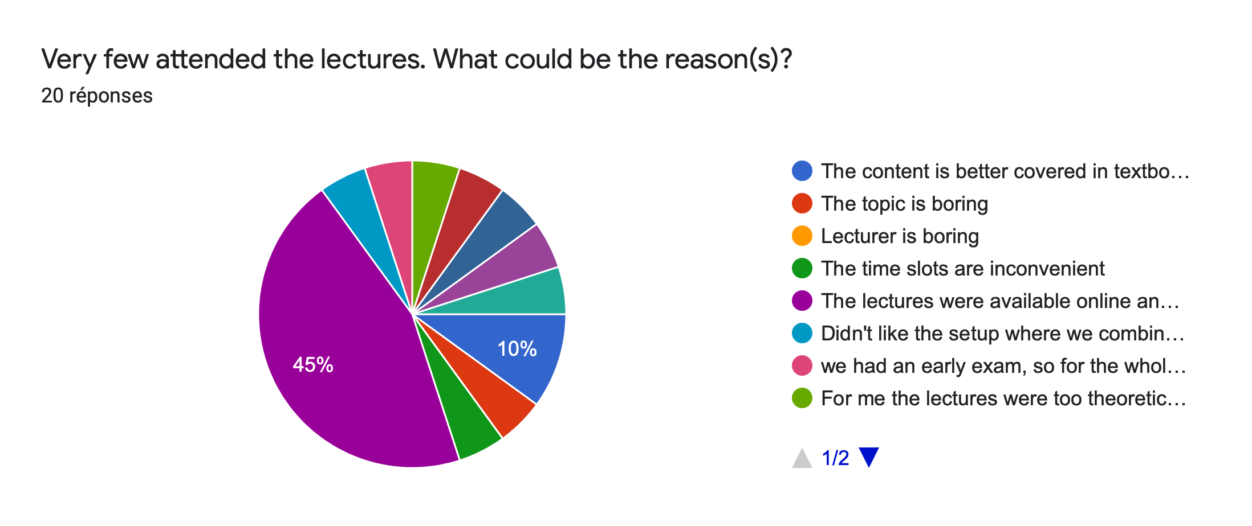
Students’ feedback—Participation

Slide 10
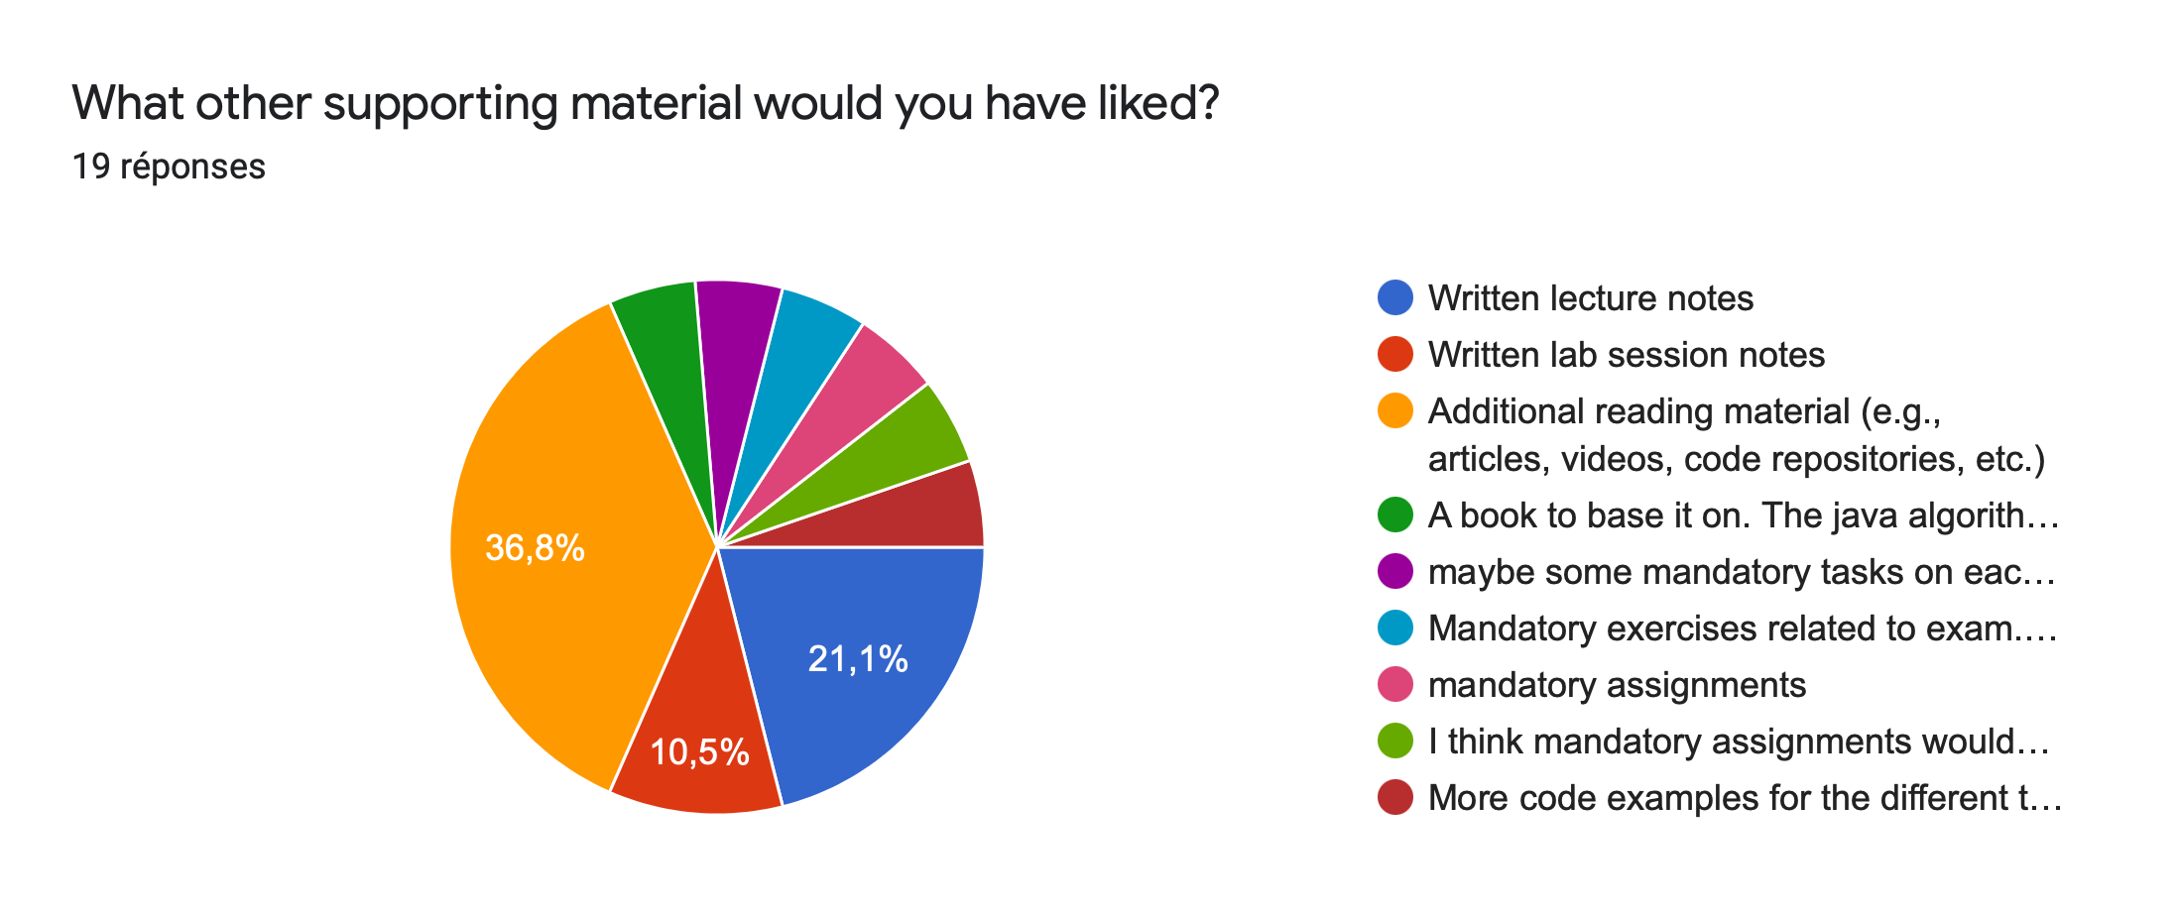
Student’s feedback—Material

Slide 11
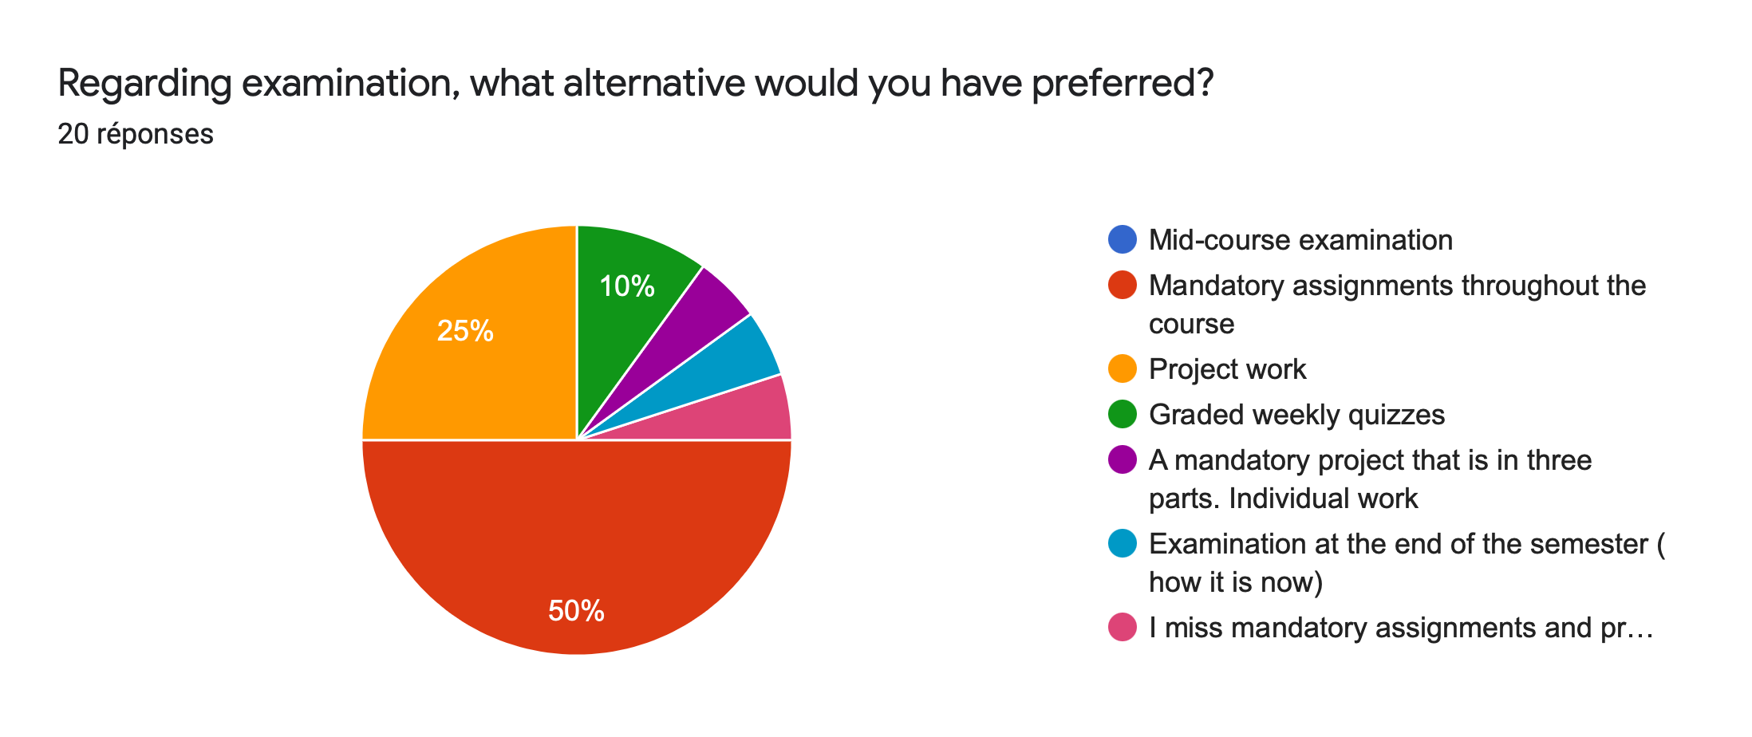
Students’ feedback—Examination

Slide 12
Plan for next round

Slide 13
Syllabus 2022 (1/2)
Test Exam 1
Foundations
Arrays
Lists
Recursion
Sorting II
Hashing
Week 1
Week 2
Week 3
Week 4
Week 5
Week 6
Week 7
Intro
RAM
Correctness
Efficiency
Alg. Analysis
Big-Oh
Arrays
Dyn. Arrays
Searching
Sorting I
Stacks & Q
Lists
Proc. Calls
Recursion
Recurrence
Quick Sort
Merge Sort
Bound
Intro
Collisions
Bloom filters
S
S
S
S
S
S
S
S
S
S
S
S
S
S
S
S
S
S
S
S
S
LN
LN
LN
LN
LN
LN
LN
LN
LN
LN
LN
LN
LN
LN
LN
LN
LN
LN
LN
LN
LN
Quiz 1
Quiz 2
Quiz 3
Quiz 4
Quiz 5
Quiz 6
Quiz 7
Lab: ???
Lab: Run-length Encoding
Lab: Sorting Visualization
Test Exam 1
solution

Slide 14
Syllabus 2022 (2/2)
Test Exam 2
Trees
Graph
Optimization
Regex
Wrap-Up
Review
Week 8
Week 9
Week 10
Week 11
Week 12
Week 13
Week 14
Trees Intro
BST
AVL Trees
Heaps
Tries
BTrees
Intro
Shortest Path
MST & Flows
Local Search
Heuristics
DP
String Match
Regex
P vs. NP
Parallel Cpt
Quantum Cpt
Alg. Design
S
S
S
S
S
S
S
S
S
S
S
S
S
S
S
S
S
S
S
S
S
LN
LN
LN
LN
LN
LN
LN
LN
LN
LN
LN
LN
LN
LN
LN
LN
LN
LN
LN
LN
LN
Quiz 8
Quiz 9
Quiz 10
Quiz 11
Quiz 12
Quiz 13
Lab: Binary Search Trees
Lab: Maze Generation & Resolution
Test Exam 2
(solution)
Review

Slide 15
Lab Sessions
Guidance from NTNU/IIR Dept
My own ideas
Java / JavaFX / MAVEN
Playful
Github Classroom / Blackboard
Not too many pen and paper exercises
Solving problem first
Complexity
Correctness
Not a Java Prog course

Slide 16
Lab Session Ideas

Slide 17
Lab: Run-length Encoding
Principle:
Black & White Image compression
Data Compression
Given:
[1,1,1,2,2,5,1,1,1,1]
Compressed as:
[3, 1, 2, 2, 1, 5, 4, 1]
Array manipulation
Calculation
Time & Space
Compression ratio
Where/When will it work best

Slide 18
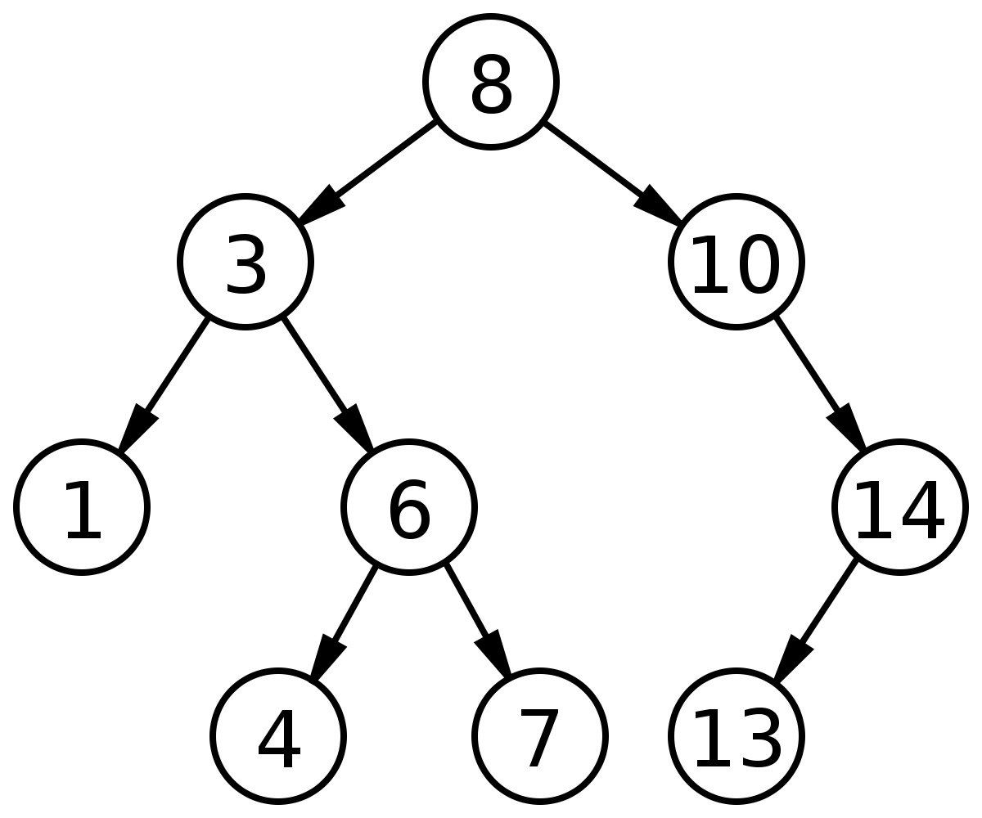
Lab: Binary Search Tree
Principle
Lab
Implement a BST module
insert
delete
depth
predecessor
search

Slide 19

Lab: Sorting Visualization
Principle
Find a permutation that adhere to the ordering
Maps arrays numbers to shades of grey
Implement various algo
Visualization of action

Slide 20
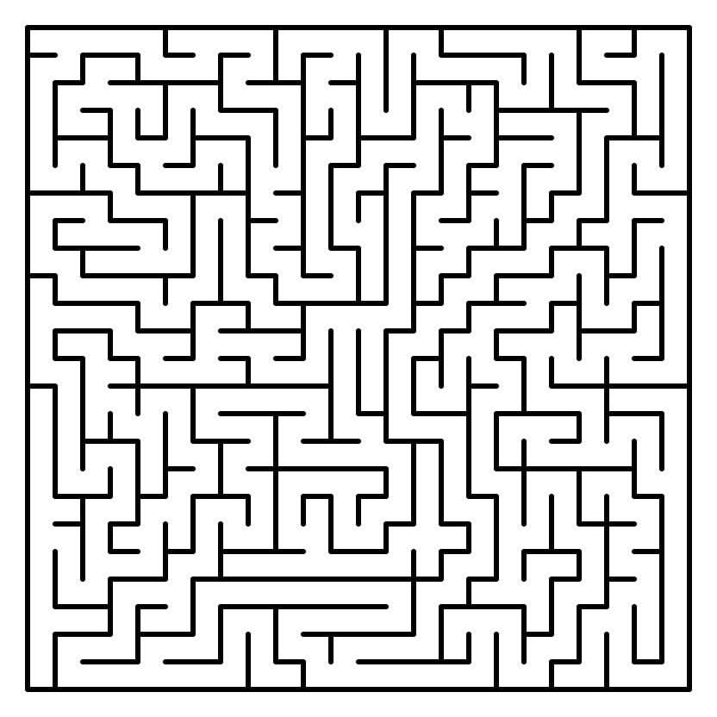
Lab: Mazes
Generate random mazes
Trees & Graph
MST
Solve Maze
Dijsktra
Optimize Route

Slide 21
Thank You! Ideas are Welcome
franck.chauvel@ntnu.no

Slide 22
Syllabus 2022 (1/2)
Test Exam 1
Foundations
Arrays
Lists
Recursion
Sorting II
Hashing
Week 1
Week 2
Week 3
Week 4
Week 5
Week 6
Week 7
Intro
RAM
Correctness
Efficiency
Alg. Analysis
Big-Oh
ADT
Arrays
Searching
Sorting I
Stacks & Qs
Lists
Proc. Calls
Recursion
Recurrence
Quick Sort
Merge Sort
Bound
Intro
Collisions
Bloom filters
S
S
S
S
S
S
S
S
S
S
S
S
S
S
S
S
S
S
S
S
S
LN
LN
LN
LN
LN
LN
LN
LN
LN
LN
LN
LN
LN
LN
LN
LN
LN
LN
LN
LN
LN
Quiz 1
Quiz 2
Quiz 3
Quiz 4
Quiz 5
Quiz 6
Quiz 7
Lab: ???
Lab: Run-length Encoding
Lab: Sorting Visualization
Test Exam 1
solution

Slide 23
Syllabus 2022 (2/2)
Test Exam 2
Trees
Graph
Optimization
Regex
Wrap-Up
Review
Week 8
Week 9
Week 10
Week 11
Week 12
Week 13
Week 14
Trees Intro
BST
AVL Trees
Heaps
Tries
BTrees
Intro
Shortest Path
MST & Flows
Local Search
Heuristics
DP
String Match
Regex
P vs. NP
Parallel Cpt
Quantum Cpt
Alg. Design
S
S
S
S
S
S
S
S
S
S
S
S
S
S
S
S
S
S
S
S
S
LN
LN
LN
LN
LN
LN
LN
LN
LN
LN
LN
LN
LN
LN
LN
LN
LN
LN
LN
LN
LN
Quiz 8
Quiz 9
Quiz 10
Quiz 11
Quiz 12
Quiz 13
Lab: Binary Search Trees
Lab: Maze Generation & Resolution
Test Exam 2
(solution)
Review

