Slide 1
Stacks and Queues
Introduction to Abstract Data Types
Week 4 / Lecture 3
Franck Chauvel
Axbit & NTNU
franck.chauvel@ntnu.no

Slide 2
Arithmetic Expression
“12 + ((15 * 3) / 2) – ((1 + 4) * 3) + 2)”
—How can we possibly interpret this?
—Using a stack!

Slide 3
Agenda
Stacks
Abstract Data Types
Correctness
Design by contract
Queues
Recap

Slide 4

Stacks
Incoming
item
Outgoing
item
Item 3
top
Item 2
length
Item 1
bottom

Slide 5
Stacks’ Operations
create()
push(item)
pop()
top(): Item
size()

Slide 6
How would you implement a Stack?
Linked list or Array?

Slide 7

With an Array
Avoid shifting the array
push => insert at the end
$Θ(1)$
pop => remove at the end
$Θ(1)$
???
addresses
Item 1
base
Item 2
size
Item 3
top
Res.
Res.
capacity
Res.
???

Slide 8
With a Linked List?
No need for a pointer to “last”.
Push => insert in front
Pop => remove in front
Size must be stored
top
Size:3
Item 3
Item 2
Item 1
/

Slide 9
So, What is this “Stack” thing?

Slide 10
Abstract Data Types
Classes
Abtsract Data Types
Interfaces
Types

Slide 11
What’s in an ADT?
Domains
Axioms
Operations

Slide 12
Domains
Item: the set of all possible items we will store on a stack
Stack: the set of all possible stacks
Boolean numbers
Integers numbers
Errors & Exceptions

Slide 13
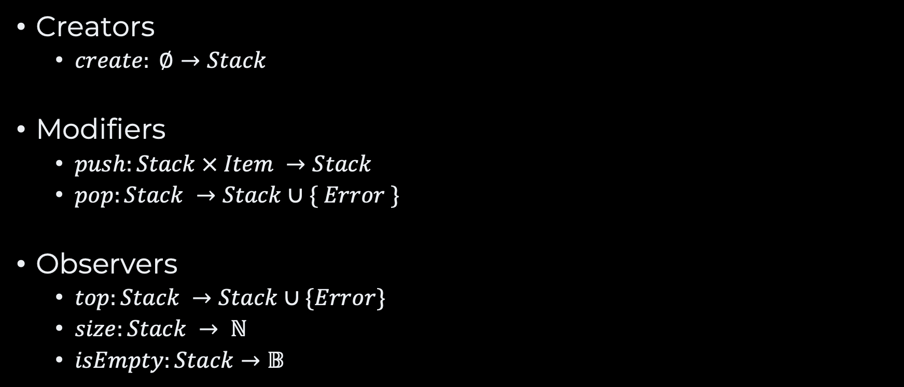
Operations
Creators
$create: ∅→Stack$
Modifiers
$push:Stack × Item →Stack$
$pop:Stack →Stack∪\{ Error \}$
Observers
$top:Stack →Stack∪\{Error\}$
$size:Stack → ℕ$
$isEmpty:Stack→𝔹$

Slide 14
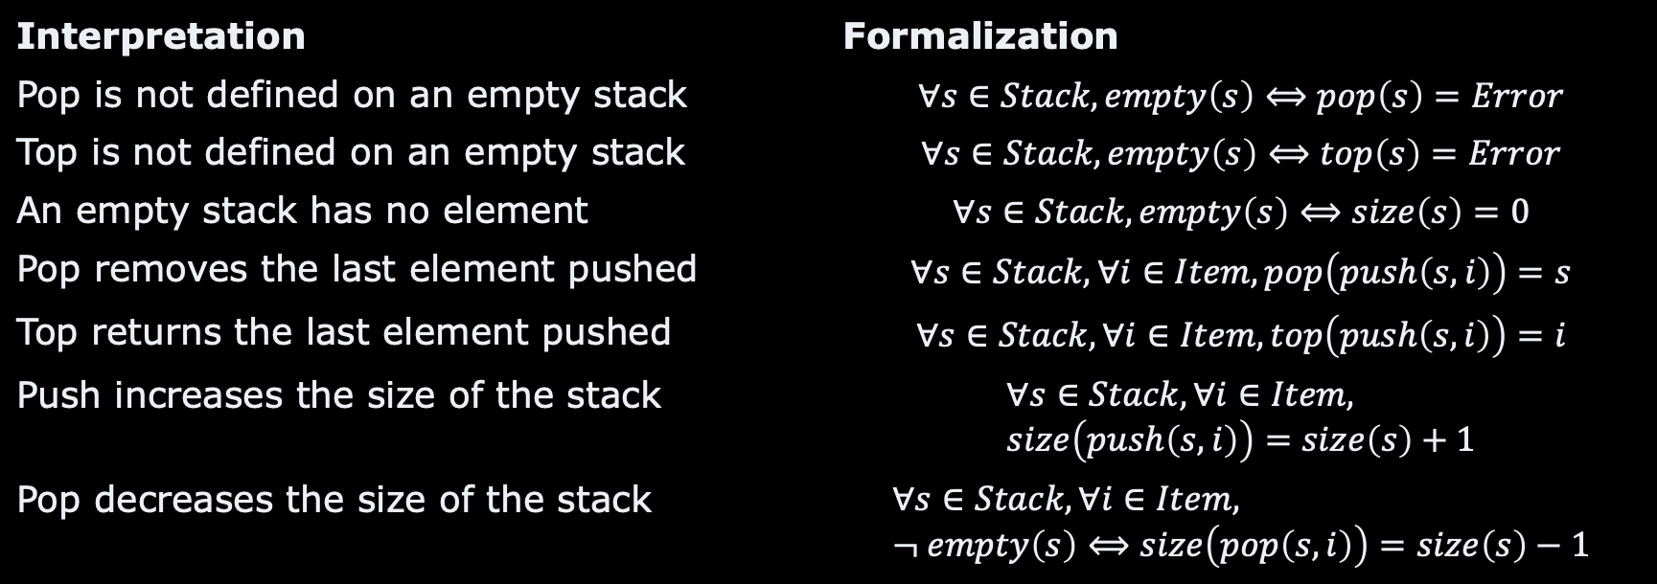
Axioms
Interpretation | Formalization
Pop is not defined on an empty stack | $$∀s∈Stack,empty\left(s\right)⟺pop\left(s\right)=Error$$
Top is not defined on an empty stack | $$∀s∈Stack, empty\left(s\right)⟺top\left(s\right)=Error$$
An empty stack has no element | $$∀s∈Stack, empty\left(s\right)⟺size\left(s\right)=0$$
Pop removes the last element pushed | $$∀s∈Stack, ∀i∈Item, pop\left(push\left(s, i\right)\right)=s$$
Top returns the last element pushed | $$∀s∈Stack, ∀i∈Item, top\left(push\left(s,i\right)\right)=i$$
Push increases the size of the stack | $$∀s∈Stack, ∀i∈Item, size\left(push\left(s, i\right)\right)=size\left(s\right)+1$$
Pop decreases the size of the stack | $$∀s∈Stack, ∀i∈Item, ¬ empty\left(s\right)⟺size\left(pop\left(s, i\right)\right)=size\left(s\right)−1$$

Slide 15
Why Does it Matters?
effort
Correctness
Proofs
Design-by-Contract
Software
Testing
confidence

Slide 16
Correctness Proofs
Specification
(contract)
Specification
(contract)
correct
implementation
product
erroneous
implementation
product

Slide 17
Design-by-contract
Methods pre-conditions
True before the method run
Methods post-conditions
True once the method has run
Classes invariants
True before and after the methods
public Item pop() {
final int previousLength = this.length;
if (this.isEmpty())
throw new IllegalStateException("Cannot 'pop’ an empty stack!");
Item top = this.top();
this.items[this.length-1] = null;
this.length -= 1;
if (this.length != previousLength-1)
throw new RuntimeException("Invalid pop behaviour")
return top;
}

Slide 18
ADT & Testing
Tests target axioms
Arrange/Act/Assert
Tests only show the presence of bugs, never their abscence
@Test
public void testPopDecreasesSize() {
// Arrange
Stack<Integer> stack = new Stack<Integer>(10);
stack.push(5);
stack.push(10);
stack.pop(); // Act
assertEquals(1, stack.size());
}

Slide 19
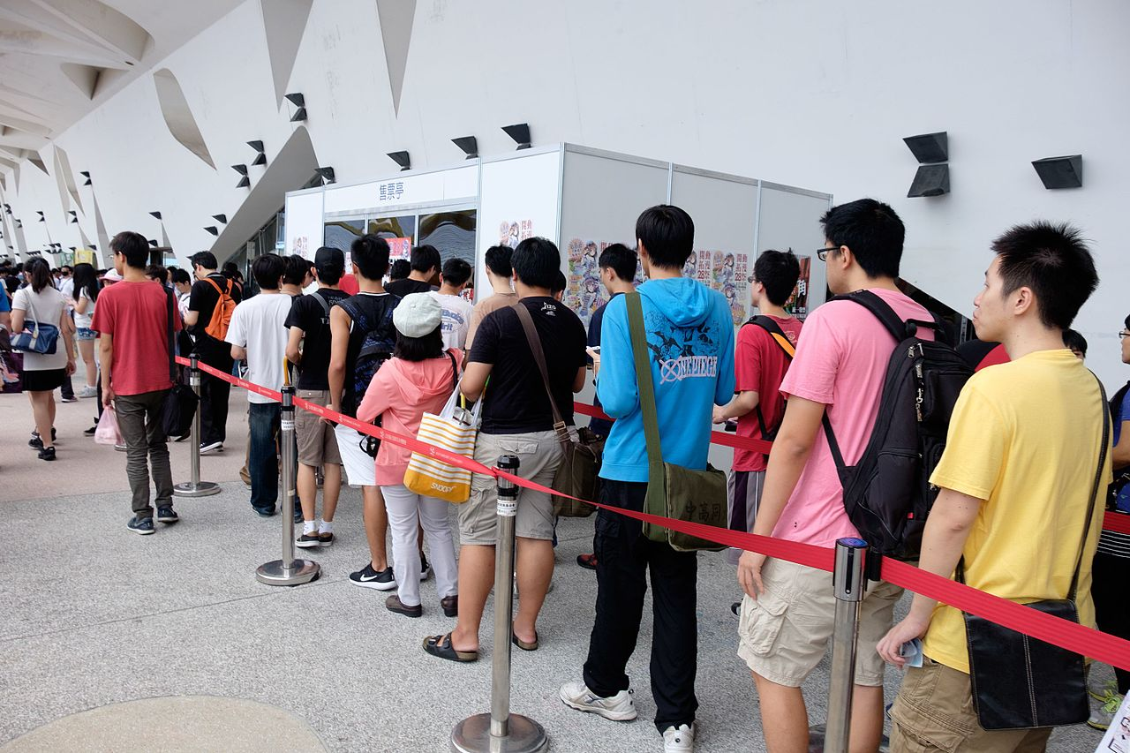
Queues
Incoming
item
back
Item 3
Item 2
length
front
Item 1
Outgoing
item

Slide 20
Queues Operation
Incoming
item
create()
Create a new queue
enqueue(item)
Add a new item at the back of the queue
dequeue(): item
Remove the item in front of the queue
size()
Returns the number of items in the queue
back
Item 3
Item 2
size
front
Item 1
Outgoing
item

Slide 21
How would you implement a queue?
Linked list or Array?

Slide 22
Arithmetic Expression
“12 + ((15 * 3) / 2) – ((1 + 4) * 3) + 2)”

Slide 23
Recap
Abstract Data Types
Specification vs. implementation
Domains + operations + axioms
Many
Stacks, queues, lists, interval, numbers, wallet, etc.
Correctness!
Foundation for OOP
Stacks
LIFO
Last in, first out
Queues
FIFO
First in, first out

Slide 24
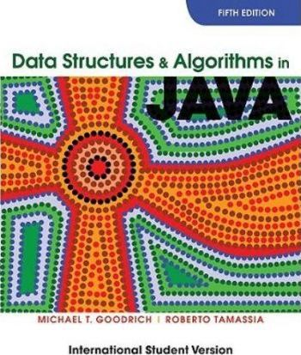
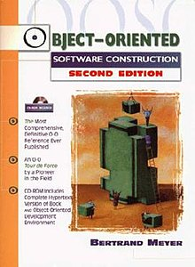
Suggested Readings
M. T. Goodrich, R Tamassia. Stacks and Queues (Chap. 5) in Data Structures and Algorithms in Java. 5th ed. Wiley. 2011
B. Meyer. Abstract Data Types (Chap 6) in “Object-oriented software construction”. Prentice Hall. 1997

Slide 25
Questions, Comments, or Ideas?
Franck Chauvel
axbit & NTNU
franck.chauvel@ntnu.no

Slide 26
Lab Session Continued
List
Roll your own linked list module!
create
insert
delete
search
length
last
first
/
Node 1
n
p
Node 2
n
p
Node 3
/

