Slide 1
Hash Tables
A Brief Introduction to Hashing
Week 7 / Lecture 1
Franck Chauvel
axbit & NTNU
franck.chauvel@ntnu.no

Slide 2



Remember “Searching”?
Array / List
Sorted Array
Place items as they come
Linear search
$O(n)$
Order items by key
Binary Search
$O(\log_{2}{n)}$
Hash tables gives us $O\left(1\right)$

Slide 3
Agenda
What is a “Hash-Table”?
ADT: Dictionary
Hash functions
Beyond Hash tables

Slide 4
The Idea
index
00
01
John Doe +47-89-89-89-89, …
key
information
01
bucket
John Doe
Hash Function
02
John Doe
+47-89-89-89-89
john@doe.com
03
?
Lisa Smith +47-67-67-67-67, …
04
04
Lisa Smith
Lisa Smith
05
+47-67-67-67-67
lisa@smith.no
…
HASH: Map keys to indexES
N

Slide 5
The “Dictionary” ADT
public class Dictionary<Key, Value> {
public Dictionary() {}
public Value get(Key key) throws KeyError;
public void put(Key key, Value value);
public boolean isEmpty();
public Value remove(Key key) throws KeyError;
}
private int hash(Key key) {
return ...;
}

Slide 6
Creation
class KeyError extends Exception {}
class Dictionary<Key, Value> {
private class Pair<Key, Value> {
final Key key;
final Value value;
Pair(Key key, Value value) {
this.key = key;
this.value = value;
}
}
private final int capacity;
private Object[] content;
public Dictionary(int capacity) {
this.content = new Object[capacity];
this.capacity = capacity;
}
private int hash(Key key) {
return …;
}
}

Slide 7
Search
index
00
01
John Doe +47-89-89-89-89, …
bucket
Hash Function
Lisa Smith
Lisa Smith
02
+47-67-67-67-67
lisa@smith.no
03
public Value get(Key key) {
int index = hash(key);
Value value = content[index];
if (value == null)
throw new KeyError(key);
return value;
}
04
Lisa Smith +47-67-67-67-67, …
04
05
…
N

Slide 8
Insertion
public void put(Key key, Value value) {
int index = hash(key);
content[index] = value;
}

Slide 9
Deletion
public Value remove(Key key) throws KeyError {
int index = hash(key);
value = content[index];
if (value == null)
throw new KeyError();
content[index] = null;
return value;
}

Slide 10

What is a good key?
Unique
Immutable

Slide 11
Collisions
index
00
01
John Doe +47-89-89-89-89, …
key
information
01
bucket
John Doe
Hash Function
02
John Doe
+47-89-89-89-89
john@doe.com
03
?
04
Lisa Smith
05
+47-67-67-67-67
lisa@smith.no
…
N

Slide 12
Hash Functions
Space of possible keys
Hash Functions
Injection?
Uniform distribution
Keys
Fixed length:
Shorter than int: bool, byte, short, int, char, float
Longer: long, double
Variable length:
string, arrays, objects
Step 1: Hashing
Integer line
Step 2: Compression
0
1
2
N
table indexes

Slide 13
Fixed Length: Casting
Bytes can mean anything
“Type” is an expectation
4 bytes
4A
6F
68
6E
1 248 815 214 (32-bit int)
1 248 815 214 (32-bit int)
3 922 459.5 (32-bit float)
John (UTF-8 text)
䩯桮 (UTF-16 text)
RGBA Color

Slide 14
Hash Code by Summation Key of variable length
int size
int hashCode(long value) {
return (int)((value >>> 32) + (int) value);
}
Part 1
Part 2
Part 3
hash(“stop”) = hash(“tops”) = hash(“post”)
Part 1
Part 2
+
Part 3
Hash code

Slide 15
Polynomial Hash Codes Keys of variable length
int size
Part 1
Part 2
Part 3
int hashCode(String text) {
final int x = 37;
int sum = 1;
for (int index=0 ; index<text.length ; index++){
sum *= x + (int) text.charAt(index);
}
return sum;
}
Part 1
x
a⁰
Part 2
x
a¹
+
Part 3
x
a²
Hash code

Slide 16
Cyclic Shifts
l
k
1
0
1
0
1
1
1
0
1
0
ROTL:
1
0
int size
(value << k) | (value >>> (l-k))
Part 1
Part 2
Part 3
k
Part 1
int hashCode(String text) {
int sum = 0;
for (int index = 0; index < text.length(); index++) {
sum = (sum << 5) | (sum >>> 27);
sum += (int) text.charAt(index);
}
return sum;
}
ROTL(
,
)
+
Part 2
ROTL(
k
,
value
)
+
Part 3
hash code

Slide 17


Compression: MOD & MAD
$MOD\left(x\right)=h mod N$
$MAD\left(x\right)=\left[\left(ah+b\right) mod p\right] mod N$

Slide 18
Hashing
Beyond hash tables

Slide 19



File Digest
Remote Server
hash
Assume no collisions
Key is the whole file!
Example:
MD5
SHA-1 / SHA-2
CRC-32
large file
checksum
Client
=?
local copy
checksum copy
local checksum

Slide 20
Cryptography
Registration:
“password”
hash
code
Hashing as encryption
Crypotgraphic hash function
Compression
User
DB
code
=?
Authentication:
“passwordd”
hash
code

Slide 21
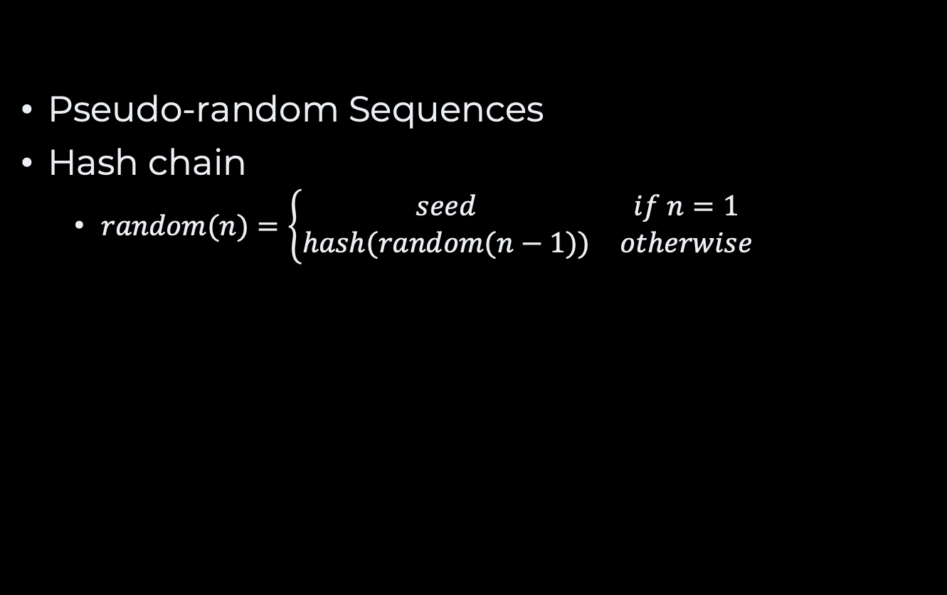
Random Number Generation
Pseudo-random Sequences
Hash chain
$random(n)=\left\{\begin{matrix}seed & if n=1 \\ hash(random(n−1)) & otherwise\end{matrix}\right.$

Slide 22
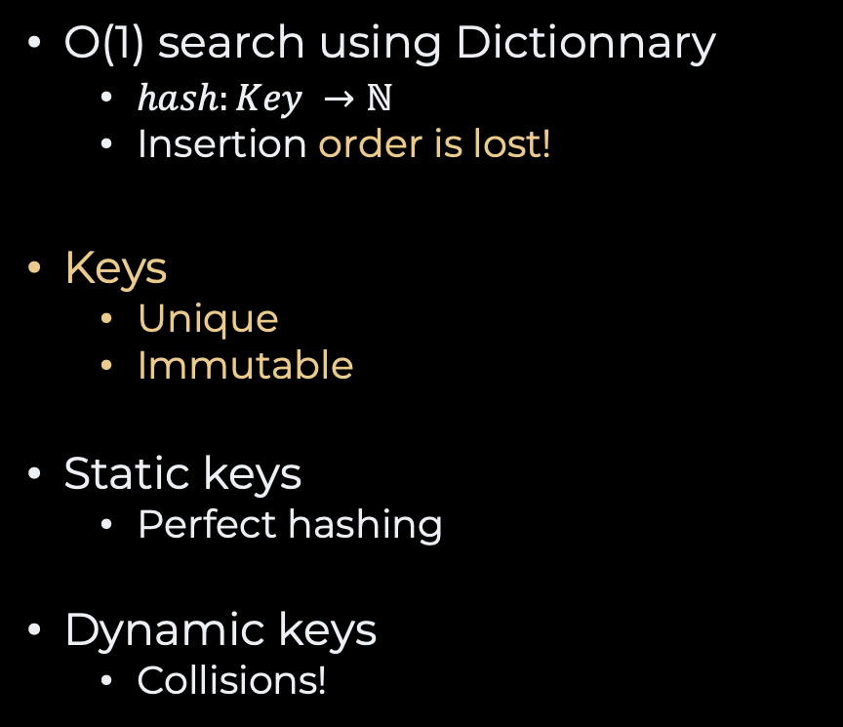
Recap
O(1) search using Dictionnary
$hash:Key →ℕ$
Insertion order is lost!
Keys
Unique
Immutable
Static keys
Perfect hashing
Dynamic keys
Collisions!
Hash = code + compression
Fixed key-length
Casting
Summation
Variable key-length
Polynomial
Cyclic shifts
Compression
MAD vs. MOD

Slide 23
Questions, Comments, or Ideas?
Franck Chauvel
axbit & NTNU
franck.chauvel@ntnu.no

Slide 24

Lab Session
Home Exam 1 solutions

