Slide 1
Procedures and Recursion
Efficiency of Dynamic Memory Allocation
Week 1 / Lecture 1
Franck Chauvel
Axbit & NTNU
franck.chauvel@axbit.com

Slide 2
Remember Linked Lists?
Pointers
Memory allocation
Procedures calls
How efficient is all of that?
  We don’t want to let any stone unturned!

Slide 3
Agenda
Pointers
Procedures C
  Inlining vs. Linking
  Call-stack
  Example: n!
Dynamic Allocation
Recap

Slide 4
Pointers
Memory:
0000
A memory cell
  that contains the address of another memory cell
Indirect addressing
Dereferencing
  Get the value stored at in the cell refered by the pointer
0001
0002
0005
0003
0004
0005
0006

Slide 5
RAM Dereferencing
CONSTANT TIME!
RAM model has no indirect addressing
Self-modifying code!
Example:
  How to load the value referenced by a pointer?
LOAD 0
ADD pointer
STORE action+1
action: LOAD 0

Slide 6
Procedure Calls
Procedures = Functions, Subroutines, etc.
  Single entry points
  Parameters
  Local variables
  Returns a results
DRY: Don’t Repeat Yourself
Enable recursion
What does it cost in terms of time and space?
  Go Back to the RAM model!

Slide 7
Two Approaches
Inlining
  The compiler
  replaces the “call” with the body
Code becomes fat
No recursive procedures!
Linking
  Branch to another program

Slide 8
Linking
Separate code for each function
  Caller evaluates the arguments
  Pass them to the callee, with the control
  Callee carries out the computation
  Callee returns a result and the control
Requires a calling convention

Slide 9
Introducing “the Call-stack”
Caller & callee need to agree upon:
  Where are the arguments
  Where the callee should return/branch
  Where the calle should place the results
Dedicated memory segment: the “call-stack”
Requires a convention
Call-stack
Free Memory
Call-stack
growth
Program Data
Address
Program Instructions

Slide 10
Convention / Caller
stack bottom
previous callers
Caller pushes each argument
Caller pushes the return address
… callee does …
Caller pops the result
Caller pops each argument
Previous frame pointer
Local variables
Argument #N
...
Argument #2
Argument #1
caller
Return address
Previous frame pointer
callee
Local variables
stack top

Slide 11
Convention / Callee
stack bottom
previous callers
pushes the frame pointer
pushes its local variables
Computes the result
pops its local variables
pushes the return address
pops and restores the callers frame pointer
pushes the result
jumps to the return address
Previous frame pointer
Local variables
Argument #N
...
Argument #2
Argument #1
caller
Return address
Previous frame pointer
callee
Local variables
stack top

Slide 12
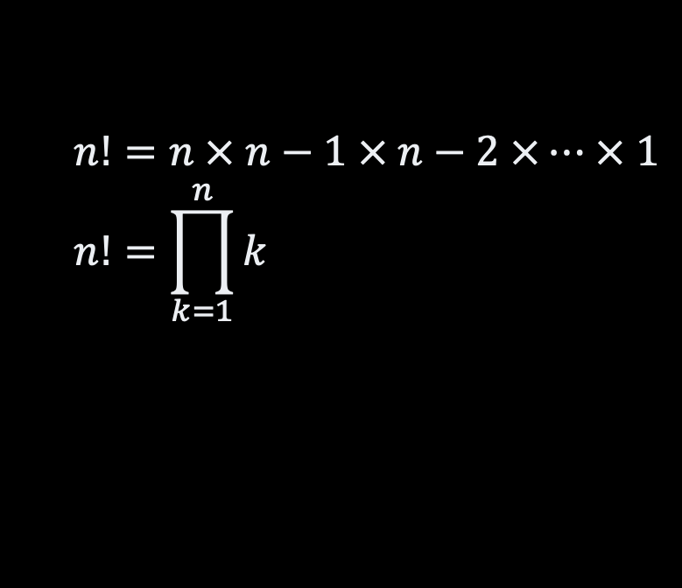
Example: n! “iterative”
#include <stdio.h>
long factorial(int value) {
long product = 1;
for(int each=2 ; each <= value ; each++) {
product = product * each;
}
return product;
}
int main() {
printf("5! = %d\n", factorial(5));
}
$$n!=n × n−1 × n−2 ×… × 1 \\ n!=\prod_{k=1}^{n}{k}$$

Slide 13
Slow Motion
stack bottom
#include <stdio.h>
long factorial(int value) {
long product = 1;
for(int each=2 ; each <= value ; each++) {
product = product * each;
}
return product;
}
int main() {
printf("5! = %d\n", factorial(5));
}
SP:
0
Result = 0
0
Arg. 1 = 5
FP:
return address
FP: 0
product: 0
each: 0

Slide 14
Example: n! recursive
#include <stdio.h>
long factorial(int value) {
if (value == 0) return 1;
return value * factorial(value-1);
}
int main() {
printf("5! = %d\n", factorial(5));
}
$$n!=n × n−1 × n−2 ×… × 1 \\ n!=\prod_{k=1}^{n}{k}$$

Slide 15
Slow Motion
stack bottom
“main” frame
#include <stdio.h>
long factorial(int value) {
if (value == 0) return 1;
return value * factorial(value-1);
}
int main() {
printf("5! = %d\n", factorial(5));
}
factorial(5)
factorial(4)
NOT CONSTANT SPACE!
factorial(3)
factorial(2)
factorial(1)
factorial(0)

Slide 16
Dynamic Memory Allocationx
How to create variables “on the fly”?
  Dynamic memory allocation
  Manual allocation
    E.g., malloc / free in C
Allocator
  Many strategies
How fast can we do that?
How much memory does it take?
Your
code
Language Runtime
(libraries)
Operating
System
Machine / Hardware

Slide 17
Introducing the “Heap”
Segment of memory dedicated for “dynamic variables”
Manual allocation
Call-stack
Free Memory
Call-stack
growth
Heap
Heap
growth
Static data
Address
Program Instructions

Slide 18
Heap & Fragmentation
Memory (Heap)
reserved
internal
fragmentation
2 operations
  allocate(size). Reserve a “block” of a given size
  free(address). Release a block
Problem: Fragmentation
  Internal: blocks are over-allocated. Memory is not used in practice
  External: only small blocks are free, but none is big enough
reserved
external
fragmentation
reserved
free blocks
growing addresses

Slide 19
Finding a Free Block
Memory (Heap)
reserved
block
start
size
Uses a “free list”
Many “allocation” strategy:
  Find the best fit
  Find the worse fit
  Find the first fit
  and more …
Not constant time!
  critical for high performance applications
block
start
size
block
start
size
best
NOT CONSTANT TIME!
reserved
block
start
size
worse
reserved
request
first

Slide 20
Recap
Call-stack
Memory Allocation
Free Memory
Call-stack
growth
Pointer
  Variable that contains an address
Stack
  Automated allocation
  Local variables
  Contiguous allocation
  Enable recursive procedures
Heap
  Manual allocation / deallocation
  Non-local variables
  Non contiguous allocation
Heap
Heap
growth
Static data
Address
Program Instructions

Slide 21
Recap
Efficiency
Pointers dereferencing takes constant time
Procedures calls takes constant time
But recursive functions take much more space!
We don’t know how much time dynamic memory allocation takes

Slide 22
Suggested Readings

Slide 23
Questions, Comments, or Ideas?
Franck Chauvel
Axbit & NTNU
franck.chauvel@gmail.com

