Slide 1
Linked Lists
Non-contiguous Memory Allocation
Week 4 / Lecture 2
Franck Chauvel
axbit & NTNU
franck.chauvel@ntnu.no

Slide 2
Why not Arrays?
Random insertion is expensive
Difficult to store items of different sizes
Arrays need resizing at some point
Sharing elements among arrays?

Slide 3
Agenda
What is a “Linked List”?
Singly Linked Lists
Search
Insertion
Deletion
Doubly Linked Lists
Insertion
Deletion
Recap

Slide 4
What is a Linked-list?
Memory:
A data structure
That stores collections
In non-contiguous memory cells
Trick: Each “node” has a “link” to the next node.
16
…
17
“F”
18
28
…
…
28
“R”
29
135
…
…
“F”
“R”
“A”
135
“A”
136
28
…
…

Slide 5
Pointers
A memory cell that contains an address
Indirect addressing
Ex: Indirect addressing on the RAM model?

Slide 6
Dynamic Memory Allocation
pointer = allocate(size)
Let us create new variables dynamically
Tell is which cells are is use and which are not.
Often provided by external libraries (e.g., libc)

Slide 7
Creating a Linked List in C
Use structures to describe both the List and its Nodes
Node* is a pointer to a Node
malloc allocates a piece of memory
free returns a piece of memory
typedef struct Node {
int value,
Node* next // This is pointer to a Node
} Node;
typedef struct List {
Node* first;
};
List* create_list() {
List* new_list = malloc(sizeof(List));
return new_list;
}

Slide 8
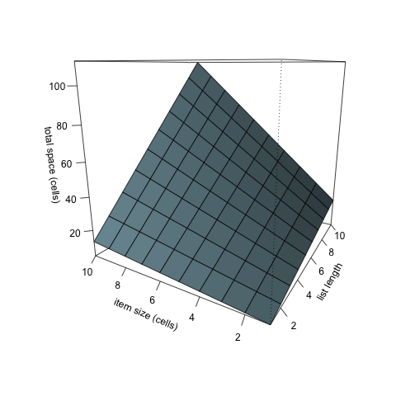
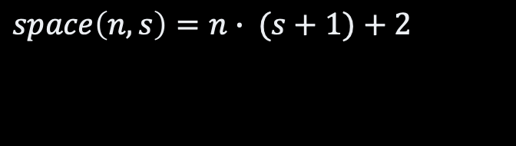
Space-efficiency
$$space\left(n, s\right)=n∙ (s+1)+2$$

Slide 9
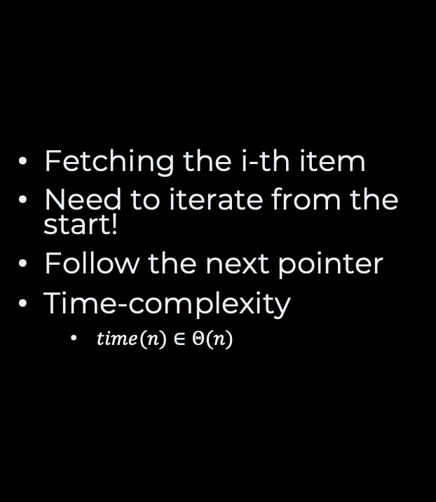
Access
Fetching the i-th item
Need to iterate from the start!
Follow the next pointer
Time-complexity
$time(n)∈{Θ(n)}^{}$
Node* get(List* list, int selected) {
Node* node = list->first;
int index = -1;
while (node != NULL) {
index += 1;
if (index == selected) {
return node;
}
node = node->next;
}
return NULL;
}

Slide 10
Search
Plain old linear search
Just like for arrays
int search(List* list, int value) {
int index = -1;
Node* current = list-> first;
while (current != NULL) {
index += 1;
if (current->value == value) {
return index;
}
current = current->next;
}
return -1;
}

Slide 11
Insertion at the back
void insert(List* list, int value) {
Node* new_node = malloc(sizeof(Node));
new_node->value = value;
new_node->next = list->first;
list->first = new_node;
}

Slide 12

Deletion
Node N-1
Node* previous = get(list, index-1);
Node* target = previous->next;
previous->next = target->next;
free(target);
Node N
Node N+1

Slide 13
Deleting the last item
List
Node* previous = get(list, index-1);
Node* target = previous->next;
if (target->next == NULL) {
list->last = previous;
previous->next = NULL;
}
free(target);
last
first
Node N-1
Node N
/

Slide 14
Deleting the first item
if (index == 0) {
Node* target = list->first;
if (target->next == NULL) {
list->first = NULL;
list->last = NULL;
} else {
list->first = target->next;
}
free(target);
}
List
last
first
Node 0
Node 1
/

Slide 15
“Doubly” Linked Lists
List
Extra pointer to the previous node
last
first
/
Node 1
n
p
Node 2
n
p
Node 3
/

Slide 16
Insertion
List
void
insert(List* list, int value, int index) {
Node* new_node = malloc(sizeof(Node));
new_node->value = value;
Node* previous = get(list, index-1);
new_node->previous = previous;
new_node->next = previous->next;
previous->next->previous = new_node;
previous->next = new_node;
}
last
first
/
Node 1
n
p
Node 3
n
p
Node 2
/

Slide 17
Insertion (at the end)
void
insert(List* list, int value, int index) {
Node* new_node = malloc(sizeof(Node));
new_node->value = value;
Node* previous = get(list, index-1);
new_node->previous = previous;
new_node->next = previous->next;
if (previous->next == NULL) {
list->last = new_node;
previous->next = new_node;
} else {
previous->next->previous = new_node;
previous->next = new_node;
}
}
List
last
first
/
Node 1
n
p
Node 2
n
p
Node 3
/

Slide 18
Insertion (in front)
void insert(List* list, int value, int index) {
Node* new_node = malloc(sizeof(Node));
new_node->value = value;
if (list->first == NULL) {
list->first = new_node;
list->last = new_node;
} else if (index == 0) {
list->first->previous = new_node;
new_node->next = list->first;
list->first = new_node;
} else {
// Previous code
}
}
List
last
first
/
Node 3
n
p
Node 1
n
p
Node 2
/

Slide 19
Deletion
List
last
first
void delete(List* list, int index) {
Node* target = get(list, index);
target->previous->next = target->next;
target->next->previous = target->previous;
free(target);
}
/
Node 1
n
p
Node 2
n
p
Node 3
/

Slide 20
Deletion (at the end)
List
void delete(List* list, int index) {
Node* target = get(list, index);
if (target->next == NULL) {
list->last = target->previous;
target->previous->next = NULL;
} else {
target->previous->next = target->next;
target->next->previous = target->previous;
}
free(target);
}
last
first
/
Node 1
n
p
Node 2
n
p
Node 3
/

Slide 21
Deletion (in front)
void delete(List* list, int index) {
if (index == 0) {
Node* target = list->first;
if (target->next == NULL) {
list->first = NULL;
list->last = NULL;
} else {
list->first = target->next;
target->next->previous = NULL;
}
free(target);
} else {
// Previous code
}
}
List
last
first
/
Node 1
n
p
Node 2
n
p
Node 3
/

Slide 22
Recap
Linked Lists
When to use them?
Non contiguous allocation
Draw the data structure!
Pointer order matters!
Take more space
Items of different size
Lots of insert/delete
Moving items between lists

Slide 23
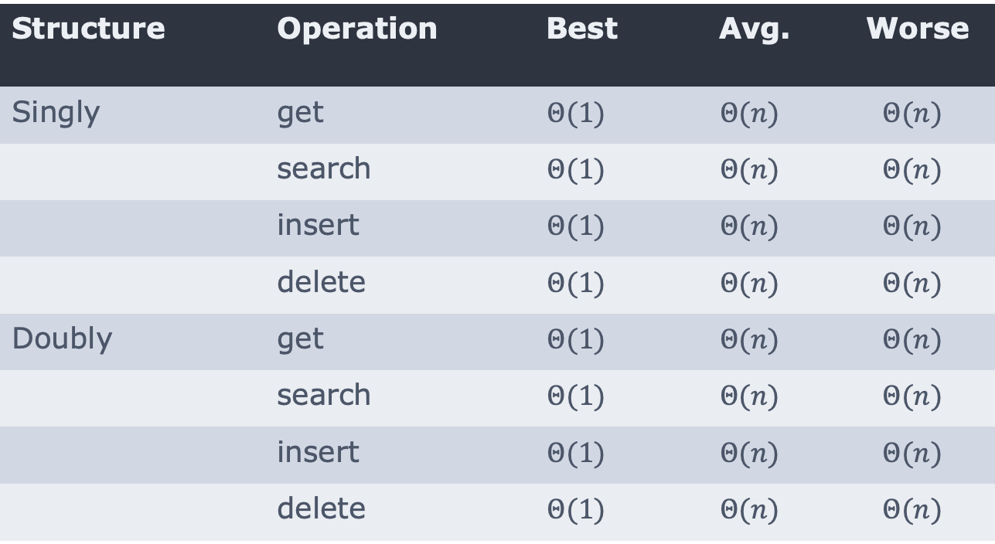
Recap
Structure | Operation | Best | Avg. | Worse
Singly | get | $$Θ(1)$$ | $$Θ(n)$$ | $$Θ(n)$$
 | search | $$Θ(1)$$ | $$Θ(n)$$ | $$Θ(n)$$
 | insert | $$Θ(1)$$ | $$Θ(n)$$ | $$Θ(n)$$
 | delete | $$Θ(1)$$ | $$Θ(n)$$ | $$Θ(n)$$
Doubly | get | $$Θ(1)$$ | $$Θ(n)$$ | $$Θ(n)$$
 | search | $$Θ(1)$$ | $$Θ(n)$$ | $$Θ(n)$$
 | insert | $$Θ(1)$$ | $$Θ(n)$$ | $$Θ(n)$$
 | delete | $$Θ(1)$$ | $$Θ(n)$$ | $$Θ(n)$$

Slide 24
Questions, Comments, or Ideas?
Franck Chauvel
axbit & NTNU
franck.chauvel@ntnu.no

Slide 25
Lab Session
List
Roll your own linked list module!
create
insert
delete
search
length
last
first
/
Node 1
n
p
Node 2
n
p
Node 3
/

