Slide 1
Chapter 17
Accounting and
Engineering Economy
Copyright Oxford University Press 2011

Slide 2
Chapter Outline
Role of Accounting
Accounting Statements
Financial Ratios
Cost Accounting
Copyright Oxford University Press 2011

Slide 3
Learning Objectives
Understand the roles of accounting
Evaluate a firm’s health and performance from the accounting statements and financial ratios
Use traditional cost accounting to calculate product costs
Understand the concepts of the activity–based costing (ABC)
Copyright Oxford University Press 2011

Slide 4

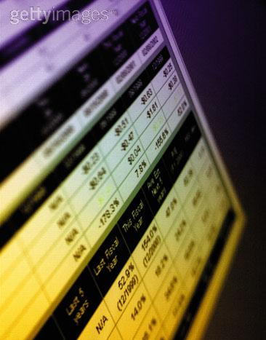
Vignette:
The Two Faces of ABB
The “bright” side of ABB:
Engineering giant with a global network of operations and forward-looking management
Modernized its accounting system with the activity-based costing (ABC)
The “dark” side of ABB:
Accounting practices were less effective
One subsidiary was exposed to numerous asbestos liability claims
Issued a poor earning report after earlier assuring it was on target of improvement
Copyright Oxford University Press 2011

Slide 5
Vignette:
The Two Faces of ABB
How might ABB’s adoption of ABC have affected investor’s assumptions about the company’s other accounting practices?
Analysts estimated that ABB lost over $690 million in 2001, why would investors still stunned by its poor showing in 2002.
How does ABB’s accounting problems compare with Enron or WorldCom?
In each of the well-publicized situations, were there ethical lapses?
Copyright Oxford University Press 2011

Slide 6
Role of Accounting
Accounting data are used
To value capital equipment
To decide whether to make or buy a part
To determine costs and set prices
To make product mix decisions
In both private and public sectors
Copyright Oxford University Press 2011

Slide 7
Role of Accounting
Budgeting
Estimating
Accounting
About past
Analyzing
Summarizing
Reporting
Fin. indicators
Economic trends
Cost acquisitions
Management
About past & future
Capital budgeting
Decision making
Setting goals
Assessing impacts
Analyzing risk
Planning
Controlling
Record keeping
Eng. Economy
About future
Feasibility study
Collect data
Analyze data
Estimate
Evaluate projects
Recommend
Audit
Trade-off & const.
Data & Communication
Data & Communication
Copyright Oxford University Press 2011

Slide 8
Accounting for
Business Transactions
Accounting function records, analyzes, and reports business transactions
Accounting function also finds, synthesizes, summarizes, and analyzes data
Most accounting is done in nominal or stable dollars
Accounting function provides data for general accounting and cost accounting
Copyright Oxford University Press 2011

Slide 9
Balance Sheet
Balance sheet shows a firm's financial position at a specific time (a financial “snapshot.”)
Fundamental accounting equation:
Assets = Liabilities + Equity (17-1)
Copyright Oxford University Press 2011

Slide 10
Balance Sheet: Assets
Assets are what the company "owns"
Current Assets (in order of decreasing liquidity)
  Cash
  Receivables
  Securities
  Inventories: Raw materials, Work-In-Progress, Finished products
Fixed Assets
  Property, Plant, and Equipment
  Original cost, less the cumulative depreciation
Copyright Oxford University Press 2011

Slide 11
Balance Sheet: Liabilities & Equity
Liabilities are what the firm "owes"
  Current liabilities (due within a year)
    Expenses, notes, and other payable accounts
  Long-term liabilities
    Mortgage, bonds, and loans with later due date
Equity or Net worth
  Original investment
    Par value + Capital surplus
  Retained earnings
Copyright Oxford University Press 2011

Slide 12
Balance Sheet, Engineered Industries
Assets
Current assets
Cash $1,940
Accounts receivable 950
Securities (at cost) 4,100
Inventories (at lower of cost or market) 1,860
(minus) Bad debt provision (80)
Total current assets 8,770
Fixed assets
Land 335
Plant and equipment 6,500
(minus) Accumulated depreciation (2,350)
Total fixed assets 4,485
Other assets
Prepays/deferred charges 140
Intangibles 420
Total other assets 560
Total Assets $13,815
Copyright Oxford University Press 2011

Slide 13
Balance Sheet, Engineered Industries
Liabilities and Equity
Current liabilities
Accounts payable $1,150
Notes payable 80
Accrued expenses 950
Total current liabilities 2,180
Long-term liabilities 1,200
Total liabilities 3,380
Equity
Preferred stock 110
Common stock 650
Capital surplus 930
Retained earnings 8,745
Total equity 10,435
Total liabilities and equity $13,815
Copyright Oxford University Press 2011

Slide 14

Financial Ratios from Balance Sheet
Working Capital = Current assets – Current liabilities
(17-2)
Liquidity ratios measure the firm’s ability to meet short-term obligations.
(17-3)
(17-4)
Copyright Oxford University Press 2011

Slide 15


Financial Ratios from Balance Sheet
Leverage ratios identify the relative importance of stockholders and outside creditors as a source of the enterprise's capital
Copyright Oxford University Press 2011

Slide 16
Income Statement
Income statement (or profit and loss statement) summarizes the financial performance of the firm over a period of time (usually a quarter or a year)
(17-5)
Operating Revenues:
Sales revenues – (returns & allowances)
Non-operating Revenues:
Rents
Interest receipts
Operating Expenses:
Cost of goods sold (COGS)
  Labor, materials, indirect cost
Selling and promotion
Depreciation
General & administrative
Lease payment
Copyright Oxford University Press 2011

Slide 17
Operating revenues and Expenses
Operating Revenues Sales $18,900
(minus) Returns and Allowances (870)
Total Operating Revenues 18,030
Income Statement
Engineered Industries
Operating Expenses
Cost of goods sold 13,060
Labor 6,140
Materials 4,640
Indirect cost 2,280
Selling and Promotion 930
Depreciation 450
General and administrative 2,160
Lease Payment 510
Total Operating Expenses 17,110
Total Operating Income 920
Copyright Oxford University Press 2011

Slide 18
Non-Operating revenues and Expenses
Non-Operating Revenues and Expenses Rents 20
Interest receipts 300
(minus) Interest payments (120)
Total Non-Operating Income 200
Income Statement
Engineered Industries
Net Income Before Taxes 1,120
Income Taxes 390
Net Profit 730
Copyright Oxford University Press 2011

Slide 19

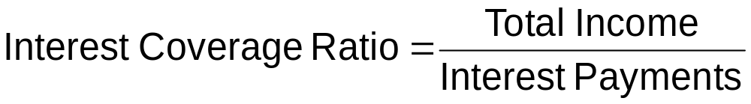
Financial Ratios from Income Statement
(17-6)
Total Income = Total Revenue – (All Expenses except Interest payments)
(17-7)
Copyright Oxford University Press 2011

Slide 20
Linking Balance Sheet, Income Statement, and Capital Transactions
Profit or Loss and Owner’s equity
Acquisition of Capital Assets
Depreciation of Capital Assets
Copyright Oxford University Press 2011

Slide 21
Traditional Cost Accounting
Cost accounting collects, analyzes, and reports operational performance data
Cost accounting data are used
  to develop product costs
  to determine the mix of labor, materials, and other costs in production
  to evaluate outsourcing and subcontracting possibilities
Copyright Oxford University Press 2011

Slide 22
Direct and Indirect Costs
Direct Costs
  From activities directly associated with final product or service
    Material costs
    Labor costs for engineering design
    Component Machining, Painting, and Assembly
Indirect Costs
  Difficult to link to specific projects, products, or services
    Receiving and shipping
    Management, Sales, and Administrative
    Depreciation, engineering and technical supports
    Customer warranties
Copyright Oxford University Press 2011

Slide 23
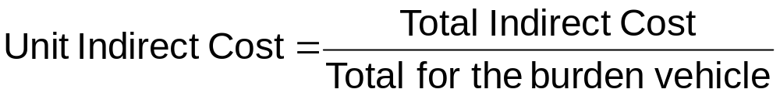
Indirect Cost Allocation
Select a burden vehicle
  Direct labor hours
  Direct labor cost
  Direct material cost
  Total direct cost
Calculate indirect costs per unit of burden vehicle
Allocate indirect cost according to the burden vehicle
Copyright Oxford University Press 2011

Slide 24
Example 17-2
Indirect Cost Allocation
 | Standard | Premium | Total
Annual Production (units) | 750 | 400
Unit Labor Cost | $400 | $500
Unit Materials Cost | $550 | $900
Labor Cost | $300,000 | $200,000 | $500,000
Materials Cost | $412,500 | $360,000 | $772,500
Overhead/Labor Cost |  |  | $1.70
Allocation by Labor Cost | $510,000 | $340,000
Overhead/Materials Cost |  |  | $1.10
Allocation by Mat’l Cost | $453,884 | $396,116
Copyright Oxford University Press 2011

Slide 25
Problems with
Traditional Cost Accounting
Can distort product cost
Direct labor content is relatively small in automation, high-tech settings
Accounting data “untimely”
Copyright Oxford University Press 2011

Slide 26
Activity-Based Costing (ABC) versus
Traditional Overhead Allocation
Direct Direct Overhead
Labor Mat’l
Machine Setup Op. Order Eng.
Product Cost
Copyright Oxford University Press 2011

