Slide 1
Chapter 2
Engineering Costs and
Cost Estimating
Copyright Oxford University Press 2011

Slide 2
Chapter Outline
Engineering Costs
Cost Estimating and Estimating Models
Copyright Oxford University Press 2011

Slide 3
Learning Objectives
Understand various cost concepts
Understand various cost estimation models
Be able to estimate engineering costs with various models
Copyright Oxford University Press 2011

Slide 4
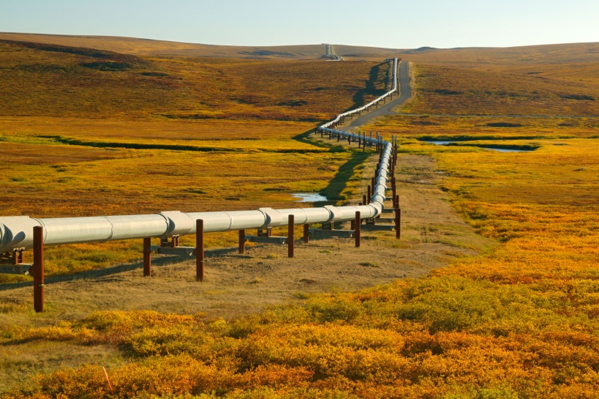
Vignette:
North Slope Natural Gas Pipeline
Alaska North Slope Natural Gas:
  35 trillion cubic feet (TCF) reserve
U.S. market:
  Annual U.S. natural gas demand: 18 TCF by 2010
  Estimated consumption rate: increase 2-3% annually
Project: Bring Alaska North Slope natural gas to U.S.
  Estimated infrastructure costs: $20 billion
  Estimated project duration: 9-year
  Design capacity: 4.5 billion cubic feet /day
Copyright Oxford University Press 2011

Slide 5
Vignette:
North Slope Natural Gas Pipeline
Project Alternatives:
  #1: 2,140 miles pipeline from Prudhoe to Chicago
  #2: 800 miles pipeline from Prudhoe to liquefaction plant, then shipped on ocean-going tankers
Questions to Consider:
  What type of cost estimating should be utilized?
  When a project is estimated to take 5-10 years to complete, should cost estimates be adjusted for inflation, regulatory changes, and changes in economic environment?
  Should large-scale project be required to meet the same rate of return requirements as smaller projects?
  Are there any ethical issues related to economics, the environment, safety, etc. that should be considered?
Copyright Oxford University Press 2011

Slide 6
Types of Costs
Fixed Costs & Variable Costs
Marginal Costs & Average Costs
Sunk Costs & Opportunity Costs
Recurring & Non-recurring Costs
Incremental Costs
Cash Costs & Book Costs
Life-Cycle Costs
Copyright Oxford University Press 2011

Slide 7
Fixed Costs and Variable Costs
Fixed Costs: constant, independent of the output or activity level.
  Property taxes, insurance
  Management and administrative salaries
  License fees, and interest costs on borrowed capital
  Rental or lease
Variable Costs: Proportional to the output or activity level.
  Direct labor cost
  Direct materials
Copyright Oxford University Press 2011

Slide 8
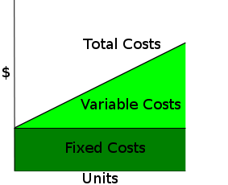
Fixed Costs and Variable Costs
Total Costs = Variable Costs(Units) + Fixed Costs
Copyright Oxford University Press 2011

Slide 9
Break-even Analysis
Total Variable Cost = Unit Variable Cost * Quantity
  TVC = VC * Q
Total Cost = Fixed Cost + Total Variable Cost
  TC = FC + VC * Q
Total Revenue = Unit Selling Price * Quantity
  TR = SP * Q
  where TVC = Total variable cost
  VC = Variable cost per unit
  Q = Production/Selling quantity
  FC = fixed costs
  TR = Total Revenue
  SP = Selling price per unit
Copyright Oxford University Press 2011

Slide 10
Break-even Analysis
Break-even point: the output level at which total revenue is equal to total cost.
  SP * BEP = FC + VC * BEP
  BEP = FC / (SP - VC)
  where BEP = breakeven point
  FC = fixed costs
  SP = selling price per unit
  VC = variable cost per unit
Applications of Break-even Analysis:
  Determining minimum production quantity
  Forecast production profit / loss
Copyright Oxford University Press 2011

Slide 11
Break-even Analysis
$
Total Revenue
Profit
Total Costs
Variable Costs
Fixed Costs
Loss
Break-even Point
Production Quantity
Copyright Oxford University Press 2011

Slide 12
Example 2-1
Total Revenue
= 35X
$1000
Profit
Total Costs
= $225 + 20X
$800
Variable Costs
= 20X
$600
$400
Fixed Costs
= $225
$200
Loss
X
# of Customers
$0
5
10
15
20
25
Copyright Oxford University Press 2011

Slide 13
Marginal Costs and Average Costs
Marginal Costs: the variable cost for one more unit of output
  Capacity Planning: Excess capacity
  Basis for last-minute pricing
Average Costs: total cost divided by the total number of units produced.
  Basis for normal pricing
Copyright Oxford University Press 2011

Slide 14
Sunk Costs & Opportunity Costs
Sunk Costs: Cost that has occurred in the past and has no relevance to estimates of future costs and revenues related to an alternative
  Purchasing price of current equipment in deciding new equipment (except for capital gain/loss consideration)
Opportunity Costs: Cost of the foregone opportunity and is hidden or implied
  Existing equipment in replacement analysis
Copyright Oxford University Press 2011

Slide 15
Example 2-2 Pricing of Old Pumps
Purchase Price of Old Pumps $7,000 (Sunk)
Storage Costs of Old Pumps $1,000 (Sunk)
List Price of Old Pumps (3yrs) $9,500 (Irrelevant)
List Price of New Pumps $12,000 (Irrelevant)
Offer of Old Pumps (2 yrs ago) $5,000 (Irrelevant)
Current Price of Old Pumps $3,000
Copyright Oxford University Press 2011

Slide 16
Recurring Costs and
Non-recurring Costs
Recurring Costs: Repetitive and occur when a firm produces similar goods and services on a continuing basis
  Office space rental
Non-recurring Costs: Not repetitive, even though the total expenditure may be cumulative over a period of time
  Typically involve developing or establishing a capability or capacity to operate
  Examples are purchase cost for real estate, and the construction costs of the plant
Copyright Oxford University Press 2011

Slide 17
Incremental Costs
Incremental Costs: Difference in costs between two alternatives.
  Suppose that A and B are mutually exclusive alternatives. If A has an initial cost of $10,000 while B has an initial cost of $14,000, the incremental initial cost of (B - A) is $4,000.
Copyright Oxford University Press 2011

Slide 18
Example 2-3
Choosing between Model A & B
Cost Items | Model A | Model B | Incremental Cost
Purchase Price | $10,000 | $17,500 | $7,500
Installation Costs | 3,500 | 5,000 | 1,500
Annual Maintenance | 2,500 | 750 | -1,750
Annual Utility | 1,200 | 2,000 | 800
Disposal Cost | 700 | 500 | -200
Copyright Oxford University Press 2011

Slide 19
Cash Costs versus Book Costs
Cash Costs: Costs that involve money/cash transaction
  Interest payments, taxes, etc.
Book Costs: Costs that that do not involve money/cash transaction
  Depreciation is charged for the use of assets, such as plant and equipment
Copyright Oxford University Press 2011

Slide 20
Life-Cycle Costs
Life-Cycle Costs: Summation of all costs, both recurring and nonrecurring, related to a product, structure, system, or service during its life span.
Life cycle begins with the identification of the economic needs or wants (the requirements) and ends with the retirement and disposal activities.
Copyright Oxford University Press 2011

Slide 21
Phases of Life-Cycle
1. Need Assessment | 2.Conceptual Design | 3. Detailed Design | 4. Production /Construction | 5.Operational /Use | 6. Decline/ Retirement
Requirements Analysis | Impact Analysis | Allocation of Resources | Production of Goods/ Services | Distribution of Goods/ Services | Phase Out
Overall Feasibility Study | Proof of Concept | Detailed Specifications | Building of Supporting Facilities | Maintenance/ Support | Disposal
Conceptual Design Planning | Prototype/ Breadboard | Component/ Supplier Selection | Quality Control/ Assurance | Retirement Planning
 | Development/ Testing | Production Planning | Operational Planning
 | Detailed Design Planning
Copyright Oxford University Press 2011

Slide 22
Cumulative Life-Cycle Costs
Committed and Spent
100%
90%
80%
70%
Life-Cycle Costs Committed
60%
50%
Life-Cycle Costs Spent
40%
30%
20%
10%
0%
Need
Conceptual
Detailed
Production
Operational
Decline/
Assessment
Design
Design
/Construction
/Use
Retirement
Copyright Oxford University Press 2011

Slide 23

Cumulative Life-Cycle Costs
Committed and Spent
Honda Bearing Cap Needs 100% Inspection

Slide 24
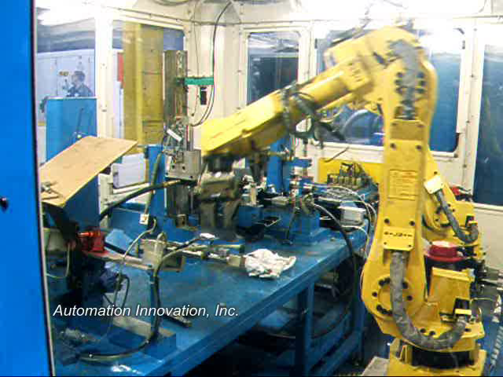
Cumulative Life-Cycle Costs
Committed and Spent

Slide 25
Cost/Ease of Design Changes in
Product Life-Cycle
100%
90%
Ease of Design Changes
80%
70%
60%
Cost of Design Changes
50%
40%
30%
20%
10%
0%
Need
Conceptual
Detailed
Production
Operational
Decline/
Assessment
Design
Design
/Construction
/Use
Retirement
Copyright Oxford University Press 2011

Slide 26
Cost Estimating
Needs for Cost Estimating
Importance of Cost Estimating
Copyright Oxford University Press 2011

Slide 27
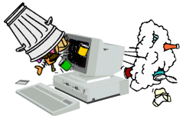
Cost Estimating
Garbage In Garbage Out

Slide 28
Cost Estimating
Needs for Cost Estimating
Importance of Cost Estimating
Types of Cost Estimating
  Rough Estimates -30% ~ +60%
  Semi-detailed Estimates -15% ~ +20%
  Detailed Estimates -3% ~ +5%
Copyright Oxford University Press 2011

Slide 29
Cost Estimating--Trade-off between Accuracy and Cost
High
Cost of Estimate
Low
Low
Medium
High
Accuracy of Estimate
Copyright Oxford University Press 2011

Slide 30
Difficulties in Estimation
One-of-a-kind Estimates
NASA Space Shuttle
  $7.45B ($43B in 2011 dollars) Development
  $9.3M ($54M in 2011) per flight
  $118/lb ($635/lb in 2011) assuming 65,000 pound capacity and 50 flights per year
  $196B total cost, $450M per flight
  134 flights gives $1.5B per flight
Copyright Oxford University Press 2011

Slide 31
Difficulties in Estimation
One-of-a-kind Estimates
Time and Effort Available
Estimator Expertise
Copyright Oxford University Press 2011

Slide 32
Categories of Cost Estimating
Capital Investment (S&H, Installation, Training)
Labor Costs (Direct and Indirect)
Material Costs (Direct & Indirect)
Maintenance Costs (Regular & Overhaul)
Property Taxes and Insurance
Operating Costs (Rental, Gas, Electricity)
Quality Costs (Scrap, Rework, Inspection)
Overhead Costs (Administration, Sales)
Disposal Costs
Revenues
Market Values
Copyright Oxford University Press 2011

Slide 33
Sources of Cost Estimating Data
Accounting records
Other sources within the firm:
  Engineering, Production, Quality
  Sales, Purchasing, Personnel
Published information:
  Statistical Abstract of US – Cost indexes
  Monthly Labor Review – Labor costs
  Building Construction Cost Data
Other sources outside the firm:
  Vendor, Salespeople
Research & Development
  Pilot plant, Test market
Copyright Oxford University Press 2011

Slide 34
Cost Estimating Approaches
Top-down Approach
  Uses historical data from similar engineering projects
  Modifies original data for changes in inflation, activity level, weight, energy consumption, size, etc…
  Best use is early in estimating process
Bottom-up Approach
  More detailed cost-estimating method
  Attempts to break down project into small, manageable units and estimate costs, etc….
  Smaller unit costs added together with other types of costs to obtain overall cost estimate
  Works best when detail design is available
Copyright Oxford University Press 2011

Slide 35
Cost Estimating Models
Per-Unit Model (Unit Technique)
Segmenting Model
Cost Indexes
Power-Sizing Model
Triangulation
Improvement and the Learning Curve
Copyright Oxford University Press 2011

Slide 36
Cost Estimating Models --
Per-Unit Model (Unit Technique)
Per-Unit Model (Unit Technique)
  Construction cost per square foot (building)
  Capital cost of power plant per kW of capacity
  Revenue / Maintenance Cost per mile (hwy)
  Utility cost per square foot of floor space
  Fuel cost per kWh generated
  Revenue per customer served
Copyright Oxford University Press 2011

Slide 37
Example 2-4 Cost Estimating using Per-Unit Model
Cost Estimation of camping on an island for 24 students over 10 days.
Planned Activities:
2 days of canoeing
3 day hikes
3 days at the beach
Nightly entertainment
Copyright Oxford University Press 2011

Slide 38
Example 2-4 Cost Estimating using Per-Unit Model
Cost Data:
Van (capacity 15) rental: $50 one-way
Camp is 50 miles away, van gets 10 miles/gallon, and gas is $3/gallon
Each cabin holds 4 campers, rent is $10/day-cabin
Meals are $10/day-camper
Boat transportation is $2/camper (one-way)
Insurance/grounds fees/overhead is $1/day-camper
Canoe (capacity 3) rentals are $5/day-canoe
Day hikes are $2.50/camper-day
Beach rental is $25/group-(half-day)
Nightly entertainment is free.
Copyright Oxford University Press 2011

Slide 39
Example 2-4 Cost Estimating using Per-Unit Model
Solution:
Assumption: 100% participation in all activities
Transportation Costs:
  Van: $50/van-trip * 2 vans * 2 trips = $200
  Gas: $3/gallon * (50 miles / 10 miles/gallon) *2 *2 = 60
  Boat: $2/camper-trip * 24 campers * 2 = 96
  Subtotal $356
Living Costs:
  Meals: $10/day-camper * 24 campers * 10 days = $2400
  Cabin rental: $10/day-cabin * (24/4) cabins *10 days = 600
  Insurance: $1/day-camper * 24 campers * 10 days = 240
  Subtotal $3240
Copyright Oxford University Press 2011

Slide 40
Example 2-4 Cost Estimating using Per-Unit Model
Solution (Continued):
Entertainment Costs:
  Canoe rental: $5/day-canoe * 2 days * (24/3) canoes = $80
  Beach rental: $25/group-(half-day) * (3*2) half-days = 150
  Day hike: $2.50/camper-day* 24 campers * 3 days = 180
  Nightly entertainment 0
  Subtotal $410
Total Costs: $4006
Cost per student: $4006/24=$166.92
Copyright Oxford University Press 2011

Slide 41
Cost Estimating Models –
Segmenting Model
Estimate is decomposed into individual components
Estimates are made at component level
Individual estimates are aggregated back together
Copyright Oxford University Press 2011

Slide 42
Example 2-5 Cost Estimating using Segmenting Model
Cost estimate of lawn mower
A. Chassis
B. Drive Train
Cost Item | Estimate
A.1 Deck | $7.40
A.2 Wheels | 10.20
A.3 Axles | 4.85
Subtotal | $22.45
Cost Item | Estimate
B.1 Engine | $38.50
B.2 Starter assembly | 5.90
B.3 Transmission | 5.45
B.4 Drive disc assembly | 10.00
B.5 Clutch linkage | 5.15
B.6 Belt assemblies | 7.70
Subtotal | $72.70
Copyright Oxford University Press 2011

Slide 43
Example 2-5 Cost Estimating using Segmenting Model
Cost estimate of lawn mower
C. Controls
D. Cutting/Collection system
Cost Item | Estimate
C.1 Handle assembly | $3.85
C.2 Engine linkage | 8.55
C.3 Blade linkage | 4.70
C.4 Speed control linkage | 21.50
C.5 Drive control assembly | 6.70
C.6 Cutting height adjuster | 7.40
Subtotal | $52.70
Cost Item | Estimate
D.1 Blade assembly | $10.80
D.2 Side chute | 7.05
D.3 Grass bag & adapter | 7.75
Subtotal | $25.60
Total material cost = $22.45 + $72.70 + $52.70 + $25.60 = $173.45
Copyright Oxford University Press 2011

Slide 44
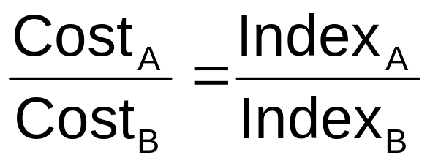
Cost Estimating Models –
Cost Indexes
Cost indexes reflect historical change in cost
Cost index could be individual cost items (labor, material, utilities), or group of costs (consumer prices, producer prices)
Indexes can be used to update historical costs
(Eq. 2-2)
Copyright Oxford University Press 2011

Slide 45
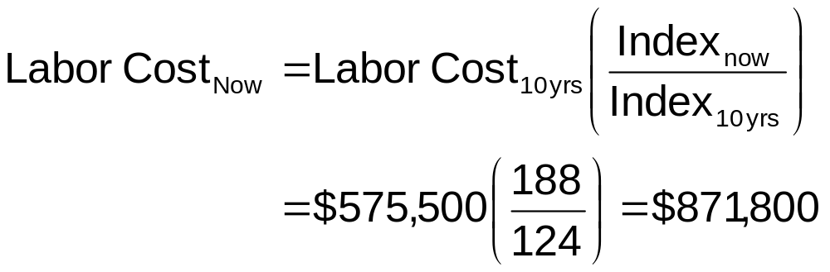
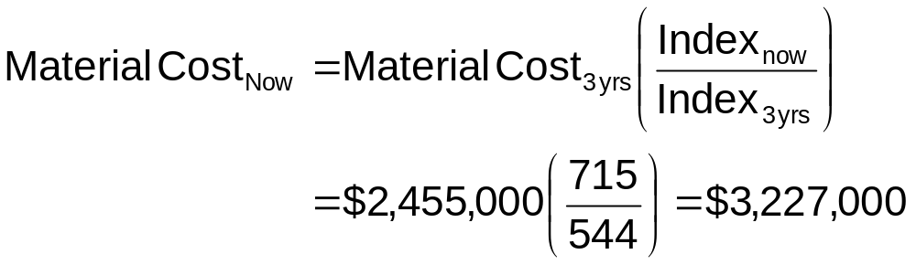
Example 2-6 Cost Estimating using Cost Indexes
Copyright Oxford University Press 2011

Slide 46
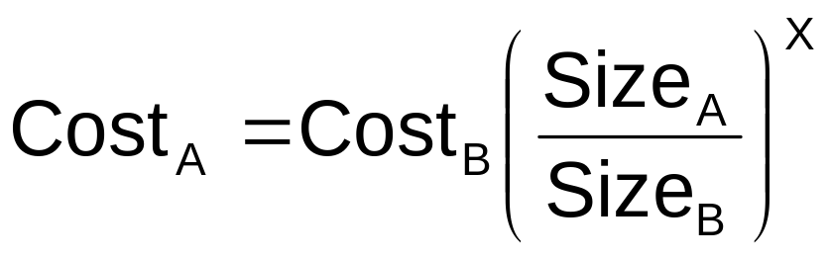
Cost Estimating Models
Power-Sizing Model
(Eq. 2-3)
X = Power-sizing exponent
Equipment/Facility | X
Blower, centrifugal | 0.59
Compressor | 0.32
Crystallizer, vacuum | 0.37
Dryer, drum | 0.40
Fan, centrifugal | 1.17
Equipment/Facility | X
Filter, vacuum | 0.48
Lagoon, aerated | 1.13
Motor | 0.69
Reactor | 0.56
Tank, Horizontal | 0.57
Copyright Oxford University Press 2011

Slide 47
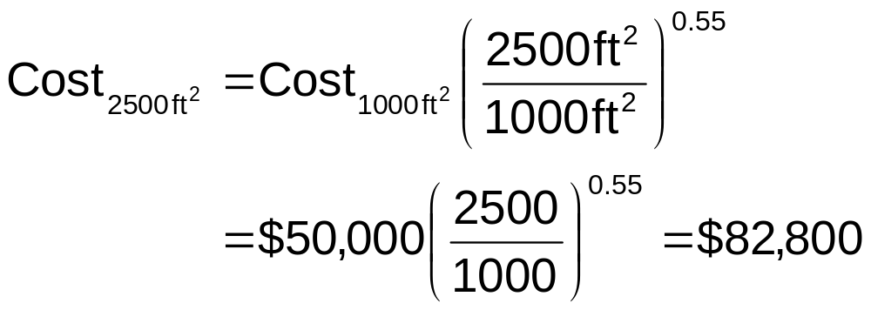
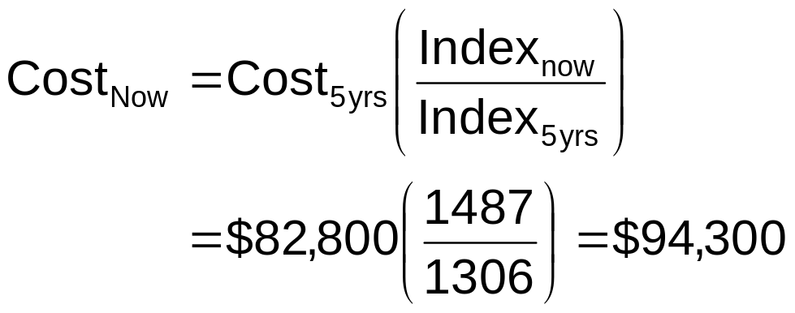
Example 2-7 Cost Estimating using Power-Sizing and Cost Indexes
A. Considering Power-Sizing Index Change
B. Considering Cost Index Change
Copyright Oxford University Press 2011

Slide 48
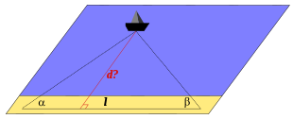
Cost Estimating Models –
Triangulation
To map the position of a ship by using three fixed points and horizontal angular distance
Copyright Oxford University Press 2011

Slide 49
Cost Estimating Models –
Triangulation
Application in Economic Analysis: To approach economic estimate from different perspectives, such as different source of data, or different quantitative models.
Copyright Oxford University Press 2011

Slide 50
Cost Estimating Models –
Improvement and Learning Curve
Learning Phenomenon: As the number of repetitions increase, performance of people becomes faster and more accurate.
Learning Curve captures the relationship between task performance and task repetition.
In general, as output doubles the unit production time will be reduced to some fixed percentage, the learning curve percentage or learning curve rate
Copyright Oxford University Press 2011

Slide 51
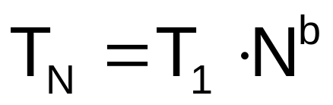
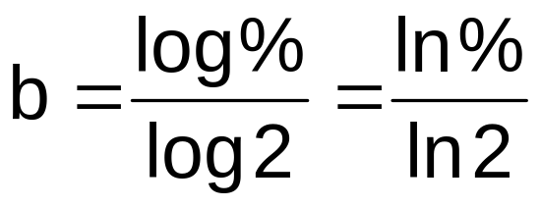
Cost Estimating Models –
Improvement and Learning Curve
Learning Curve
Let T₁ = Time to perform the 1st unit
T_{N} = Time to perform the N^{th} unit
b = Constant based on learning curve %
N = Number of completed units
(Eq. 2-4)
(Eq. 2-5)
Copyright Oxford University Press 2011

Slide 52
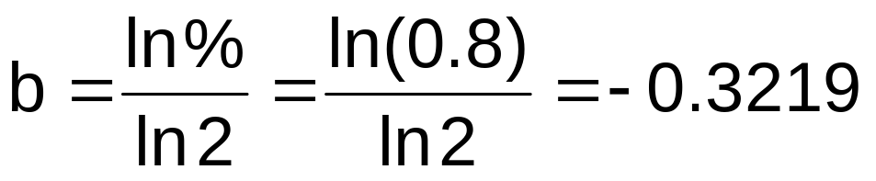
Example 2-8 Cost Estimating using Learning Curve
Copyright Oxford University Press 2011

Slide 53
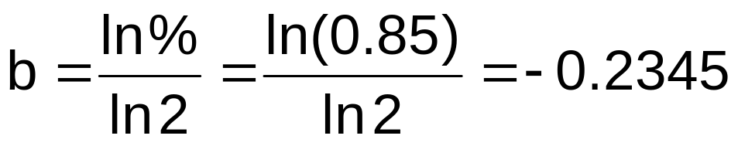
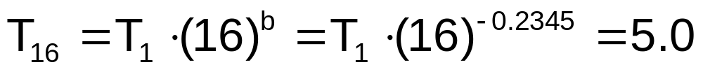
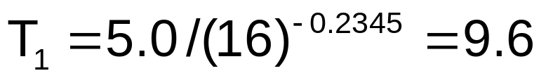
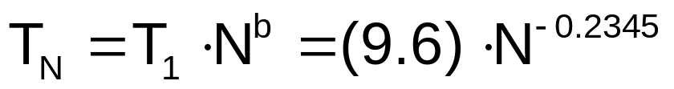
Example 2-9 Cost Estimating using Learning Curve
Copyright Oxford University Press 2011

Slide 54
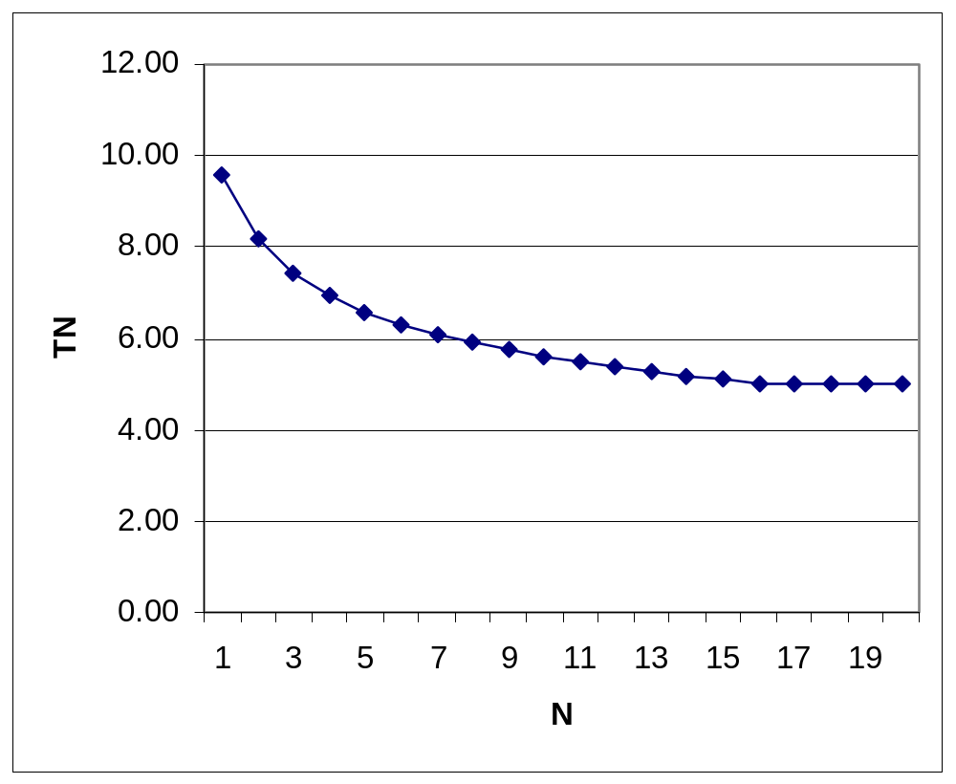
Example 2-9 Cost Estimating using Learning Curve
Example 2-9 Cost Estimating using
Learning Curve
N | T_{N}
1 | 9.60
2 | 8.16
3 | 7.42
4 | 6.94
5 | 6.58
6 | 6.31
7 | 6.08
8 | 5.90
9 | 5.73
10 | 5.59
N | T_{N}
11 | 5.47
12 | 5.36
13 | 5.26
14 | 5.17
15 | 5.09
16 | 5.00
17 | 5.00
18 | 5.00
19 | 5.00
20 | 5.00
Copyright Oxford University Press 2011

Slide 55
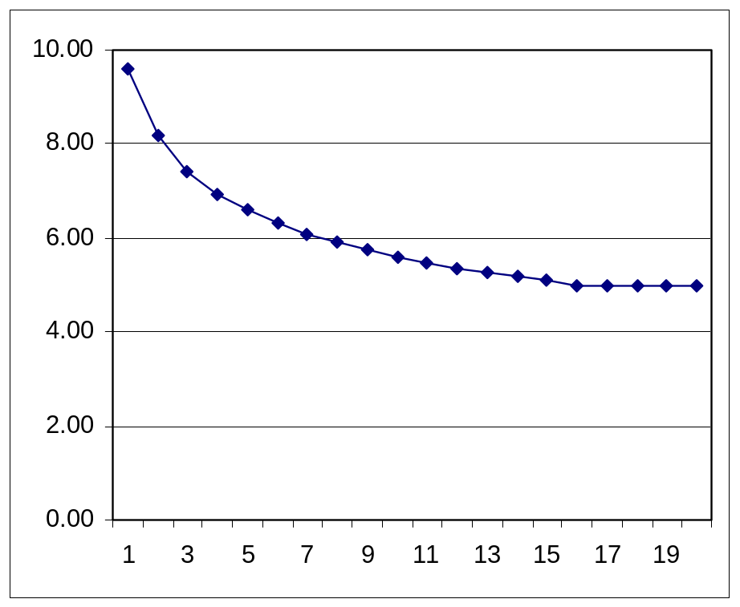
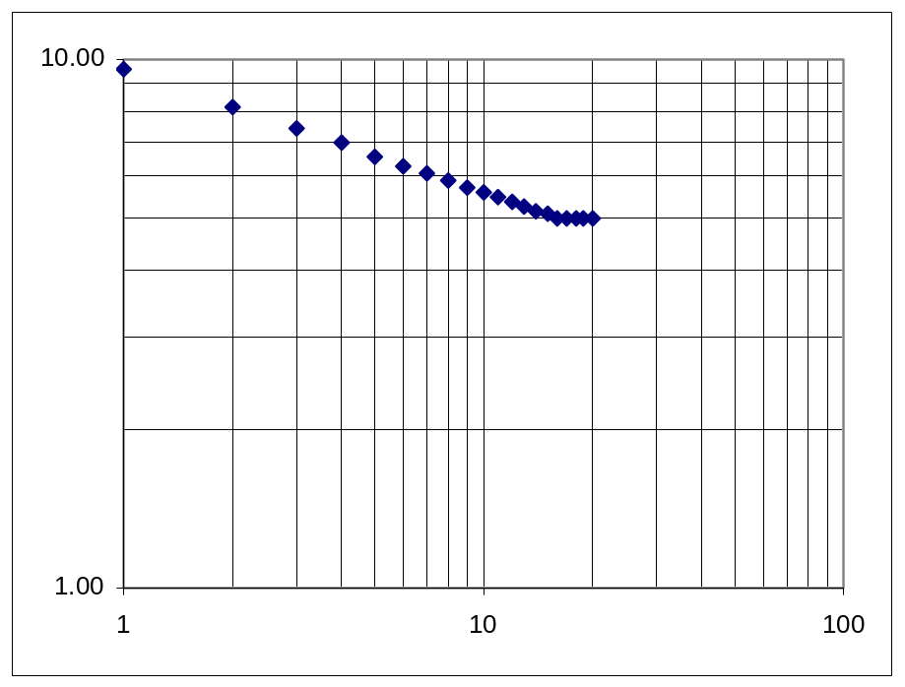
Example 2-9 Cost Estimating using Learning Curve
Example 2-9 Cost Estimating using
Learning Curve
Normal Scale
Log-Log Scale
Copyright Oxford University Press 2011

Slide 56
Estimating Benefits
Sample Benefits
  Sales of products
  Revenues from bridge tolls & electric power sale
  Cost reduction from reduced material or labor costs
  Less time spent in traffic jams
  Reduced risk of flooding
Cost concepts and cost estimating models can also be applied to economic benefits
Uncertainty in benefit estimating is typically asymmetric, with a broader limit for negative outcomes, e.g. -50%~+20%
Benefits are more difficult to estimate than costs since they occur further in the future
Copyright Oxford University Press 2011

Slide 57
Cash Flow Diagrams (CFD)
CFD summarize costs & benefits occur over time
CFD illustrates the size, sign, and timing of individual cash flows
Components of CFD
  A segmented time-based horizontal line, divided into time units
  A vertical arrow representing a cash flow is added at the time it occurs
  Arrow pointing down for costs and up for benefits
Copyright Oxford University Press 2011

Slide 58
Cash Flow Diagrams (CFD)
Example
Timing of Cash Flow | Size of Cash Flow
At time zero (now) | Positive $100
1 time period from today | Negative $100
2 time periods from today | Positive $100
3 time periods from today | Negative $150
4 time periods from today | Negative $150
5 time periods from today | Positive $50
0
1
2
3
4
5
Copyright Oxford University Press 2011

Slide 59
Categories of Cash Flows
First cost: expenses to build or to buy and install
Operations and maintenance (O&M): annual expense, such as electricity, labor, and minor repairs
Salvage value: receipt at project termination for sale or transfer of the equipment
Revenues: annual receipts due to sale of products or services
Overhaul: major capital expenditure that occurs during the asset’s life
Copyright Oxford University Press 2011

Slide 60
Drawing a Cash Flow Diagram
CFD shows when all cash flows occur
In a CFD, the end of period t is the same time as the beginning of period t+1
Rent, lease, and insurance payments are usually treated as beginning-of-period cash flows
Operations and maintenance, salvage, revenues, and overhauls are assumed to be end-of-period cash flows
The choice of time 0 is arbitrary
Copyright Oxford University Press 2011

Slide 61
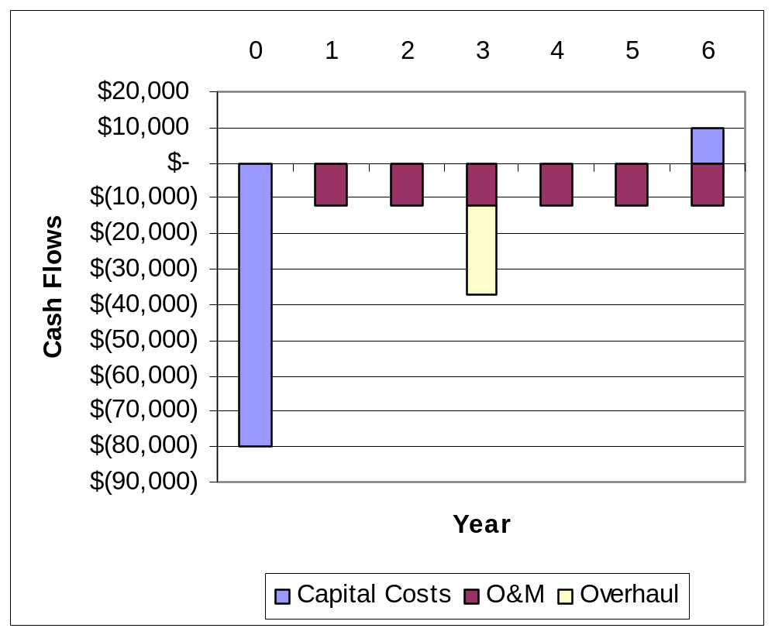
Drawing Cash Flow Diagrams with Spreadsheet
Year | Capital Costs | O&M | Overhaul
0 | -$80,000
1 |  | $(12,000)
2 |  | $(12,000)
3 |  | $(12,000) | $(25,000)
4 |  | $(12,000)
5 |  | $(12,000)
6 | $ 10,000 | $(12,000)
Copyright Oxford University Press 2011

