Slide 1
Computer Architectures
Compute as you sew
Florent Chuffart – INSERM/IAB/EpiMed

Slide 2
Plan
Computer Architectures
2 Parallel Programming Paradigms

Slide 3

Basic Computer Architecture
CPU
RAM
HD

Slide 4



Basic Model

Slide 5
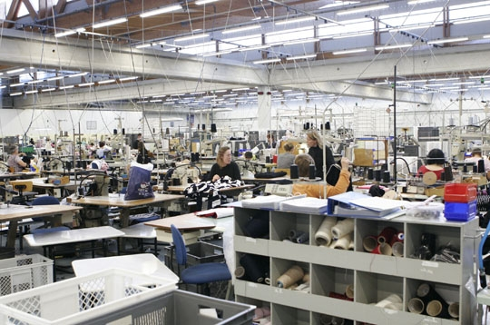
Advanced Computer Architecture
Hyper Threading
Multicore
Multiple CPUs
Many Cache Level
Non Uniform Memory Access (NUMA)

Slide 6






Multiple CPUs, Multicore

Slide 7





Cache levels
super fast access
fast access
less fast access

Slide 8











Cache levels and NUMA

Slide 9
No Hard Drive in a Near Future

Slide 10
Take Home Model
Fast access to RAM
Slow access to disk

Slide 11
Many Cores
⬇
Parallel Programming

Slide 12
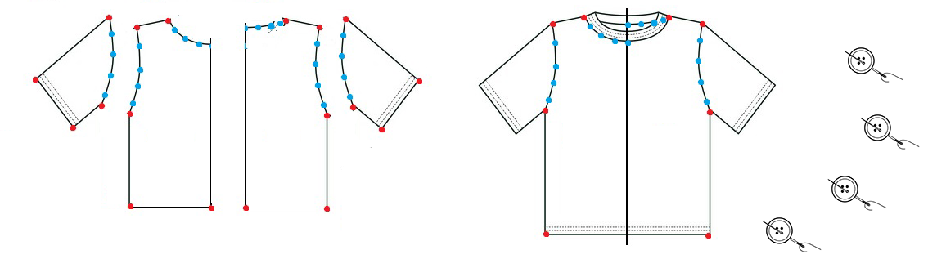
Example of parallelism
3
1
2
1 – parallel (build of many pieces)
2 – sequential (merge pieces)
3 – parallel (sew buttons)

Slide 13
2 Parallel Programming Paradigms
Distributed Memory
Shared Memory

Slide 14
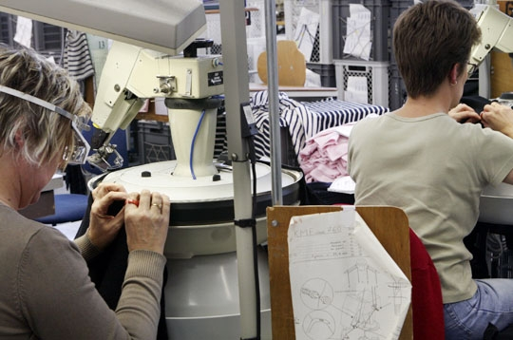
Distributed Memory

Slide 15
Distributed Memory
- 3 samples (sample1, sample2, sample3)
- 2 tasks (align and count)

Slide 16
Sequential
- 3 samples (sample1, sample2, sample3)
- 2 tasks (align and count)
align sample1 | count > tab1.tab ;
align sample2 | count > tab2.tab ;
align sample3 | count > tab3.tab ;

Slide 17
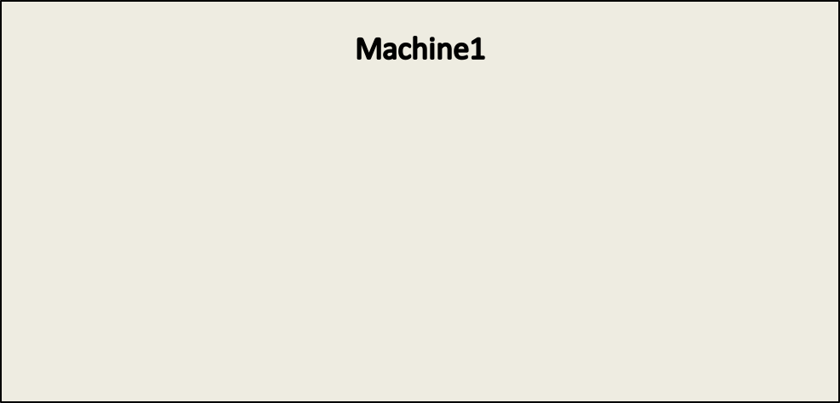



Sequential
- 3 samples (sample1, sample2, sample3)
- 2 tasks (align and count)
align sample1 | count > tab1.tab ;
align sample2 | count > tab2.tab ;
align sample3 | count > tab3.tab ;

Slide 18


Sequential
- 3 samples (sample1, sample2, sample3)
- 2 tasks (align and count)
align sample1 | count > tab1.tab ;
align sample2 | count > tab2.tab ;
align sample3 | count > tab3.tab ;

Slide 19


Sequential
- 3 samples (sample1, sample2, sample3)
- 2 tasks (align and count)
align sample1 | count > tab1.tab ;
align sample2 | count > tab2.tab ;
align sample3 | count > tab3.tab ;

Slide 20
Parallel on 1 Machine
- 3 samples (sample1, sample2, sample3)
- 2 tasks (align and count)
align sample1 | count > tab1.tab &
align sample2 | count > tab2.tab &
align sample3 | count > tab3.tab &

Slide 21

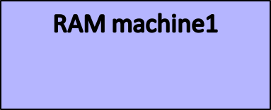

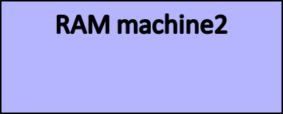


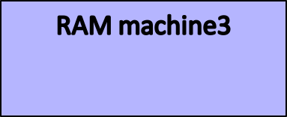

Parallel on a Cluster (Ciment)
- 3 samples (sample1, sample2, sample3)
- 2 tasks (align and count)
ssh mach1@ciment align sample1 | count > tab1.tab
ssh mach2@ciment align sample2 | count > tab2.tab
ssh mach3@ciment align sample3 | count > tab3.tab

Slide 22

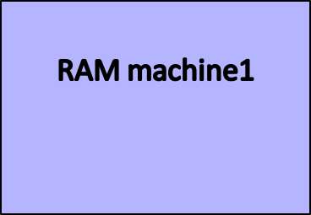

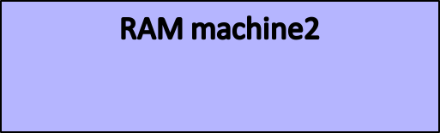



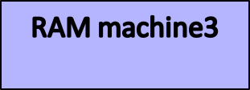
Parallel on a Grid (Grid5000)
- 3 samples (sample1, sample2, sample3)
- 2 tasks (align and count)
ssh mach1@lyon align sample1 | count > tab1.tab
ssh mach2@nancy align sample2 | count > tab2.tab
ssh mach3@lille align sample3 | count > tab3.tab

Slide 23
Parallel on a Grid (Grid5000)
MPI

Slide 24

Parallel on a Grid (Grid5000)
Hadoop – Map/Reduce

Slide 25
Distributed Memory
  Embarrassingly Parallel
= independent tasks
= no communication between tasks
= 99% of bioinfo/biostat tasks
  With communications = MPI

Slide 26

Shared Memory

Slide 27


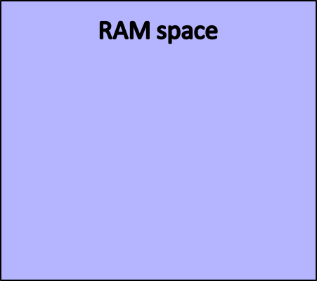
Shared Memory
8 | 2 | 5 | 1
1 | 0 | 100 | 8
5 | 63 | 21 | 4

Slide 28



Shared Memory
8 | 2 | 5 | 1
1 | 0 | 100 | 8
5 | 63 | 21 | 4
read/write
read/write
read/write

Slide 29
2 Parallel Programming Paradigms
Distributed Memory
  Embarrassingly Parallel
= independent tasks
= no communication between tasks
= 99% of bioinfo/biostat tasks
  With communication = MPI
Shared Memory
  OpenMP
  Posix Threads

Slide 30
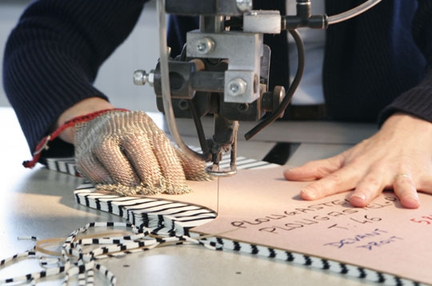
Vectorisation

Slide 31
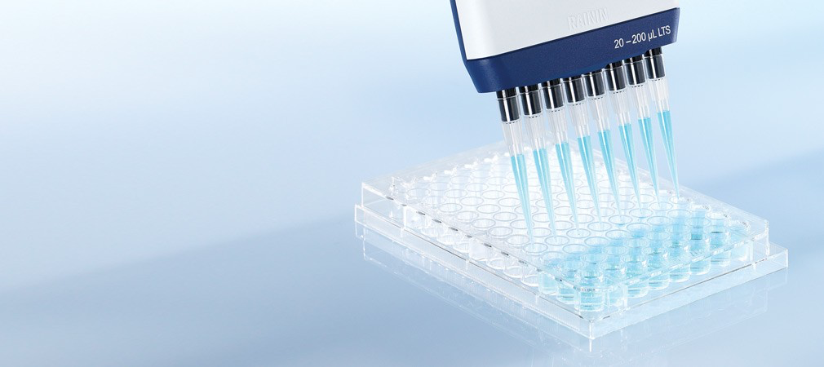
Vectorisation

Slide 32
Summary
Computer Architectures
  Many cores
  Fast access to memory
  Slow access to hard drive
2 Parallel Programming Paradigms
  Distributed memory
  Shared memory

Slide 33
Acknowledgment
http://www.journaldunet.com
Dans le secret des tricots Saint James

