Slide 1
Design Document
MyTaxiService

Slide 2
Architectural Description
Client Interface Layer
Business and Web Layer
Database Management Layer

Slide 3
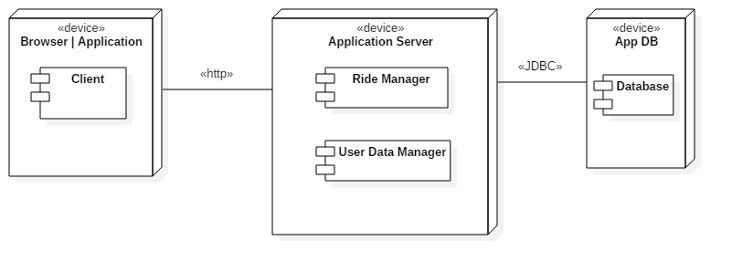
Deployment view

Slide 4
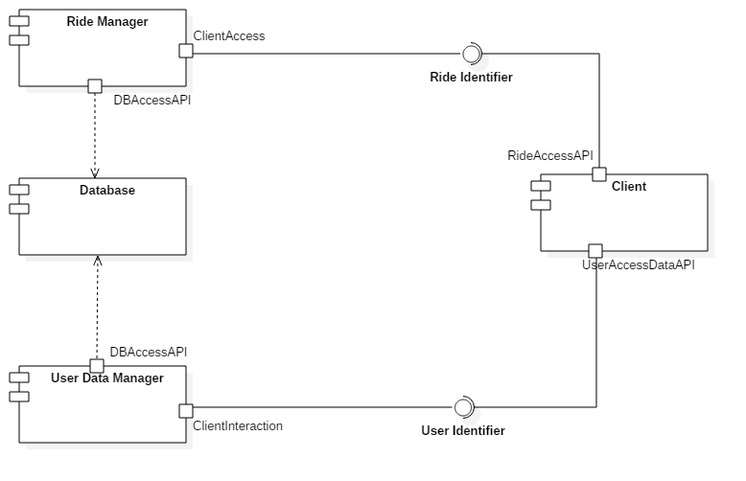
High-level Component View

Slide 5
Client Interface Layer
Its purpose is to interact with all types of users. This includes both a web interface, reserved for customers, and a mobile application, used by both customers and drivers.

Slide 6
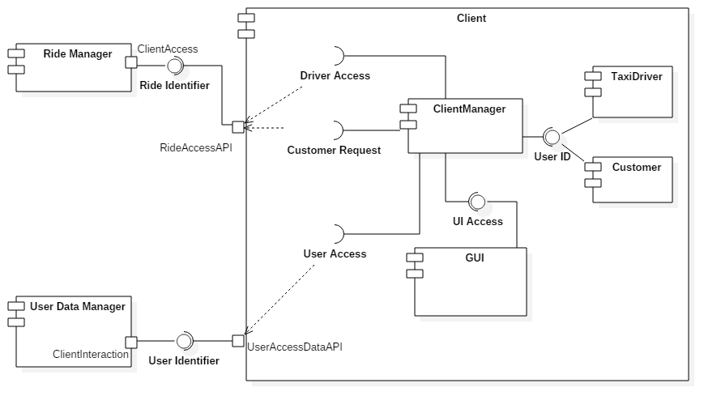
Client Interface Layer

Slide 7
Business and Web Layer
This layer is responsible for the connection of the first layer with the Database Management Layer. It connects users to the information management system on the server.
It is divided in Ride Manager and User Data Manager

Slide 8
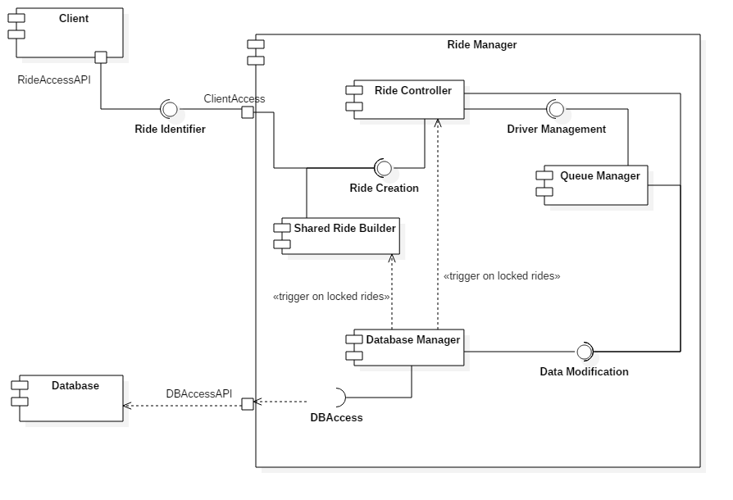
Ride Manager

Slide 9
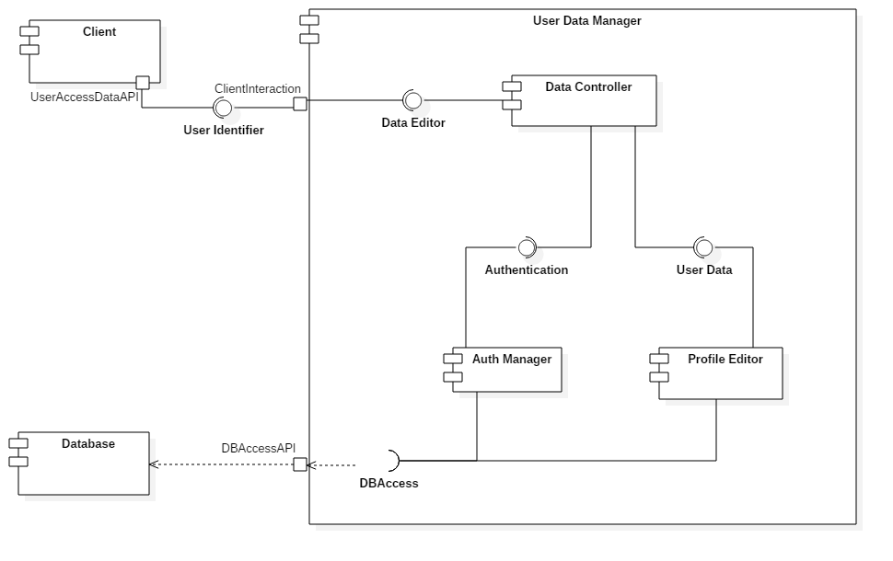
User Data Manager

Slide 10
Database Management Layer
Responsible for both user information management as well as reservation storage
Stores information about the Users and the Reservations
Communicates with the Business Layer on a event basis when shared rides are to be created or locked

Slide 11
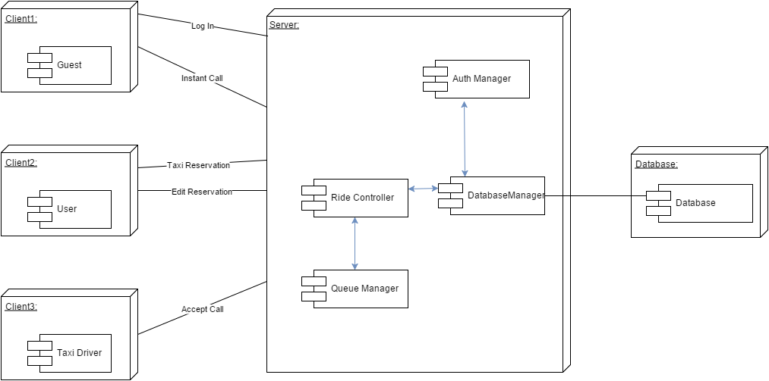
RunTime View

Slide 12
Component Interfaces
Intra-Components
Ride Identifier: Used to send data from the Client to the Ride Manager and to enable Ride creation and modification, both for Instant and Booked Rides. Also, it allows Taxi Drivers to interact with Rides
User Identifier: Contains methods authentication and insertion of User’s data

Slide 13
Component Interfaces
Client
Driver access: This interface is used to access driver-only functions about the status of the Ride
User access: This interface is used for authentication and access to the user information database
Customer request: This interface gives users the methods to do all things related to Rides
User ID: This interface gives separate methods to taxi driver users and regular customers to login to the service
UI Access: Methods in this interface are used to render the graphical part of the mobile application

Slide 14
Component Interfaces
Ride Manager
Ride Creation: This interface handles the requests to create and edit rides
Driver Management: This interface allows the manager to insert and remove a Taxi Driver from the queue and the controller to pick the first available driver
Data Modification: This interface is an intermediary between the controller and DB accessor
DB Access: This interface handles database access

Slide 15
Component Interfaces
User Data Manager
Data Editor: This interface takes all incoming requests to the data controller
Authentication: The methods in this interface let users and drivers log into the system
User Data: This interface handles profile editing
DB Access: This interface handles database access

Slide 16
Selected Architectural Styles and Patterns
Multi-Tier Architecture
Component Based Architecture
Event-Driven System
Singleton - Queue

Slide 17
Algorithm Design
Taxi queueing System
Shared Ride structure
Composition of Rides

Slide 18
Taxi Queueing System
When a Taxi Driver begins to work or finishes a job, he is inserted at the bottom of the Queue. When comes the time to assign a Driver to a Ride, the system, based on the two criteria that are “time in the queue” and “proximity to the location”, sends a notification to the driver that it chose.
If the Driver accepts, he is removed from the Queue; otherwise he is moved to the bottom.

Slide 19
Shared Ride Structure
Each Shared Ride is composed by a single itinerary, which includes all stops the taxi has to make on the route, and by a set of individual reservations, each referring to a separate booking.

Slide 20
Composition of Rides
Before being assigned to a Ride, all the Shared Ride orders are seen as regular Booking in the system. The Shared Ride in only created when a Ride has to be locked.
A Shared Ride is created considering the following criteria:
gain of the passenger
length of the ride
number of rides joined

Slide 21
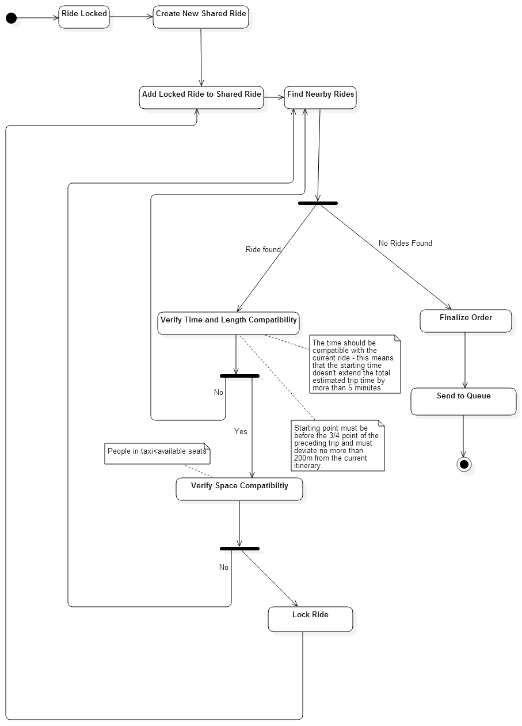

Slide 22
User Experience and Interface Design
We used UX-Diagrams to describe three main parts:
Log in, Sign up and Data Editing
Taxi Calls
Driver’s pages

Slide 23
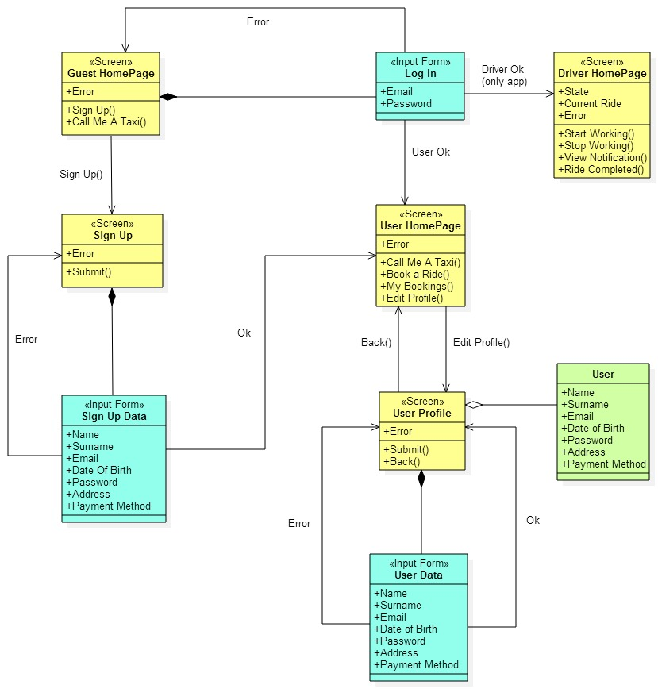
Log in, Sign up and Data editing

Slide 24
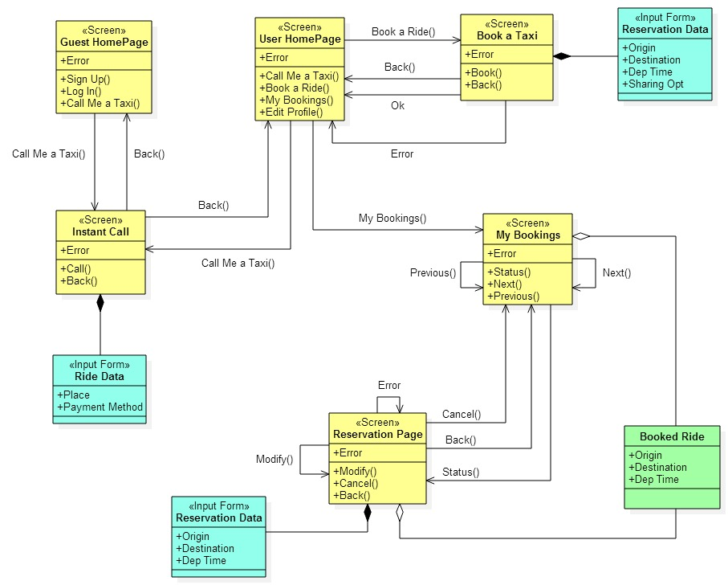
Taxi calls

Slide 25
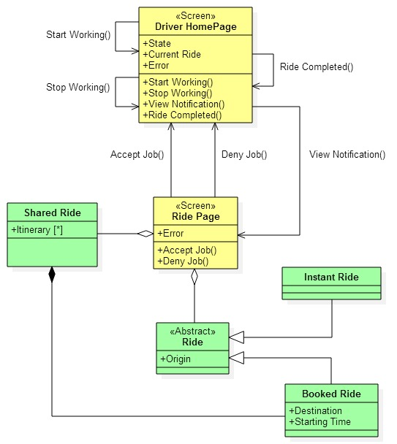
Driver’s pages

Slide 26
Requirements Traceability
In this section we explained how the requirements are implemented in our system.
i.e. the System Registration requirement is implemented by the ClientManager, that through the User Access interface communicates with the User Data Manager and saves the new data.

