Slide 1
Integration Test Plan Document
myTaxiService

Slide 2
Elements to be integrated
The components we want to test are the ones described in our Design Document.
Client Components
Client Manager
Ride Manager Components
Ride Controller
Queue Manager
Shared Ride Builder
Database Manager
Data Manager Components
Data Controller
Authentication Manager
Profile Editor

Slide 3
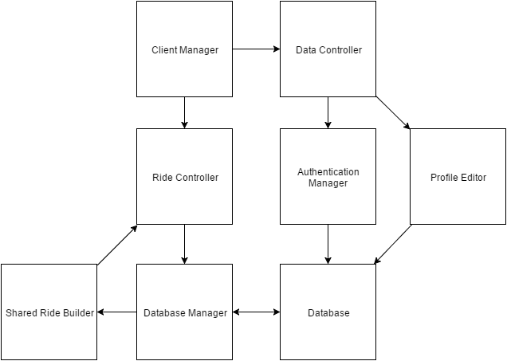
Elements to be integrated

Slide 4
Strategy
We decided to use the bottom-up approach. Before testing the top level we need to be sure that lower levels work in order to understand where hypothetical problems or issues may arise.
Test will have to be performed sequentially to verify the complete functionality of the system.

Slide 5
Test case
User Functions
User Data Interactions
Instant Call Creation Process
Request Handling
Ride Management
Shared Ride Creation
Driver Tests

Slide 6
Tools
The following tools should be used to run the integration tests described previously:
Mockito (http://site.mockito.org/) is a test framework that can be used to create mock objects in java. It’s purpose in testing shall be to create objects whenever a test requires them.
Arquillan (http://arquillian.org/) is a test framework that will handle container management and initialization. It will handle the test concering the correct functionality and operation of our glassfish server.
jUnit (http://junit.org/) as mentioned previously in the document, unit testing will have to be performed. Although we won’t be using it for actual integration testing, it still is a vital component in performing tests on our service’s components.

