Slide 1
RASD - Requirements and Specifications
myTaxiService

Slide 2
Purpose and Scope
Implementing myTaxiService
This document is aimed to all types of people, both the people that requested the project, as well as the future devs
Defining the client and server specifications
Client - Mobile and web apps
Server - Application and database

Slide 3
Definitions
Guest A guest to the service, namely someone who may be a driver or a registered user but has not been authenticated.
Registered User/User A user of the service who has gone through the registration process, whose information is stored within the service’s database.
Driver A user of the service that provides their taxi for the service. They are registered in a manner different from that of other users.
Customer Any person trying to use a taxi through the application, both a registered users and guests.
Ride Generic term to talk about a taxi trip
Instant Ride A ride ordered directly through the application which instantly assigns a taxi to a customer.
Reservation/Booked Ride A ride booked in advance through the application.
Ride Locking Term used to indicate reservations that have been ”locked”from cancellation. A reservation is considered locked when it can no longer be cancelled or modified (2 hours before the start of the trip).

Slide 4
Application and Goals
We are aiming to build a reservation service that must allow customers and drivers to the the following things:
Allow a customer to instantly call for a taxi
Allow users to make a reservation for a future date
Allow users to share rides with other users
Allow drivers to accept or refuse ride requests
Assign drivers to customers automatically and in a fair mannerr

Slide 5
Overview
1. The introduction
2. Overall description, describing how the service will work
3. Requirements, an analysis of what is needed of the application
4. UML, self explanatory
5. Alloy, formalization of properties and limitations of the service

Slide 6
Functions: User Registration
User registration is done with email and password. Password recovery is available.
Reservation
Personal Page
Payment methods

Slide 7
Functions: Instant Call
This is the most basic function, available to unregistered users as well
By simply communicating the current position, the order is placed into the queue and a taxi driver is assigned to the customer

Slide 8
Functions: Reservation
Registered users only
Allows a user to reserve a taxi for a future date, specifying a time and place for the start of the trip. Sharing may be enabled on reservations. Reservations must be made, modified and cancelled all with at least 2 hours advance.
Once the 2 hour limit is reached, the ride is locked, and when 10 minutes are left from the start of the ride, the order is inserted into the live queue

Slide 9
Functions: Sharing Rides
An extension of the reservation function.
A reservation with sharing enabled is treated like a normal reservation until locked. It may either be locked at the 2 hour mark or by another ride. Upon locking, the reservation is merged with other rides into a mass order, with a defined itinerary and timings. The algorithm is described more thoroughly in the Design Document.
Note that a reservation with sharing enabled may end up as a regular reservation if no compatible rides are found.

Slide 10
Function: Taxi Driver Status
Taxi drivers are free to set their own schedule. As a result, a driver may change their status from not working to working and vice-versa. The former automatically inserts a driver into the queue, while the latter removes them.
While in working status, a driver may receive job offers. Accepting an offer triggers a taxi notificaiton. Refusing an offer instead places the driver at the end of the queue.
Drivers may also regularly pick up passengers. To do so, they can remove themselves manually from the queue till the end of their ride.
When a driver ends a ride, the app is used for confirmation and the driver is enqueued.

Slide 11
Functions: Taxi Notifications
When a driver accepts a ride, a notification is sent to the customer with details about the taxi coming to pick up the customer and the ETA.

Slide 12
Functions: Queues
There are 2 separate queues in the system, one for drivers and one for orders.
The driver queue is handled automatically by the system with simple commands from the app. More information on that is given later.
The order queue is very fast changing as it only acts in the 10 minute period from the start of the rides. Its interaction with the driver queue is described in the DD.

Slide 13
Constraints, Assumptions and Scenarios
Constrains, assumptions and scenarios are included in out document. They are very straightforward and are used to better outline the application and service must operate, by providing context and examples for typical usage, to explain our design choices.

Slide 14
Functional Requirements
Our requirements section gives a brief description of what the expected behavior of the application is, by accompanying some of our functions with mockups.
https://github.com/fciceri17/taxisched/blob/master/Deliveries/rasd.pdf

Slide 15
Non Functional Requirements
Performance: Speed is key, delays should be minimized. Even at heavy load, the service should have no downtime and responses must be immediate.
System availability: We will be accessing the application through mobile apps as well as a web interface. The system has to be scalable, since usage may grow steadily in short periods. Therefore we will use a Cloud Virtual Service provider.
Security: aside from the login system, where passwords will have a required length and type, we will also use obfuscate as much information as possible when relaying information to drivers or other users. We will also use a captcha system when orders are placed to prevent spam and erroneous ordering

Slide 16
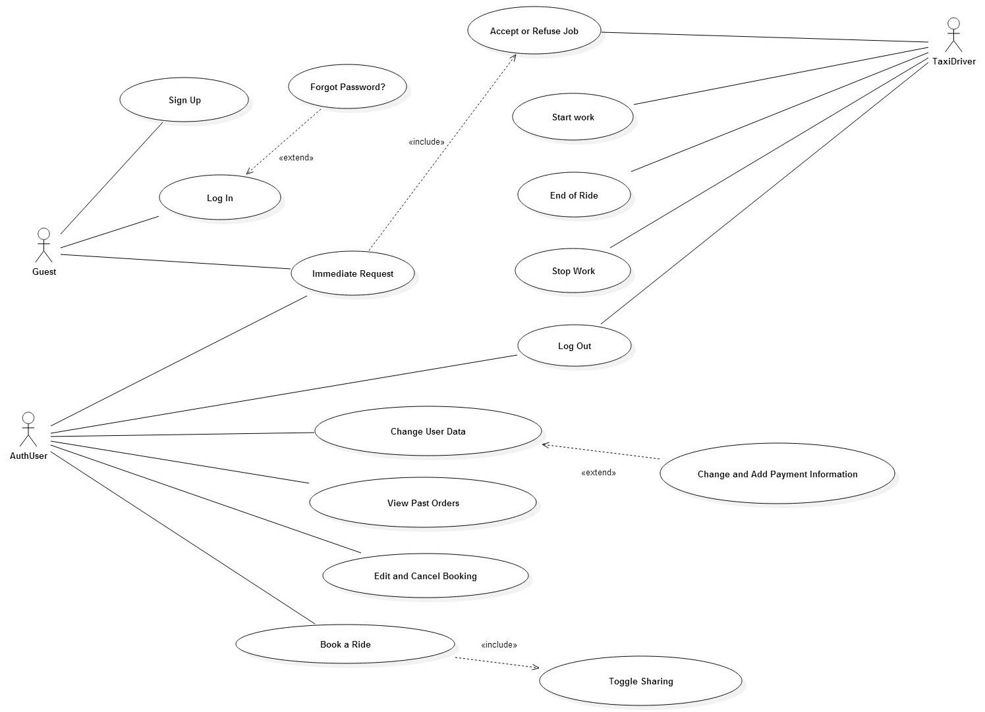
Use Case Diagram

Slide 17
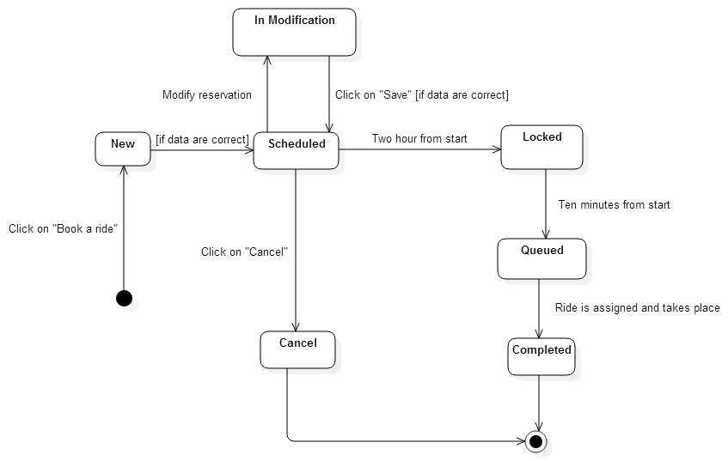
State Charts: Reservation

Slide 18
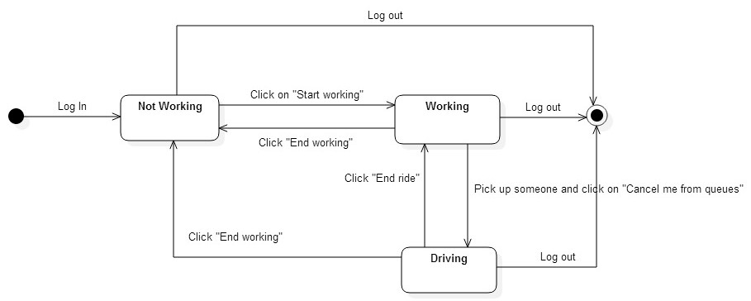
State Charts: Driver Status

Slide 19
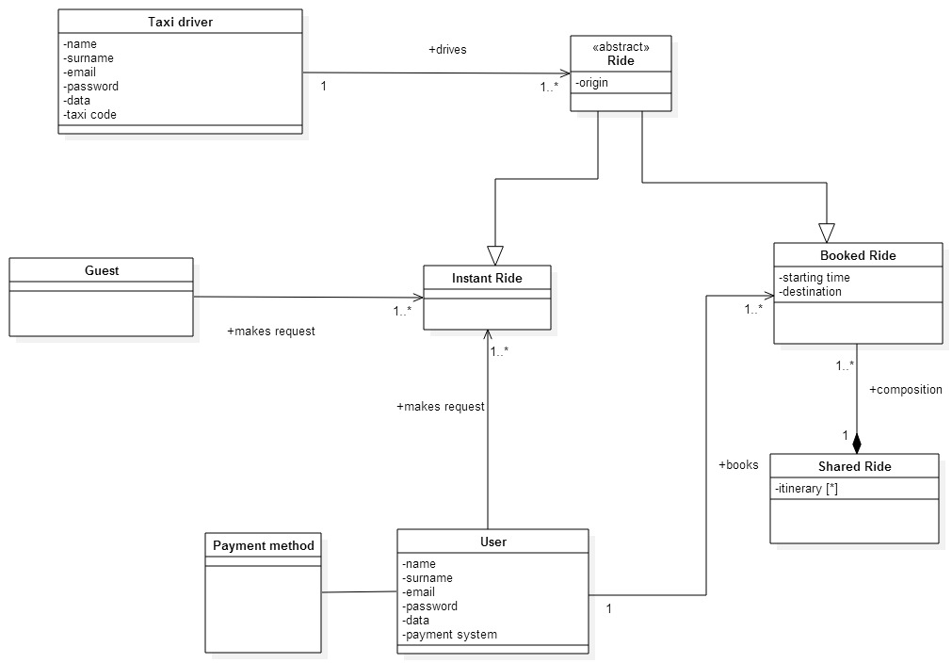
Class Diagram

Slide 20
Alloy Intro
Our alloy model is heavily focused on ride structure and assignment. We made sure no user could be in 2 rides at the same, no 2 rides could be assigned to the same driver at the same time, and no ride could start and end in the same place.
To represent our model we generated 3 worlds:
A simple show() predicate, with at least 1 of each sig
A showSharing() predicate, showing the structure of shared rides
A showRides() predicate, showing differences between booked and instant rides

Slide 21
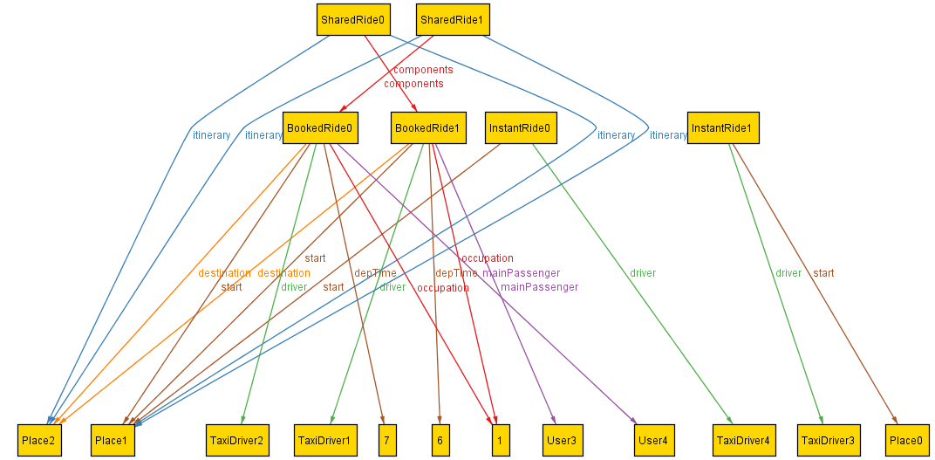
Alloy Generated Worlds - show()

Slide 22
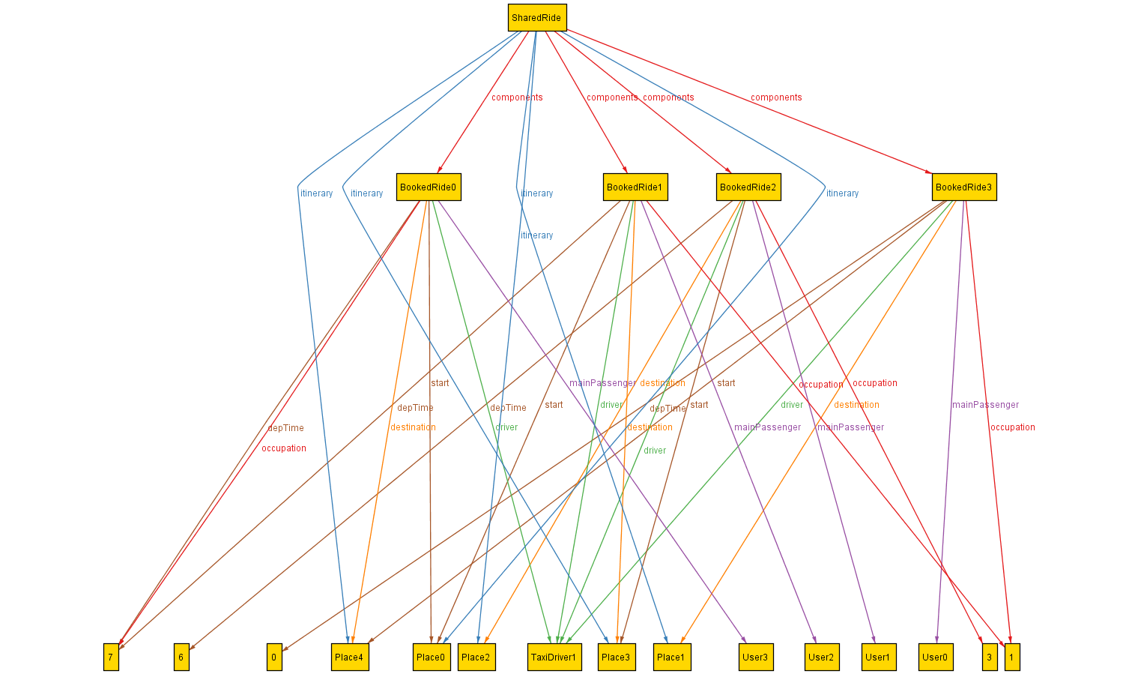
Alloy Generated Worlds - showSharing()

Slide 23
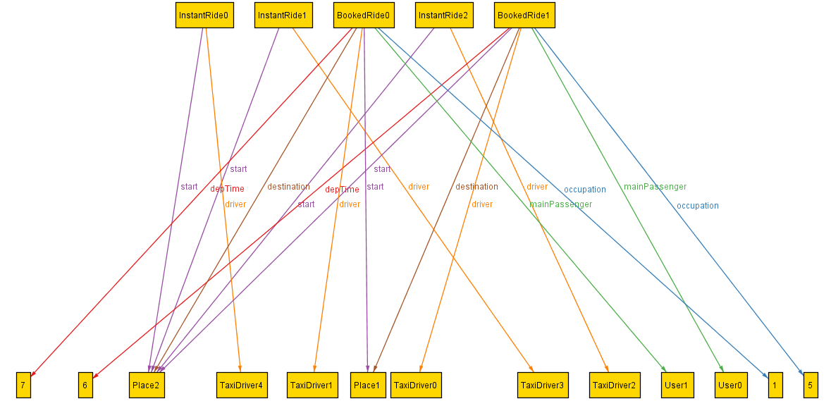
Alloy Generated Worlds - showRides()

