Slide 1
HeatGuard
Adaptive heat-safety scheduling for Gulf outdoor crews
Replacing the blunt calendar ban with a condition-responsive, provable system
London Hackathon 2026

Slide 2
Team
[Add each member's name and one-line skillset]
A multidisciplinary build: thermal-physiology + occupational-health standards, backend/data engineering, and front-end / product.

Slide 3
What is the problem?
Millions of migrant workers do outdoor labour across the Gulf, where summer heat exceeds the limits of human thermoregulation.
24,000,000 migrant workers in the Arab States — 41.4%, the highest share of any world region.
~10,000 migrant deaths/year — and over half are certified with no underlying cause, so the heat toll is hidden.
The control is a fixed CALENDAR ban (e.g. Saudi 12:00–15:00, 15 Jun–15 Sep). It is wrong in BOTH directions:
misses May/September heat, humid mornings, and unacclimatized newcomers — the people who actually die
and needlessly stops safe work, so employers resent and evade it.

Slide 4
~10,000
migrant deaths a year in the Gulf (all-cause). Most are certified without an underlying cause, so the heat-attributable toll is hidden — and only 1 of 19 worker-heat studies worldwide comes from the Gulf. The danger is huge and largely unmeasured.

Slide 5
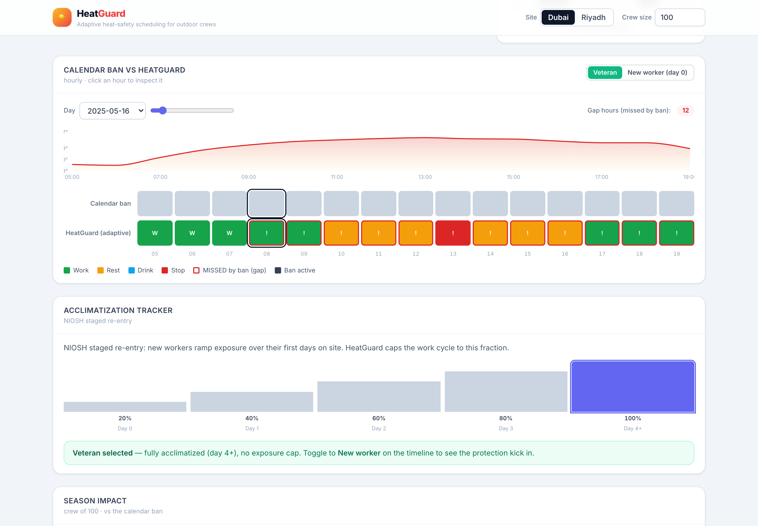
What is your solution?
A site-level, WBGT-driven work–rest–hydration scheduler for the supervisor — one cheap sensor per site, not a wearable per worker.
Senses WBGT (or a ~$300 on-site meter) → outputs the actual ACGIH/ISO 7243 work-rest cycle and ISO 7933 hydration target for current conditions and the worker.
Broadcasts one signal everyone understands: WORK · REST IN SHADE · DRINK NOW · STOP.
Ramps new arrivals in safely (NIOSH) and logs everything to a tamper-evident, privacy-by-design worker-protection record.

Slide 6
How does it work?
Data: free Open-Meteo reanalysis weather (cached for an offline demo).
WBGT: the validated Liljegren model (ECMWF thermofeel) with a vendored solar calc — or a measured on-site reading.
Schedule: hardcoded ACGIH TLV / Action-Limit tables (ISO 7243); ISO 7933 Predicted Heat Strain (pythermalcomfort) for hydration and max exposure; NIOSH acclimatization ramp.
Decision: the most-conservative of table · ramp · physiology → one signal. Every reading is SHA-256 hash-chained.
One pure Python engine with a FastAPI API, a React dashboard, a Streamlit app, and a validation notebook — 79 tests + green CI.

Slide 7
Why is it meaningful?
It makes a cheap, proven intervention adaptive and auditable — the missing implementation layer.
Per 100-worker crew, one season: 1,237 dangerous hours the ban missed; 7.7 acute-kidney-injury cases averted; productivity maintained or raised 10–20%.
Validated: the impact model reproduces the real La Isla / Adelante (Nicaragua) outcome — AKI −94%, productivity +10–20%.
Productivity-positive with a ~6-week payback, plus a compliance shield — so it actually gets switched on.

Slide 8
~1,900
lives saved across a 5,000,000-worker regional season — with ~383,000 kidney-injury cases averted and $1.6–2.5B in value (illustrative, conservative). A 100,000-worker megaproject: ~38 lives, 7,670 AKI cases averted, $32–50M of value.

Slide 9
3–5×
ROI with a ~6-week payback in Dubai; 7–10× in Riyadh, where the blunt ban also destroys safe work. About $95/worker, mostly one-time capital. Not a safety cost — a productivity gain.

Slide 10
What would you do with more support?
Pilot with a Gulf labour-supply contractor: deploy cheap on-site WBGT meters + a site horn/light and validate against real outcomes.
Development-finance pathway: lenders and ESG mandates already attach occupational-safety conditions — HeatGuard is the affordable implementation-and-verification layer.
Close the data gap: there is almost no public Gulf worker-heat data — partner to collect it.
Scale the engine to other heat-exposed sectors and regions (agriculture, logistics).

Slide 11
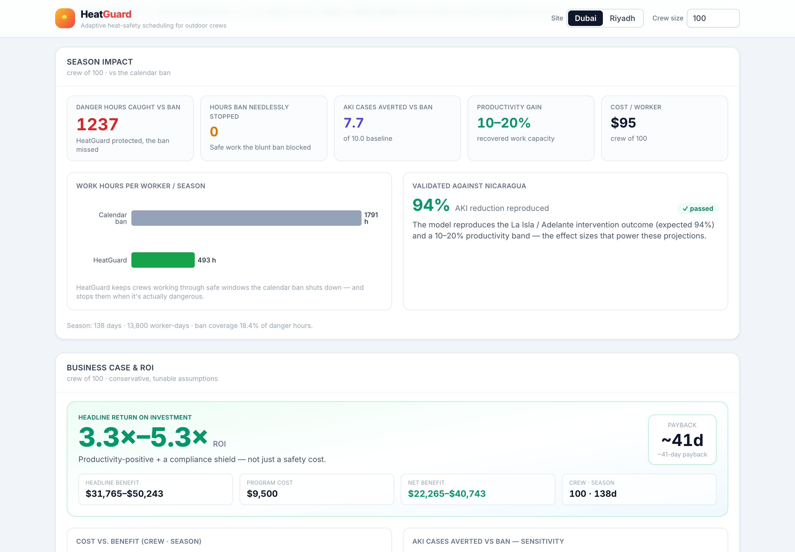
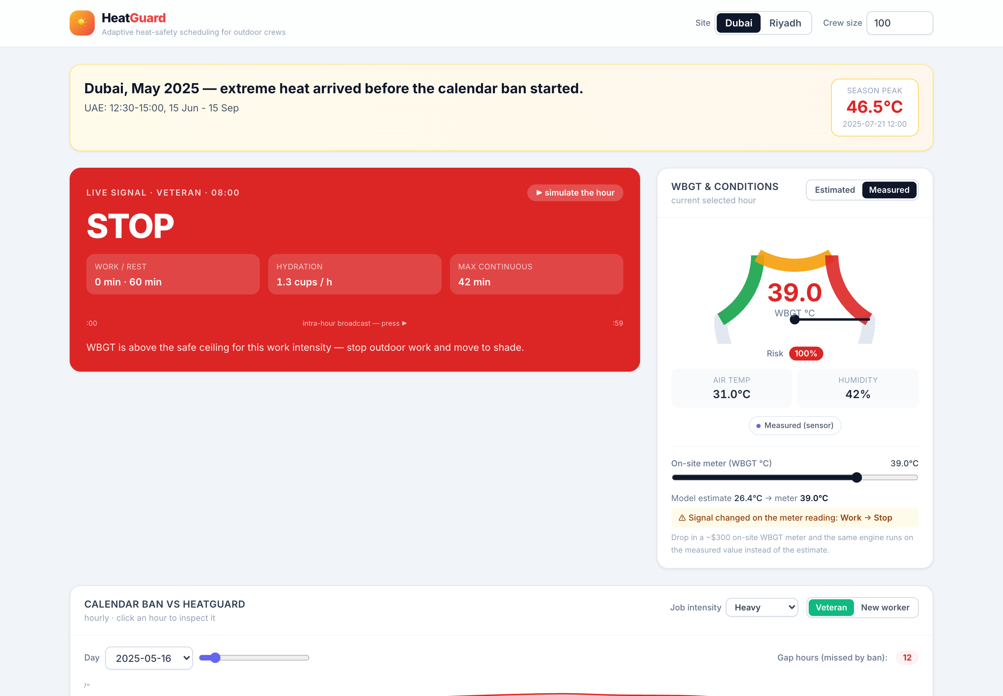
Product demo
Live dashboard: the signal, the calendar-ban-vs-HeatGuard timeline, sensor-vs-estimate, per-worker individualization, the worker-protection record, and the business case.
github.com/fcistud/heatguard · 79 tests + green CI · MIT
A prototype, not certified safety equipment.

