Slide 1
EM-SLAM
Chaojie Feng

Slide 2
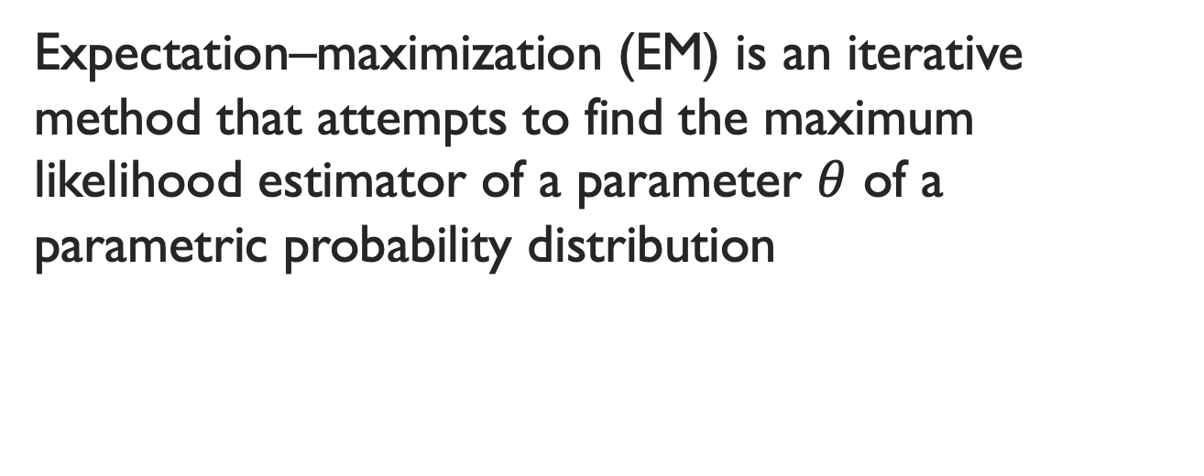
Expectation Maximization Setting
Expectation–maximization (EM) is an iterative method that attempts to find the maximum likelihood estimator of a parameter $θ$ of a parametric probability distribution

Slide 3
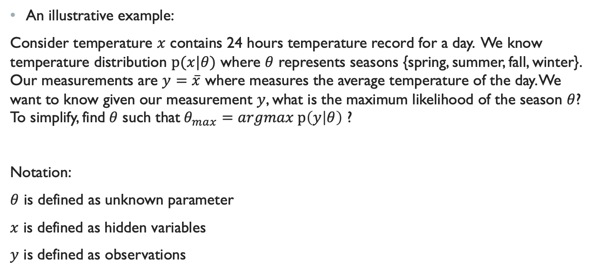
EM Toy Example
An illustrative example:
Consider temperature $x$ contains 24 hours temperature record for a day. We know temperature distribution $p(x|θ)$ where $θ$ represents seasons {spring, summer, fall, winter}. Our measurements are $y=\overline{x}$ where measures the average temperature of the day. We want to know given our measurement $y$, what is the maximum likelihood of the season $θ$? To simplify, find$θ$ such that$θ_{max}=argmax p\left(y | θ\right)$ ?
Notation:
$θ$ is defined as unknown parameter
$x$ is defined as hidden variables
$y$ is defined as observations

Slide 4
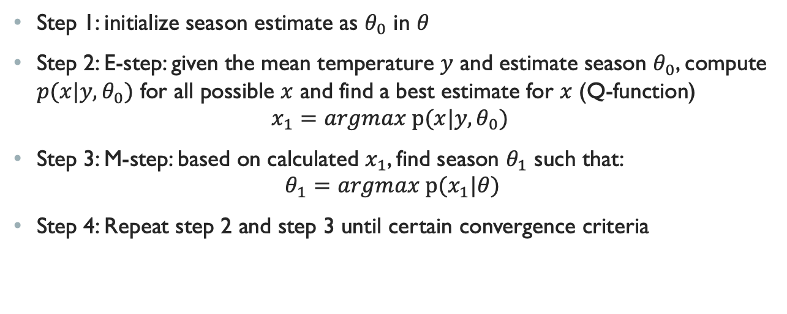
EM Toy Example
Step 1: initialize season estimate as $θ_{0}$ in $θ$
Step 2: E-step: given the mean temperature $y$ and estimate season $θ_{0}$, compute ${p(x|y,θ}_{0})$ for all possible $x$ and find a best estimate for $x$ (Q-function)
$$x_{1}=argmax p(x|y, θ_{0})$$
Step 3: M-step: based on calculated $x_{1}$, find season $θ_{1}$ such that:
$$θ_{1}=argmax p(x_{1}|θ)$$
Step 4: Repeat step 2 and step 3 until certain convergence criteria

Slide 5
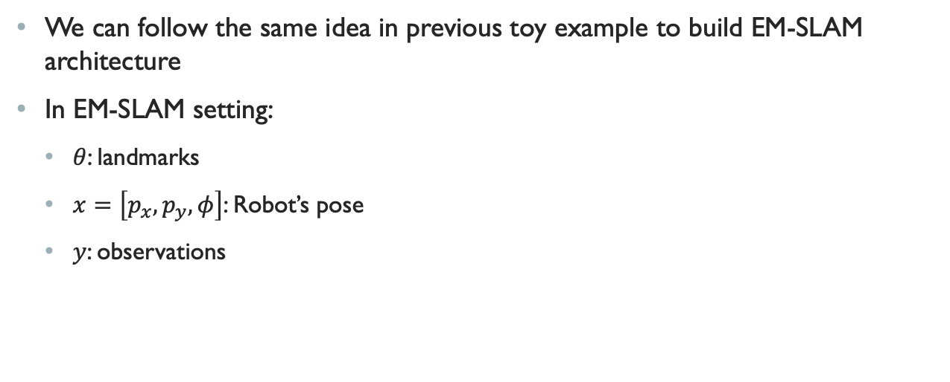
EM-SLAM
We can follow the same idea in previous toy example to build EM-SLAM architecture
In EM-SLAM setting:
$θ$: landmarks
$x=\left[p_{x}, p_{y},φ\right]$: Robot’s pose
$y$: observations

Slide 6
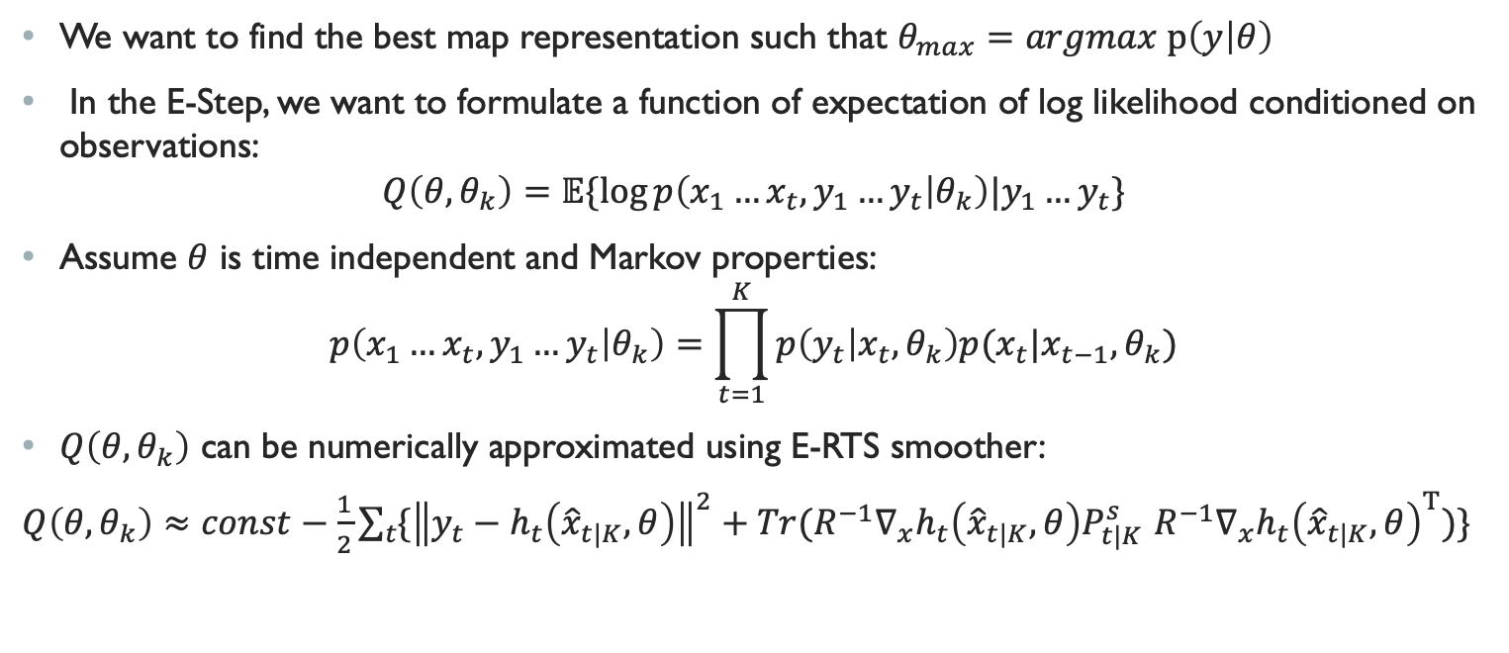
EM-SLAM Framework
We want to find the best map representation such that $θ_{max}=argmax p\left(y | θ\right)$
In the E-Step, we want to formulate a function of expectation of log likelihood conditioned on observations:
$$Q\left(θ,θ_{k}\right)=𝔼\{\log{p\left(x_{1}…x_{t}, y_{1}…y_{t} | θ_{k}\right)|y_{1}…y_{t}\}}$$
Assume $θ$ is time independent and Markov properties:
$$p\left(x_{1}…x_{t}, y_{1}…y_{t} | θ_{k}\right)=\prod_{t=1}^{K}{p\left(y_{t} | x_{t},θ_{k}\right)p(x_{t}|x_{t−1},θ_{k})}$$
$Q\left(θ,θ_{k}\right)$ can be numerically approximated using E-RTS smoother:
$Q\left(θ,θ_{k}\right)≈const−\frac{1}{2}\sum_{t}{\{{\left\|y_{t}−h_{t}\left({\hat{x}}_{t|K}, θ\right)\right\|}^{2}+Tr(R^{−1}∇_{x}h_{t}\left({\hat{x}}_{t|K}, θ\right)P_{t|K}^{s}}$ $R^{−1}∇_{x}h_{t}{\left({\hat{x}}_{t|K}, θ\right)}^{T})\}$

Slide 7
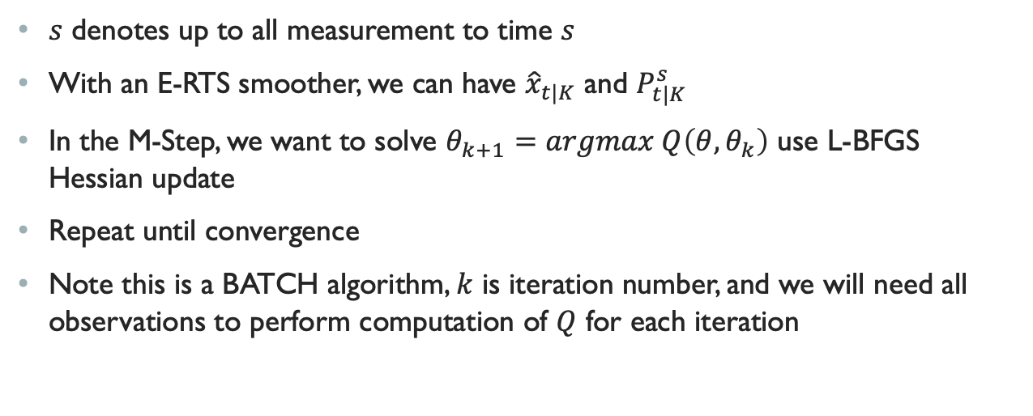
EM-SLAM Framework
$s$ denotes up to all measurement to time $s$
With an E-RTS smoother, we can have ${\hat{x}}_{t|K}$ and $P_{t|K}^{s}$
In the M-Step, we want to solve $θ_{k+1}=argmax Q\left(θ,θ_{k}\right)$ use L-BFGS Hessian update
Repeat until convergence
Note this is a BATCH algorithm, $k$ is iteration number, and we will need all observations to perform computation of $Q$ for each iteration

Slide 8
Obtaining Initial Guess
Personally, I think this is the most important part in this paper in terms of implementation
EM is susceptible to local minimum if we have a bad initialization
What is a “bad” initialization ?
In EM-SLAM setting, any orientation with uncertainty is a bad initialization
Thus, the process noise for orientation needs to be set to 0

Slide 9
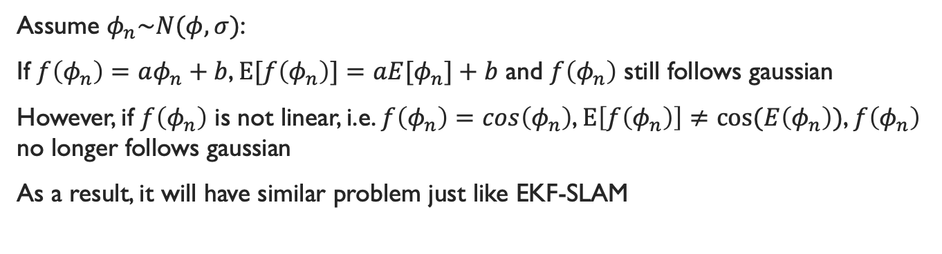
Obtaining initial Guess
Assume $φ_{n}\sim N(φ,σ)$:
If $f\left(φ_{n}\right)=aφ_{n}+b$, $E[f\left(φ_{n}\right)]=a{E[φ}_{n}]+b$ and $f\left(φ_{n}\right)$ still follows gaussian
However, if $f\left(φ_{n}\right)$ is not linear, i.e. $f\left(φ_{n}\right)=cos\left(φ_{n}\right)$, $E\left[f\left(φ_{n}\right)\right]≠cos⁡(E\left(φ_{n}\right))$, $f\left(φ_{n}\right)$ no longer follows gaussian
As a result, it will have similar problem just like EKF-SLAM

Slide 10
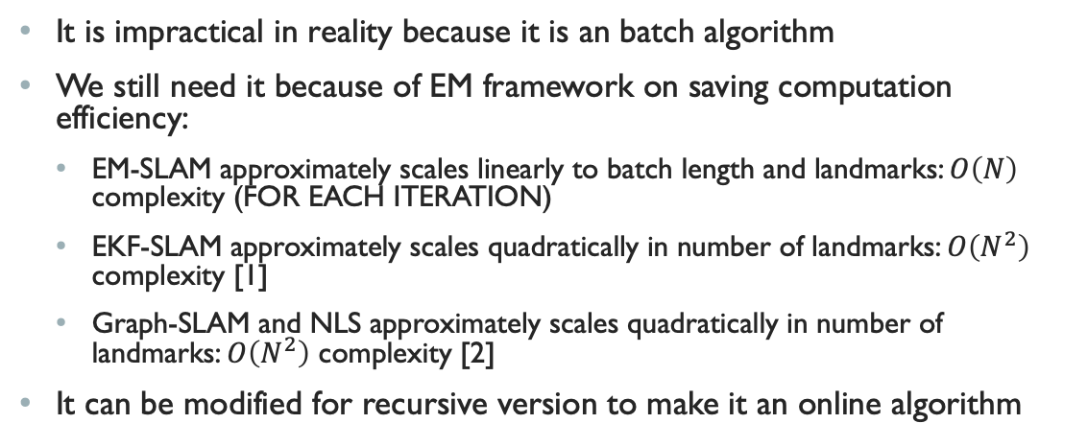
Why we use EM-slam?
It is impractical in reality because it is an batch algorithm
We still need it because of EM framework on saving computation efficiency:
EM-SLAM approximately scales linearly to batch length and landmarks: $O\left(N\right)$ complexity (FOR EACH ITERATION)
EKF-SLAM approximately scales quadratically in number of landmarks: $O\left(N^{2}\right)$ complexity [1]
Graph-SLAM and NLS approximately scales quadratically in number of landmarks: $O\left(N^{2}\right)$ complexity [2]
It can be modified for recursive version to make it an online algorithm
[1] : http://ais.informatik.uni-freiburg.de/teaching/ws12/mapping/pdf/slam08-kf-wrapup.pdf
[2]: Sjanic, Zoran et al. "EM-SLAM With Inertial/Visual Applications".

